Slide 1
Procedural Caves
Environment Generation with GANs
Murray Dunne - 2017

Slide 2
Outline
Objective
DCGAN Review
Approach
GAN Phase
Connection Phase
Results
Other Approaches
Future Work

Slide 3
Procedural Cave Generation
Aim to generate infinitely wide environments for simulations and games
Learn the characteristics of the image and generate larger matching environments
Given an image “prefix”, extend it indefinitely
Focus on extending only a single dimension
Generate new pixels infinitely without repetition

Slide 4
Simple Cave Environment
Aaron Moen - 2017

Slide 5
DCGAN Review
Generator and Discriminator
Discriminator is composed of convolutions then fully connected layers
Generator is fully connected then deconvolutions
Append discriminator onto generator to produce the adversarial network
Discriminator weights are fixed in adversarial network
Alternate training discriminator and generator
Use cross entropy as loss function

Slide 6
DCGAN Review
Adversarial Network
generator
discriminator
noise
vector
image
realness
[1,0]

Slide 7
DCGAN Scaling
DCGAN network sizes do not scale well
28x28 network has ~2.3M trainable parameters
28x100 network has ~5.0M
28x480 network has ~23.2M
1400x480 network has ~550M
1 color channel
4 convolution layers at 32,64,128,256 filters
Trainable parameters scale poorly with pixels
Large images quickly become non-viable
Cannot use pooling layers, they are non-reversible

Slide 8
DCGAN Fixed Size
DCGAN was originally for fixed size images
SeqGAN focuses on discrete samples, not a continuous environment
GANs for infinite real-valued generation are relatively unexplored

Slide 9
Approach Outline
Train DCGAN on vertical slices of input
Train second network to operate DCGAN
Generate sequential matching elements
Append them infinitely in one dimension
Cave continues indefinitely without repetition

Slide 10
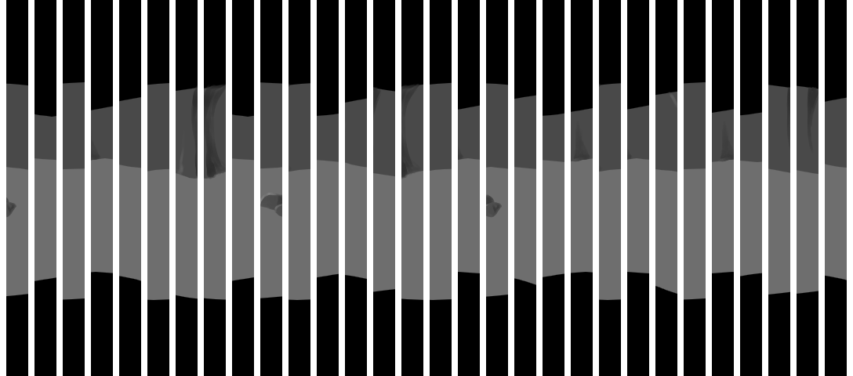
DCGAN Preparation
Slice the input environment image into vertical slices
3173 slices, 28x480 pixels, grayscale

Slide 11
Generator Network
Fully connected layer from noise
Dropout for training
4 deconvolution layers
ReLU activation
Normalization
Adjust activations to standard normal (μ = 0, σ = 1)
480x28x32
480x28x16
480x28x1
120x7x128
240x14x64
100

Slide 12
Discriminator Network
4 convolution layers
Leaky ReLU (y=0.2x for x < 0)
Avoids sparse gradient problem
Dropout for training
Fully connected layer
Ends with single sigmoid activation
480x28x1
480x28x16
480x28x32
240x14x64
120x7x128
1

Slide 13
Training
RMSProp optimizer with decay
Multiply learning rate by running average of recent gradients
Discriminator has more decay but higher initial learning rate
10,000 update steps
~250 samples randomly selected per step
Cross entropy loss function

Slide 14
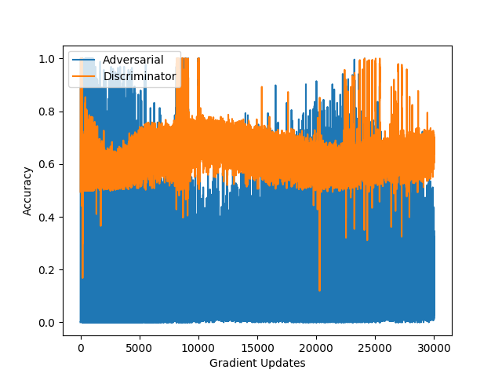
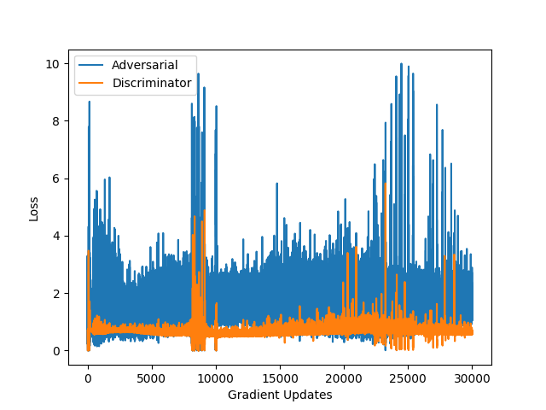
Training Accuracy and Loss
30,000 gradient steps
32 hours on 12GB Tesla K80

Slide 15
DCGAN Results
30,000 gradient updates

Slide 16
Connection Phase
Train a network to connect samples generated by DCGAN
Minimize difference between
Rightmost column of existing environment
Leftmost column of generator output
Four fully connected layers
ReLU activation, dropout for training
480x1
480
480
240
100
generator
480x28
480x1

Slide 17
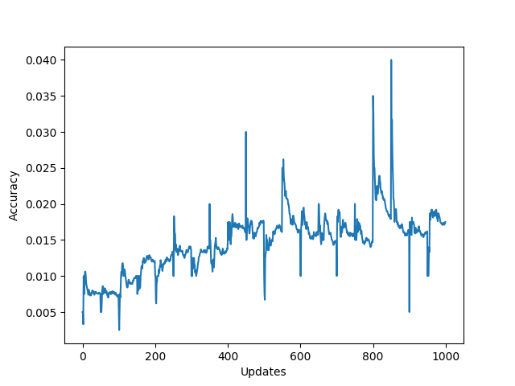
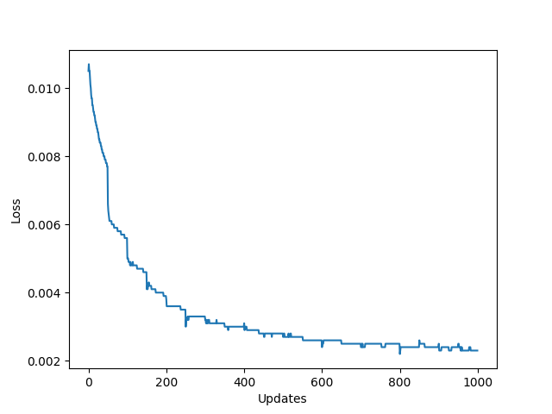
Connection Phase - Training
RMSProp optimizer
20 epochs
10,000 training samples

Slide 18
Connection Phase Results
50 samples (1400x480)

Slide 19
Connection Phase - Issues
Optimizing for smoothness yields overly smooth results
Methods to improve variation
Add noise to rightmost column vector
LSTM based methods

Slide 20
Other Approaches
LSTM
DCGAN with extra input
DCGAN with simple comparison

Slide 21
Other Approach - LSTM
Too large a sample space
480 units of output
Requires large memory
Collapses quickly
Difficult to teach not to be perfectly smooth

Slide 22
Other Approach – DCGAN Extra
Add input to generator along with noise
Last column of previous slice
Quasi-RNN
previous slice
discriminator
acceptability[1,0]
generator
image
noise
vector

Slide 23
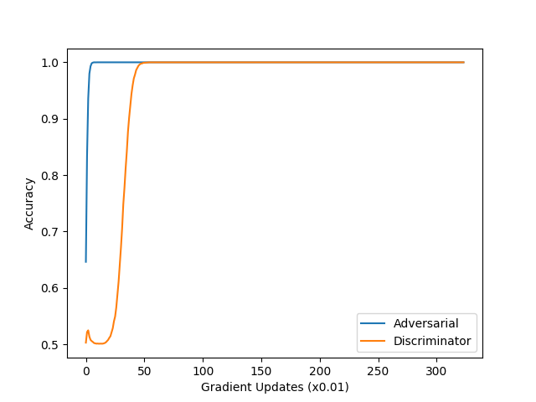
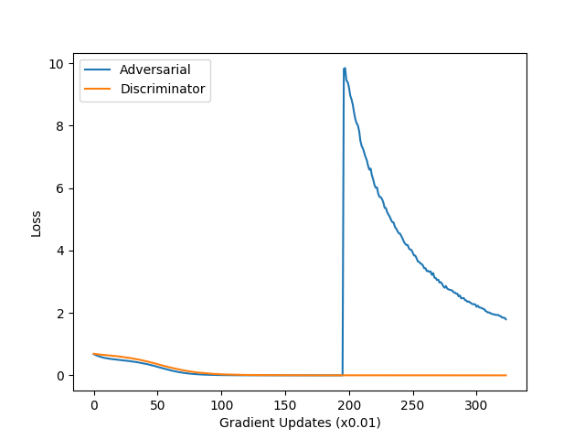
Other Approach – DCGAN Extra
Non-random input vector never converges
Conflating realness with smoothness

Slide 24
Other Approach – DCGAN Extra
32400 gradient updates

Slide 25
DCGAN - Simple Comparison
Run the DCGAN with noise as input
Append to environment if it fits
Rerun DCGAN as needed
Euclidean distance between pixel columns
Accept if below a threshold
Accept it too much time has passed
Adjust quality for real time results

Slide 26
Simple Comparison Result
50 samples (1400x480)
Original for Reference

Slide 27
Future Work
Use an LSTM for the connection phase
Apply horizontal smoothing to results
Train for longer
Visible improvements between 10,000 and 30,000 updates
More filters in convolution
Bring out the extra features on the cave wall
Not enough memory available

Slide 28
Slide Citations
Neural Networks for Machine Learning
G. Hinton, N. Srivastava, K. Swersky
http://www.cs.toronto.edu/~tijmen/csc321/slides/lecture_slides_lec6.pdf
How to Train a GAN? Tips and tricks to make GANs work
S. Chintala
https://github.com/soumith/ganhacks
GAN by Example using Keras on Tensorflow Backend
R. Atienza
https://medium.com/towards-data-science/gan-by-example-using-keras-on-tensorflow-backend-1a6d515a60d0

Slide 29
Questions

