Slide 1
Adaptive Attention Span in Transformers
Sainbayar Sukhbaatar
Edouard Grave
Piotr Bojanowski
Armand Joulin
Facebook AI Research
Neural machine translation by jointly learning to align and translate by Bengio et al.
End-To-End Memory Networks by Sukhbaatar et al.
Attention is all you need by Vaswani et al.
Presented by Genseric Ghiro

Slide 2
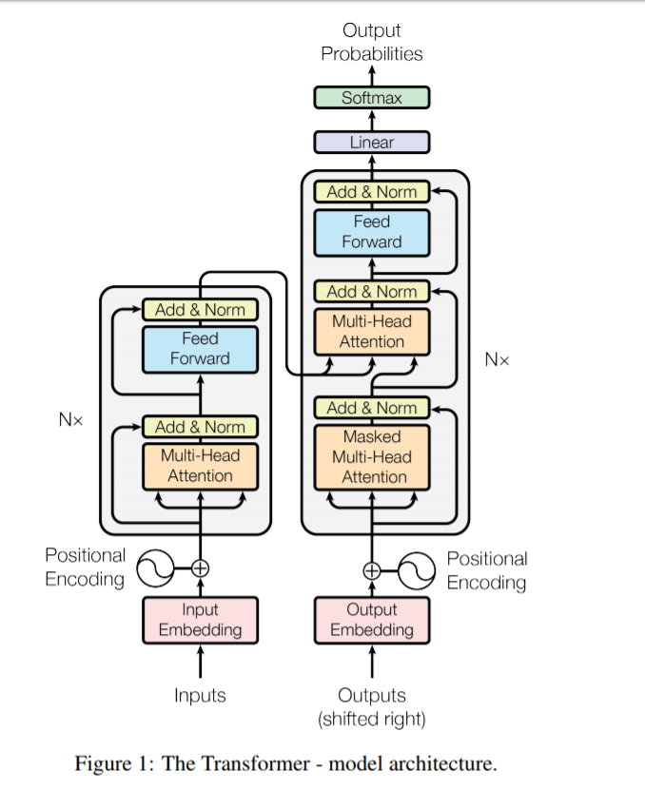
Higher purpose of this paper (i.e. goal of using an adaptive attention span)?
Make these more efficient!

Slide 3
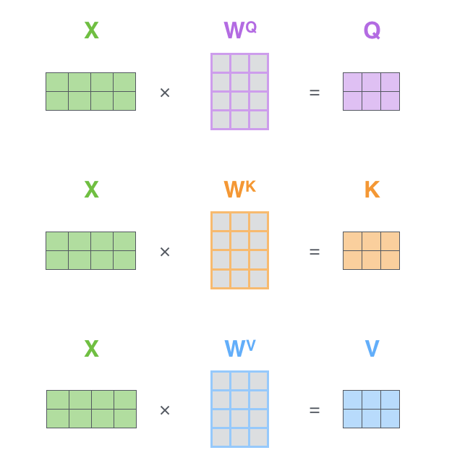
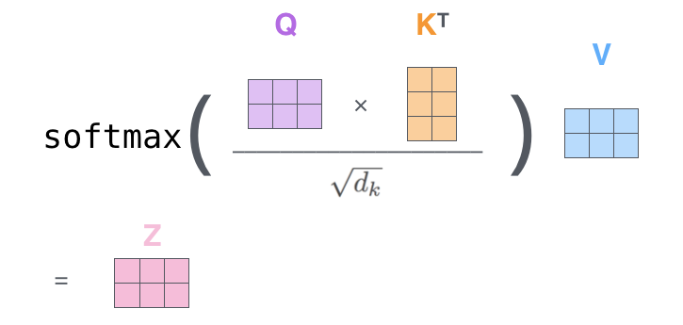
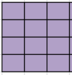
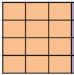
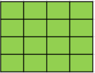
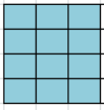
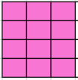
Quick recap on how attention works
Number of comparisons gets squared!
Attention mechanism used in the transformer scales quadratically with the size of the input sequence.
What if the number of tokens (input) doubles?
Need to compare all the words against each other
This is a problem since many words have a long dependency, which can’t be captured because the input sequence size is limited.
This means that the size of the input sequence can’t be too large. It is usually 512 tokens for smaller models and up to 3800 tokens for XL models.

Slide 4
Quick recap on how attention works
n
…
n
Size of input sequence. In the transformer, this is also the size of the attention span, i.e. the set of words on which attention is computed.
n

Slide 5
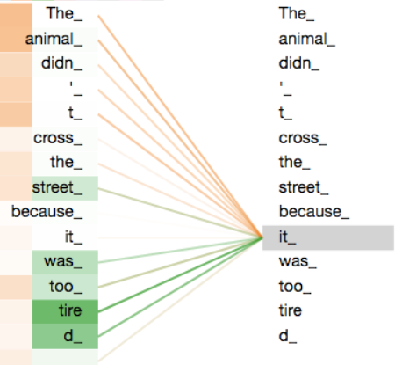
For example, here the word “it” has a “left” attention span of 9 and a “right” attention span of 5.
9
5

Slide 6
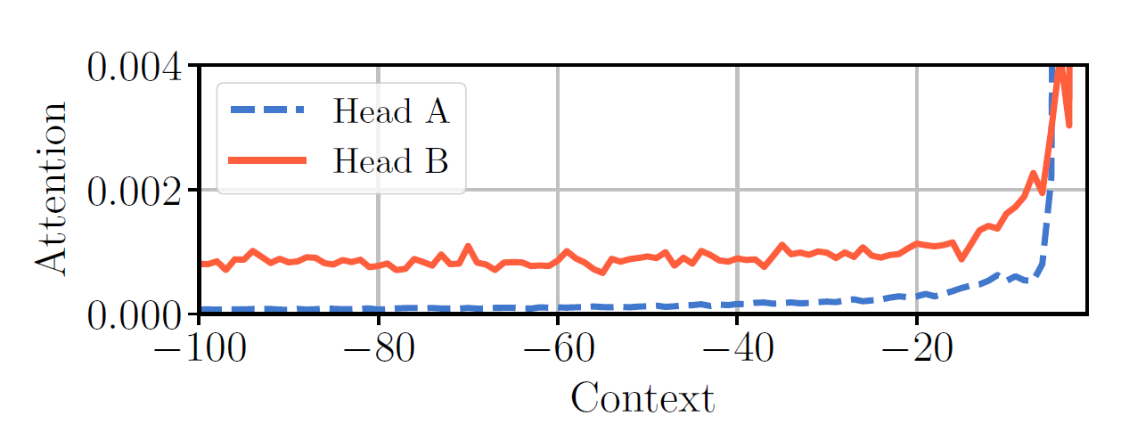
This means that the attention span is fixed at all time in the transformer
(attention span = size of input sequence).
This greatly reduces the size of the input sequence that can be passed to the transformer (because attention mechanism scales quadratically).
However, different heads might use different contexts!
Lack of information: head would like to look further away, but it is limited by the context size given
Unnecessary computation: past this point, all the “key-query” weights will be approximately 0, and therefore will not bring any new additional information

Slide 7
Moral:
Fixed attention span leads to a lack of information in some cases,
and to unnecessary computation in other cases.
Therefore, knowing beforehand which words in the context are meaningful could reduce computation time and allow certain heads to use a larger context size. This is what adaptive attention span tries to solve.

Slide 8
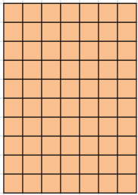
Idea behind adaptive attention span
Q
K^{T}
n, size of input sequence
X
2
10
2
Let’s assume we are looking at the 6th word of our sequence
With fixed attention span, 10 dot products
But with adaptive attention span, maybe only 5 dot products…

Slide 9
Naïve approach to choosing the span size
$$m_{z}\left(x\right)= 𝟙\left\{\left|x\right|<z\right\}$$
-Z
X: relative position of a token w.r.t current token
Z: attention span size

Slide 10
For example, let’s assume Z = 5
m_{z}(x) = 0
Current word
m_{z}(x) = 0
5
5
m_{z}(x) = 1
Context size
Problem: function is not differentiable, gradient descent will not work
$$m_{z}\left(x\right)= 𝟙\left\{\left|x\right|<z\right\}$$

Slide 11
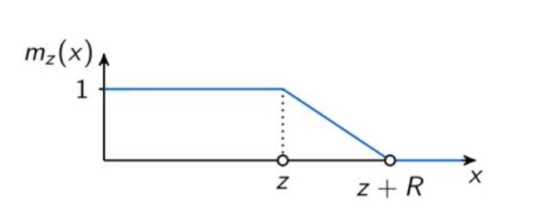
Better idea
-Z - R
-Z
$$m_{z}\left(x\right)= min\left[max\left[\frac{1}{R}\left(R+z− \left|x\right|\right) , 0\right] , 1\right]$$
where R is a hyper-parameter that controls softness (if R is very small, then it will look a lot like the first idea)

Slide 12
For example, let’s assume Z = 5,
and R = 3
m_{z}(x) = 0
Current word
m_{z}(x) = 0
5
5
m_{z}(x) = 1
Context size
0 < m_{z}(x) < 1

Slide 13
$$m_{z}\left(x\right)= min\left[max\left[\frac{1}{R}\left(R+z− \left|x\right|\right) , 0\right] , 1\right]$$
Z:
• length of the attention span
• can be different at each layer
• can be different for each head, within each layer!
• is a parameter, so needs to be trained like the other parameters
• is initialized to 0

Slide 14
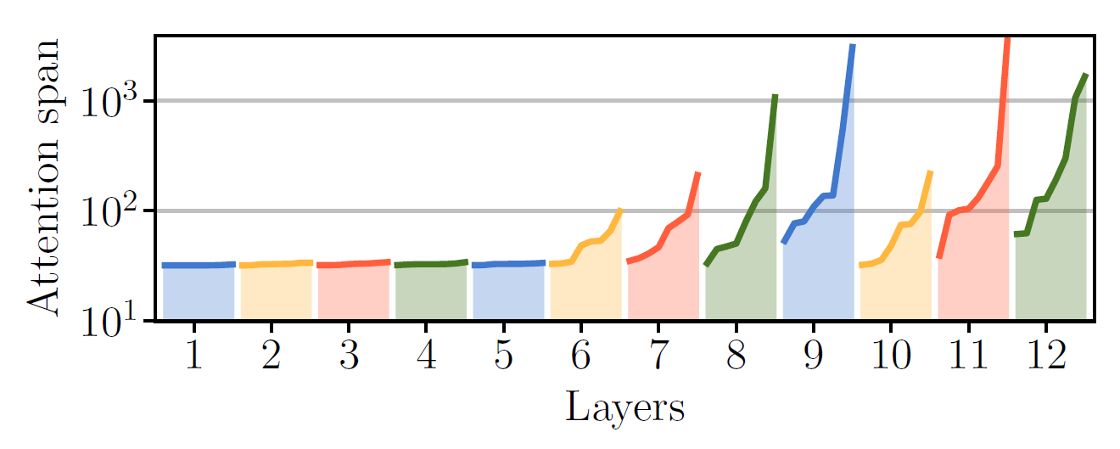
• Attention heads in the same layer consider different attention span
• Attention span increases in later layers

Slide 15
Attention weights calculation
$$a_{tr}=\frac{m_{z}\left(t−r\right)×exp(s_{tr})}{\sum_{q= 1}^{S}{m_{z}\left(t−q\right)×exp(s_{tq})}}$$
Where,
• t is the position of the current token
• a_{tr} is the attention weight computed between current token and token at position r
• s_{tx} is the “query-key” weight computed between current token and token at position x
• S is the size of the input sequence

Slide 16
Loss function
• first part is for language modeling (can be changed)
• M: number of heads in each layer
• λ: regularization hyper-parameter
• i is for each attention head
• Goal is to force the model to learn small attention spans
Notes:
Regularization forces model to use small spans

Slide 17
Dynamic attention span
• Attention span different for each layer
• Attention span different for each head within the same layer
• Attention span different for each input token
$$m_{z_{t}}\left(x\right)= min\left[max\left[\frac{1}{R}\left(R+z_{t}− \left|x\right|\right) , 0\right] , 1\right]$$
$$a_{tr}=\frac{m_{z_{t}}\left(t−r\right)×exp(s_{tr})}{\sum_{q= 1}^{S}{m_{z_{t}}\left(t−q\right)×exp(s_{tq})}}$$
…same equations, but one additional step
$$z_{t}= Sσ(v^{T}x_{t}+b)$$
Same loss function, but parameters to learn are now v and b (as opposed to z)

Slide 18
Results
1 • Increasing attention span limit helps as long as the heads can look at what they want
2 • Attention span length is very steady even when increasing the span limit
3 • Number of FLOPS is almost independent of span limit (consequence of 2)

Slide 19
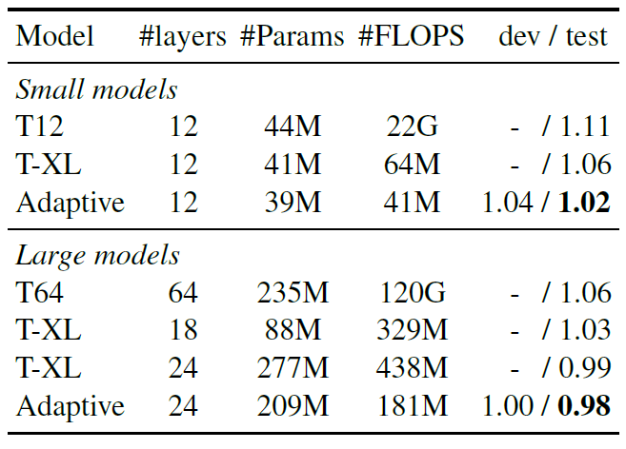
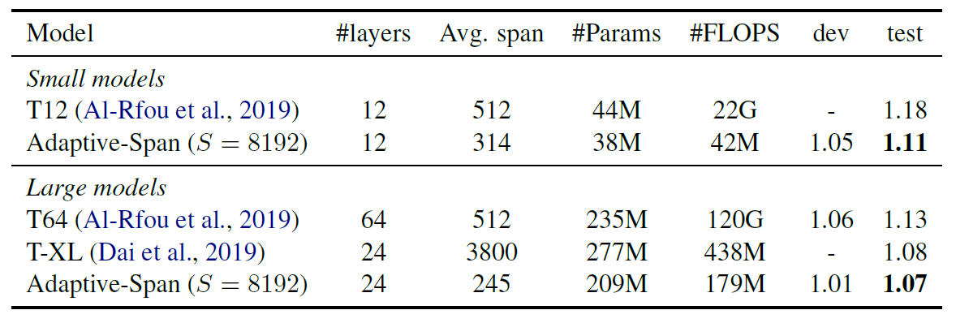
Results
♠ Less parameters to learn
♠ Lower number of FLOPS
♠ Smaller attention span on average
♠ Better bit per character (bpc)!

Slide 20
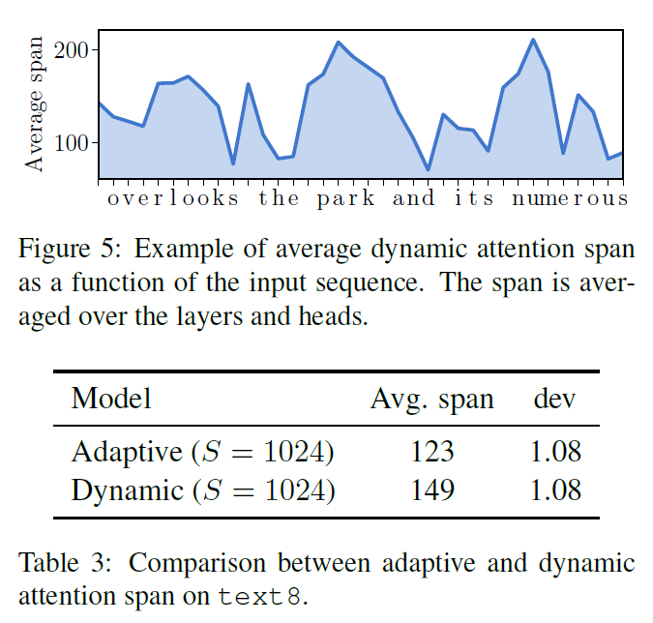
Results

Slide 21
Conclusion
Based on their results, is attention a matter of quantity or quality? In other words, even when given a very long input sequence, almost all heads chose to look at a very small portion of it, and yet they still outperformed traditional models.

