Slide 1

Energy System Control with Deep Neural Networks
Fiodar Kazhamiaka
Mikhail Kazhamiaka
CS 898

Slide 2
Trends in Energy (over the last decade)
Renewable energy distributed energy generation
Energy storage technologies are getting cheaper flexibility
Emerging players (Virtual Power Plants, electric vehicles, etc.) new applications
Emergence of new systems with interesting control problems

Slide 3
Neighbour
Energy Grid
Tesla + SolarCity concept house: Powerwall 2.0, Model 3 EV, solar roof

Slide 4
Outline
Online Control
  Why deep learning?
Project Design
    System under study
  Training and evaluation setup
Preliminary Results
Remaining/Future Work

Slide 5
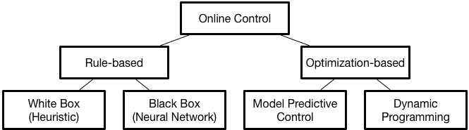
Online Control
Control objective: Minimize cost (for example)
Doesn’t scale with system complexity
Our approach
State of the art

Slide 6
MPC vs. Neural Network
 | MPC | (Deep) Neural Network
Performance | High | TBD

Slide 7
MPC vs. Neural Network
 | MPC | (Deep) Neural Network
Performance | High | TBD
Offline Effort | Medium (requires mathematical formulation of optimization problem) | Medium (requires formulation) High? (training effort, TBD)

Slide 8
MPC vs. Neural Network
 | MPC | (Deep) Neural Network
Performance | High | TBD
Offline Effort | Medium (requires mathematical formulation of optimization problem) | Medium (requires formulation) High? (training effort, TBD)
Online Computational Cost | High | Low

Slide 9
MPC vs. Neural Network
 | MPC | (Deep) Neural Network
Performance | High | TBD
Offline Effort | Medium (requires mathematical formulation of optimization problem) | Medium (requires formulation) High? (training effort, TBD)
Online Computational Cost | High | Low
Requires Predictions | Yes | No (but can use, if available)

Slide 10
Why deep NN vs. other learning methods?
There’s a huge variety of systems and applications
  Combinations of storage technology, electricity price, electricity sources, and what the system is being used for; no one-size-fits-all solution
We don’t know the features
  Could probably study a single instance of a system and pick out the right features, but this is tedious [1].
Throw every possible input at a deep NN and have it learn to control
[1]. Kazhamiaka, Fiodar, Catherine Rosenberg, and Srinivasan Keshav. "Practical strategies for storage operation in energy systems: design and evaluation." IEEE Transactions on Sustainable Energy 7.4 (2016): 1602-1610.

Slide 11
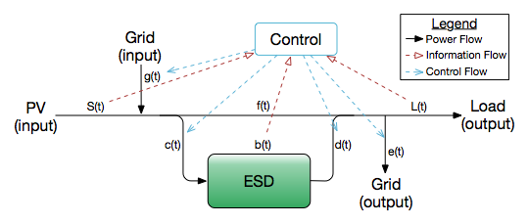
System
Residential building with Photovoltaic (PV) panels and energy storage device (ESD)
Objective: Minimize grid payments

Slide 12
Training and Evaluation setup
Generate Training Data
Train Neural Network
Evaluate Control Performance
Solve linear programs offline to generate a dataset of optimal control actions
Regression problem
Simulate the system using the NN to make control decisions

Slide 13
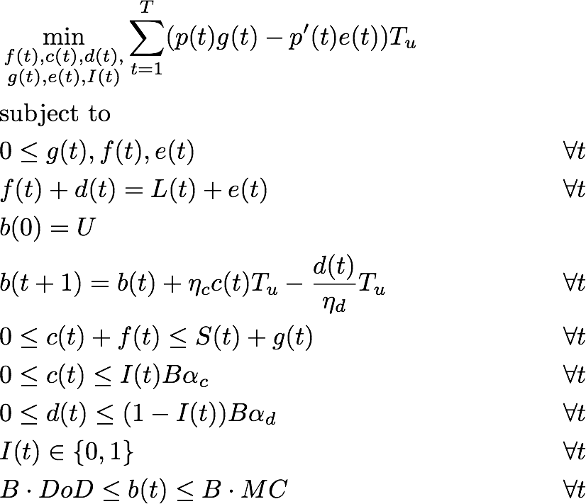
Training data through linear programming
buy/sell electricity prices
battery model parameters
control variables
money spent – money earned
Optimization problem solved using CPLEX solver

Slide 14
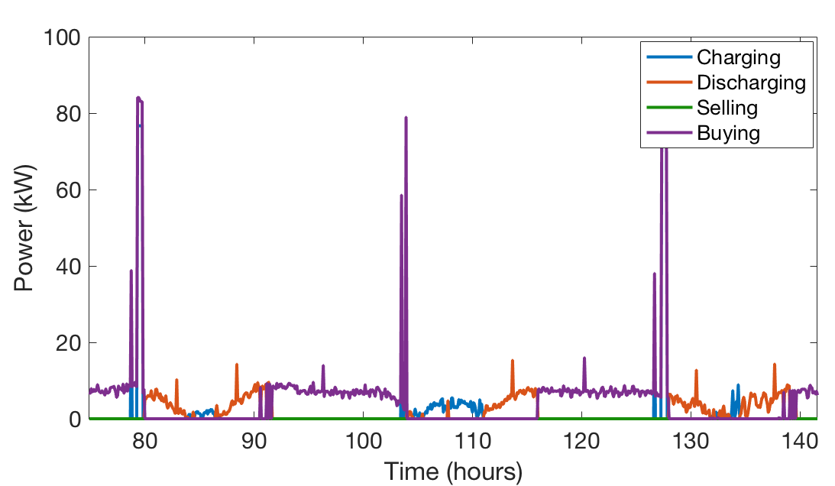
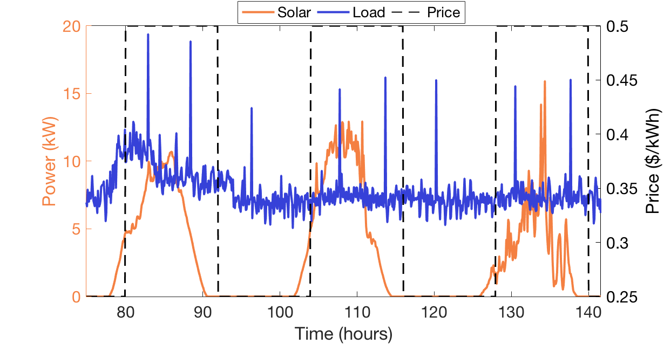
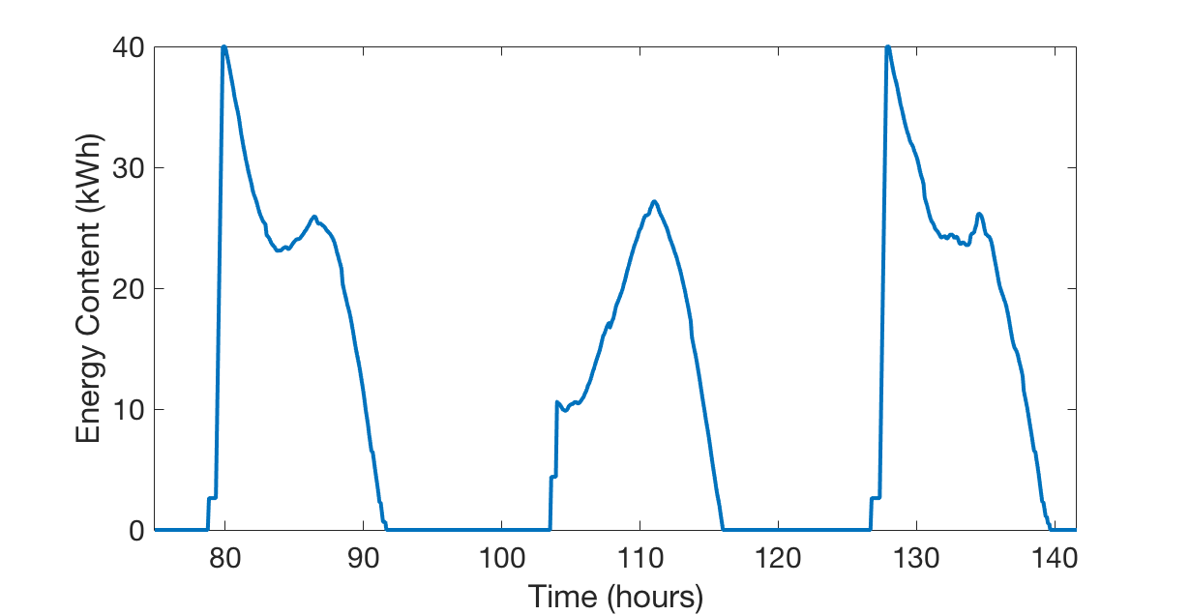
Training data through linear programming
Mapping from input to optimal control actions:
Perturb solar and load data to generate new optimal control datasets to train on

Slide 15
Neural Network input
Load
PV generation
Battery state (energy)
Grid price
  (for next X hours)
PV predictions
  (for next Y hours)
Load predictions
  (for next Z hours)

Slide 16
Neural Network input
Load
PV Generation
Battery state (energy)
Grid price
  (for next X hours)
PV predictions
  (for next Y hours)
Load predictions
  (for next Z hours)
Charging
Power
Discharging
Power
Power Bought
Power Sold
Fully connected network

Slide 17
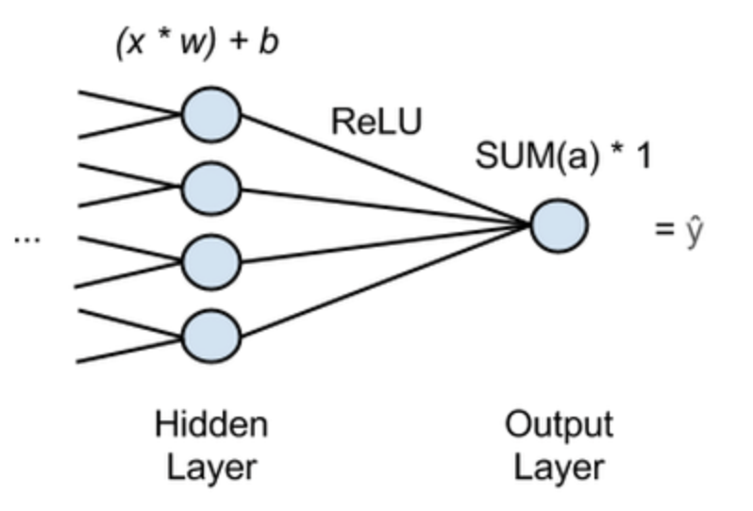
Neural Networks for Regression Problems
Cost function: Mean-Squared Error (MSE)
Activation function on output: none
Image borrowed from deeplearning4j.org tutorial

Slide 18
Evaluating Performance
Simulate system, using NN to make control decision
  Adjust the control output to satisfy constraints
Calculate resulting objective function
Neural Network

Slide 19
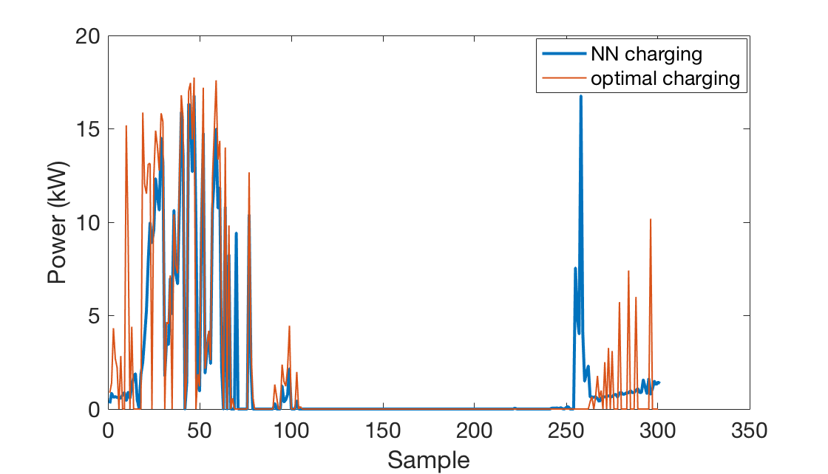
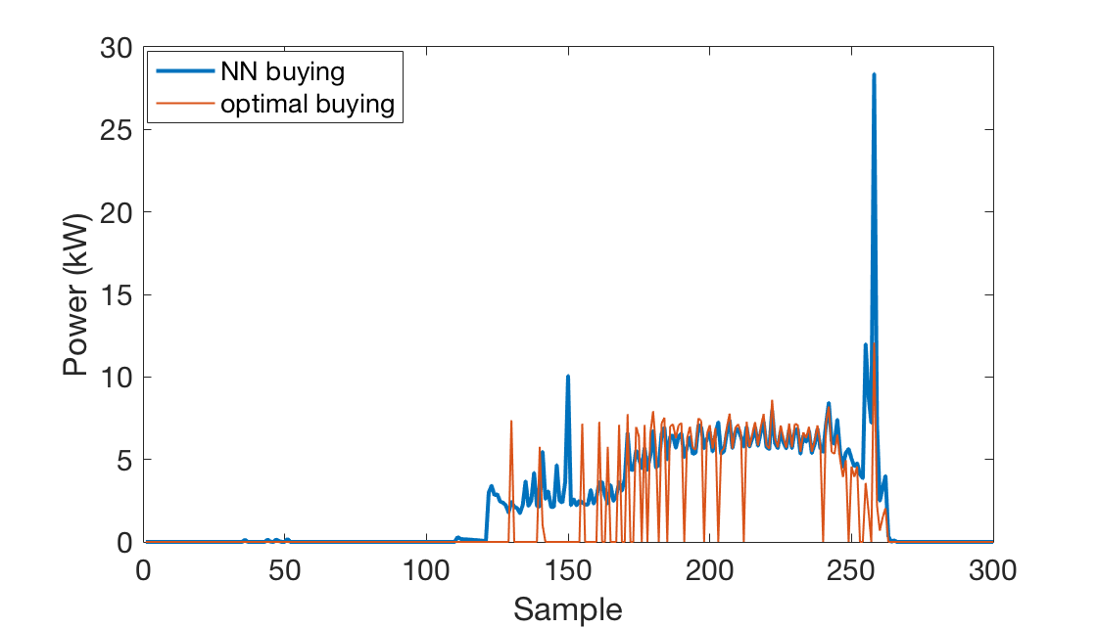
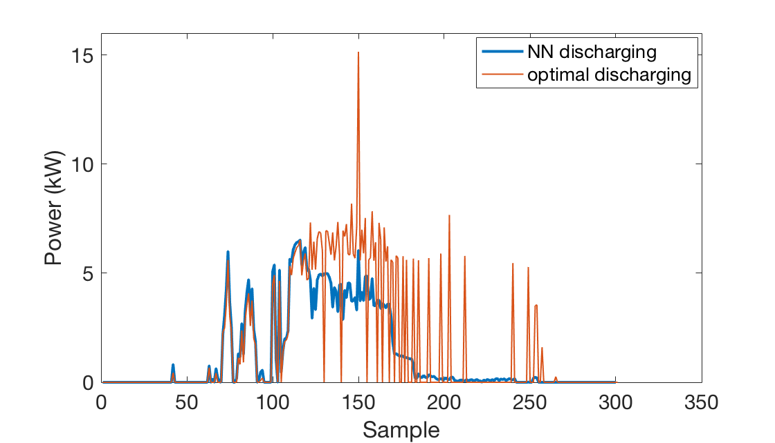
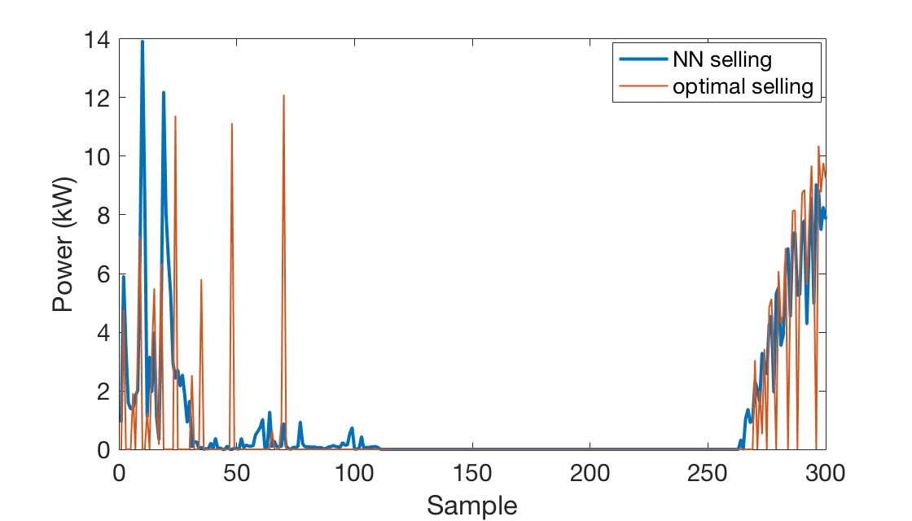
Visual inspection of NN output
Notes:
May not satisfy power balance constraints of the system, so we can adjust buying and selling to ensure that it does.

Slide 20
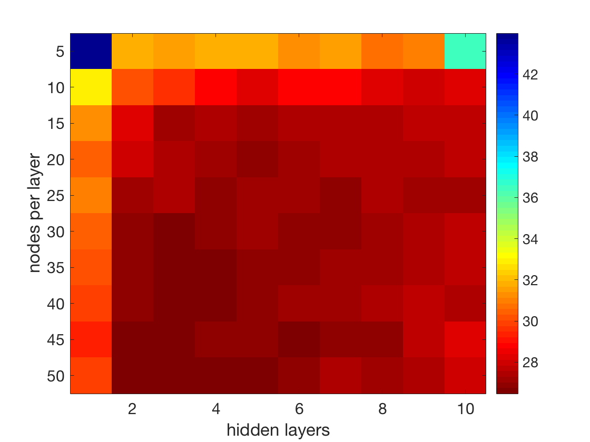
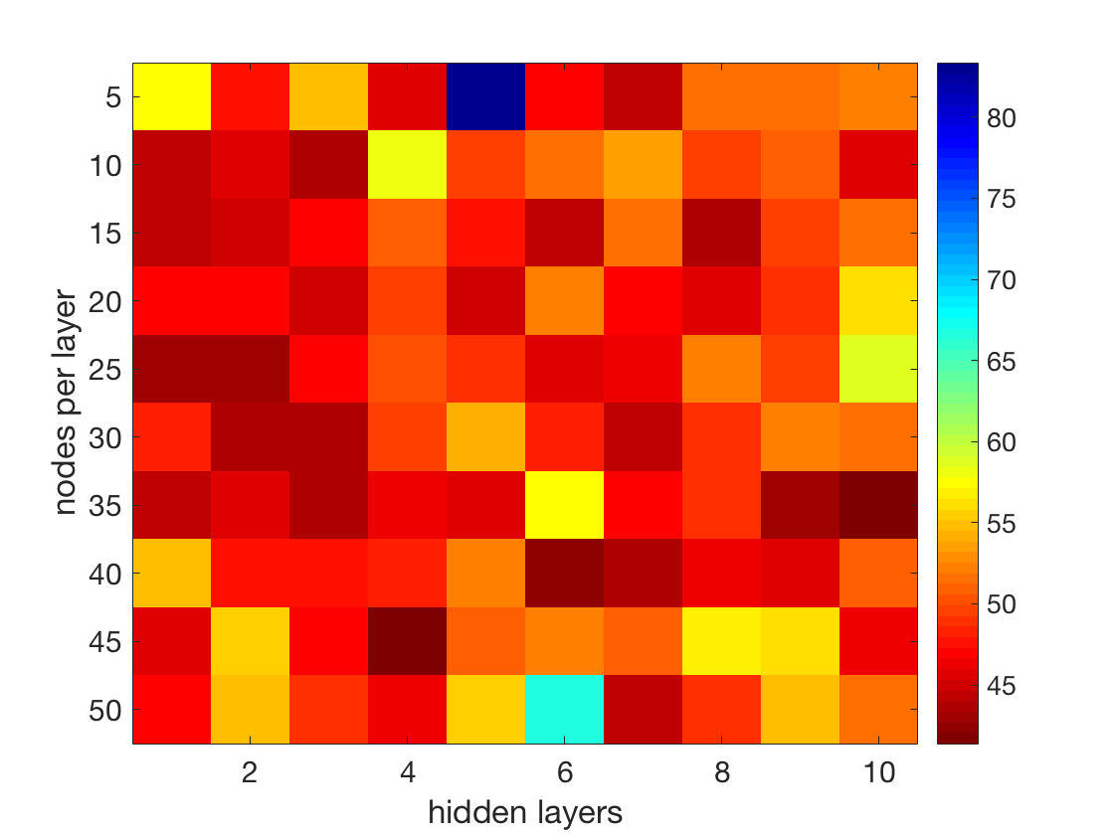
Hidden layers, nodes per layer (MSE loss)
Training
Testing

Slide 21
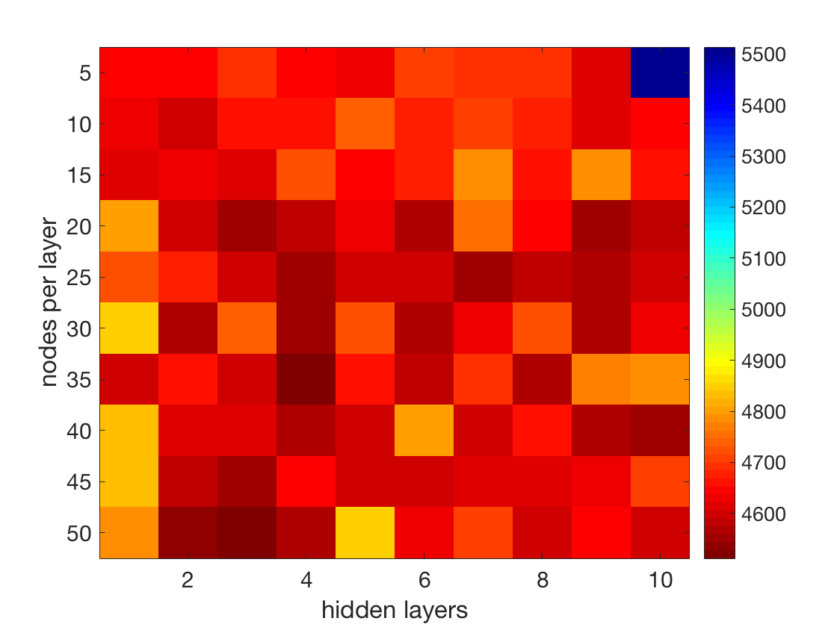
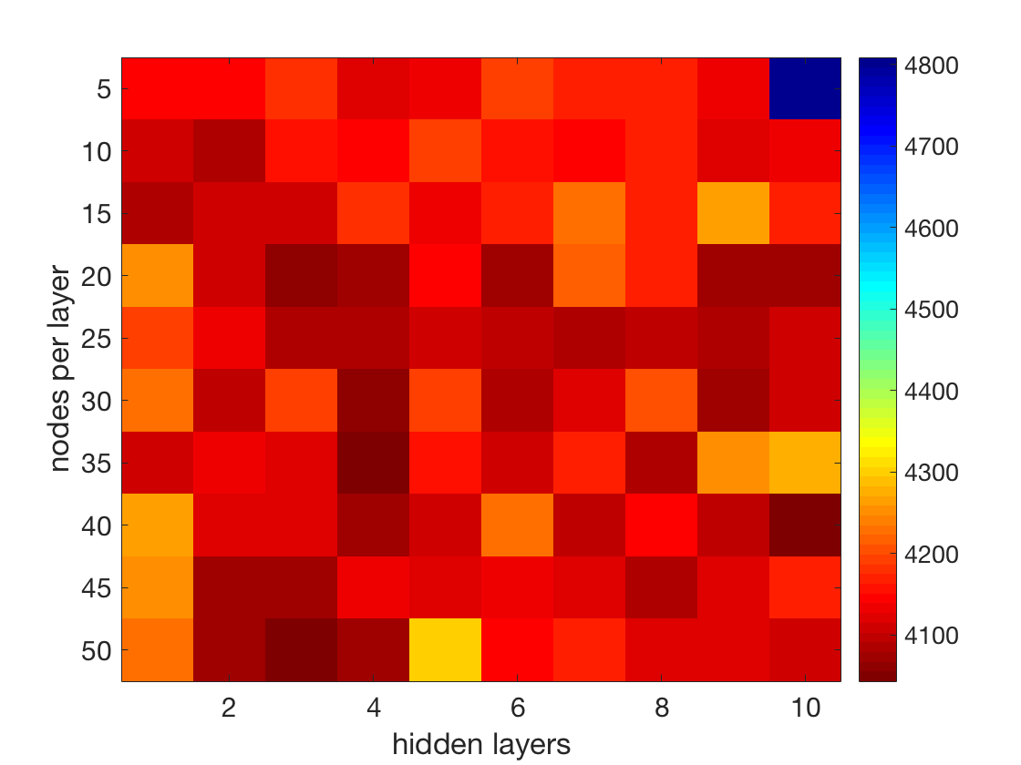
Hidden layers, nodes per layer (simulated cost)
Training
Testing

Slide 22
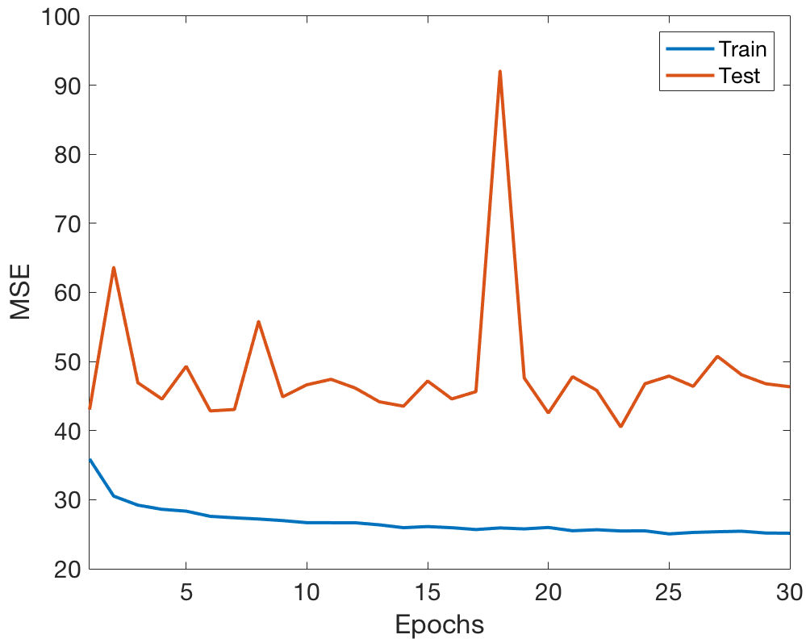
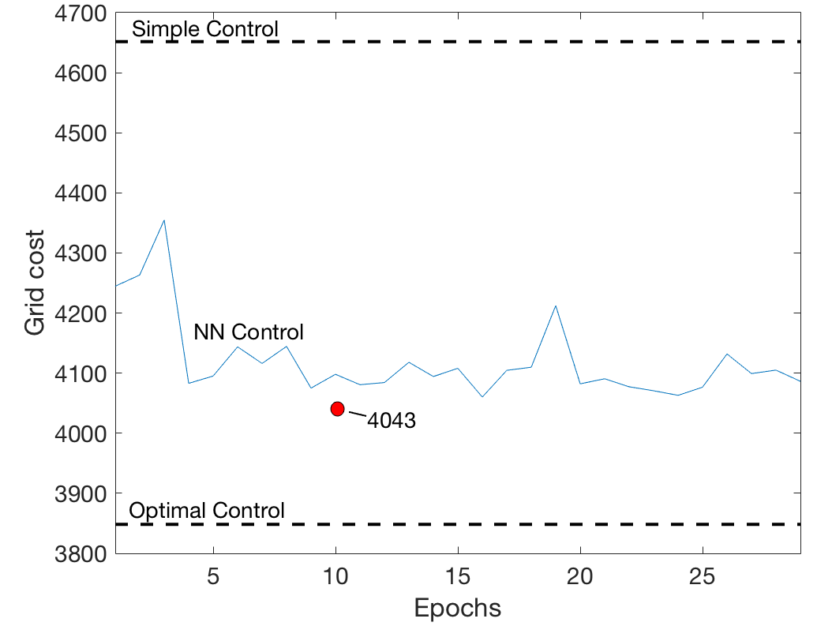
Epochs vs. MSE and simulated grid cost
Best NN result: 3 layers, 50 nodes, 10 epochs

Slide 23
Future Work
Continue to tune the hyper-parameters
Add predictions of Solar and Load as input
Add PV panel and battery size as inputs
Compare with MPC and other control algorithms
Explore ways of integrating the “real” evaluation of NN performance into the training
Thank you!

