Slide 1
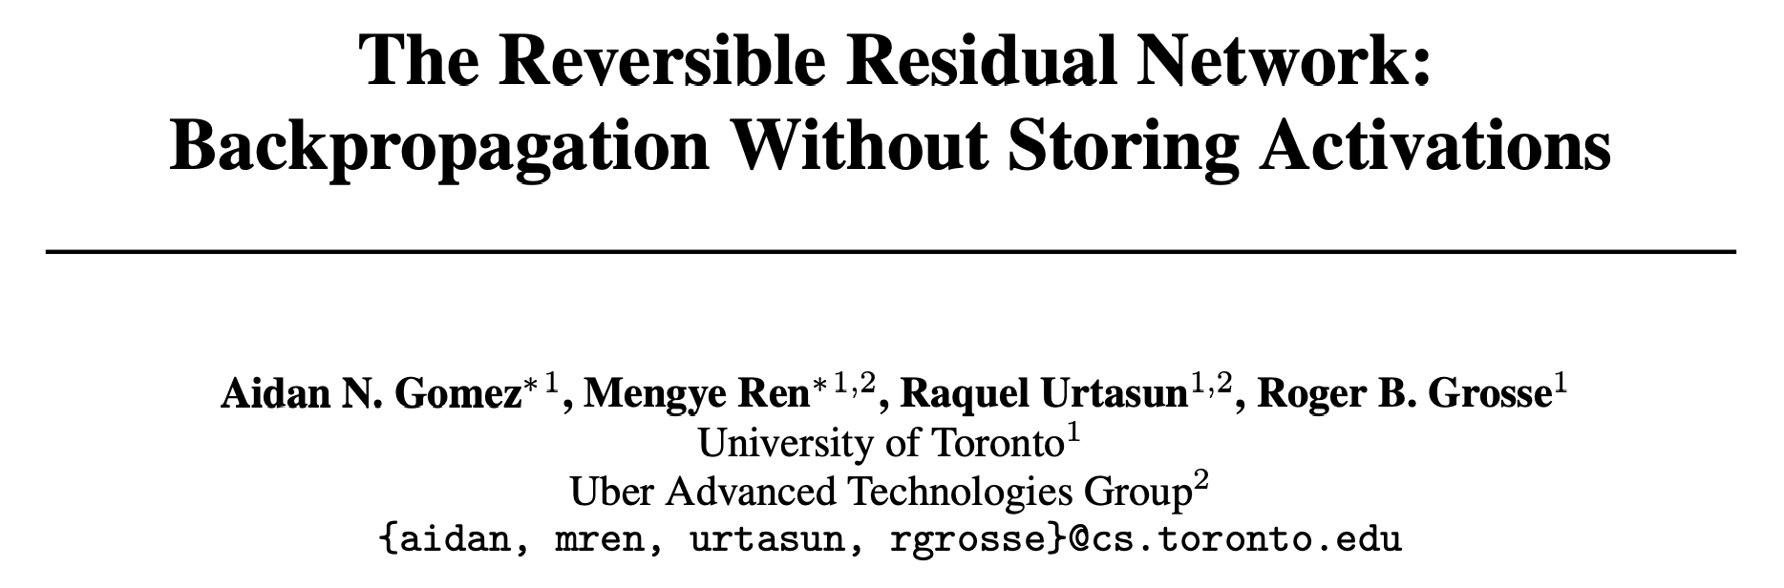
Yuqing Xie, Feb 10, 2020 https://arxiv.org/pdf/1707.04585.pdf
Notes:
Hi everyone, today I am going to present this paper: The Reversible Residual Network: Backpropagation Without Storing Activations.
This paper is written by the Aidan under Roger in University of Toronto and published at the NIPS 2017.
This paper is originally designed to reduce the memory of ResNet in Image processing, so that larger models can be fit into GPUs.
Recently, Google Research publised a conference paper at ICLR 2020 called Reformer, which applied this technology in transformer.
So I am going to take a closer look at this algorithm and explain how it is going to be applied in reformer.
Later, natalie is going to explain the other part of the Reformer paper to you.
The whole idea of Reformer is that, if we could use less GPU memory while training, we can feed the GPU with longer sentence.
This paper mainly reduce memory useage by accomplish back propagation without storing activations.

Slide 2
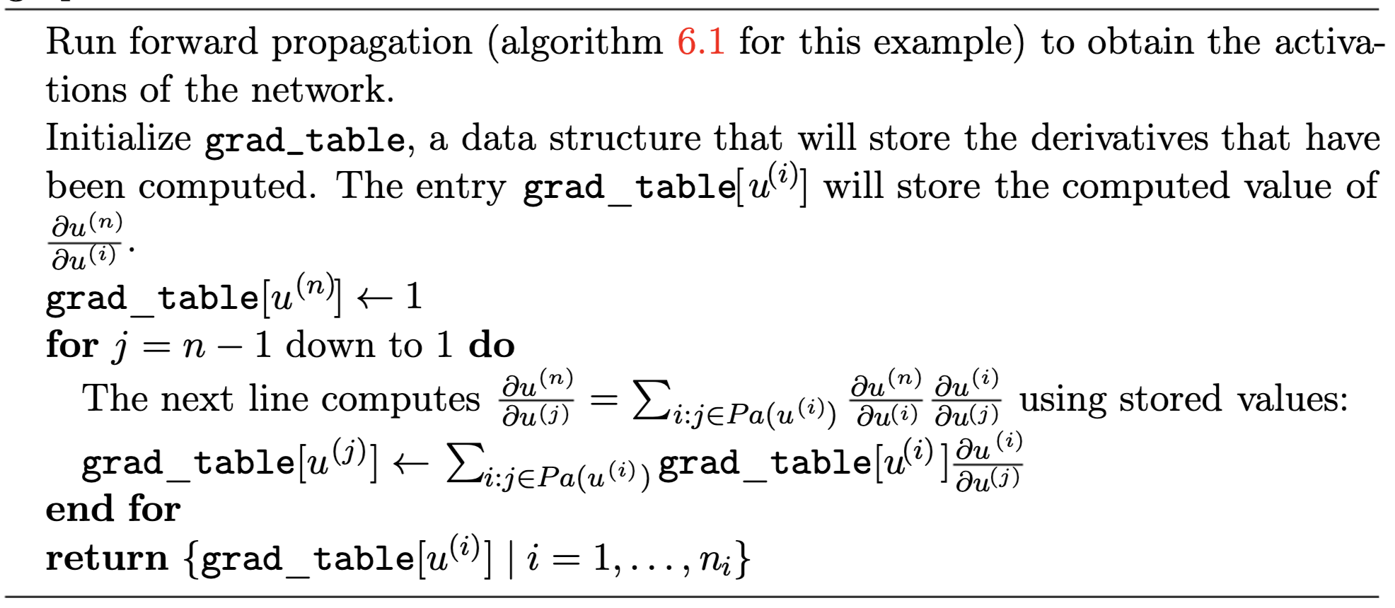
A Recall of Back Propagation
Ian Goodfellow, Yoshua Bengio, and Aaron Courville. 2016. Deep Learning. The MIT Press.
Notes:
To better understand the idea, let’s first recall the procedure of back propagation
This is the pseudocode of BP taken from the deep learning book.
We are computing the derivative of the loss function with regard to every other nodes, the loss function is denoted as un here
during the BP, when we have to compute the gradient of uj, we will have to go through all the father nodes of uj, compute the product of the father node’s gradient and the derivative of the activation function.
note here, the father node’s gradient is passed by the father node, but the derivative of the activation function have to be computed according to the value of uj.
So the algorithem have to store all the value of uj for backpropgation.

Slide 3
Related work - reducing the storage
Checkpointing - stores a subset of the activations (called checkpoints) and recomputes the remaining activations as required. T. Chen, B. Xu, C. Zhang, and C. Guestrin. Training deep nets with sublinear memory cost. arXiv preprint arXiv:1604.06174, 2016. A. Gruslys, R. Munos, I. Danihelka, M. Lanctot, and A. Graves. Memory-efficient backpropagation through time. In NIPS, 2016 J. Martens and I. Sutskever. Training deep and recurrent networks with Hessian-free optimization. In Neural networks: Tricks of the trade, pages 479–535. Springer, 2012.

Slide 4
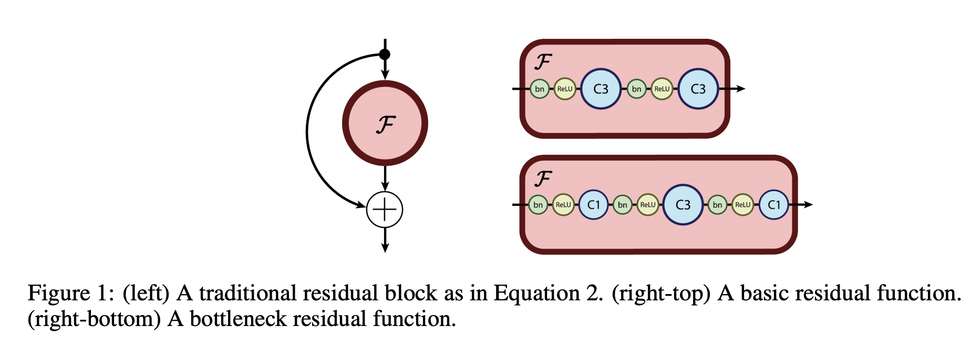
ResNet
Notes:
The proposed algorithm is based on residule network, so let’s also recall the structure of the residule network

Slide 5
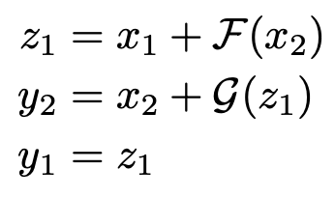
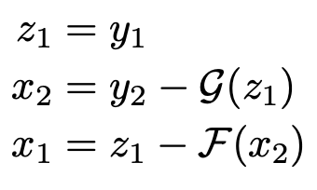
Reversible ResNet
Z1
Z1
Notes:
Next, let’s take a look at the algorithm. How does the model accomplish the activation restoring.

Slide 6
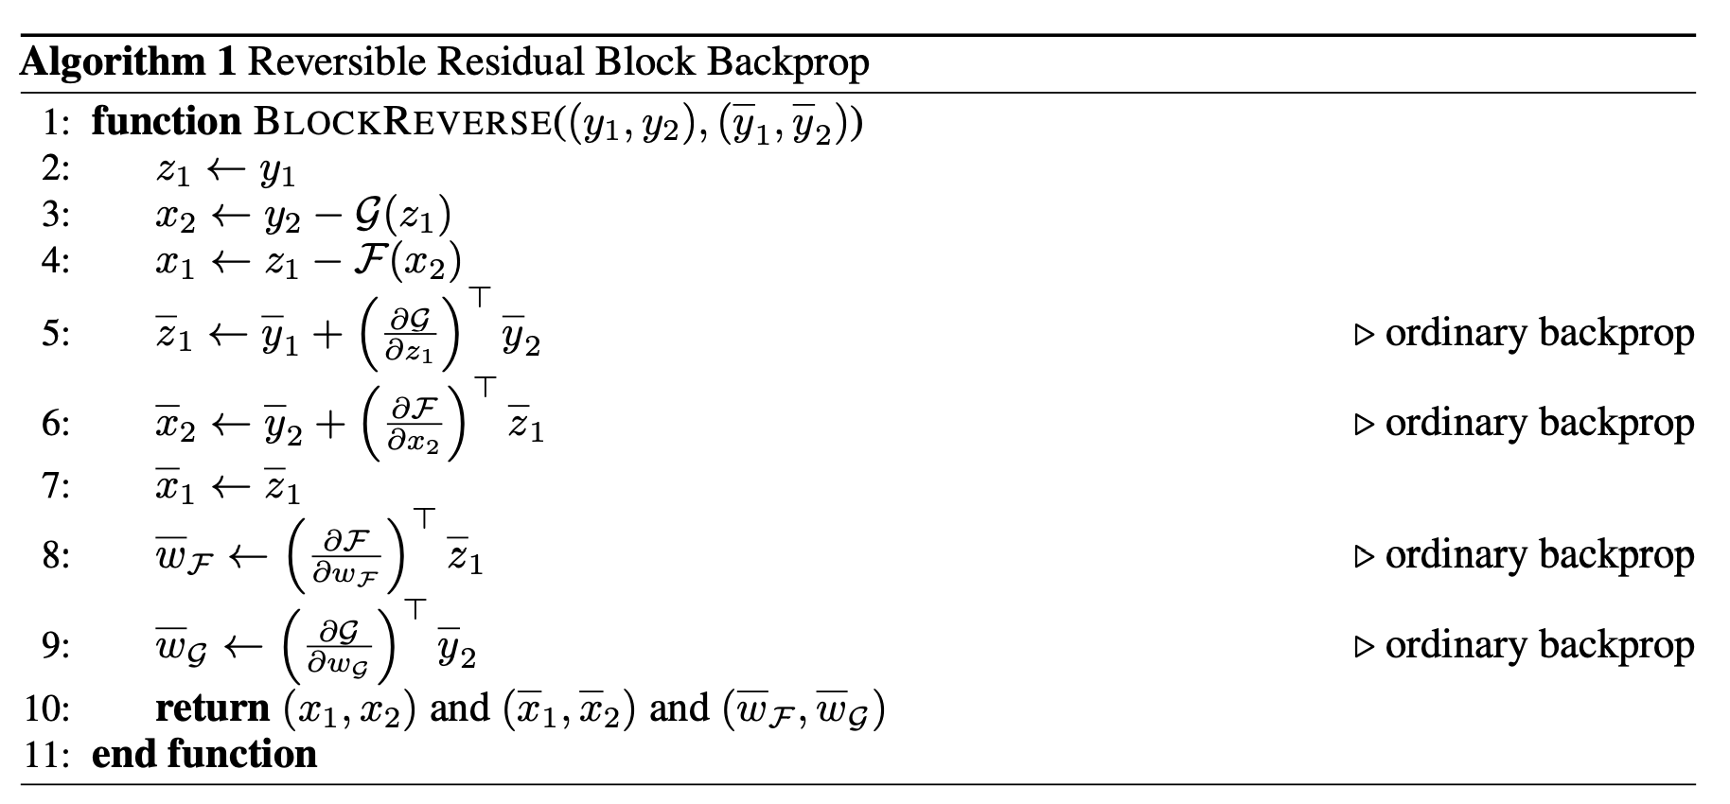
Algorithm of BP
Extra computation
Notes:
Computational overhead.
N connections,
the forward and backward
N and 2N add-multiply operations
RevNet, 4N, or roughly 33% more
the forward and backward passes equally expensive on GPU
the computational overhead of RevNets is closer to 50%

Slide 7
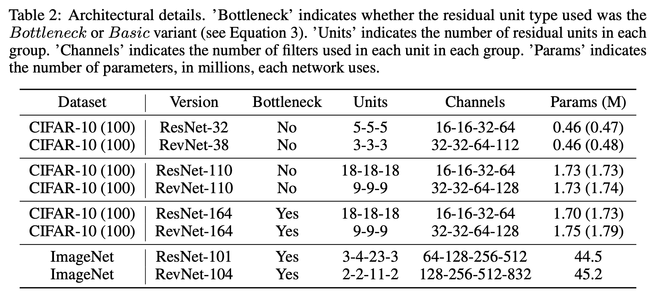
Notes:
We experimented with RevNets on three standard image classification benchmarks: CIFAR-10,
CIFAR-100, [15] and ImageNet [24].
tried to match both the computational depth and the number of parameters as closely as
possible.
We observed that each reversible block has a computation depth of two original residual
blocks. Therefore, we reduced the total number of residual blocks by approximately half, while
approximately doubling the number of channels per block, since they are partitioned into two.

Slide 8
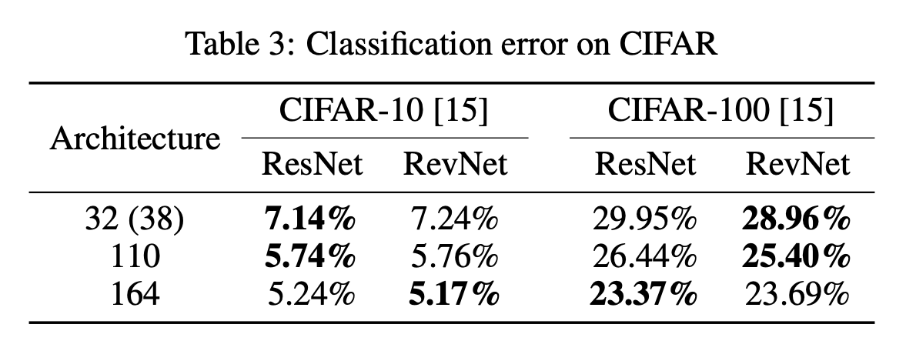
Notes:
Our ResNet implementation roughly matches the previously reported classification error rates [11].
As shown in Table 3, our RevNets roughly matched the error rates of traditional ResNets (of roughly
equal computational depth and number of parameters) on CIFAR-10 & 100 as well as ImageNet
(Table 4). In no condition did the RevNet underperform the ResNet by more than 0.5%, and in some
cases, RevNets achieved slightly better performance. Furthermore, Figure 3 compares ImageNet
training curves of the ResNet and RevNet architectures; reversibility did not lead to any noticeable
per-iteration slowdown in training. (As discussed above, each RevNet update is about 1.5-2× more
expensive, depending on the implementation.) We found it surprising that the performance matched
so closely, because reversibility would appear to be a significant constraint on the architecture, and
one might expect large memory savings to come at the expense of classification error.

Slide 9
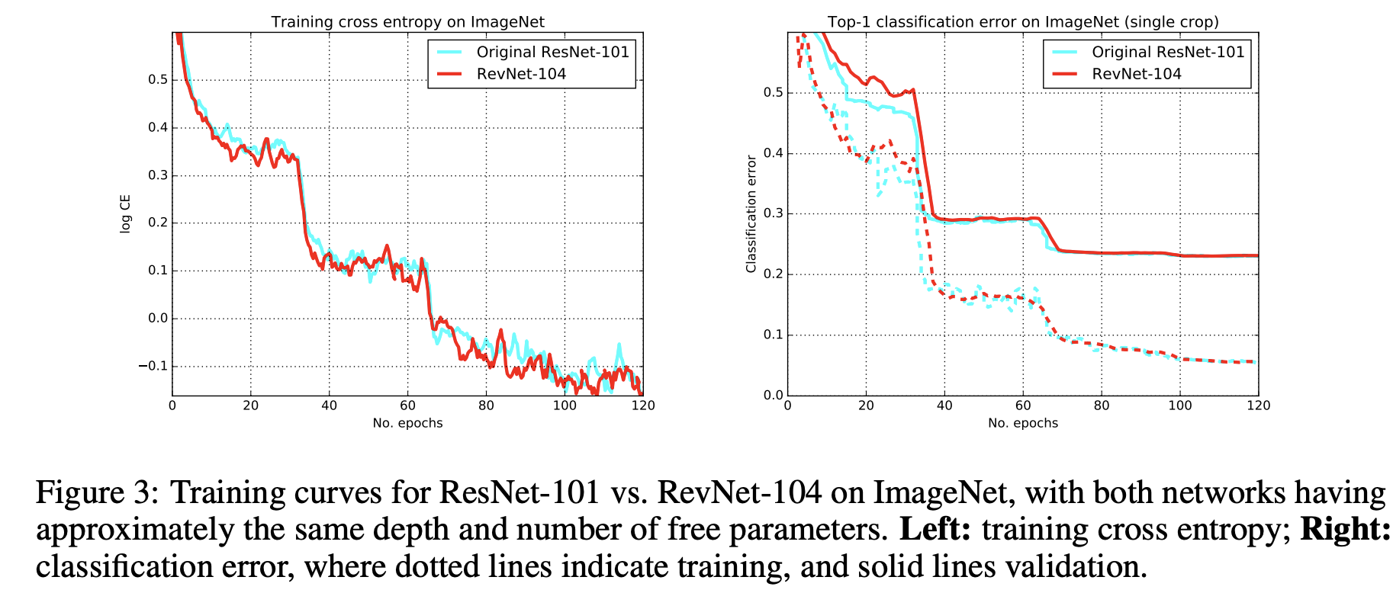

Slide 10
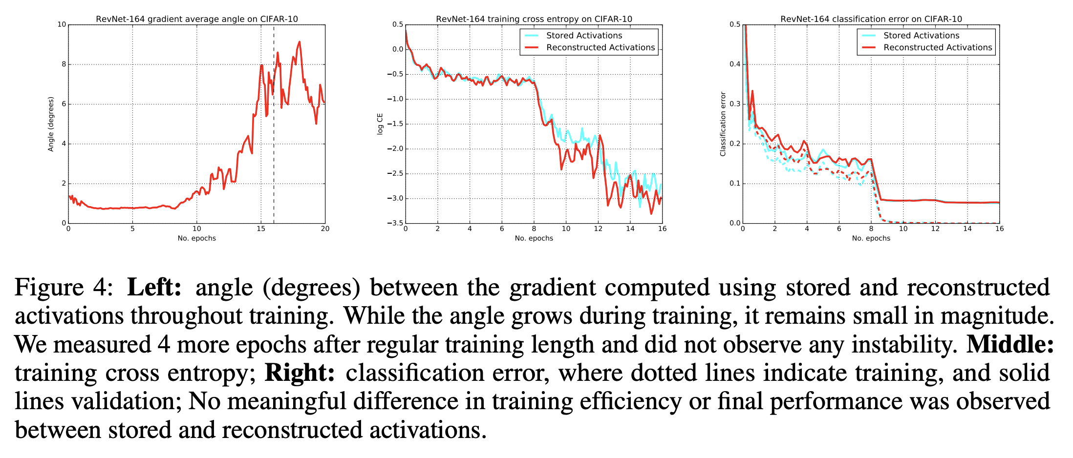
Notes:
Numerical error. While Eqn. 8 reconstructs the activations exactly when done in exact arithmetic,
practical float32 implementations may accumulate numerical error during backprop.
the error is noticeable in our experiments, it does not significantly affect final performance.
Impact of numerical error.
In order to measure the magnitude of this effect, we computed the angle between the gradients computed using stored and reconstructed activations over the course of training.
Figure 4 shows how this angle evolved over the course of training for
a CIFAR-10 RevNet; while the angle increased during training, it remained small in magnitude.
Figure 4 also shows training curves for CIFAR-10 networks trained using both methods of computing
gradients. Despite the numerical error from reconstructing activations, both methods performed
almost indistinguishably in terms of the training efficiency and the final performance.

Slide 11
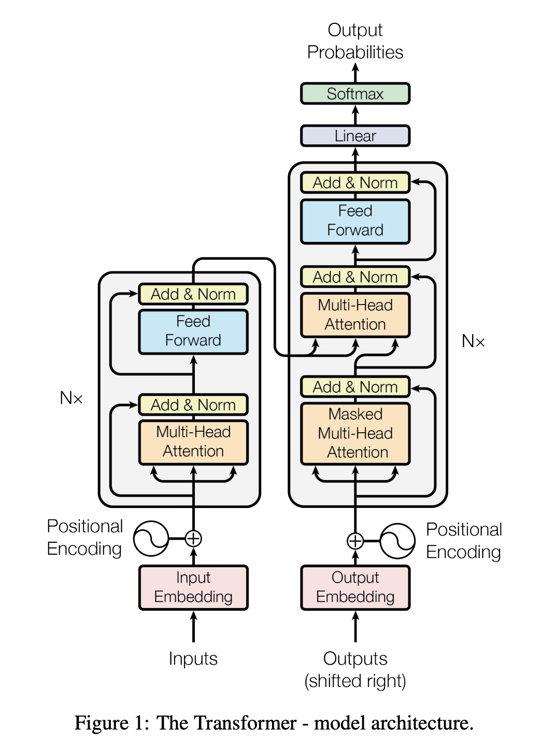
Reversibel Transformer

Slide 12
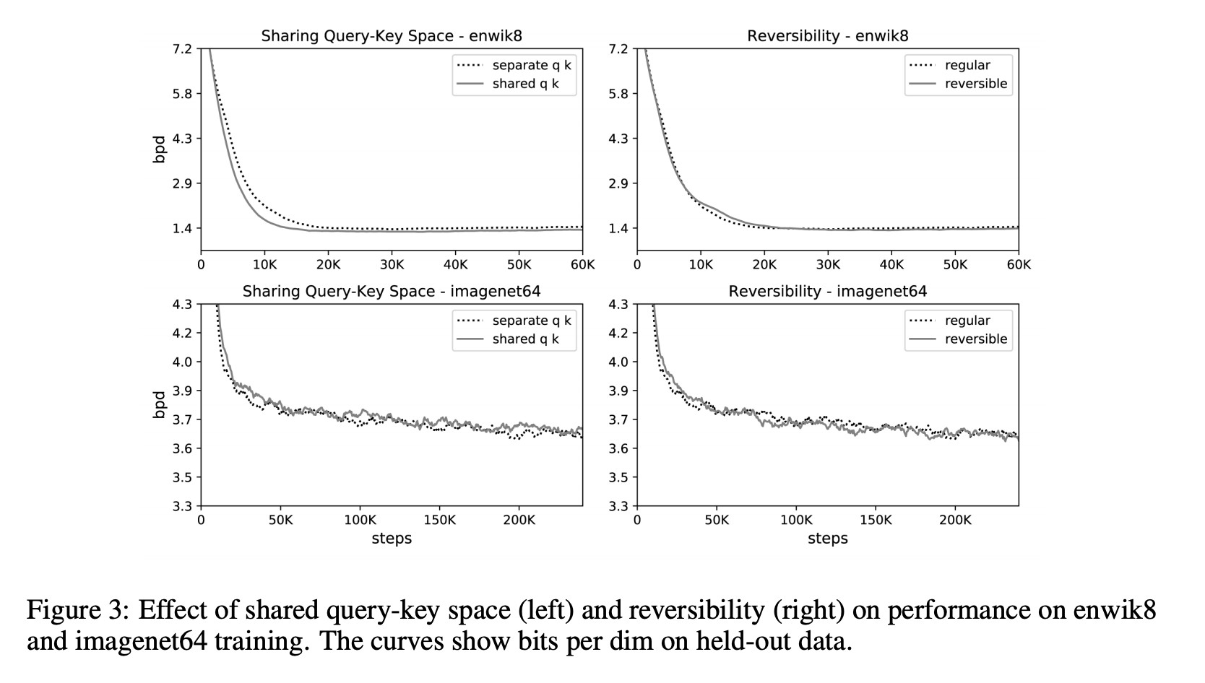

Slide 13
Reference
The Reversible Residual Network: Backpropagation Without Storing Activations Aidan N. Gomez, Mengye Ren, Raquel Urtasun, Roger B. Grosse
Reformer: The Efficient Transformer Nikita Kitaev, Łukasz Kaiser, Anselm Levskaya
Attention Is All You Need Ashish Vaswani, Noam Shazeer, Niki Parmar, Jakob Uszkoreit, Llion Jones, Aidan N. Gomez, Lukasz Kaiser, Illia Polosukhin

