Slide 1
Automatic Clinical Report Generation
2022.02.04
Yiping Wang
CS 886
Notes:
Hello everyone, my name is Yiping Wang, and I am currently a first-year master’s student at the School of Computer Science. I am interested in Computer Vision and NLP for healthcare applications. Today, I would like to share an interesting and challenging topic in the biotechnology section, automatic clinical report generation, which combines both cutting-edge technology from both Computer Vision and NLP.

Slide 2
Outline
Problem Statement
Background and Literature Review
Improving Factual Completeness and Consistency of Image-to-Text Radiology Report Generation
Progressive Transformer-Based Generation of Radiology Reports
Weakly Supervised Contrastive Learning for Chest X-Ray Report Generation
Main paper
Hybrid Retrieval-Generation Reinforced Agent for Medical Image Report Generation
Future work
Notes:
Here is the outline of my presentation. I will first describe the problem statement, define symbols and the objective. Next, we will go through some recent advances in the automatic clinical report generation domain. I will go through the high-level algorithms, with a detailed explanation of the novelties. Unfortunately, I didn’t implement these algorithms, so some nitty-gritty details I might not be able to explain. Furthermore, we will discuss a paper that combines Reinforcement Learning into this problem, with a doctor-inspired workflow to solve this problem. Finally, I will try to discuss what’s future challenges or problems we can aim to solve besides the basic report generation.

Slide 3
Problem Statement
One of the most common and essential tasks for radiologists is the analysis of X-ray images.
With the increasing demand for imaging examinations, the burden on radiologists has increased over time.
Technologies have emerged that enable the automated generation of a draft radiology report, assisting the radiologists in handling large caseloads.
Notes:
One of the most common and essential tasks for radiologists is the analysis of X-ray images in medical practice. With years of training, experts learn to detect and recognize particular features in the images, which they later transcribe into a clinical report that details the symptoms, signs, diagnosis, treatment, and follow-up of an individual patient. Generally, this is a time-consuming and expensive task, especially for young trainees. With the increasing demand for imaging examinations, for instance, during COVID-19 diagnosis, the burden on radiologists has increased over time, which requires additional technologies to improve their workflow. Particularly, technologies have emerged that enable the automated generation of a draft radiology report, assisting the radiologists in handling large caseloads.

Slide 4
Problem Statement
Top figure from https://visualqa.org/
Notes:
One similar problem is the Visual Question Answering. Given an image and a natural language question about the image, the task is to provide an accurate natural language answer. For instance, suppose the given image is the pizza, and question can be “How many slices of pizza are there”. The algorithm is expected to give an accurate answer. This is a challenging problem, and it seems like if you solved the Visual Question Answering, you also pass the Turing test. So there are lots of opportunities in this domain, in fact, I think there is a new CS faculty member at Waterloo who is working on this problem as well.

Slide 5
Problem Statement
Top figure from https://visualqa.org/
Bottom figure from https://arxiv.org/abs/1805.08298
Notes:
This image shows typical training data for training and the automatic clinical report generation algorithms. The left is a chest X-ray image, and the middle is a ground truth clinical report produced by a doctor. Usually, the algorithm focuses on generating the *Finding* section. The right is a generated report produced by an algorithm.

Slide 6
Problem Statement
Goal: generating a report consisting of a sequence of sentence Y = (y_1, y_2, …, y_M) given a set of medical images I = {I_j}^K_{j=1} of a patient case. Each sentence comprises a sequence of words y_i = (y_{i,1}, y_{i,2}, …, y_{i,N}), y_{i,j}\in V where i is the index of sentences, j is the index of the words, and V is the vocabulary of all output tokens.
Challenges: Medical reports are usually dominated by normal findings. Abnormal findings are relatively rare and diverse.
Notes:
Now let’s define the problem more precisely. Our goal is to generate a report, which contains a sequence of sentence y, and each sentence contains a sequence of word y_i, and each word y_i belongs to a vocabulary. The input image is denoted as I.
The challenges is that the ground truth medical reports are usually dominated by normal findings, while abnormal findings are relatively rare and diverse. A desirable medical report not only needs to describe normal and abnormal findings, but also need to find the location and attributes of visual evidences. Compared to Visual Question Answering, the reports are usually long and coherent.

Slide 7
Literature Review: 1st paper
Improving Factual Completeness and Consistency of Image-to-Text Radiology Report Generation by Miura et al.
Notes:
The first paper I would like to share is Improving Factual Completeness and Consistency of Image-to-text Radiology Report Generation, which was published on the 2022 Annual Conference of the North American Chapter of the Association for Computational Linguistics.

Slide 8
Literature Review: 1st paper
Improving Factual Completeness and Consistency of Image-to-Text Radiology Report Generation by Miura et al.
Introducing two simple rewards to generate radiology domain entities consistent with the reference, and one that uses natural language inference to encourage these entities to be described in inferentially consistent ways.
“Entities” means disease and anatomy
“Inferentially consistent” means the conclusion is can be logically inferred from the description of the entities.
Notes:
The novelty in this paper is that the authors proposed two simple rewards signals, as in Reinforcement Learning, to generate domain entities consistent report, and encourage the entities to be described in inferentially consistent ways. Here, the entities mean the disease and anatomy. And the inferentially consistent means the conclusion can be logically derived from the description of the entities.

Slide 9
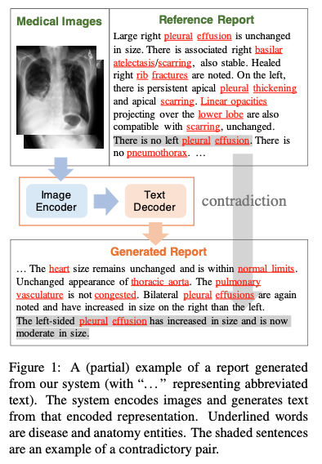
Literature Review: 1st paper
Issue:
Incomplete: it neglects an observation of atelectasis
Inconsistent: it mentions left-sided pleural effusion, but is not present in the images.
This generated report is not factual completeness and consistency.
Solution:
Exact Entity Match Reward: Capture the completeness by measuring its coverage of entities compared with reference report.
Entailing Entity Match Reward: Combining a natural language inference model to consider how inferentially consistent the generated entities are with the their descriptions.
Notes:
The left image is taken from the paper. It illustrates the issue the author aims to solve. For instance, it neglects the observation of a disease. So the generated report is not complete. Furthermore, the generated report mentioned left-sided pleural effusion, but it is not present the images, which is inconsistent. Thus, this generated report is not factually complete and consistent.
The authors proposed a solution that contains two simple reward to encourage their RL algorithm to address the above issues. The Exact Entity Match Reward, captures the completeness by measuring its coverage of entities, compared with reference report. The goal of the exact entity match reward is to better capture disease and anatomical knowledge that are encoded in the entities.
The Entailing Entity Match Reward, combines a pre-trained natural language inference model to check how inferentially consistent the generated entities are with the descriptions.

Slide 10
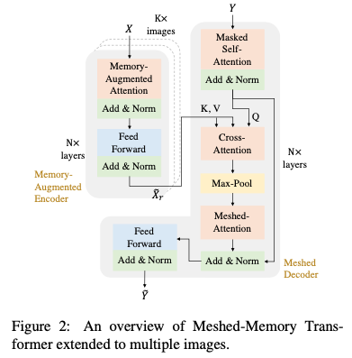
Literature Review: 1st paper
Notes:
This figure illustrated the Transformer architecture the authors used, it is a variant of vanilla Transformer, called Meshed-Memory Transformer. Since this presentation is not about Transformer, I will go into the details about this architecture.

Slide 11
Literature Review: 1st paper
Task: given K individual images x_{1,...,K} of a patient, the task is to generate a sequence of words to form a textual report y.
Notes:
Just to reiterate about the task we want to solve. Given a number individual images of a patient, the task is to generate a sequence of sentences to form a report y.

Slide 12
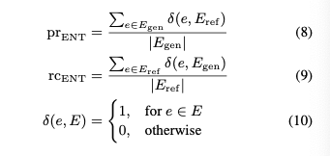
Literature Review: 1st paper
Exact Entity Match Reward
Authors designed an F-score entity match reward to capture factual completeness.
A named entity recognizer is applied to generated y_hat and the reference report y. Then compute the precision and recall of entity match.
The named entity recognizer is a pre-trained model from other research projects.
For instance, the common entities among the reference report and the generated report is pleural and effusion.
Notes:
Now, let’s talk about the Exact Entity Match Reward. This reward is computed by an F-score, and this reward assumes that entities encode disease and anatomical knowledge that relates to factual completeness. Also, a pre-trained name entity recognizer is applied to generate the detected entities. The precision and recall is computed with the function delta on the detected entities. The harmonic mean of precision and recall is to reward match of entities.

Slide 13
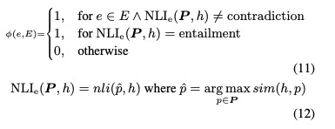
Literature Review: 1st paper
Entailing Entity Match Reward
Natural Language Inference to capture factual consistency.
Expand the \delta in Eq. 10
h is a sentence that includes e, P is all sentences in the corresponding reference report.
nli(*, *) is an NLI function (pre-trained) that returns a label which is one of {entailment, neutral, contradiction}/
sim(*, *) is a text similarity function (pre-trained).
Notes:
Second, the emailing entity match reward is an expansion of the exact entity match reward, by adding a pre-trained natural language inference model to capture factual consistency. The natural language inference model is used to control the overestimation of disease. Here, in the expanded delta function, h is a stance that includes e, and P is all sentences in the corresponding reference reprot. Moreover, nil is an NLI function that returns an NLI label which is one of the {entailment, neural, contraction}, and sim(*) is a text similarity function. The similarity is computed by the BERTscore pre-trained modeel. Thus, this harmonic mean of precision and recall encourage a balanced factual consistency between a generated text and the corresponding reference text.

Slide 14
Literature Review: 1st paper
Entailing Entity Match Reward
Natural Language Inference to capture factual consistency.
Expand the \delta in Eq. 10
h is a sentence that includes e, P is all sentences in the corresponding reference report.
nli(*, *) is an NLI function (pre-trained) that returns a label which is one of {entailment, neutral, contradiction}/
sim(*, *) is a text similarity function (pre-trained).
Notes:
From this paper, we can see the authors leverage a three pre-trained models, which demonstrated the power of transfer learning from natural language to biomedical domain. The reward is fairly simple in concept, and helps the model to generate promising results.

Slide 15
Literature Review: 2nd paper
Progressive Transformer-Based Generation of Radiology Reports by Nooralahzadeh et al.
Introducing a image-to-text-to-text generation framework where the problem of the radiology report generation is divided into two steps.
The model generates global concepts from the image in the first step, and then reforms them into finer and coherent texts using a Transformer architecture.
Notes:
The second paper I would like to discuss is the Progressive Transformer-Based Generation of Radiology Reports.
The word “progressive” means step-by-step, and in Computer Vision, “progressive” training is used. For instance, if you wish to classify high-resolution images, you can start by resizing the high-resolution images into smaller solution, and trian a model on it, and use the trained model as a starting point to train the higher-resolution images.
Anyways, this paper introduces a image-to-text-to-text generation framework. First, the authors generates a high-level, global concepts of the image, and then reform those concepts into a refiner and coherent texts.

Slide 16
Literature Review: 2nd paper
Motivation: modeling the clinical coherence across the entire report.
Method: X -> C -> Y, where X = {x_1, x_2, …, x_S} where X is a radiology images, and x_s is sequence of patch features from visual extractor. C = {c_1, c_2, …, c_T} and Y = {y_1, y_2, …, y_T} are the generated tokens at intermediate and final steps.
Three components: 1) visual backbone 2) intermediate encoder-decoder as a visual language model 3) final encoder-decoder as a language model.
Notes:
The motivation is similar to previous paper, which is to generating a coherent clinical report. There are three components in this framework. First, a visual backbone, which is a pre-trained CNN that extract useful form the images. Second, an intermediate encoder-decoder for the visual language model 3) a final encoder-decoder to translate the high-level concepts to the finer detailed report.

Slide 17
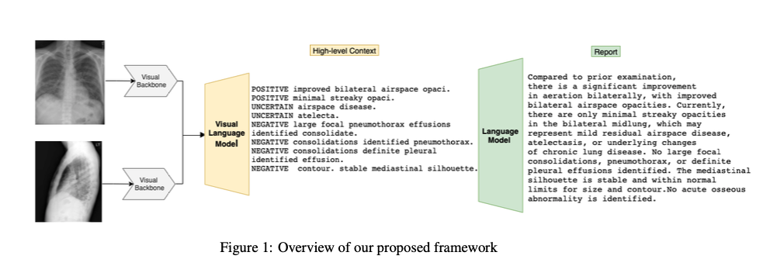
Literature Review: 2nd paper
Notes:
This is a visual description of the 3 components in the proposed framework. Pretty straightforward idea.
You might wonder how do we get the High-level context during training, since the only available ground truth data is the full reference clinical report? The authors took advantage of a tool MIRQI, so each training report is processed with disease word extraction, negation/uncertainty extraction, and attributes extraction based on the dependence graph parsing.
Thus, the context ground truth is pre-generated by this tool. Then, given the image feature and the context, the Visual Language Model can be fine-tuned, and further the Language Model can also be fine-tuned in the context feature and report ground truth.
Finally, after fine-tuned the Visual Language Model and th Language Model, the model first generates the intermediate context and subsequently generates the full radiology report by adding finer-grained details at the final stage.

Slide 18
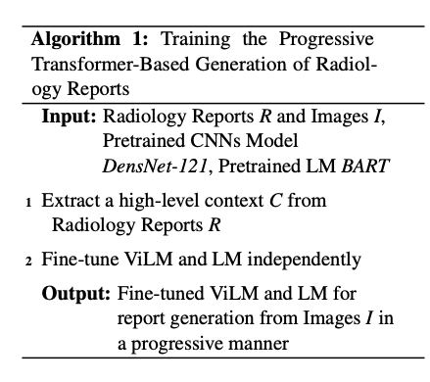
Literature Review: 2nd paper
Notes:
This demonstrates the overall algorithm in a formal description. Again, we see the Transfer Learning here. The mode started with pre-trained language models, and then fine-tune on the medical report dataset.
This paper is simple and interesting as it utilized a progressive strategy. Progressive strategy has been shown effective for many Computer Vision problems, such as classification. So it is nice to see another Computer Vision technique applied on Language processing domain.

Slide 19
Literature Review: 3rd paper
Weakly Supervised Contrastive Learning for Chest X-Ray Report Generation by Yan et al.
Previous methods struggle to generate informative sentences for clinical diagnoses, as normal findings dominate the datasets.
The authors proposed a novel weakly-supervised contrastive learning algorithms to alleviate this issue.
Notes:
The third paper I would like to share is the Weakly Supervised Contrastive Learning for Chest X-Ray Report Generation.
The motivation of this paper is that previous methods struggle to produce informative sentences for clinical diagnosis, because of the dominated amount of normal findings in the biomedical dataset. Thus, the authors proposed a novel weakly-supervised contrastive learning to alleviate the issue.
Don’t be scared by the terminology. “Weakly-supervised” simply means the supervision is easily available. For instance, in a segmentation problem, Strong supervision is the pixel-level ground truth, while weakly-supervised can be just the bounding box of an image. “Contrastive learning” simply means a branch of self-supervised learning algorithms that aims to learn generic features by contrastive examples. For example, given an image for classification, instead of classifying what object is in the image, we can rotate the original to 90, 180, 270 degrees, and let the classifier to classify the rotation. This enables the learning algorithm to learn generic features without human labelling.

Slide 20
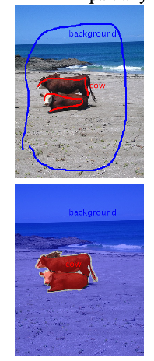
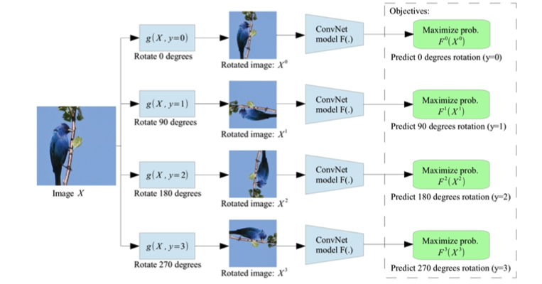
Literature Review: 3rd paper
Notes:
Don’t be scared by the terminology. “Weakly-supervised” simply means the supervision is easily available. For instance, in a segmentation problem, Strong supervision is the pixel-level ground truth, while weakly-supervised can be just the bounding box of an image. “Contrastive learning” simply means a branch of self-supervised learning algorithms that aims to learn generic features by contrastive examples. For example, given an image for classification, instead of classifying what object is in the image, we can rotate the original to 90, 180, 270 degrees, and let the classifier to classify the rotation. This enables the learning algorithm to learn generic features without human labelling.

Slide 21
Literature Review: 3rd paper
Given a chest X-ray image I, its visual features X are extracted by a pre-trained CNN. Standard encoder in Transformer to obtain the hidden visual feature H_x. Then the decoding process at each time step t can be formalized as
Notes:
Similarly, this paper also shares the same problem formulation. As the novelty of this paper focused on the design of objective function, so the authors simply follow the Transformer structure on handling image-to-text problem.

Slide 22
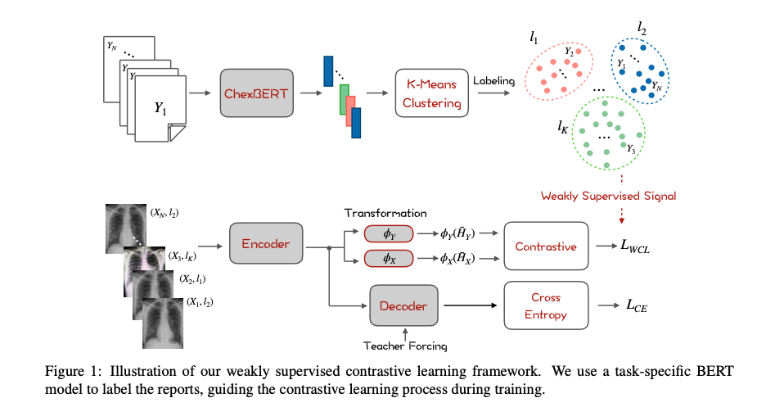
Literature Review: 3rd paper
Notes:
This is an illustration of the algorithm the authors designed.
First stage is labeling Reports with Finetuned BERT
Extract the embeddings of each report from ChexBERT, to represent report-level features.
Then, K-means is applied to cluster the reports into K groups.
Each report Y is assigned with a corresponding cluster label l, where reports in the same cluster are considered to be semantically close to each other.

Slide 23
Literature Review: 3rd paper
Weakly-supervised contrastive learning
Project the hidden representations of image and target sequence from the Encoder to a latent space
Then, contrastive learning comes in by maximizing the similarity between the pair of source image and target sequence, while minimizing the similarity between the negative pairs
Notes:
H_x and H_y are the average pooling of the hidden states from the Transformer encoder. \phi_x and \phi_y are two fully connected layers with ReLU activation.
S_i,j = sim(z_x, z_y) where sim is a cosine similarity. L denotes the weakly assigned report.
This slides concludes the third paper. This paper is interesting as it proposed a objective function that guides the contrastive learning process during training. Although I don’t think their method is weakly, as they still needs the reference report. It would be interesting if the reference report is limited to only key words.

Slide 24
Main paper
Hybrid Retrieval-Generation Reinforced Agent for Medical Image Report Generation by Li et al.
It introduces a hybrid mode that combines the traditional retrieval-based approaches populated with human prior knowledge, and the modern ML-based approaches to achieve desirable reports.
HRGR-Agent provides hierarchical decision making procedure, with a retrieval policy module to retrieve a template sentence from an off-the-shelf template database, and a generation module to generate novel sentences.
Notes:
Finally, we can discuss the main paper, which is Hybrid Retrieval-Generation Reinforced Agent for Medical image Report Generation, which is NIPS 2018. This is a relative old paper, but its core idea is intuitive as the algorithm is inspired by how doctors write clinical report.

Slide 25
Main paper
For normal cases, a retrieval-based system can perform well due to the low variance of the language.
Pure generation pipelines are biased towards generating plausible sentences that look natural by the language model but poor at finding visual groundings.
The authors propose to jointly train the retrieval policy module and generation module via Reinforcement Learning guided by sentence-level and world-level rewards.
Notes:
Previous work we have reviewed all aiming at building a single generative model from images. However, as the normal findings are so common, it is not necessary to training a generative model on it. Also, in real-world, if there is no diseases, the doctors usually simply follow a template to write the report. Thus, the authors proposed a two modules to generate reports.
First, it is a retrieval policy. It retrieves sentences and words from a large template bank for a database. Second, if there is abnormal findings, the retrieval policy will invoke another molde, the generation module, to produce abnormal findings.

Slide 26
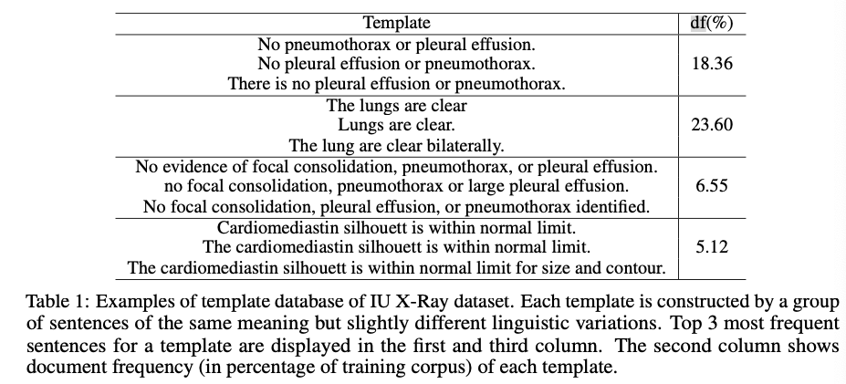
Notes:
This is table illustrates the percentage of the common sentences in the clinical report. It is can be easily observed that some sentences, such as the “The lungs are clear”, exists in nearly 25% of all the clinical report. These sentences are so common and can squeeze the ability of the learning model for other abnormal sentences.

Slide 27
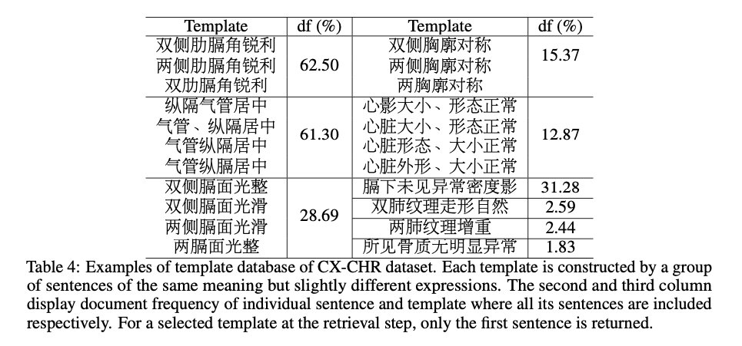
Notes:
Here is another table for the frequency of sentences in the Chinese clinical report. Some Chinese description occupies nearly 60% of all clinical report. So it makes sense to retrieve common sentences or phrases from a large database.

Slide 28
Main paper
Aiming at generating a report consisting of a sequence of sentences Y = (y_1, y_2, …, y_M) given a set of medical images I = {I_j}^K_{j=1} of a patient case. Each sentence comprises a sequence of words y_i = (y_{i,1}, y_{i,2}, …, y_{i,N}), y_{i,j} \in V where i is index of sentences, j the index of words, and V the vocabulary of all output tokens.
Notes:
Similar to previous, this paper also shares a similar problem statement.

Slide 29
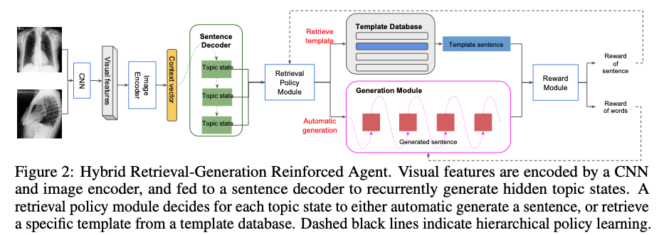
Main paper
Notes:
This figures illustrates the main algorithms from the paper. The authors first use CNN to extract visual features and transformed into a context vector by an image encoder. Then a sentence decoder generates a sequence of hidden states, which represents a sentence topics. Given each topics q, a retrieval policy either automatically a new sentence by invoking a generation module, or retrieve an existing template from the template database.
By using the template database, the generative can focus on learning how to generate abnormal findings, instead of biased towards generating normal findings and plausible sentence instead of describing visual findings of the diseases and symtoms.

Slide 30
Main paper
Image Encoder
Given a set of images {I_j}^K_{j=1}, we first extract their features {v_j}^K_{j=i} with a pretrained CNN, and take the average of {v_j}^K_{j=1} to obtain v.
The image encoder converts v into a context vector h^v, which is used as the visual input for all subsequence modules.
Notes:
The image encoder is parameterized as a fully-connected layer, and the visual features are extracted from the last convolution layer of a DenseNet or VGG-19.

Slide 31
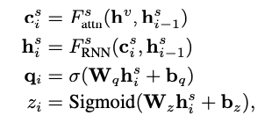
Main paper
Sentence Decoder
Sentence decoder comprises stacked RNN layers which generates sequence of topic states q.
Notes:
The authors equip the stacked RNNs with attention mechanism to enhance the text generation. Each stacked RNN first generates an attentive context vector c_i given the image context vector and previous hidden states. It then generates a hidden states h_i based on c_i and h_{i-1}. Further, the generated hidden state h_i^s is further projected into a topic space as q_i and a stop control probability z through a nonlinear function.
As you may observe, it is a paper from 2018, so the main architecture used here is a recurrent NN.

Slide 32
Main paper
Retrieval Policy Module
Given each topic state q_i, the retrieval policy module takes two steps.
It predicts a probability distribution u_i \in R^{1+|T|}, over actions of generating a new sentence and retrieving from |T| candidate template sentences.
Notes:
Based on the prediction of the first step, it triggers different actions. If automatic generation obtains the highest probability, the generation module is activated to generate a sequence of words conditioned on current topic state.
If a template in T obtains the highest probability, it is retrieved from the off-the-shelf template database and serves as the generation result of the current sentence topic.

Slide 33
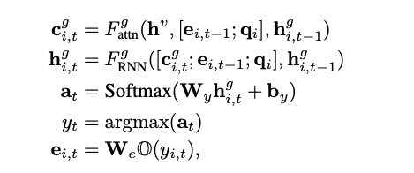
Main paper
Generation Module
Generation module generates a sequence of words conditioned on current topic state q_i and the image context vector h^v for each sentence.
Notes:
It comprises RNNs which take environment parameters and previous hidden state h_{i, t-1} as input, and generate a new hidden state h^g_{i,t} which is further transformed to a probability distribution a_{i, t} over all words in V.

Slide 34
Main paper
Hierarchical Reinforcement Learning
Designing reward signal
The authors used the automatic metrics CIDEr for computing rewards.
Two kinds of reward functions: sentence-level reward and word-level reward.
CIDEr is a metric that measures consensus.
For each sentence, compute a delta of CIDEr score at sentence level
For each word, similarly, compute a delta of CIDEr score at word level.
The sentence-level and word-level rewards are used for computing discounted reward for retrieval policy module and generation module.
Policy updates for Retrieval Policy Module and Generation Module
Notes:
The authors proposed a two-level hierarchical RL algorithm. As any RL algorithms, the authors first need to design reward signal. CIDEr is used as the signal, and CIDEr is a metric that measures consensus. For each sentence, the authors compute a delta of CIDEr score at sentence level. Similarly, a delta of CIDEr score is also computed at word level. Sentence level reward assesses the advantages the generated sentence bring in to the existing sentences when evaluating the quality of the whole report.
Finally, the authors used the REINFORCE algorithm with the sentence-level and word-level two rewards as the discounted reward to perform the policy updates on the Retrieval Policy and Generation modules.

Slide 35
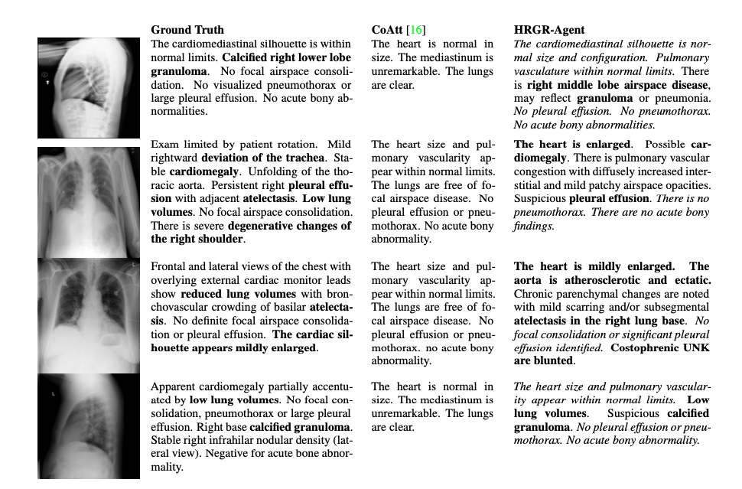
Notes:
This is an example output from the trained model. As we can see, the HRGR-Agent is able to detect the abnormality terms, as highlighted in the figure. While the baseline failed to do so.
Moreover, one highlights of this paper is that the authors distributed the results to doctors, and ask for their opinions. HRGR-Agent achieves much higher human preference than all baseline models.

Slide 36
Future works
In practice, doctors analyze the X-ray images and write clinical reports with specific clinical questions in mind. This question is typically based on the medical history of a patient.
Given a set of clinical questions (e.g., has the airspace disease improved compared to the last examination?, What is the probability of having atelectasis, or airspace opacity?) and an X-ray image, can we develop a novel machine learning algorithm that generates a radiology report tailored to answer those specific clinical questions.
Notes:
So far, all the previous works have been focused on generating reports only from images.
However, In practice, doctors analyze the X-ray images and write clinical reports with specific clinical questions in mind. This question is typically based on the medical history of a patient. Can we go beyond the direct image-to-text generation and aim to auto-generate radiology reports starting with a specific medical question. For instance, given a set of clinical questions (e.g., has the airspace disease improved compared to the last examination?, What is the probability of having airspace opacity?) and an X-ray image, can we develop machine learning algorithm that generates a radiology report tailored to answer those specific clinical questions.

Slide 37
Future works
Information Maximizing Visual Question Generation by Krishan et al.
Notes:
Some related work approach that problem to maximizing the mutual information between the a question and an image. For instance, in the Information Maximizing Visual Question Generation paper, the authors proposed to generate questions based on two conditions, first is the image and the second is the expected answer category.
For example, given this image and an answer category, such as object, the algorithm should output something like what is the person throwing. However, applying this algorithm directly to medical image report generation is difficult. As a report is long and comprehensive report, but just a single stance. Thus, it requires further research to develop a algorithm for it.

