Slide 1
Vision Transformer for COVID-19 CXR diagnosis
Xinyu Shi

Slide 2
Agenda
Background of Vision Transformer (ViT)
Problem Definition: Chest X-Ray Analysis
Federated Split Vision Transformer for COVID-19 CXR Diagnosis using Task-Agnostic Training
Multi-task vision transformer using low-level chest X-ray feature corpus for COVID-19 diagnosis and severity quantification

Slide 3
Background
1. Transformer v.s. CNN?
2. How ViT (Vision Transformer) works?
3. Some interesting findings about ViT?

Slide 4
ViT v.s. CNN
Transformers lack the inductive biases of Convolutional Neural Networks (CNN)
Translation invariance
Locally restricted receptive field
Transformers cannot process grid-structured data, we need sequences.
For images, we need to convert the spatial non-sequential signal to a sequence

Slide 5
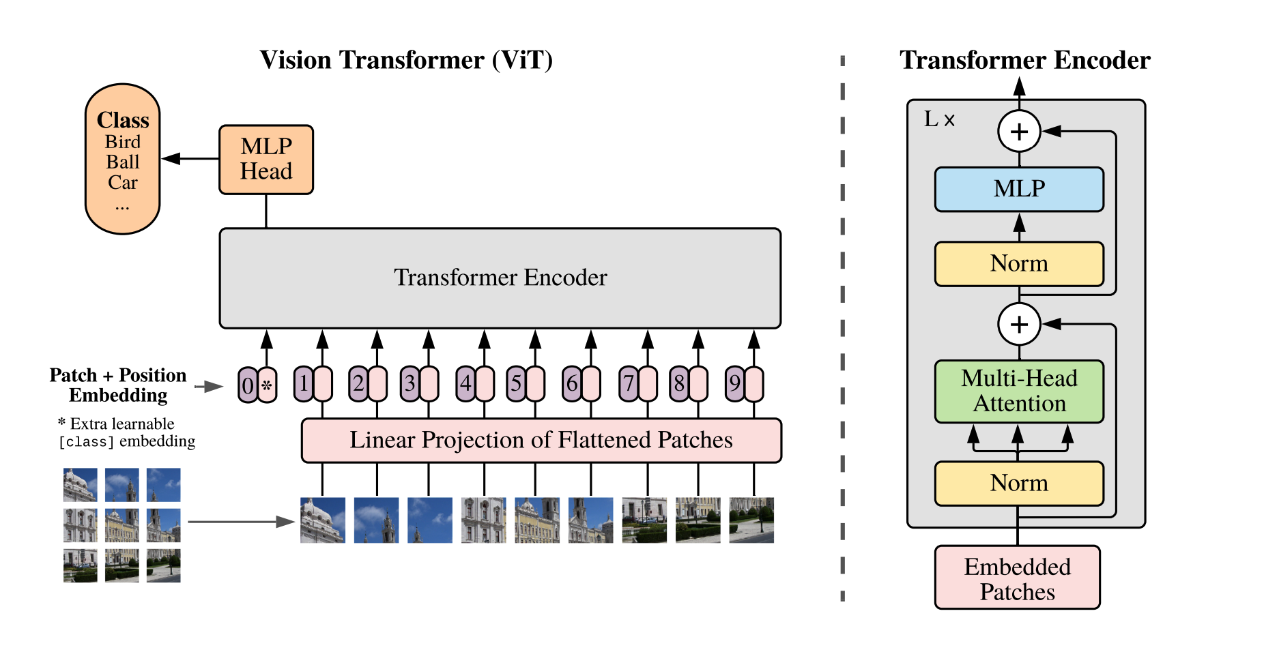

Slide 6
How ViT works
Split an image into patches
Flatten the patches
Produce lower-dimensional linear embeddings from the flattened patches
Add positional embeddings
Feed the sequence as an input to a standard transformer encoder
Pretrain the model with image labels (fully supervised on a huge dataset)
Finetune on the downstream dataset for image classification

Slide 8
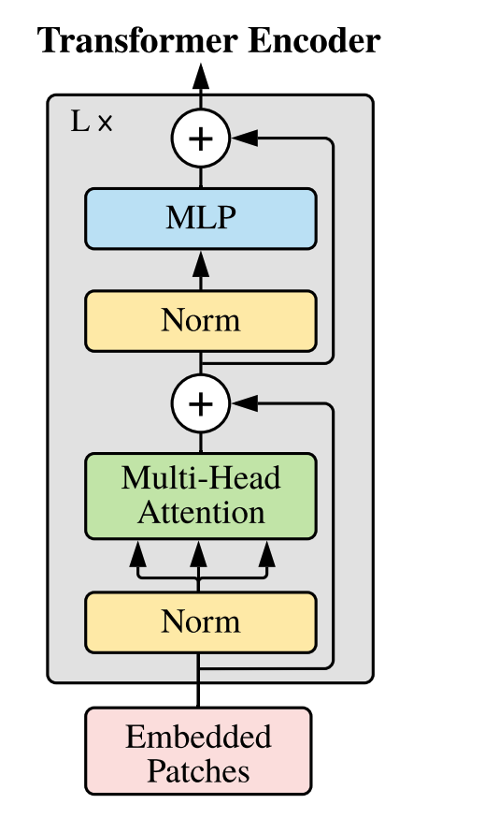
Transformer Block

Slide 9
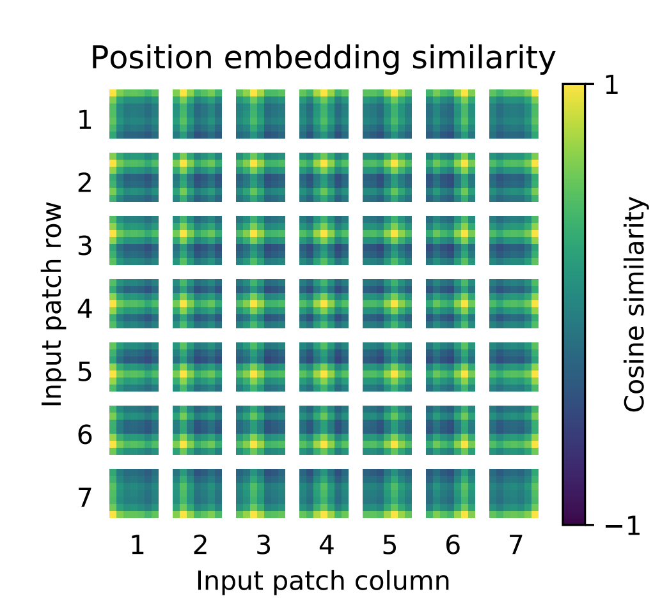
Key Findings – Position embedding

Slide 10
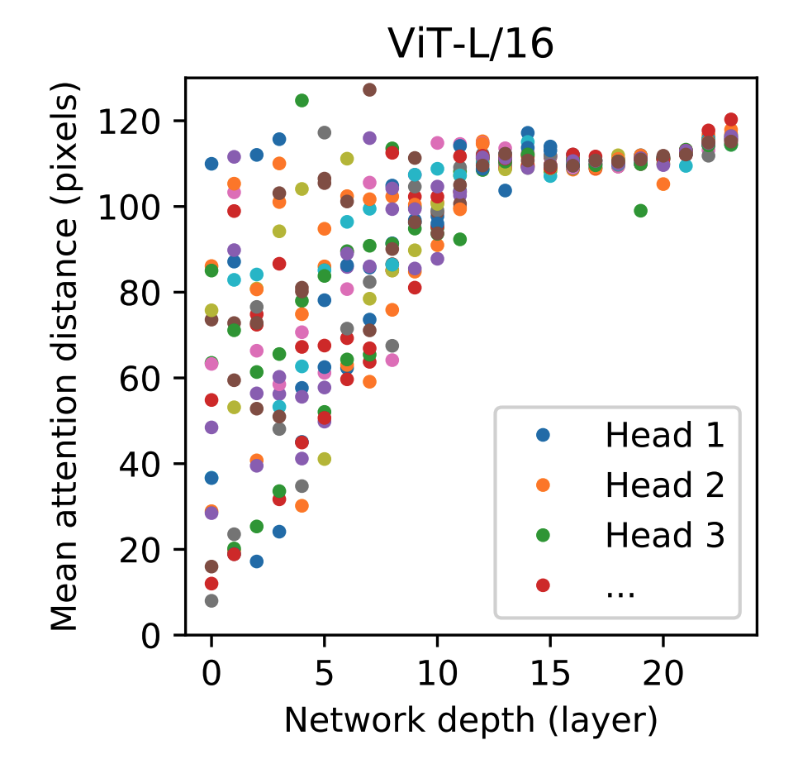
Key Findings – Non-local Interactions

Slide 11
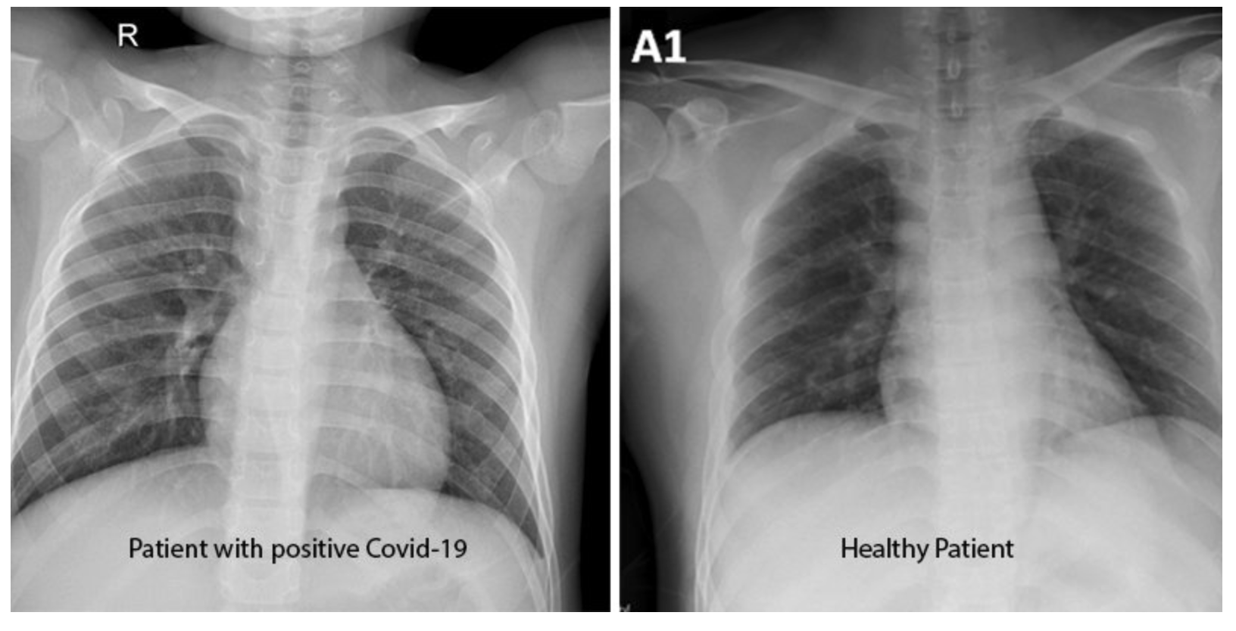
Problem Definition
Chest X-ray Analysis

Slide 12
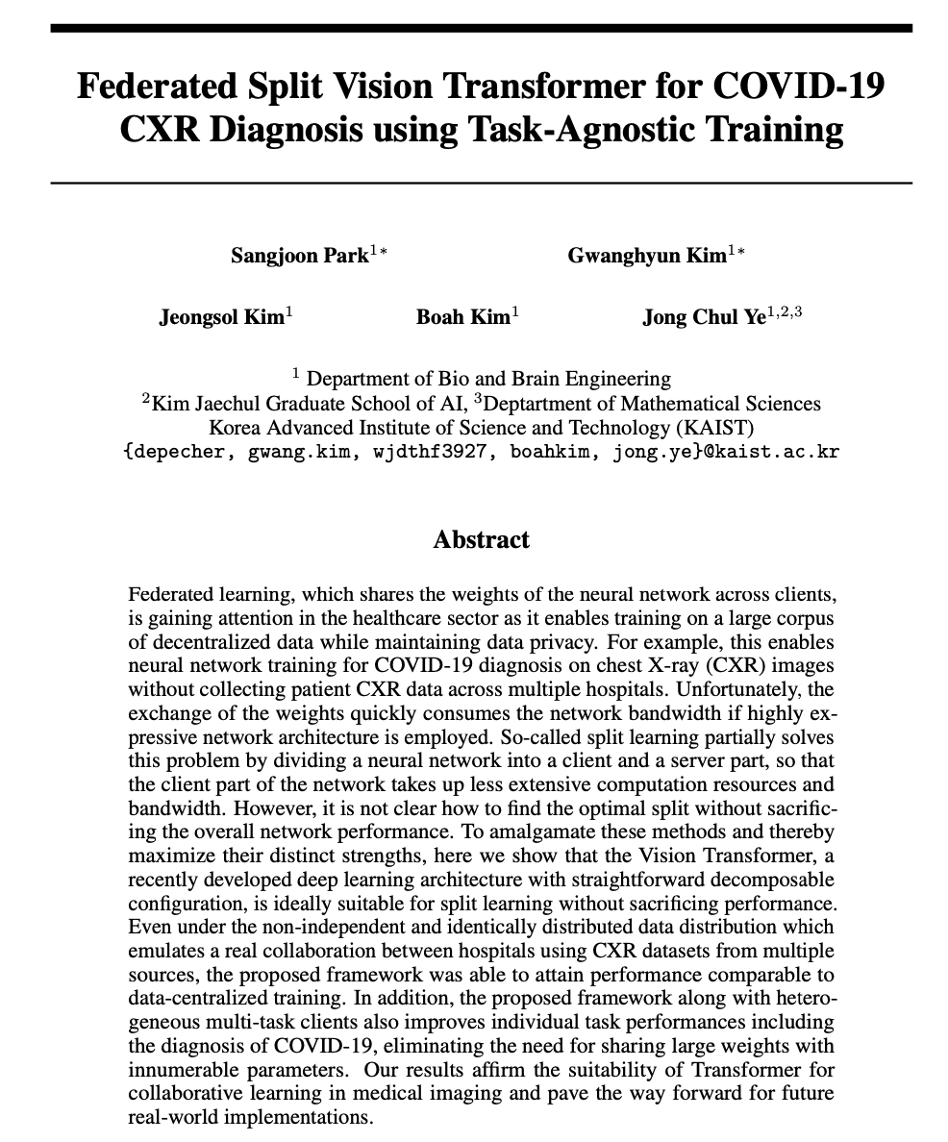

Slide 13
Main Contributions
The authors proposed a novel FESTA learning framework equipped with the ViT by utilizing its decomposable design to amalgamate the merit of FL and SL.
The authors showed that the model trained with the FESTA framework can leverage the robust representations from multiple related tasks to improve the performance of the individual task.

Slide 14
Federated Learning
Federated Learning is simply the decentralized form of Machine Learning.
Traditional machine learning trains the model using the data stored in a centralized server.
-> “privacy nightmare”

Slide 15
Federated Learning
1. The centralized machine learning model will have a local copy on all devices.
2. The local model will now gradually learn and train itself.
3. The devices are allowed to transfer the training results, from the local back to the central server.
Remember, only results, not data!
4. The results will be aggregated together in the centralized server.
5. The centralized cloud server now updates its central machine learning model from the aggregated training results.

Slide 16
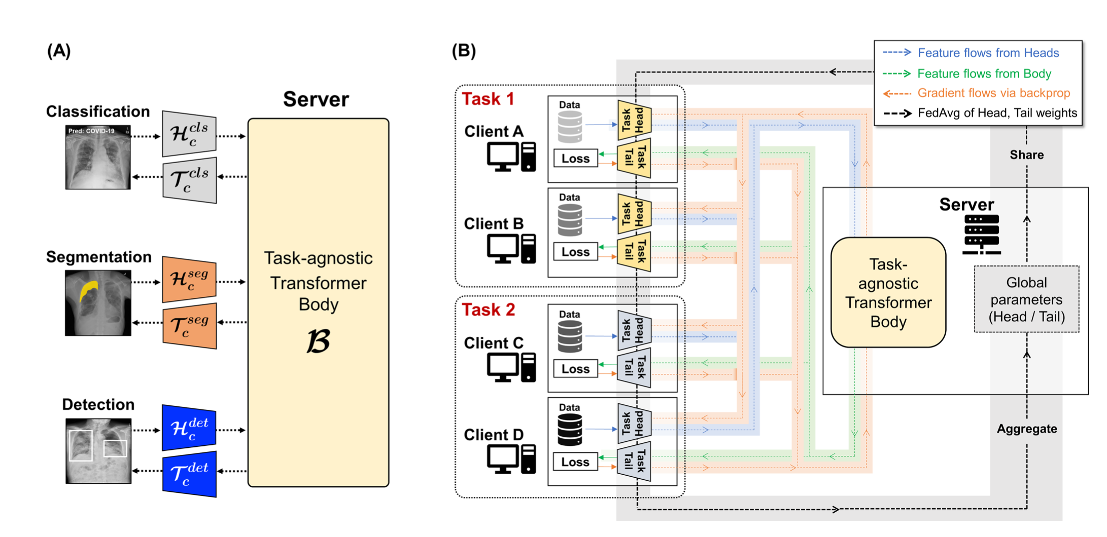

Slide 17
Dataset for COVID-19 Diagnosis

Slide 18
Experiment results
Comparison of the performances of the proposed model with other strategies

Slide 19
Experiment results
Comparison of the performances between single-task learning and multi-task learning

Slide 20
Discussions
The good:
Privacy protection
Performance of the model
Novel decentralization framework
Limitations
Vulnerable to other privacy threatening such as inversion attack
Communication bottleneck
Fault tolerance

Slide 21
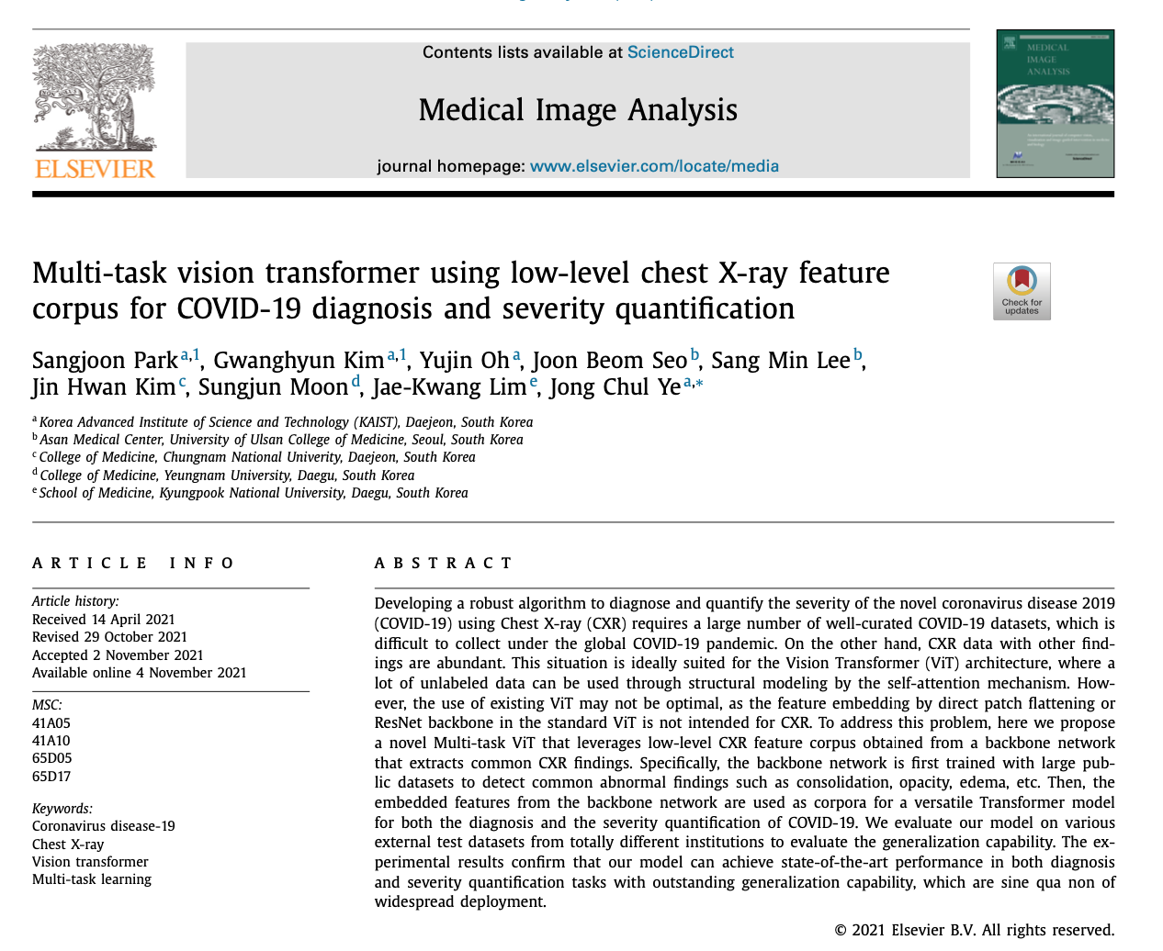

Slide 22
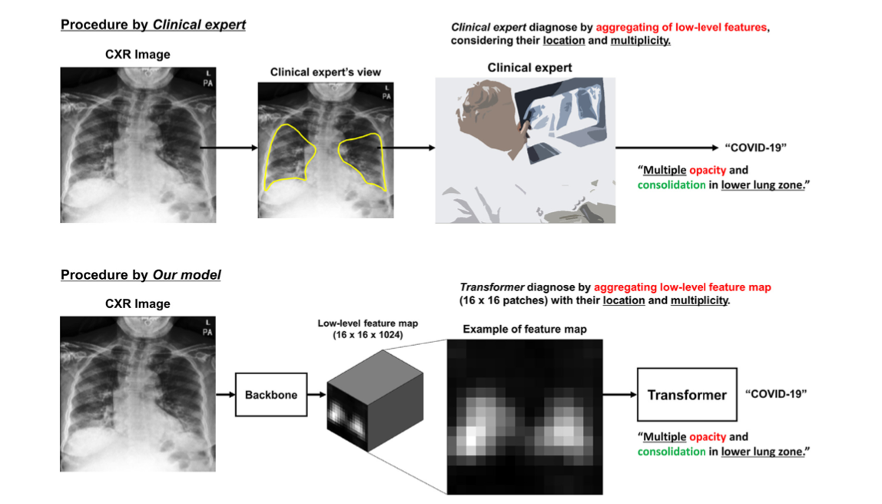
Basic Idea
Photo credit: @bruce.digital

Slide 23
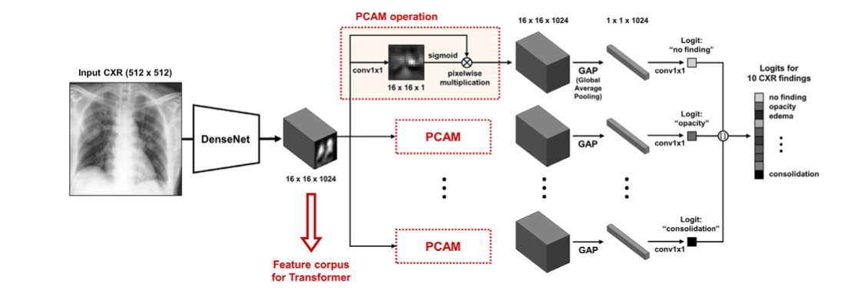
Backbone Network to extract low-level CXR feature corpus

Slide 24
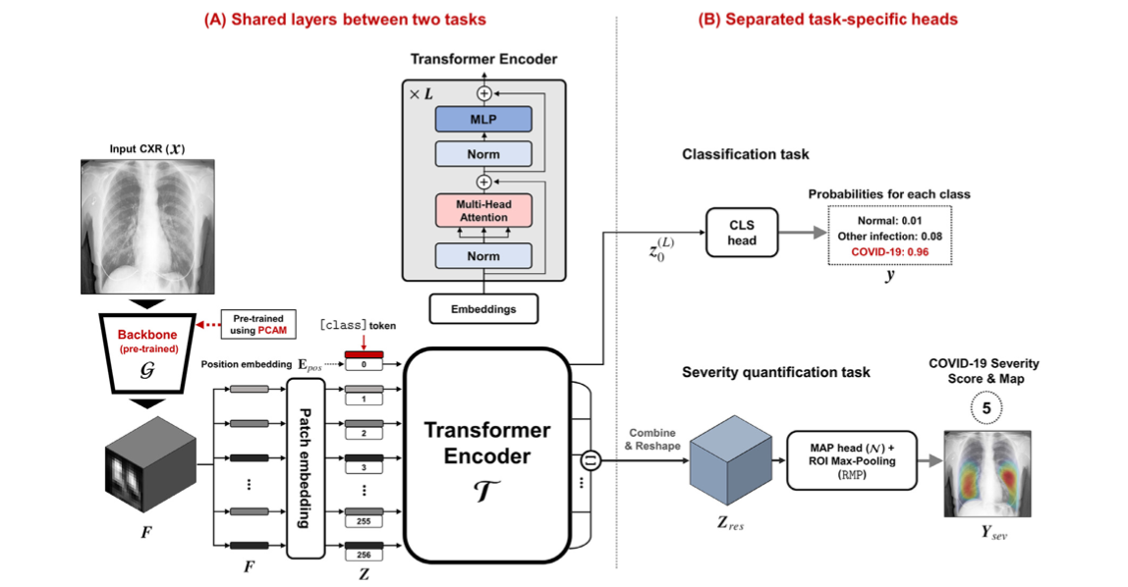
Proposed Multi-task ViT Model

Slide 25
The procedure of severity prediction and labeling

Slide 26
Experiment Results
Benefit of multi-task learning

Slide 27
Experiment Results
Model interpretability results

Slide 28
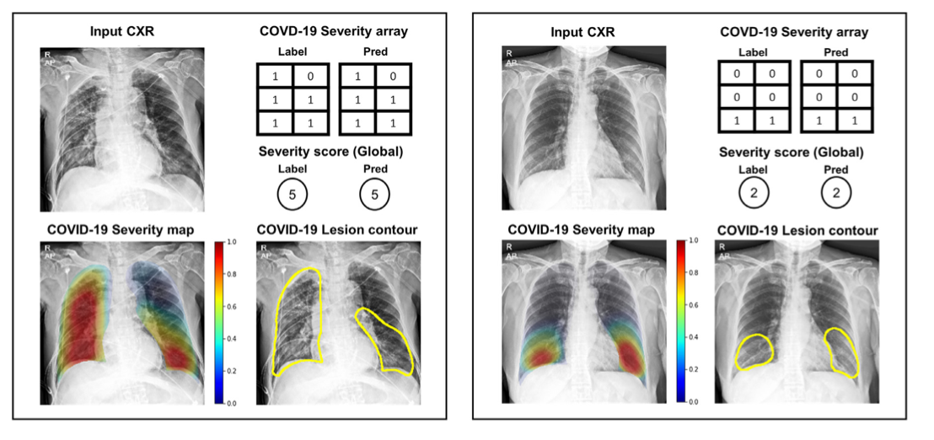
Experiment Results
Severity quantification performance

Slide 29
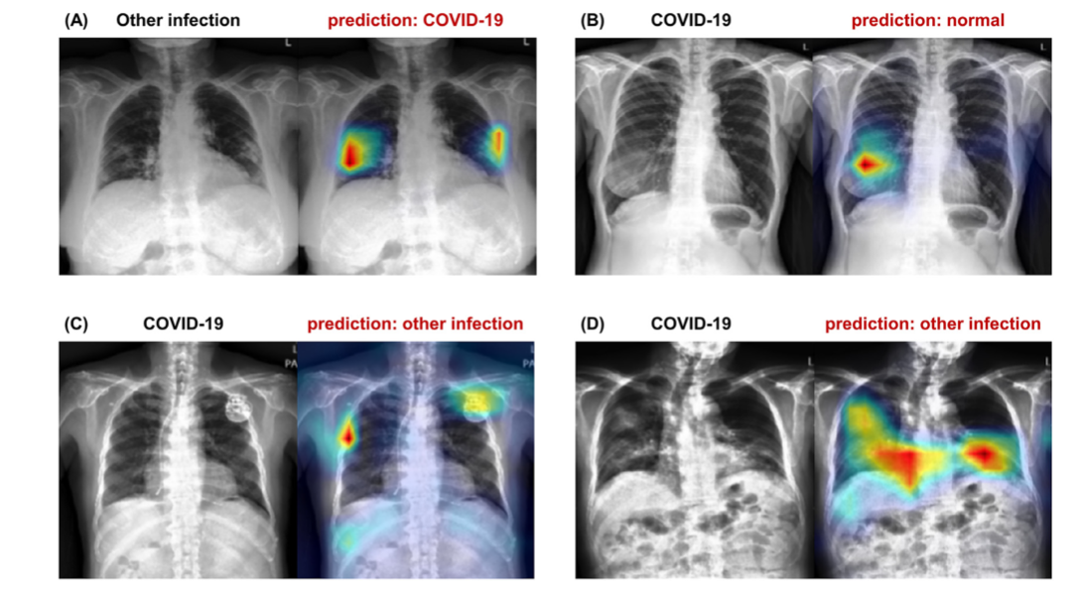
Experiment Results
Failure Cases

Slide 30
Discussion and Conclusion
Common problem of automated diagnosis:
sensitive to specific settings of images
overfit to unimportant findings of image
-> difficult to deploy in the real-world applications.
2. With multi-task learning, the generalization ability of the model is broadened.
3. Model Interpretability is needed in clinical setting.

Slide 31
Thanks for listening! Any questions?

