Slide 1
Target and Aspect based Sentiment Analysis Using Bert
Sheik Shameer - CS 886 - 002 (Winter 2020)

Slide 2
Sentiment Analysis
Simplest task : Is the Sentiment Positive or negative
Moderate task : Rank the positivity or negativity (Generally get a collection of large samples, calculate positive values and use the percentile)
Advanced : Detect target , aspect and classify attitude types

Slide 3
Approaches
Rule Based Approach : Find a bag of words , calculate frequency of words and their correlation
Learning Based Approach : Use a learning algorithm on a labelled set and let the model learn
Hybrid Approach : Combine Rule and learning based approach into one. Improve it with word embeddings.

Slide 4
Target and Aspect Based Sentiment Analysis (TBSA)
Ex : “This book is a hardcover version, but the price is a bit high.”
Finding the sentiment towards a target , its aspect and classifying the sentiment.
Fine grained to get more information out of the text
Target | Aspect | Emotion
Book | Cover | Positive
Book | Price | Negative

Slide 5
Challenges and Approaches
Bert is trained task agnostic - masked representation. So it is not domain specific.
Aspect Based Sentiment Analysis is very much Domain dependent and the results depend upon the domain corpus.
But Bert (cased) can also be further easily trained with a simple Dense layer and a soft max layer.
Its context can be further improved as well.

Slide 6
Before BERT
Target-dependent LSTM (TD-LSTM) to capture the aspect information when modeling sentences. A forward LSTM and a backward LSTM towards target words are used to capture the information before and after the aspect.
Attention mechanism to concentrate on corresponding parts of a sentence when different aspects are taken as input.

Slide 7
Target-Dependent Sentiment Classification With BERT
ZHENGJIE GAO , AO FENG , XINYU SONG, AND XI WU
Published on Nov 4, 2019

Slide 8
Abstract
Traditional sentiment analysis methods require complex feature engineering and embedding representations have dominated leaderboards for a long time.
However, the context-independent nature limits their representative power in rich context, hurting performance in Natural Language Processing (NLP) tasks.
We implement three target-dependent variations of the BERT base model, with positioned output at the target terms and an optional sentence with the target built in.
Dataset used - SemEval-2014 and a Twitter dataset

Slide 9
Conflict Emotion
‘‘I bought a mobile phone, its camera is wonderful but battery life is short’’
Its camera is wonderful - positive
Battery life is short - negative
So the conveyed emotion is termed as conflict

Slide 10
Problem Definition and Polarity
Tuple (s,t) = y
Sentence s = [w 1 , w 2 , . . . , w i , . . . , w n ]
Target t = [w i , w i+1 , . . . , w i+m−1 ] , m = number of targets
y ∈ {positive, negative, neutral, conflict}

Slide 11
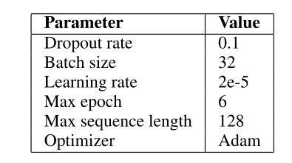
Devise Three types of BERT
They use BERT base model (TB - 12, HL - 768, SAH - 12, Params - 110M)
Target Dependent BERT - FC
Adding an Auxiliary question -
Target Dependent TD-BERT-QA-MUL
Target Dependent TD-BERT-QA-CON

Slide 12
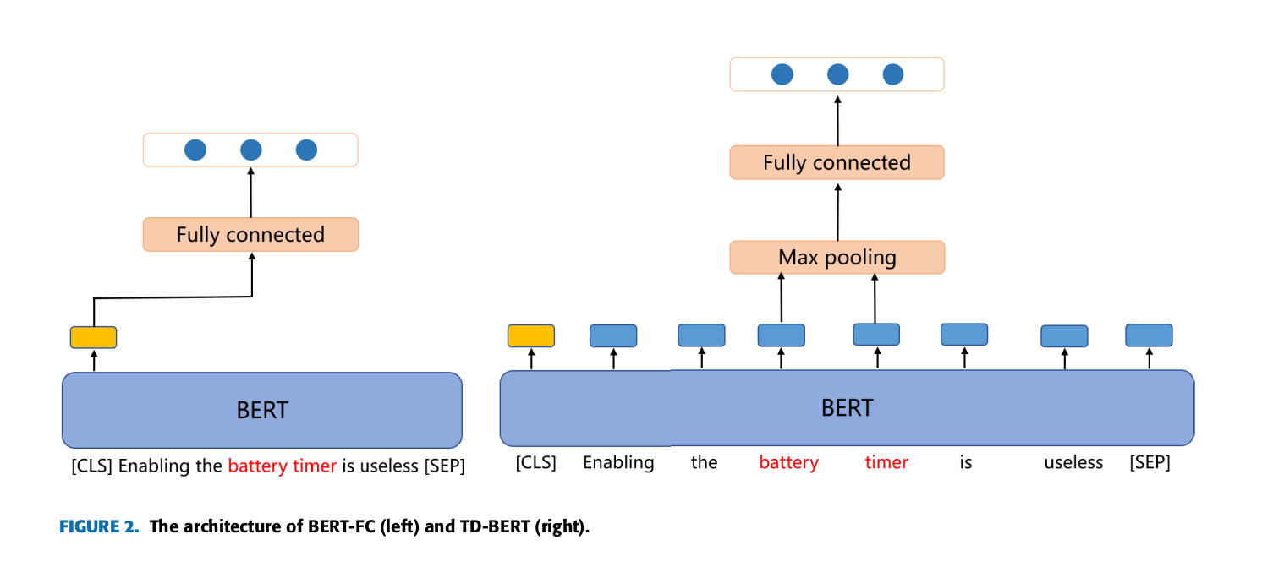
BERT-FC and TD-BERT

Slide 13
Auxiliary Question
Sentence - “Enabling the battery timer is useless”
Auxiliary Question - “what do you think of the battery timer of it”
Advantages - increases the context of the sentence, and BERT is better in Question answering when compared to sentiment analysis.

Slide 14
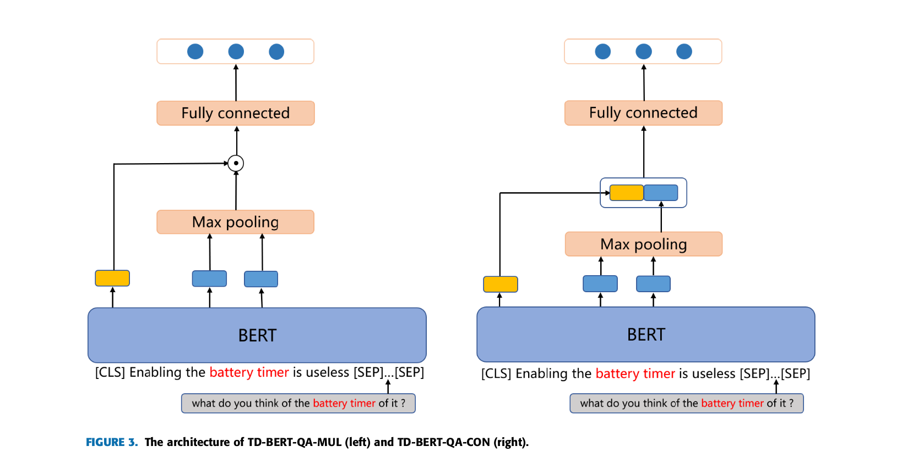

Slide 15
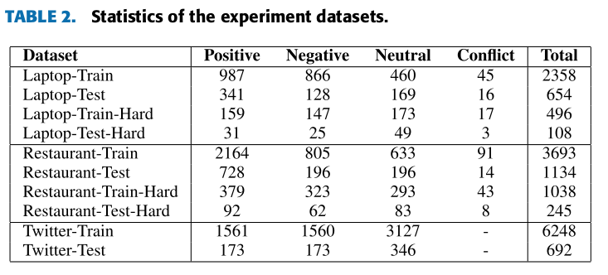
Dataset

Slide 16
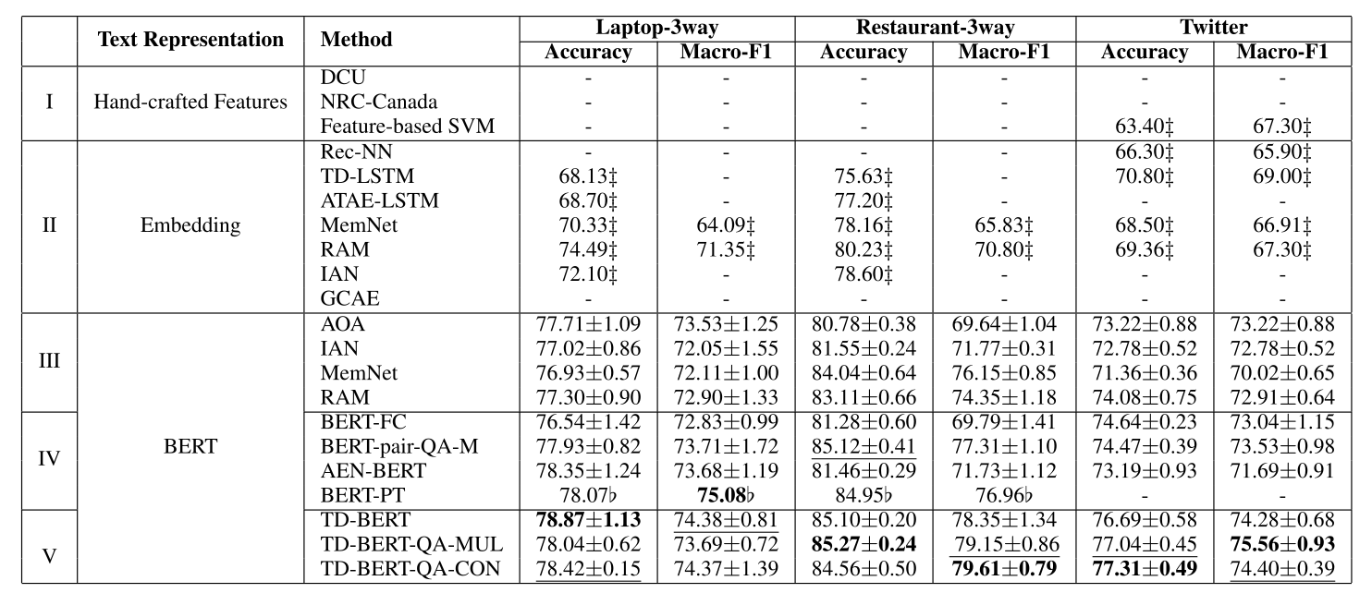
Results - 3 way classification

Slide 17
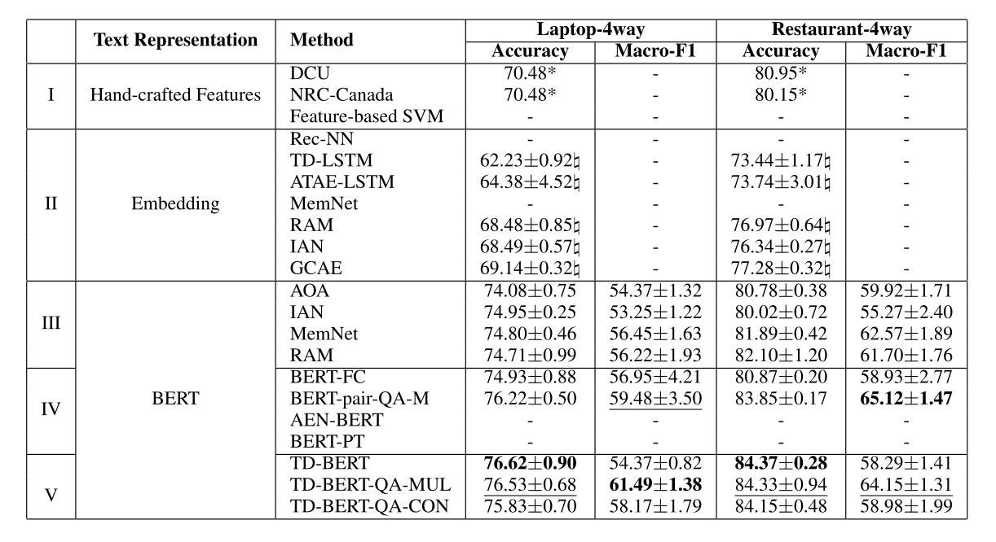
4 way classification

Slide 18
Results
Our three models achieve new state-of-the-art performance on three datasets, especially for Twitter, in which our model has a 2-3% margin over the best previous result.
After the position output information of the target is integrated into the BERT-pair-QA-M model, the classification accuracy of TD-BERT-QA-MUL and TD-BERT-QA-CON is also improved, slightly over TD-BERT on Twitter and Restaurant in its 3-way classification task
The information fusion is applied with either element-wise multiplication or concatenation, but the performance comparison between them is almost equivalent.

Slide 19
Discussion
TD-BERT significantly outperforms the BERT-pair-QA-M model on the Twitter collection , while the pattern is not observed in the other two datasets.
Our assumption is that BERT-pair-QA-M model is susceptible to interference from unrelated information and works poorly for recognizing the neutral polarity.
Negative, neutral, positive samples account for 25%, 50%, 25%, respectively, in the Twitter datasets, and the percentage of neutral samples is much smaller in the other two datasets, in which BERT-pair-QA-M works comparably well.

Slide 20
Neutral Samples

Slide 21
Testing on Neutral Samples
To further examine our model in complex cases, we test its expressiveness in a multi-target scenario with inconsistent sentiment polarities.
We construct a hard-data-only dataset. In terms of classification accuracy, the TD-BERT model is 6-10% higher than BERT-pair-QA-M, showing its advantage in handling complex sentiment labels with multiple targets.

Slide 22
Hard data

Slide 23
Results on Hard data

Slide 24
Utilizing Bert for ASBA via constructing an auxiliary sentence
Chi Sun, Luyao Huang, Xipeng Qiu
Published on 22 Mar,2019

Slide 25
Abstract
Construct Auxiliary sentence from the aspect
Convert ABSA to Question Answering and Natural language Inference task
Experiment with 4 types of Auxiliary sentence
Dataset : Sentihood and SemEval 2014

Slide 26
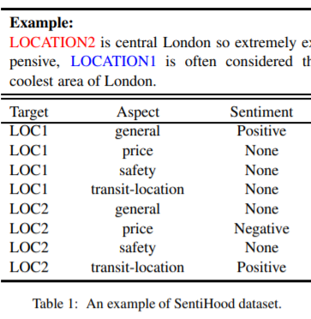
QA-M : “what do you think of the safety of location-1?”
NLI-M: “location-1-safety”
QA-B: “The polarity of the aspect safety of location -1 is positive/negative/none”
NLI-B: “location - 1 - safety - positive/negative/none”

Slide 27
Input Representation:
Sentence s = {w1, · · · , wm}, Targets t = {t1, · · · , tk} , Aspect = {general, price, …}
Predict sentiment polarity y ∈ {positive, negative, none} over {(t, a) : t ∈ T, a ∈ A}.

Slide 28
Fine tuning and Hyper Parameters
BERT - base (Transformers block -12, hidden layer size - 768, parameters - 110M)
Classification layer
Softmax layer
Epochs - 4 , learning rate - 2e-5, batch size 24

Slide 29
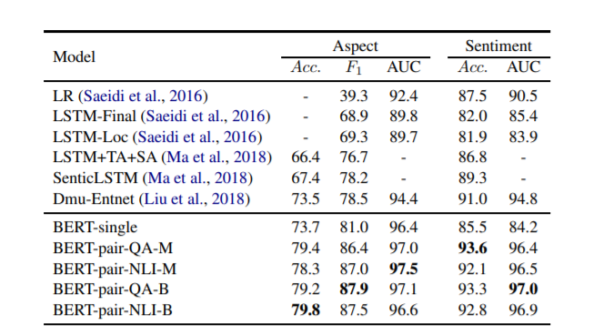
Sentihood - Aspect and Sentiment

Slide 30
Results - Sentihood
BERT- PAIR outperforms other models on aspect detection and sentiment analysis.
BERT pair NLI model performs relatively better in aspect detection
BERT pair QA models perform well on sentiment classification
BERT pair QA B and BERT pair NLI B achieve better on sentiment classification

Slide 31
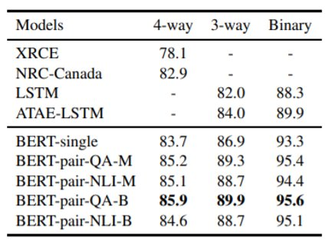
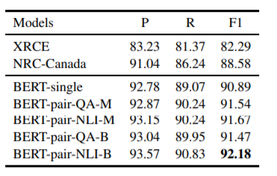
Semeval Dataset
Aspect Detection
Aspect Polarity

Slide 32
Results - Semeval
BERT - single has achieved better results
BERT - pair has achieved further improvement over BERT single.
BERT - pair NLI B model achieves the best performance for aspect category detection
BERT QA B performs best on all 4 way , 3 way and Binary settings

Slide 33
Discussion
Providing more context by adding an auxiliary question
BERT model has an advantage dealing with sentence pair classification task - supervised masked language model and next sentence prediction task
The modeling of the question probably also contributed the accuracy in the sentiment classification

Slide 34
Some Other Methods
Using context from different languages
They use the LDA method to find correlation of words from different languages
Basically , find correlated words from one language. if you are not able to find the correlation in this specific language, Try to find the correlation in some other language and translate to this language.
Domain Adaptation using BERT
Use the uncased BERT or XLNET , try to train your model after training from BERT with your domain specific data. So that the BIAS of the BERT with your DOMAIN can be overwritten.
This also allows BERT to be domain adapted , but also depends on the complexity of the DOMAIN.

Slide 35
References
Utilizing BERT for Aspect-Based Sentiment Analysis via Constructing Auxiliary Sentence - arXiv:1903.09588
Z. Gao, A. Feng, X. Song and X. Wu, "Target-Dependent Sentiment Classification With BERT," in IEEE Access, vol. 7, pp. 154290-154299, 2019. - https://ieeexplore.ieee.org/abstract/document/8864964
Using context from different languages - M. Shams, N. Khoshavi and A. Baraani-Dastjerdi, "LISA: Language-Independent Method for Aspect-Based Sentiment Analysis," in IEEE Access, vol. 8, pp. 31034-31044, 2020. https://ieeexplore.ieee.org/document/8995576
BERT Post-Training for Review Reading Comprehension and Aspect-based Sentiment Analysis - https://arxiv.org/abs/1904.02232
Adapt or Get Left Behind: Domain Adaptation through BERT Language Model Finetuning for Aspect-Target Sentiment Classification - arXiv:1908.11860

