Slide 1
On Extractive and Abstractive Neural Document Summarization with Transformer Language Models by S. Subramanian, R. Li, J. Pilault & C. Pal - 2019
Presenter: Archit Shah (20773927)
Notes:
They present a method to produce abstractive summaries for long documents
With a pre-processing step that first extracts important sentences from the document
A Transformer Language Model is conditioned on those sentences to produce abstract summary

Slide 2
Summarization Task in NLP
Extractive Summarization
Identify important words/phrases from given text
Generate a summary verbatim just based on these
Analogous to when you highlight important sections in a paper with a highlighter
Abstractive Summarization
Learns & para-phrase internal language representation
Generate sentences not seen in original text
Can produce more coherent summary than extractive
But is also harder than extractive summarization

Slide 3
Core Idea – a bit of both!
(Extractive + Abstractive) Summarization
Step 1: Extract important sentences from the given text document
Step 2: Leverage these sentences to condition a Transformer Language Model and generate an Abstractive summary.

Slide 4
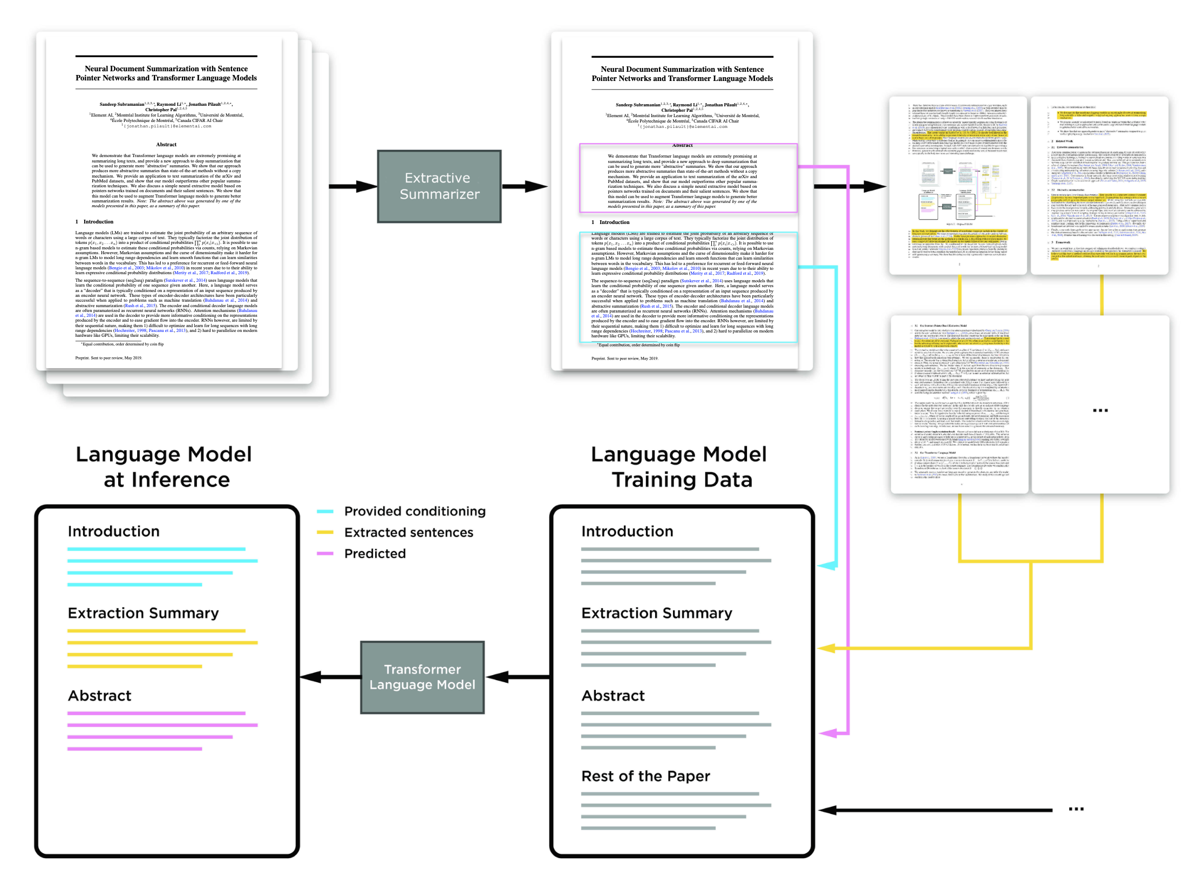

Slide 5
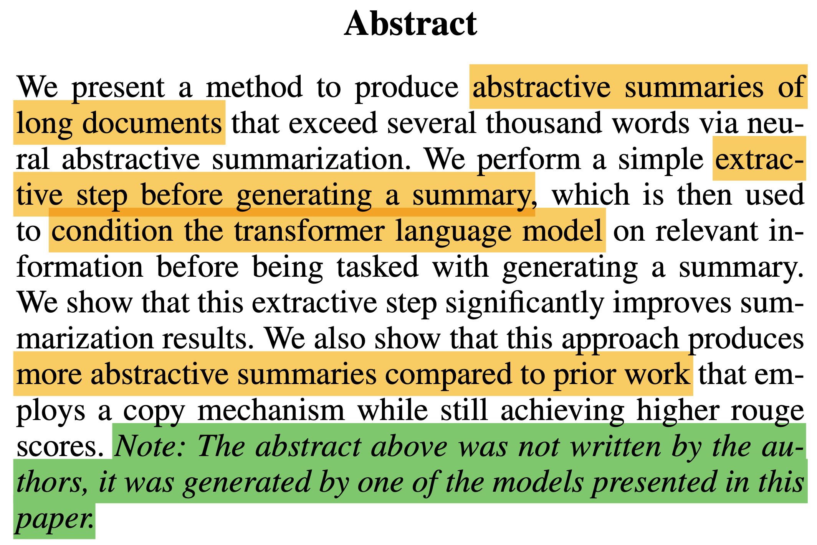
Notes:
- This summary tells how well their model is able to perform
- especially in summarizing scientific papers
- Its shows that the model is able to understand the key concepts in the text

Slide 6
Framework

Slide 7
Step 1a: Extractive Model (Sentence Pointer)
a. Sentence Pointer (Chen and Bansal, 2018*)
Tasked with extracting salient sentences in the document.
Consider documents as a list of N sentences D = (S₁,…..,S_{N})
Given ground truth of extracted summary with M sentences (S_{i1},…..,S_{im}) where i₁ to i_{m} are indices of extracted sentences.
Extraction targets determined by finding sentences in the document that have highest ROUGE score with the sentence in the summary.
*Chen, Y. C., & Bansal, M. (2018). Fast abstractive summarization with reinforce-selected sentence rewriting. arXiv preprint arXiv:1805.11080.

Slide 8
Step 1a: Extractive Model (Sentence Pointer)
a. Sentence Pointer (Chen and Bansal, 2018*)
Encoder has a hierarchical structure:
Token Level: Bi-directional LSTM encoding each sentence, producing (s₁,..s_{N}) sentence embeddings.
Sentence Level: Bi-directional LSTM further encodes this sequence of sentence embeddings to document representations with (d₁,…d_{N}). This incorporates global context and captures long-range sentence dependencies. The Bi-directional LSTM takes into account, the context of all previous and future sentences in the training set
*Chen, Y. C., & Bansal, M. (2018). Fast abstractive summarization with reinforce-selected sentence rewriting. arXiv preprint arXiv:1805.11080.

Slide 9
Step 1a: Extractive Model (Sentence Pointer)
a. Sentence Pointer (Chen and Bansal, 2018*)
Decoder is an auto-regressive LSTM.
Output computed by attention mechanism from decoder’s previous hidden state over document representations.
Dot product attention method.
*Chen, Y. C., & Bansal, M. (2018). Fast abstractive summarization with reinforce-selected sentence rewriting. arXiv preprint arXiv:1805.11080.

Slide 10
Step 1a: Extractive Model (Sentence Pointer)
a. Sentence Pointer (Chen and Bansal, 2018*)
Attention weights a_{t} produce context vector c_{t}, which is then used to compute attention aware hidden state.
Attention aware hidden state is concatenated to input in next time step giving,
*Chen, Y. C., & Bansal, M. (2018). Fast abstractive summarization with reinforce-selected sentence rewriting. arXiv preprint arXiv:1805.11080.

Slide 11
Step 1b: Extractive Model (Sentence Classifier)
b. Sentence Classifier
Same hierarchical LSTM encoder as Sentence Pointer network
A final document representation is computed as below with b_{d} and W_{d} as learnable parameters,
Probability of each sentence belonging to extractive summary is given by,

Slide 12
Step 2: Transformer Language Model
Authors have used Transformer architecture identical to GPT-2, trained it from scratch.
The trick - “format” training dataset in a way, to make transformer generate effective summaries.
For training on arXiv and PubMed datasets, each scientific paper is arranged as below:
Paper Introduction
Extracted Sentences
Abstract
Rest of the paper (optional, treated as additional in-domain data?)
During inference, provide paper introduction and extracted sentences as conditioning to generate its abstract.
A special token is used to indicate the start of summary, and at inference using this symbol triggers model to start generating a summary.

Slide 13
Experiments

Slide 14
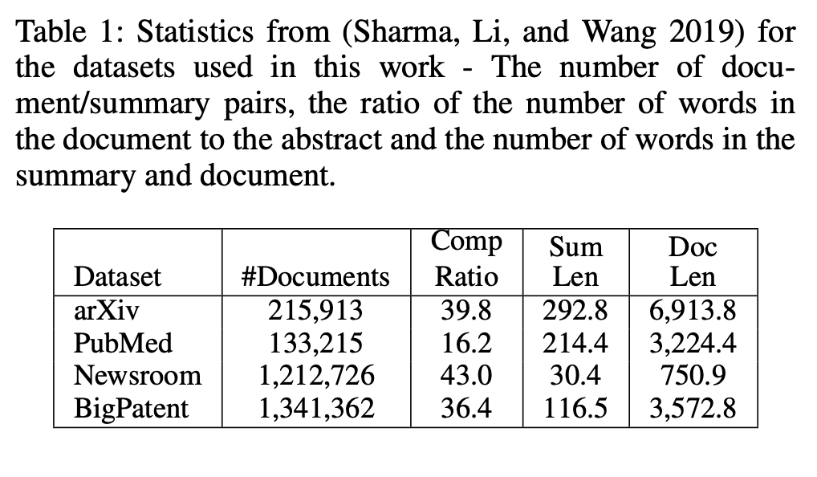
Datasets

Slide 15
Evaluation & Comparison
Evaluation: Full length F1 ROUGE score
Comparison Candidates:
Extractive Models
SumBasic (2007)
LexRank (2004)
LSA (2004)
Abstractive Models
Seq2Seq (2016)
Mix Models
Pointer Generator Seq2Seq (2007)
Discourse Aware (2004)

Slide 16
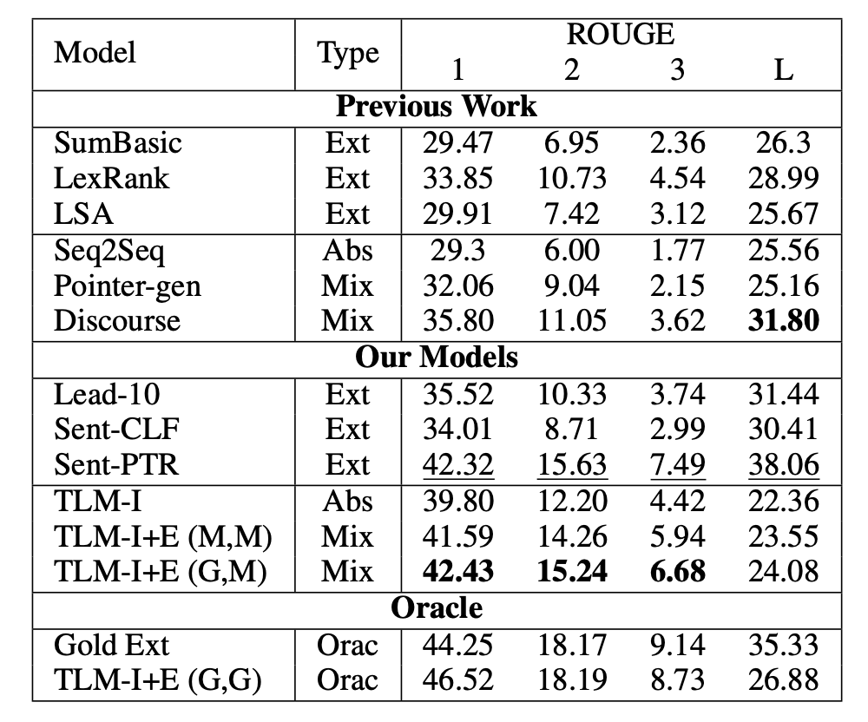
Quantitative Results - arXiv

Slide 17
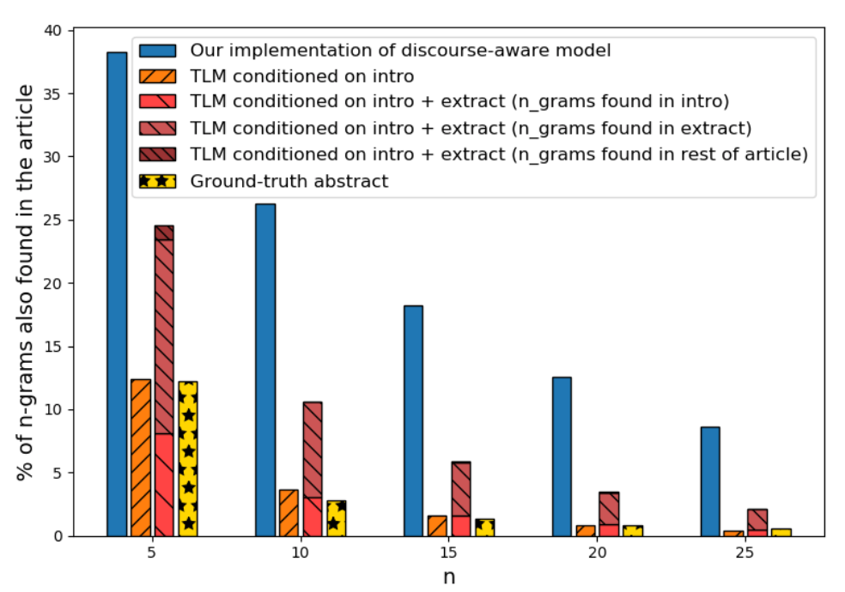
Quantitative Results – arXiv (n-gram overlap)
Original Abstract and TLM conditioned on Introduction have similar overlap
Discourse Aware model with copy mechanisms, generates summary by copying over large chunks.
Authors claim, this make their TLM more abstractive in nature.

Slide 18
Qualitative Results – arXiv (With Intro only TLM)

Slide 19
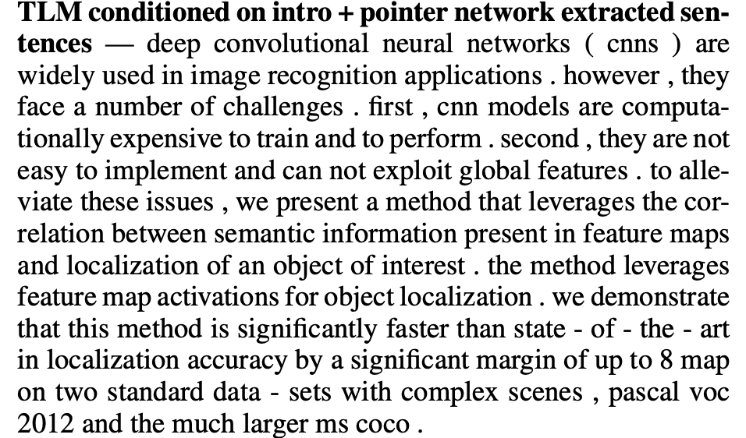
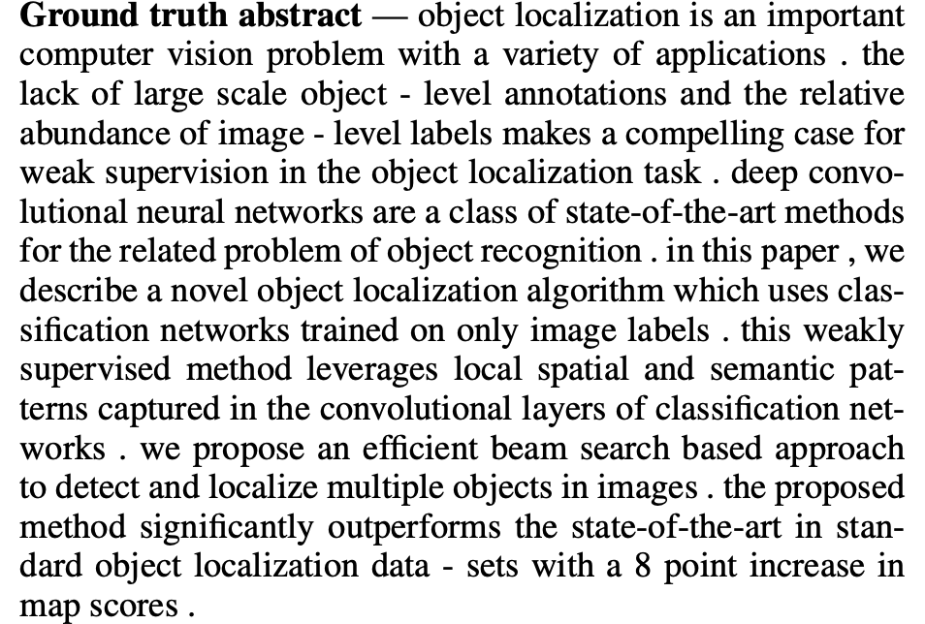
Qualitative Results – arXiv (With Intro + Extract TLM)

Slide 20
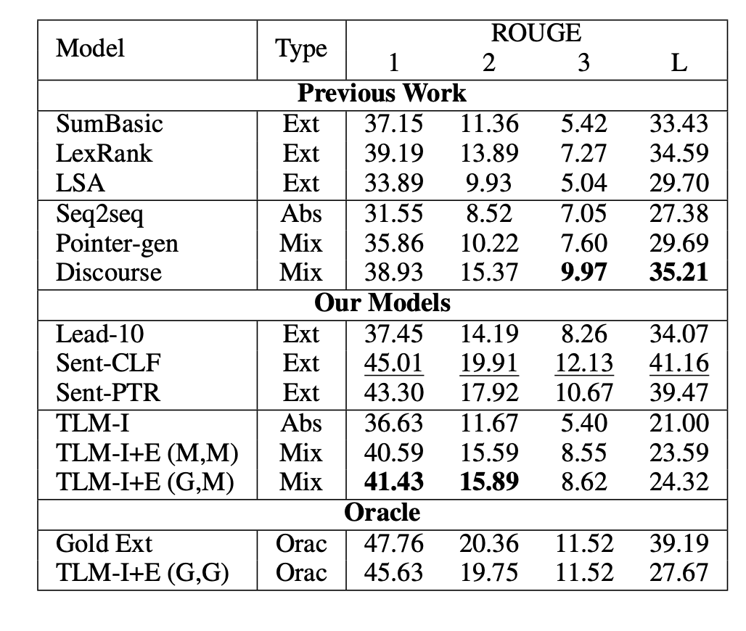
Quantitative Results - PubMed

Slide 21
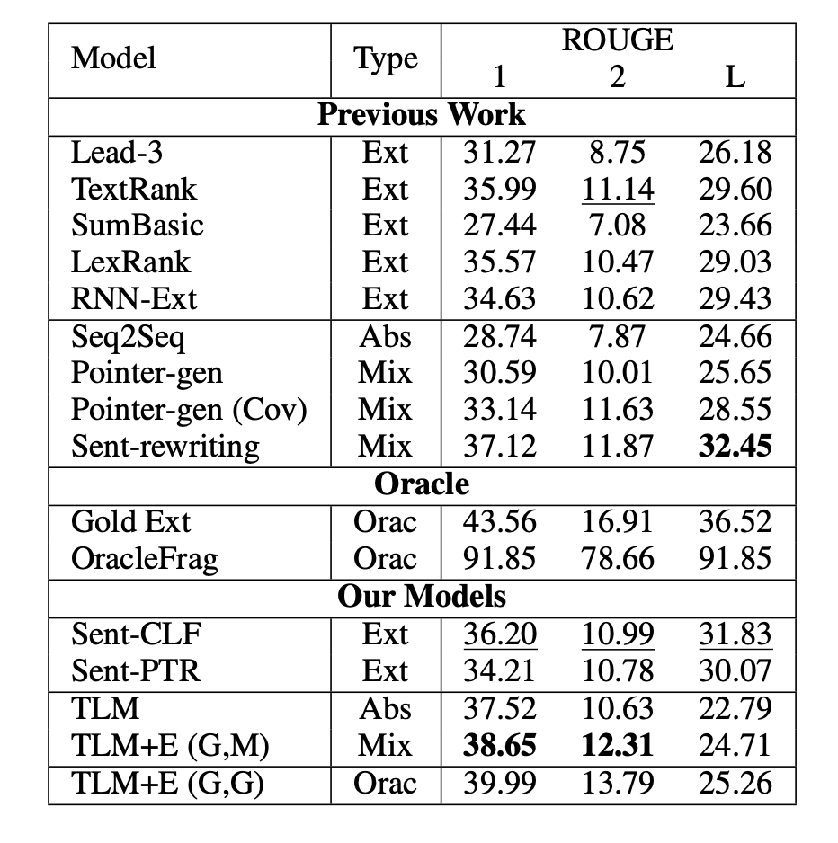
Quantitative Results - BigPatent

Slide 22
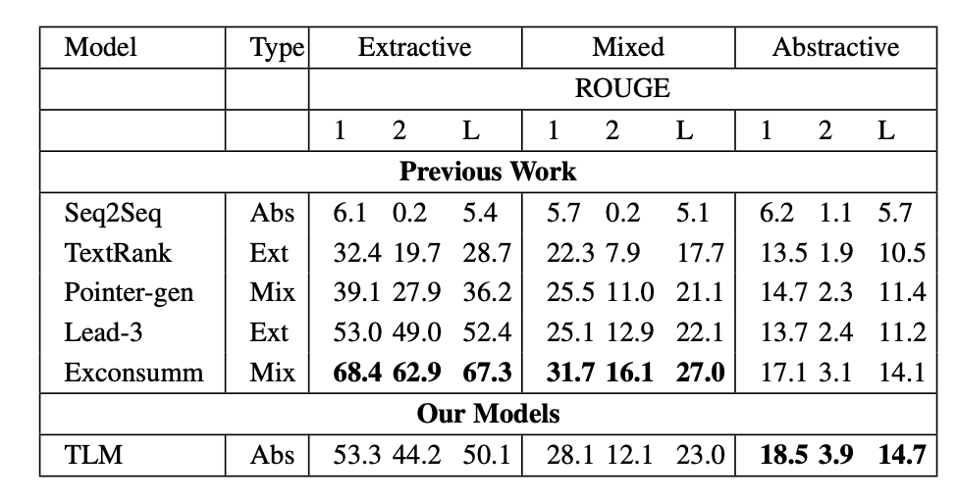
Quantitative Results - Newsroom

