Slide 1
XLNet: Generalized Autoregressive Pretraining for Language Understanding
Zhilin Yang , Zihang Dai, Yiming Yang , Jaime Carbonell , Ruslan Salakhutdinov , Quoc V. Le

Slide 2
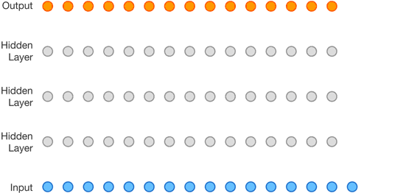
AR and AE
An autoregressive model’s output ht at time t depends on not just xt, but also all xs from previous time steps.
Autoregressive (AR) language modeling:
given a text sequence x = (x1, · · · , xT ), AR language modeling factorizes the likelihood into a forward product.$\text{p}\text{(}\text{x}\text{)}=\prod{\text{p}\text{(}\text{xt}\text{ | }\text{x}\text{<}\text{t}\text{)}}$
Examples:
GPT , ELMO(The simple combination of 2 AR models)

Slide 3
AR and AE
Autoencoding(AE) Language Modeling:
The AE language model aims to reconstruct the original data from corrupted input.
Corrupted input: The corrupted input means we use [MASK] to replace the original token
Example:
BERT

Slide 4
Pros and Cons of AR and AE
AR:
Advantages: good at generative NLP tasks.
(When generating context,It’s usually forward)
Disadvantages: it only concerns one direction(forward or backward.)
AE:
Advantages: bi-directional. Downstream language understanding tasks often require bidirectional context information.
Disadvantages: 1. the artificial symbols like [MASK] used by BERT during pretraining are absent from real data at finetuning time, resulting in a pretrain-finetune discrepancy.
2. It assumes the predicted (masked) tokens are independent of each other given the unmasked tokens.
Example: I am [mask] in the [mask] of Waterloo.
studying University
The 2 masks are corelated but in Bert, they are treated as independent words.

Slide 5
Can we combine the 2 methods so that we can take their pros and avoid their cons?
Yes!
XLNet, a generalized autoregressive method that leverages the best of both AR language modeling and AE while avoiding their limitations.

Slide 6
XLNet
Recall: In AR methods, we maximize the likelyhood in a fixed forward or backward factorization order
Idea:
XLNet maximizes the expected log likelihood of a sequence w.r.t. all possible permutations of the factorization order.
Permutations:
For example, we have a sentence with 4 tokens [x1 x2 x3 x4], and we want to predict x3.
Then we will have 4!(24) permutations.
[x1 x2 x3 x4],[x1 x3 x2 x4],[x1 x4 x3 x4],[x2 x1 x3 x4 ]…
Every token can appear before x3, then if we apply the forward maximum likelihood function, it concerns all tokens in this sentence.

Slide 7
XLNet
Maximize the expectation for a factor order in all permutations
Also, , XLNet does not rely on data corruption.(which means no masks in XLnet)
FYI: For Bert, since Bert introduces masks, mt indicates if it’s a mask

Slide 8
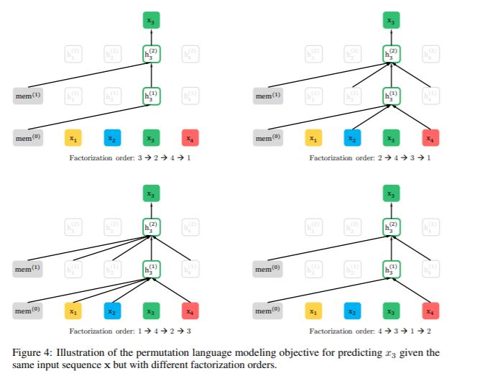

Slide 9
Problems:
contradictory in a standard Transformer architecture:
1.To predict the token x_t, the model should only see the position of x_t, not the content of x_t
2.To predict the token x_t, the model should encode all tokens before x_t as the content
(In transformers, word embedding and position information are combined)
Solution: 2-stream self-attention
The model will only encounter text sequences with the natural order during finetuning. Which means we can not chenge the sentences, we have to implement permutation in encoders.
Solution: Attention Mask

Slide 10
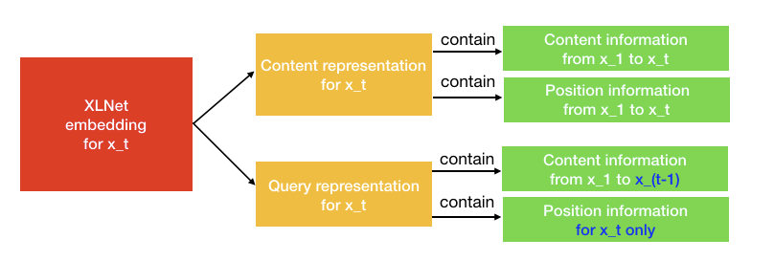
Two-Stream Self-Attention
Content stream attention: the standard self-attention in transformers.
query stream attention.: it’s used for predicting x_t

Slide 11
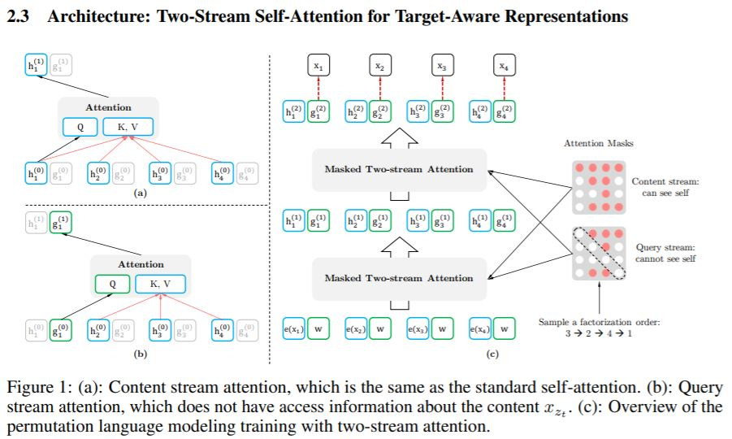
Original sequence order:
[x1,x2,x3,x4]
Sample a random factorization order: [x3,x2,x4,x1]
Calculate content stream attention:
KV = [h1, h2, h3, h4] Q=h1
Calculate query stream attention:
KV = [h2, h3, h4] Q=g1
The initial value for h_i = e(x_i) and
g_i = w
Recall:
In this graph, the other parts of the encoder are omitted. Actually, they used the same structure as Transformer-XL
Where g is from the last layer of query representation

Slide 12
Partial prediction
It’s expensive since N! is really large and it will cause slow convergence
Formally, we split z into a non-target subsequence z≤c and a target subsequence z>c, where c is the cutting point. And we only predict the tokens after c
Generally, only 1/K tokens will be selected for predictions. (k=6 or 7 is recommended)
Some methods in Transformer-XL are incorporated.
Such as relative positional encoding scheme and the segment recurrence mechanism.(They are helpful for long context)

Slide 13
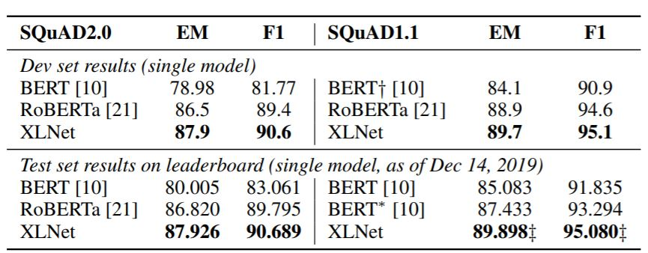
Results:
XLNet outperforms BERT.
ROBERTa was released after XLNet. And It’s hard to tell which one is better, XLNet may be better in reading comprehension tasks(especially for longer context).

Slide 14
Reference:
https://arxiv.org/pdf/1906.08237.pdf
https://eigenfoo.xyz/deep-autoregressive-models/
https://towardsdatascience.com/what-is-xlnet-and-why-it-outperforms-bert-8d8fce710335

