Slide 1
Deep Learning Applications for Atrial Fibrillation Detection in ECG Signals
By: Sara Ross-Howe
CS 898

Slide 2
Agenda
Atrial Fibrillation (AFIB) – Definition, Characterization, and Real-World Impact of this condition
Traditional Biomedical Signal Analysis Approaches to AFIB Detection
Deep Learning Classification Models
Autoencoders
LSTM Network
Convolution Network
Summarize Classification Results
Next Steps

Slide 3
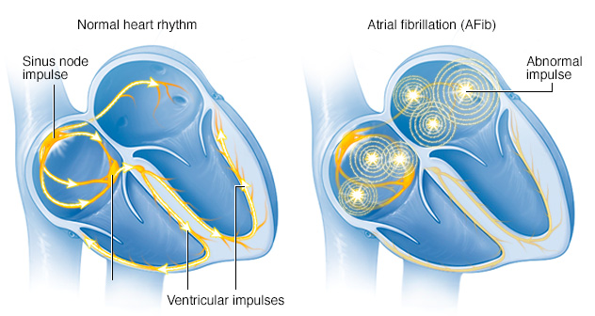
Atrial Fibrillation
Definitions
Cardiac arrhythmia that is characterized by rapid and irregular ventricular beats.
Instead of impulses originating directly from the Sinus Node, they initiate from multiple sites in the Atria, resulting in a chaotic heart rhythm.
Estimated to cause 1 in 3 strokes for people over the age of 60 (https://www.heartandstroke.ca/heart/conditions/atrial-fibrillation)
This condition contributes to an estimated 130,000 deaths each year in the United States (https://www.cdc.gov/dhdsp/data_statistics/fact_sheets/fs_atrial_fibrillation.htm)
http://www.mayoclinic.org/diseases-conditions/atrial-fibrillation/symptoms-causes/dxc-20164936

Slide 4
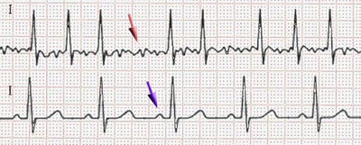
Atrial Fibrillation
Key Characteristics
Irregular heart beat with increased R Peak-Peak variability
Absence of a P-Wave before QRS complex
Elevated ventricular rate >100 beats per minute
https://en.wikipedia.org/wiki/Atrial_fibrillation
P-Wave
T-Wave
QRS Complex

Slide 5
Atrial Fibrillation – Types
Paroxysmal: Self terminating within 7 days or episodes that are cardioverted within 7 days.
Persistent: Last for longer than 7 days and are terminated by either drugs or electrical cardioversion.
Long-Standing: Lasting ≥ 1 year and this is often the threshold for more aggressive rhythm control strategy.
Permanent: Long standing Atrial Fibrillation were rhythm control strategies are not being pursued.
http://www.doctoryg.com/2016/10/types-of-atrial-fibrillation.html?spref=pi

Slide 6
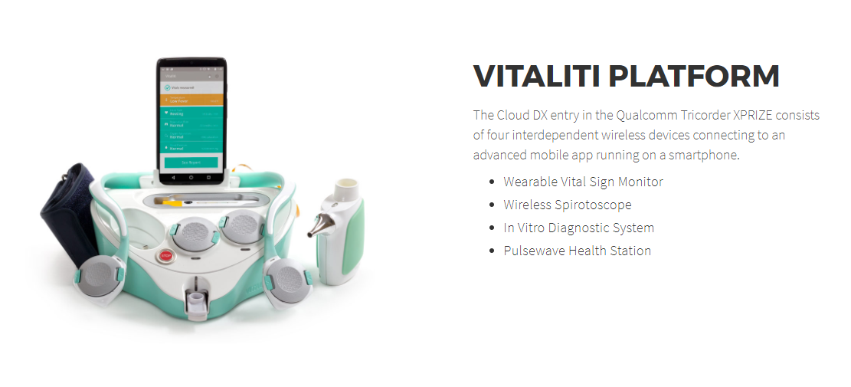
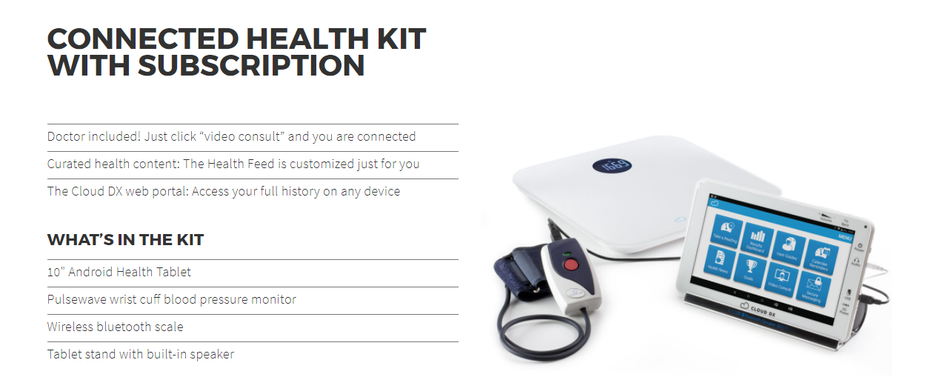
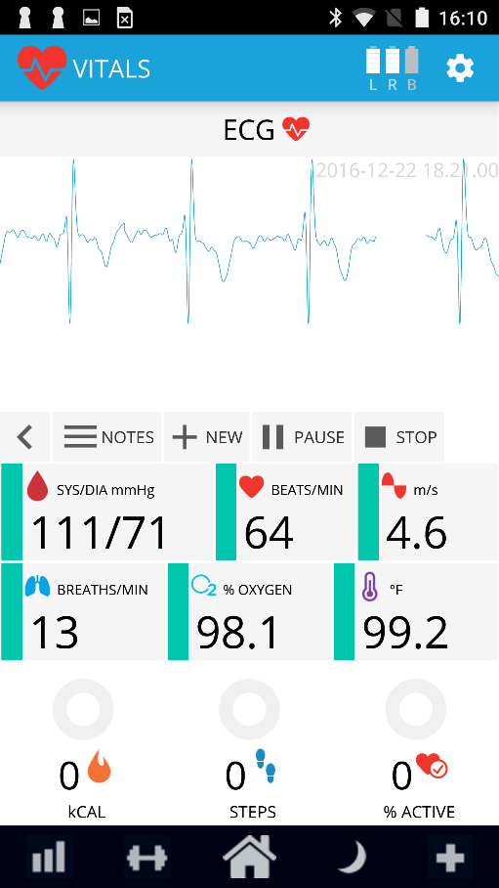
Cloud DX – Biomedical Technology
Goal is non-invasive AFIB detection and monitoring in the home
www.clouddx.com

Slide 7
Quality Metrics
Sensitivity = Recall = $\frac{True Positives}{(True Positives+False Negatives)}$
Specificity = $\frac{True Negatives}{(True Negatives+False Positives)}$
Precision = $\frac{True Positives}{(True Positives+False Positives)}$
Accuracy = $\frac{(True Positives+True Negatives)}{(True Positives+False Positives+True Negatives+False Negatives)}$
 | Disease Positive | Disease Negative
Test Positive
Test Negative
False Positive
True Positive
False Negative
True Negative

Slide 8
Traditional Biomedical Signal Analysis Approaches to AFIB Detection
Tateno and Glass - Automatic detection of atrial fibrillation using the coefficient of variation and density histograms of RR and ARR intervals - McGill University - 2001
Used the Komolgorov-Smirnov test based on cumulative distributions of ΔRR intervals from reference intervals from the MIT-BIH atrial fibrillation database
Sensitivity: 93.2% and Specificity: 96.7%
https://pdfs.semanticscholar.org/9509/63148f853e0239840ba40bf763e2de24ab37.pdf
Zhou et. al. - Automatic online detection of atrial fibrillation based on symbolic dynamics and Shannon entropy
Used symbolic dynamics to describe Δ RR _{n} and then Shannon entropy is calculated on the symbolic sequence to determine if the beat represents AFIB.
Training - Sensitivity: 96.72% and Specificity 95.07%
Testing on MIT-BIH AFIB database – Sensitivity: 96.89%, Specificity: 98.25%, Accuracy: 97.67%
https://biomedical-engineering-online.biomedcentral.com/articles/10.1186/1475-925X-13-18

Slide 9
Traditional Biomedical Signal Analysis Approaches to AFIB Detection
Annavarapu and Kora - 2016 - ECG-based atrial fibrillation detection using different orderings of Conjugate Symmetric–Complex Hadamard Transform
Used a Hadamard transform to extract features for a Levenberg-Marquardt Neural Network (LMNN) classifier (20 input neurons, 10 neurons in hidden layer, and 3 neurons in the output). Trained on 1800 ECG beats and tested on 1006 ECG beats
Sensitivity: 99.97%, Specificity: 98.7%, and Accuracy: 99.5%
http://www.sciencedirect.com/science/article/pii/S2405818116300538

Slide 10
PhysioNet – MIT-BIH AFIB Database
25 patient recordings of 10 hour duration
250 Hz sampling frequency with 12-bit resolution over a range of ±10 millivolts
Captured using ECG ambulatory recorders at Boston's Beth Israel Hospital (now the Beth Israel Deaconess Medical Center)
Annotated by manual identification of ECG beats as Atrial Fibrillation, Atrial Flutter, AV Junction Rhythm, or Normal Sinus Rhythm (all others)
https://physionet.org/physiobank/database/afdb/

Slide 11
PhysioNet – MIT-BIH AFIB
Most recordings represent paroxysmal atrial fibrillation events
Rhythm | Hours | Episodes | Beats
Atrial Fibrillation | 94.99 | 319 | 532,276
Atrial Flutter | 1.98 | 40 | 16,563
Other Rhythms | 163.03 | 293 | 733, 550
Total | 260.00 | 652 | 1,282,369

Slide 12
ECG Data Preparation
Human heart beat range 40 bpm – 200 bpm
Five second analysis window 3.33 beats – 16.67 beats
1 second stride
Balanced AFIB samples for each patient with NSR (plus other cardiac arrhythmias).
Lead I configuration was used
Samples are given a binary classification of AFIB if any beats in the region represent the arrhythmia.

Slide 13
ECG Signal Pre-Processing
Fundamental signal preprocessing was done to the data before segmentation into training and testing sets.
60 Hz Notch Filter used to remove the electromagnetic interference (EMI)
Moving average subtraction was used to correct the baseline drift for DC offset ( $xi=xi −\sum_{k=0}^{n}{x\text{i}\text{−}\text{k}})$
Motion artifact
DC Offset Baseline Wander

Slide 14
ECG Training and Testing Data Sets
Patient Recording | AFIB Samples | NSR (other arrhythmias) Samples | Total Training Samples | Total Testing Samples
04015 | 190 | 190 | 380 | 162
04043 | 5834 | 5834 | 11668 | 4998
04048 | 278 | 278 | 556 | 236
04126 | 989 | 989 | 1978 | 846
04746 | 12071 | 12070 | 24141 | 10344
04908 | 2186 | 2186 | 4372 | 1872
04936 | 7055 | 7054 | 14109 | 6046
05091 | 89 | 89 | 178 | 74
05121 | 9458 | 9457 | 18915 | 8106
05261 | 376 | 376 | 752 | 320
06426 | 1109 | 1108 | 2217 | 950
06453 | 282 | 282 | 564 | 240
06995 | 12164 | 12164 | 24328 | 10426
07162 | 0 | 0 | 0 | 0
07859 | 0 | 0 | 0 | 0
07879 | 10225 | 10224 | 20449 | 8764
07910 | 4123 | 4123 | 8246 | 3534
08215 | 4998 | 4997 | 9995 | 4282
08219 | 5702 | 5702 | 11404 | 4886
08378 | 5406 | 5406 | 10812 | 4632
08405 | 7158 | 7157 | 14315 | 6134
08434 | 1008 | 1008 | 2016 | 862
08455 | 7940.5 | 7940.5 | 15881 | 6804
Subtotal |  |  | 197276 (70.01%) | 84518 (29.99%)
Hours |  |  | 273.99 Hours | 117.39 Hours
Total |  |  | 281794 Samples | 391.38 Hours

Slide 15
Autoencoders
Autoencoder is an unsupervised learning algorithm, where X_{i} represents both the input and output label Y_{i}
Backpropagation is applied to learn an output function where $Hw,b\left(x\right)≈X1$
Minimize the reconstruction error - Loss(x) = ${\text{‖(}\text{X}\text{1}\text{−}\hat{X}\text{1}\text{)‖}}^{2}$
X₄
$\hat{X}$₄
X₃
Y₂
$\hat{X}$₃
H_{w,b}(x)
X₂
Y₁
$\hat{X}$₂
X₁
B₁
$\hat{X}$₁
B₁
http://ufldl.stanford.edu/tutorial/unsupervised/Autoencoders/

Slide 16
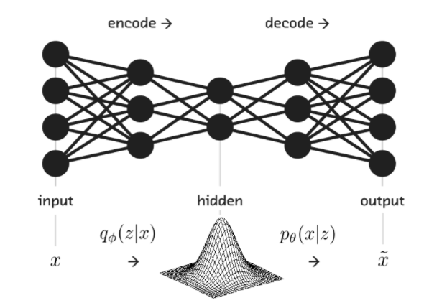
Autoencoders - Variations
Vanilla Autoencoder
Basic format where train an output function such that $Hw,b\left(x\right)≈X1$
Loss(x) = ${\text{‖(}\text{X}\text{1}\text{−}\hat{X}\text{1}\text{)‖}}^{2}$
Layers are incomplete, thus forcing the network to
compress the input
De-noising autoencoder (DAE)
$\tilde{X\text{i}}$= X_{i} + Z_{i} ~ N(X_{i},N)
Variational Auto Encoder (VAE)
A stochastic model of inputs, hidden units, and output
L(ϕ,θ;x)=E_{z∼qϕ(z|x)[}log(pθ(x|z))]−D_{KL}(q_{ϕ}(z|x)||p_{θ}(z))
Loss function = Reconstruction loss + regularizer term
(Kullback-Leibler divergence)
http://blog.fastforwardlabs.com/2016/08/22/
under-the-hood-of-the-variational-autoencoder-in.html

Slide 17
Autoencoders - Variations
Sparse autoencoder
Hidden layer over-represents the input and penalty terms are used to encourage sparcity during training.
This can be achieved by removing weights
Loss(x) = ${\text{‖(}\text{Xi}\text{−}\hat{X}\text{i}\text{)‖}}^{2}$ + λ ${\text{‖}\text{H}\text{‖}\text{i}}^{}$
Reconstruction loss is added to a sparcity term
Convolution autoencoder
Use convolution filter banks and pooling layers to generate feature maps

Slide 18
Autoencoders
Decoder Layer 4
X₁
X₂
X₃
X₄
…
X₂₄₇
X₂₄₈
X₂₄₉
X₂₅₀
$$\hat{Y}1$$
$$\hat{Y}2$$
…
X₁₂₄
X₁₂₅
Decoder Layer 3
Incomplete/Contractive hidden layers
Stacked with 2 encoding layers
Z₁
Z₆₂
Encoder Layer 2
Y₁
Y₂
…
Y₁₂₄
Y₁₂₅
Encoder Layer 1
X₁
X₂
X₃
X₄
…
X₂₄₇
X₂₄₈
X₂₄₉
X₂₅₀

Slide 19
Autoencoders - Results
Reference Versus Decoded Output – Layer 1
Reference Versus Decoded Output Layer 2

Slide 20
Autoencoder – Reconstruction Loss

Slide 21
Autoencoders - Challenges
Signal Baseline
Weighted Average of All Inputs

Slide 22
Autoencoders - Encoding
Sample Encoded Signals

Slide 23
Autoencoders – Lessons Learned
Tie the output weights by using the transpose of the encoder for the decoder layer
Smaller input signal window better than larger ones
Initialize the network weights to small values in proportion to the nodes in the layer with (min $=\frac{−1}{\sqrt{nInputs}}$, max $=\frac{1}{\sqrt{nInputs}}$)
Reduce the layer sizes by ~1/2 nodes of the previous layer
Use the Adam Optimizer (https://arxiv.org/abs/1412.6980)
Use layer-wise training
Use a smaller batch size (32) for increased accuracy but longer training times
Use shuffle batch with 100*batch size for capacity
Utilize more patient data to ensure variability and/or additive gaussian noise to the inputs.
Use Tanh as the activation function
Ensure the data is normalized to efficiently use the -1 : +1 range

Slide 24
Contractive De-Noising Autoencoders (CDAE) for ECG
Xiong et al- 2016 – A stacked contractive denoising auto-encoder for ECG signal denoising
Used the MIT-BIH Arrhythmia Database for the training and testing sets (samples at 360 Hz) + MIT-BIH noise stress database. Includes baseline wander (BW), muscle artifact (MA), and electrode motion (EM).
Used a 270->135->70->270 topology and additive noise to model EM interference.
Reported a 2.40 dB improvement in the Signal to Noise Ratio from current standards (SNR$=\sqrt{\frac{1}{N}}\sum_{n=0}^{N−1}{{[x\left(n\right)−xm(n)]}^{2}})$and 0.075-0.350 improvement in the Root Mean Square Error (RMSE=10log$\frac{\sum_{n=0}^{N−1}{{[x(n)]}^{2}}}{\sum_{n=0}^{N−1}{{[xm\left(n\right)−x(n)]]}^{2}}}$)
https://pdfs.semanticscholar.org/9509/63148f853e0239840ba40bf763e2de24ab37.pdf

Slide 25
Autoencoders + Fully Connected Network Classifier
AE₁
Y₁
AE₂
Y₁
Z₁
AE₃
…
Z₂
AE₄
Y₂₅₅
AE₅
Y₂₅₆
310 Input Features

Slide 26
Autoencoders + Fully Connected Network Classifier
Training Accuracy: 61.82%
Testing Accuracy: 53.52%

Slide 27
Autoencoders + Fully Connected Network Classifier
Training Sensitivity: 59.38%
Training Specificity: 63.76%
Testing Sensitivity: 47.66%
Testing Specificity: 59.38%

Slide 28
Long Short Term Memory (LSTM) Networks
Z₁
Z₂
A₁
A₂
A₃
A₄
A₅
250 Input Features : Five Steps

Slide 29
Long Short Term Memory (LSTM) Networks
Training Accuracy: 74.46%
Testing Specificity: 59.38%

Slide 30
Long Short Term Memory (LSTM) Networks
Training Sensitivity: 77.14%
Training Specificity: 71.78%
Testing Sensitivity: 81.61%
Testing Specificity: 22.50%

Slide 31
LSTM Networks for ECG Beat Classification
Sucheta et al. – Anomaly Detection in ECG Time Signals via Deep Long Short-Term Memory Networks - 2015
Used an LSTM network with ECG signal input with training and testing data from the PhysioNet MIT-BIH Arrhythmia Database
Looked at identifying Premature Ventricular Contraction (PVC), Atrial Premature Contraction (APC), Paced Beats (PB), and Ventricular Couplet (VC)
http://ieeexplore.ieee.org/document/7344872/
Abnormality | Precision | Recall
Ventricular Couplet | 95.59 | 25.55
Premature Ventricular Couplet | 99.09 | 51.09
Atrial Premature Contraction | 92.31 | 9.53
Paced Beats | 99.30 | 99.86

Slide 32
LSTM – Lessons Learned
Larger input window per LSTM node with smaller steps
Larger number of hidden nodes (constrained by memory)
Use a smaller batch size ( 32 ) for improved accuracy but longer training time
Initialize the network weights to using random normal distribution
Use the Adam Optimizer (https://arxiv.org/abs/1412.6980)
Soft max with logits for output
Ensure the data is normalized to efficiently use the -1 : +1 range
Use shuffle batch with 100*batch size for capacity
Use balanced data representing disease and non-disease state

Slide 33
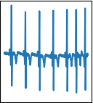
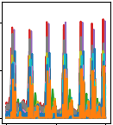
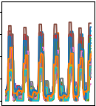
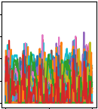
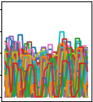
Convolution Network (ConvNet)
Fully Connected Layer 3
Convolution Layer 1
Convolution Layer 2
X_{n}
…
Y₂
X₂
Y₁
Input Signal
1x1250
Convolution Filter
1x48x32
Average Pooling
1x32
Convolution Filter
1x24x64
Average Pooling
1x16
X₁
Output Layer
B₁
1024 Nodes

Slide 34
Convolution Network
Training Accuracy: 98.55%
Testing Accuracy: 92.29%

Slide 35
Convolution Network
Training Sensitivity: 98.58%
Training Specificity: 98.51%
Testing Sensitivity: 92.25%
Testing Specificity: 92.33%

Slide 36
ConvNet – Lessons Learned
Batch normalization (https://arxiv.org/pdf/1502.03167.pdf)
Reduce the size of kernel and average pooling on each convolution layer
Initialize the network weights to small values in proportion to the nodes in the layer (min $=\frac{−1}{\sqrt{nInputs}}$, max $=\frac{1}{\sqrt{nInputs}}$)
Use the Adam Optimizer (https://arxiv.org/abs/1412.6980)
Soft max with logits for output
Ensure the data is normalized to efficiently use the -1 : +1 range
Use shuffle batch with 100*batch size for capacity
Use balanced data
Use dropout on the fully connected layer
Use ReLU as an activation function

Slide 37
Deep Learning Classification Results for Atrial Fibrillation
Model | Accuracy - Training | Accuracy - Testing | Sensitivity - Testing | Specificity - Testing
Autoencoder + Fully Connected Neural Network | 61.82% | 53.52% | 59.38% | 47.66%
LSTM | 74.46% | 59.38% | 81.61% | 20.61%
Convolution Network | 98.55% | 92.29% | 92.25% | 92.33%

Slide 38
Deep Learning Classification Results for Atrial Fibrillation

Slide 39
Next Steps
Contractive De-noising Autoencoders (CDAE)
Remove baseline drift for DC offset, electromagnetic interference (EMI), and muscle artifact
R-Peak detection for computationally efficient inference for real-time heart rate and heart rate variability

Slide 40
Next Steps
Convolution Networks
N-Fold Cross Validation
Investigate L1 and L2 regularization to improve generalization
AFIB quantification for cardiac ablation surgery decision support.
Investigate other rhythms for cardiac arrhythmia detection (such as Ventricular Tachycardia, Atrial Flutter)
Hybrid network topologies involving CDAE -> ConvNet -> LSTM

Slide 41
Computing Environment
TensorFlow
NVIDIA GEOFORCE GTX 770M
8 GB RAM
Windows 10
C++ in Microsoft Visual Studio for data preparation

Slide 42
References
http://www.medicine.mcgill.ca/physio/glasslab/pub_pdf/method_2001.pdf
Goldberger AL, Amaral LAN, Glass L, Hausdorff JM, Ivanov PCh, Mark RG, Mietus JE, Moody GB, Peng C-K, Stanley HE. PhysioBank, PhysioToolkit, and PhysioNet: Components of a New Research Resource for Complex Physiologic Signals. Circulation 101(23):e215-e220 [Circulation Electronic Pages;http://circ.ahajournals.org/content/101/23/e215.full]; 2000 (June 13).
https://www.heartandstroke.ca/heart/conditions/atrial-fibrillation
https://www.cdc.gov/dhdsp/data_statistics/fact_sheets/fs_atrial_fibrillation.htm
http://www.doctoryg.com/2016/10/types-of-atrial-fibrillation.html?spref=pi
https://pdfs.semanticscholar.org/9509/63148f853e023984 0ba40bf763e2de24ab37.pdf
https://biomedical-engineering-online.biomedcentral.com/articles/10.1186/1475-925X-13-18
https://pdfs.semanticscholar.org/9509/63148f853e0239840ba40bf763e2de24ab37.pdf
https://physionet.org/physiobank/database/afdb/
http://ufldl.stanford.edu/tutorial/unsupervised/Autoencoders/
http://blog.fastforwardlabs.com/2016/08/22/under-the-hood-of-the-variational-autoencoder-in.html
http://ieeexplore.ieee.org/document/7344872/
https://pdfs.semanticscholar.org/9509/63148f853e0239840ba40bf763e2de24ab37.pdf
http://www.sciencedirect.com/science/article/pii/S2405818116300538
Adam Optimization: https://arxiv.org/abs/1412.6980
Batch Normalization: https://arxiv.org/pdf/1502.03167.pdf

Slide 43
Acknowledgements
Dr. Hamid Tazhoosh and the entire Kimia Laboratory (http://kimia.uwaterloo.ca/)
Dr. Ming Li – University of Waterloo
Cloud DX – www.clouddx.com

