Slide 1
Positional Encoding (in Transformers)
Rasoul Akhavan Mahdavi
CS886-002: Deep Learning for NLP

Slide 2
Motivation
Approaches
Positional Embedding
Discussion
Conclusion
Outline

Slide 3
Motivation
Recurrent Networks have an inherent notion of order, …
but transformers don’t!

Slide 4
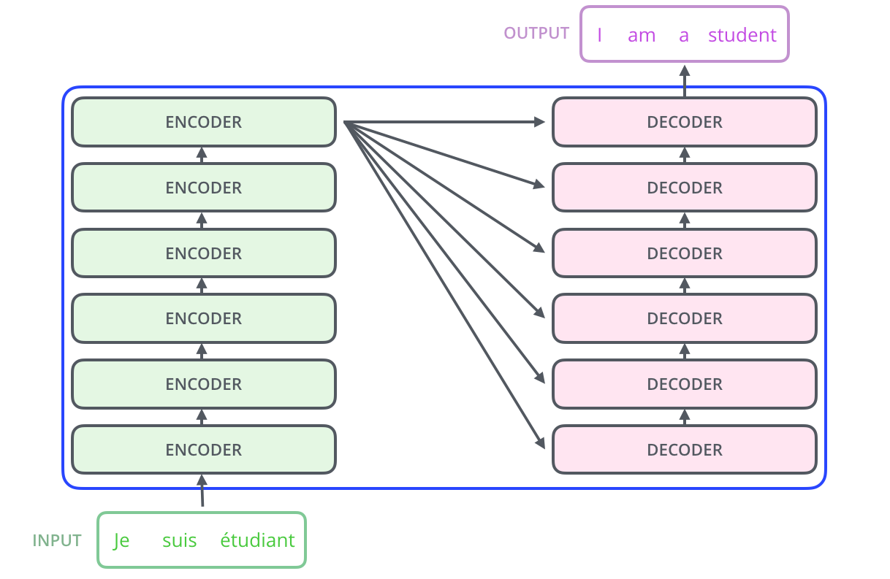
Motivation
Words flow simultaneously through
the encoder/decoder stacks

Slide 5
We need a notion of position!

Slide 6
Approaches?
Linear Position Assignment (1,2,3, …)
Unseen sentence lengths cannot be interpreted
Floats in a range ([0,1])
Different meaning dependent on sentence size
0
0.66
0
0.285
0.571
0.857
0.33
1
0.142
0.428
0.714
1
I love this course
I love many things but not this course

Slide 7
Properties
Unique positional encoding for each time step
Reasonable notion of relative distance
Independent of sentence size
Deterministic

Slide 8
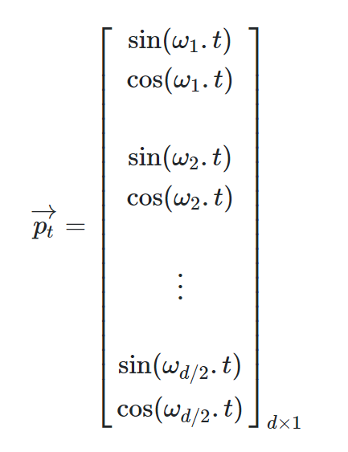
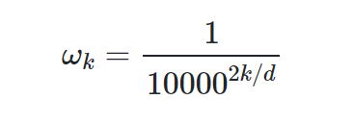
Sinusoidal/Cosinusoidal Positional Embedding
Position will be a vector (instead of number)

Slide 9
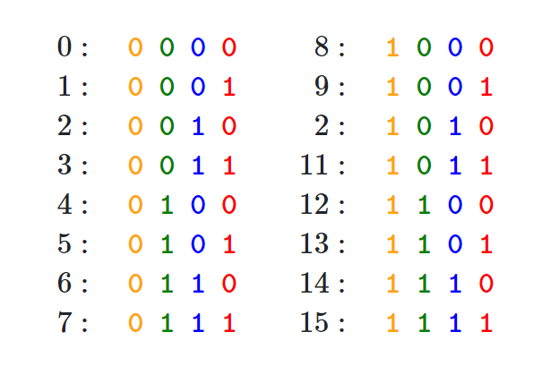
Intuition?

Slide 10
Visualizing Encodings

Slide 11
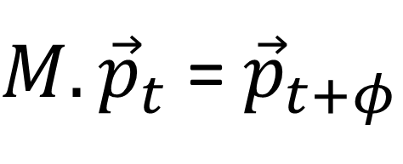
Rough Proof
$$φ$$
$M.{\vec{p}}_{t}$ = ${\vec{p}}_{t+φ}$
$$t$$
$M.\left[\begin{matrix}sin⁡(ω_{k}t) \\ cos(ω_{k}t)\end{matrix}\right]$ = $\left[\begin{matrix}sin⁡(ω_{k}(t+φ)) \\ cos(ω_{k}(t+φ))\end{matrix}\right]$
No “t” involved
$M=\left[\begin{matrix}\cos{(ω_{k}φ)} & \sin{(ω_{k}φ)} \\ −sin{(ω_{k}φ)} & \cos{(ω_{k}φ)}\end{matrix}\right]$

Slide 12
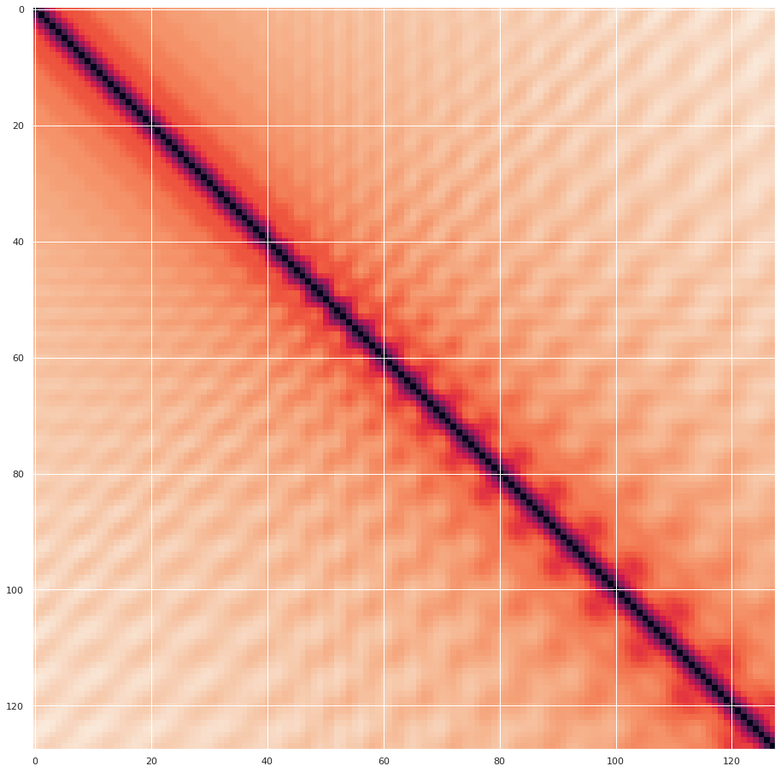
Visualizing Encodings
Consistent Relative Distance
position
position

Slide 13
Discussion
Embedding is added. Why add instead of concatenate?
Does is last throughout the layers?
Why sinuses and cosines?

Slide 14
Conclusion
Why positional embedding is needed
Drawbacks of simple approaches
Sinusoidal/Cosinusoidal Positional Embedding

Slide 15
References
https://kazemnejad.com/blog/transformer_architecture_positional_encoding/
https://timodenk.com/blog/linear-relationships-in-the-transformers-positional-encoding/
https://jalammar.github.io/illustrated-transformer/
https://jalammar.github.io/visualizing-neural-machine-translation-mechanics-of-seq2seq-models-with-attention/
https://github.com/tensorflow/tensor2tensor/issues/1591
https://www.reddit.com/r/MachineLearning/comments/cttefo/d_positional_encoding_in_transformer/
Thank you!
Questions?

