Slide 1
Fill-in-The-Blank Using Sum Product Network
Pan Pan Cheng
CS 898 Final Project
2017

Slide 2
Outline
Background
Probabilistic Graphic Model + Deep Architecture
Definition
Example
Application: Fill-in-the-blank
Data Source: Microsoft Research Sentence Completion Challenge (2011)
Future Work

Slide 3
Probabilistic Graphic Models (PGMS)
Bayesian Network
Markov Network
In many NLP application, Interest ➔ Estimate the underlying distribution and Infer the following quantities:
Joint Probabilities: Language Modeling ➔ Infer how likely certain sequence of words occurs in a language, e.g. Pr(W1, W2, W3, W4, W5) in a 5-gram model
Conditional Probabilities: Sentiment Analysis ➔ Infer how likely a given statement is positive, e.g. Pr(Positive | Context)
Figure source [Koller et al. 2009]

Slide 4
Deep Architecture
Stack many layers
RNN, CNN, and etc
Potentially much more powerful than shallow architectures [Bengio, 2009]
But Inference is even harder

Slide 5
Sum-Product Networks (SPNs)
A Sum-Product Network S over RVs X is a rooted weighted DAG consisting of distribution leaves (network inputs), sum and product nodes (inner nodes)
A leaf n defines a tractable, possibly unnormalized, distribution over some RVs in X
An nonnegative weight w is associated to each edge linking a sum node n to child nodes
Purposed by Poon & Domingos (2011)

Slide 6
SPNs vs PGMs
SPN is order of magnitude faster
The cost of exact inference in PGMs sometimes is exponential in the worst case ➔ Approximate Techniques
 | SPN | PGM (DBN)
Learning | 2-3 Hours | Days
Inference | < 1 second | Minutes or Hours

Slide 7
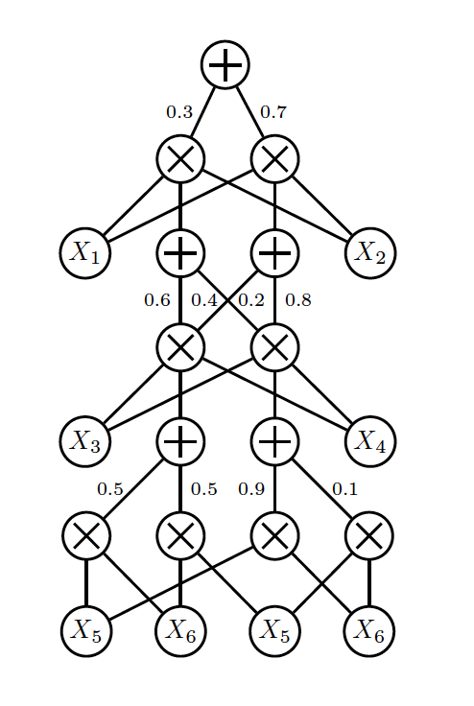
SPNs – NNs
In a classic MLP hidden layer, computing
SPNs ➔ DAG of MLPs
SUM Node
PRODUCT Node
Figure source [Di Mauro et al. 2016]

Slide 8
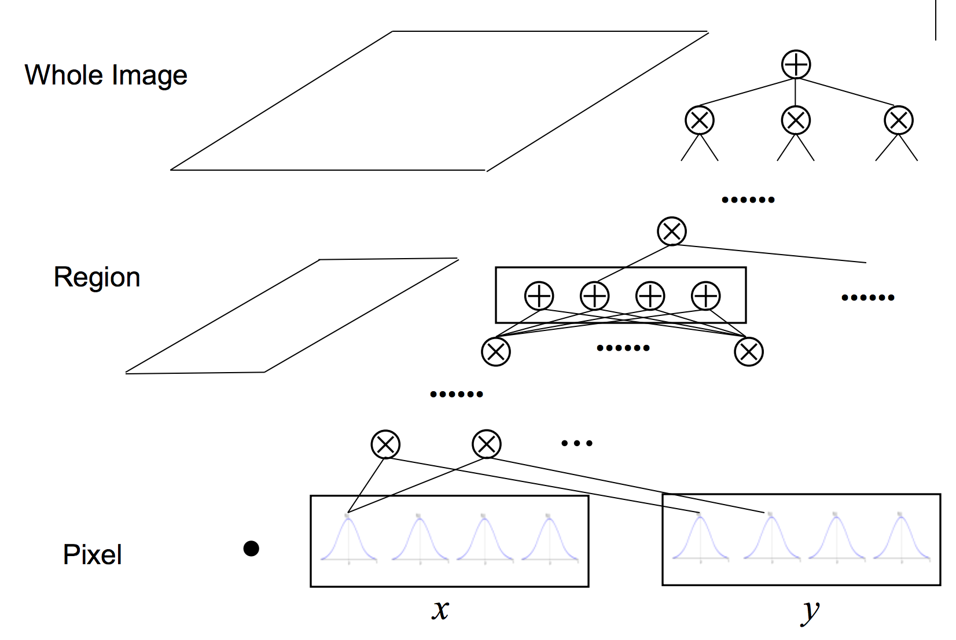
SPNs – Example
Figure source [Poon et al. 2011]

Slide 9
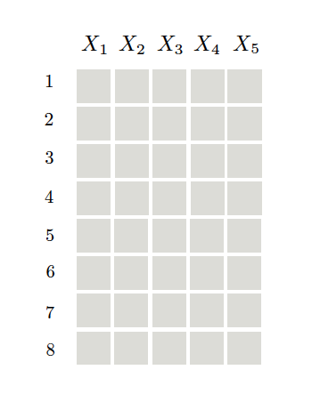
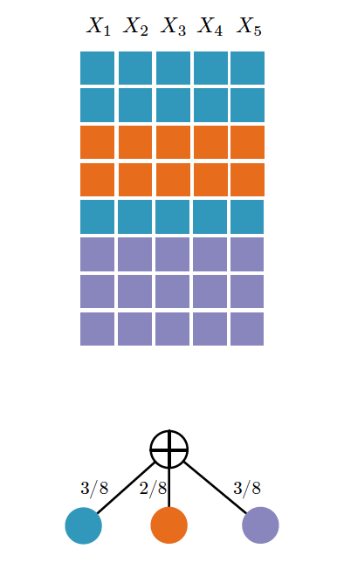
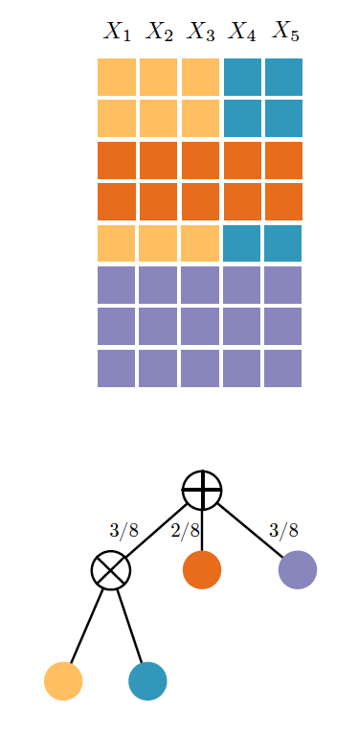
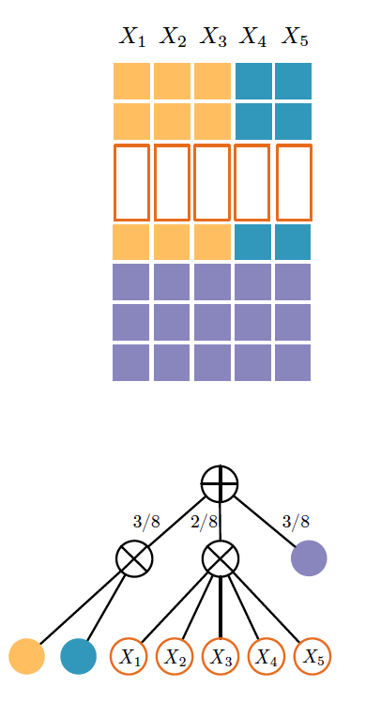
SPNs – Example
Figure source [Di Mauro et al. 2016]

Slide 10
SPNs – Learning
Parameter learning ➔ Estimate w from data considering an SPN as a latent RV model, or as a NN.
Structure learning ➔ Build the network from data by assigning scores to tentative structures or by exploiting constraints

Slide 11
SPNs – Learning
Handcrafted structure ➔ Parameter learning [Poon and Domingos 2011] [Gens and Domingos 2012]
Random structures ➔ Parameter learning [Rashwan et al. 2016]
Structure learning ➔ Parameter learning (fine tuning) [Zhao et al. 2016]
Learn both weight and structure at the same time [Gens and Domingos 2013;]

Slide 12
Experiment – Fill-in-the-blank
Related to:
Speech Understanding
Machine Comprehension Tasks
Data Source
Microsoft Research Sentence Completion Challenge (2011)
Data Summary
Training Set:
Texts selected from 522 19th century novels (~41.5 million words, 227 Mb)
Test Set:
1040 sentences selected from Sherlock Holmes novels where 1 word is missing and 5 choices for the missing word

Slide 13
Experiment – cont’
- Texts is completely unannotated and untokenized;
- Do not have the same format as the testing set;

Slide 14
Experiment – cont’
A single word in the original sentence has been replaced by an impostor word with similar occurrence statistics.

Slide 15
Experiment – cont’
Learning via Random Structure was used
2 different pre-trained word embedding libraries:
Google word2vec model: 300 d/word
GloVE (Global Vector for Word Representation): 50d & 100d/word
Extract Sentence ➔ Extract all possible 5 gram & 10 gram tokens for training corresponding language models using SPN
For 300d embedding vector, the total size is ~ 500GB
Trained on personal desktop: 16 GB DDR3 (1333 MHz), i7-2600, GTX 1060 (6GB)

Slide 16
Experiment – cont’
N-gram | Embedding Size | Training File Size | Epoch | Training Time
5 | 300 | 29.3GB (at most 5k samples/file) | 1 | ~ 3 hrs
5 | 300 |  | 25 | ~ 14 hrs
5 | 50 | 69.1 GB | 1 | ~ 5 hrs
5 | 50 |  | 25 | ~ 45 hrs
10 | 50 | 66 GB (at most 50k samples/file) | 1 | ~ 4 hrs
10 | 50 |  | 5 | ~ 7 hrs
10 | 100 | 83 GB (at most 25k samples/file) | 1 | ~ 5 hrs
10 | 100 |  | 5 | ~ 8 hrs

Slide 17
Experiment – cont’
Human Accuracy: ~ 90%
State-of-the-art models:
* 50 – 60% (ensembling)
* 40 – 50% (single model)
Accuracy of SPNs: ~30% (Similar to N-gram & Word2Vec)
Figure source [Woods et al. 2016]

Slide 18
Future Work
Can we incorporate the recurrent idea to SPNs?
Mazen: Recurrent Sum-Product Networks for Sequence Data Modeling
How to do the structural learning in this case?
Abdullah: Online structure learning for sum-product networks with Gaussian leaves
How to train with discriminative learning?
To learn the conditional probability Pr(Word | Context)
How to build a scalable library to train SPNs?
https://github.com/ppcheng/cs898-spn-experiments
https://github.com/KalraA/Tachyon

Slide 19
Thank You !!

Slide 20
SPNs – Conditions
Complete:
Under a Sum node, children cover the same set of variables
Product:
Under a Product node, no variable in one child while the negation is in another
Valid SPN ➔ correctly presenting a probabilistic distribution
Figure source [Poon et al. 2011]

