Slide 1
Deep learning for crispr technology
By Owen Chambers
Jiecong Lin, Ka-Chun Wong, Off-target predictions in CRISPR-Cas9 gene editing using deep learning, Bioinformatics, Volume 34, Issue 17, 01 September 2018, Pages i656–i663

Slide 2
Outline
Introduction
CRISPR and biology background
Competing methods
How deep learning for CRISPR was incorporated
Results and Conclusion
Ethics of CRISPR

Slide 3
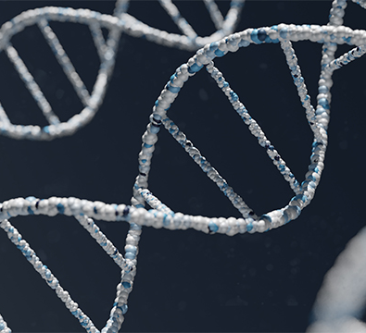
Background
Gene editing began when humans selectively bred animals.
After DNA was discovered, scientists tried to edit it by shooting radiation into plants to cause random effects.
CRISPR has revolutionized the way humans perform gene editing with increased accuracy and precision.

Slide 4
CRISPR Technology

Slide 5
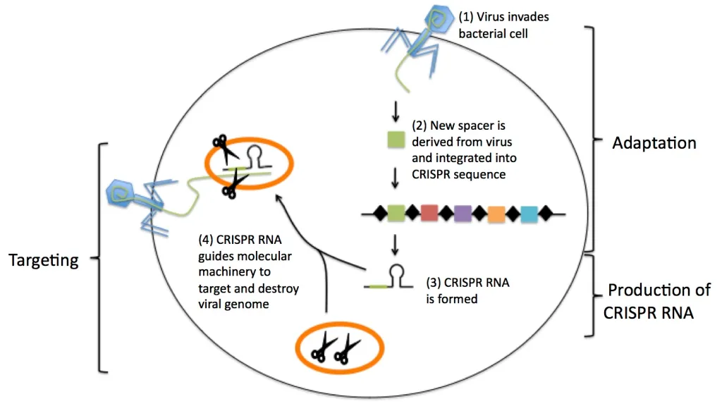

Slide 6
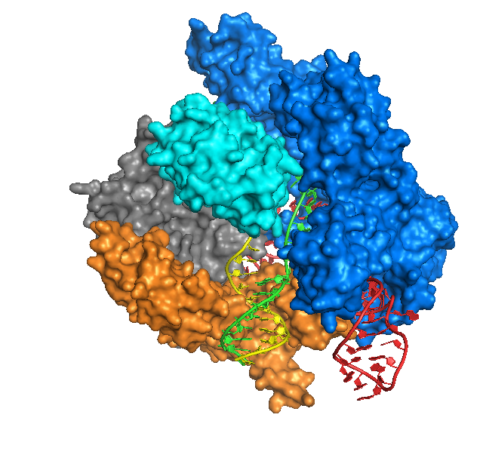

Slide 7
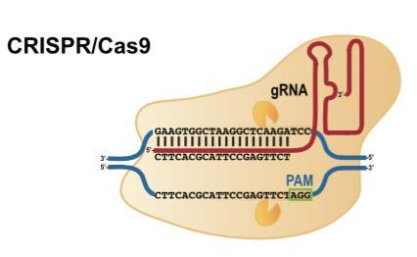

Slide 8
Off-target Predictions in CRISPR-Cas9 gene editing using Deep Learning
Jiecong Lin, Ka-Chun Wong, Bioinformatics, Volume 34, Issue 17, 01 September 2018, Pages i656–i663

Slide 9
Datasets
CRISPOR:
Data taken from 8 studies that detected and quantified off-target cleavage sites.
31 different guide RNAs studied.
Dataset contains the target sequence, mutated sequence, gRNA, and number of mismatches.
GUIDE-Seq:
10 different sgRNA’s used.
Used to evaluate model trained on CRISPOR dataset.

Slide 10
CFD off-target Prediction
Cutting Frequently Determination
Data obtained by infecting cells with a lentiviral library containing thousands of guides for all possible nucleotide mismatches.
CFD calculates the off target activity by using the LFC (log fold change) value.

Slide 11
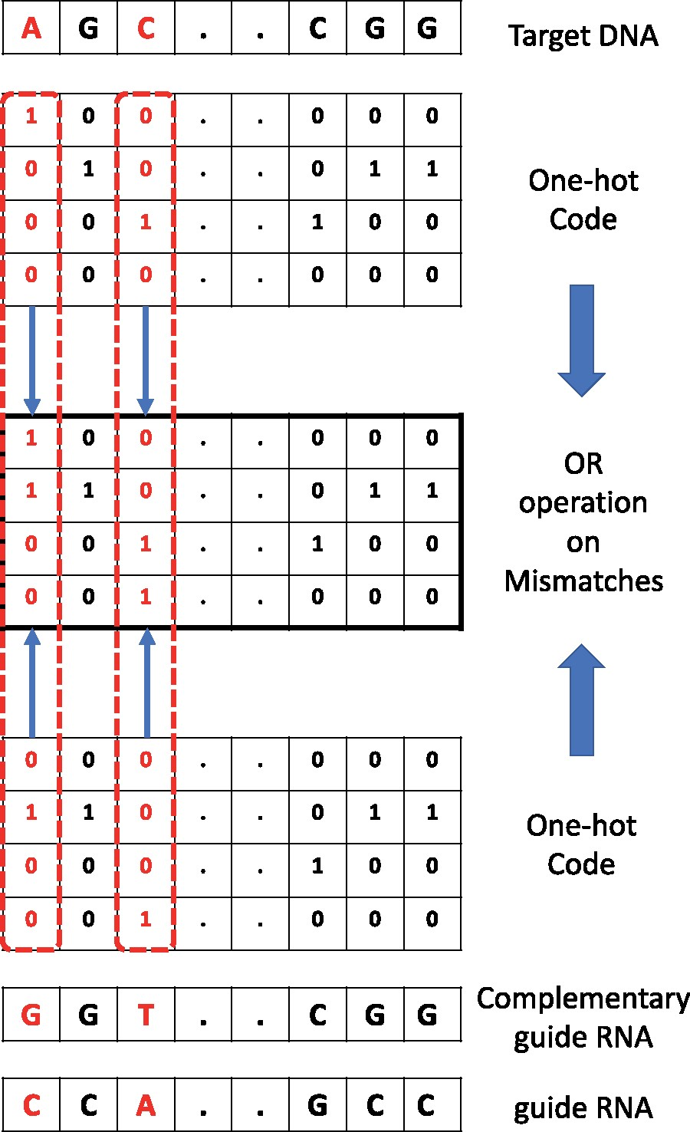
Data Preprocessing
AGCT DNA compounds turned into 4 dimensional unit vectors.
The guide RNA/DNA sequence is OR’d with the target DNA to identify mismatches.
This 4x23 vector is fed into the CNN.

Slide 12
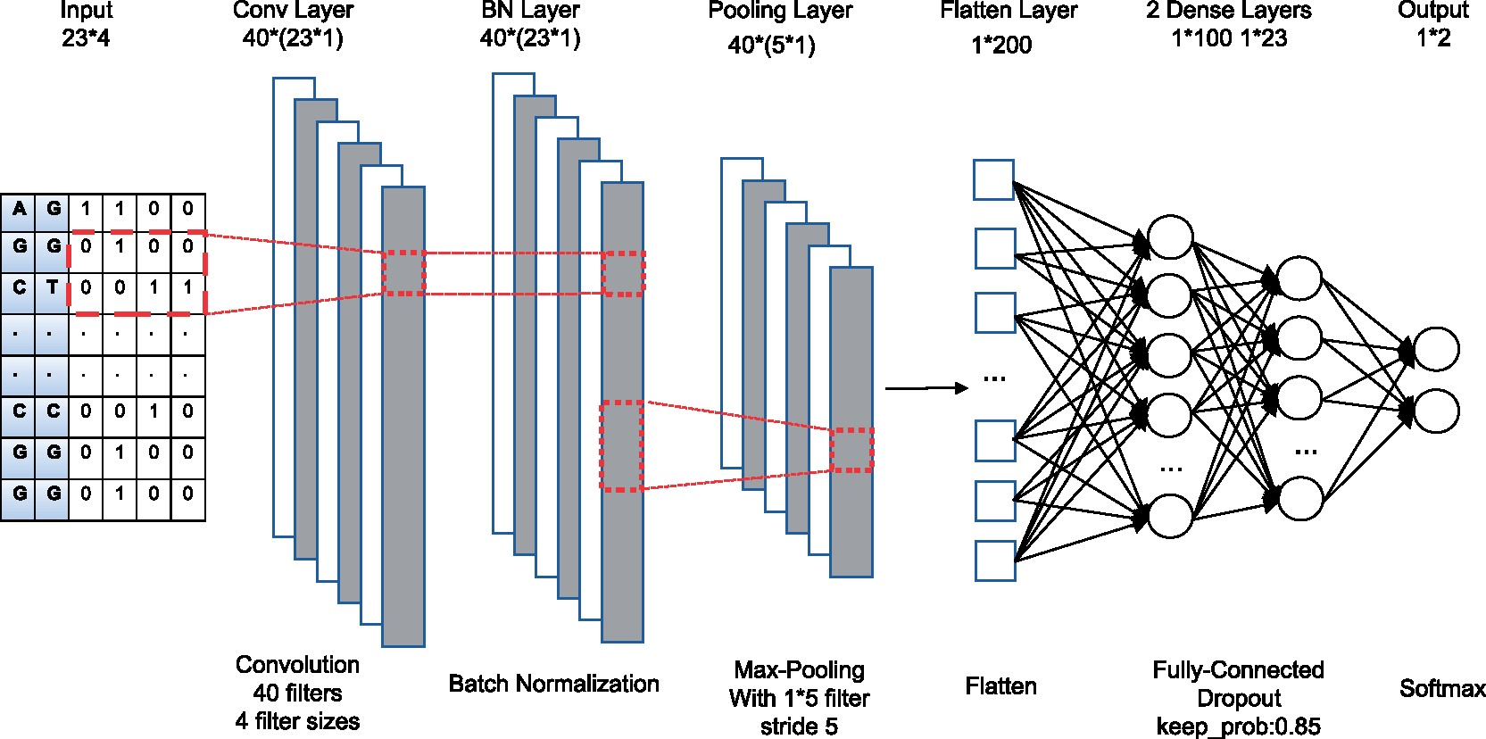
Model
Convolution layer extracts the sgRNA-DNA information using 40 filters.
Batch Normalization is used to reduce covariate shift.
Max pooling layer outputs the maximum value of its respective BN layer outputs.
Two fully connected dense layers with a dropout layer.
Output consists of two classification results.

Slide 13
Competing Models
Current Algorithms
Machine Learning Algorithms
CFD.
MIT.
CROP-IT.
CCTop.
Random Forest.
Gradient Boosting Trees.
Logistic Regression

Slide 14
Results

Slide 15
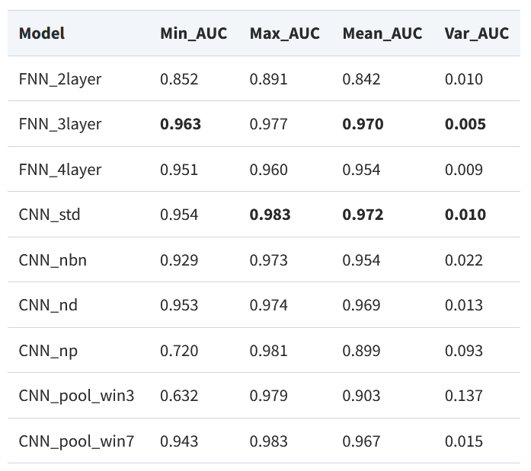
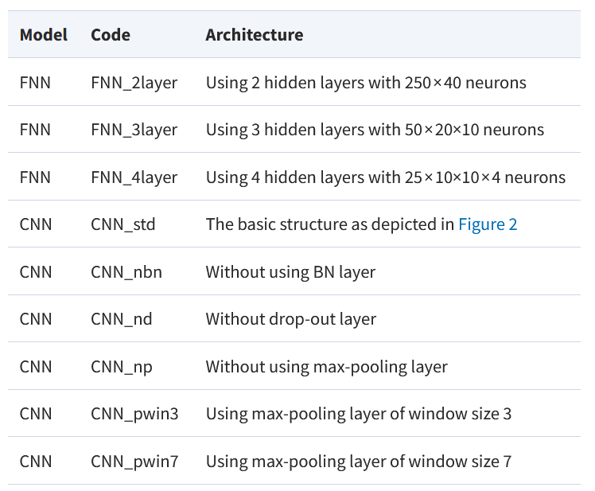

Slide 16
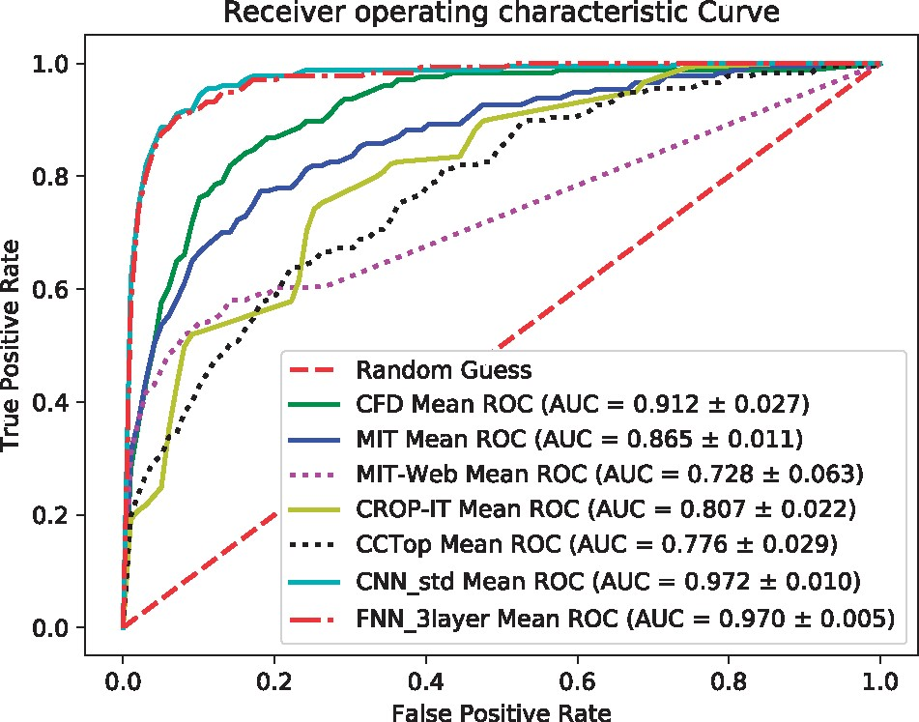
Comparison with Current Algorithms
CNN and FNN significantly outperformed the other methods
CFD outperformed the other algorithm which is expected.
Authors note that this shows deep learning has competitive edges over existing methods

Slide 17
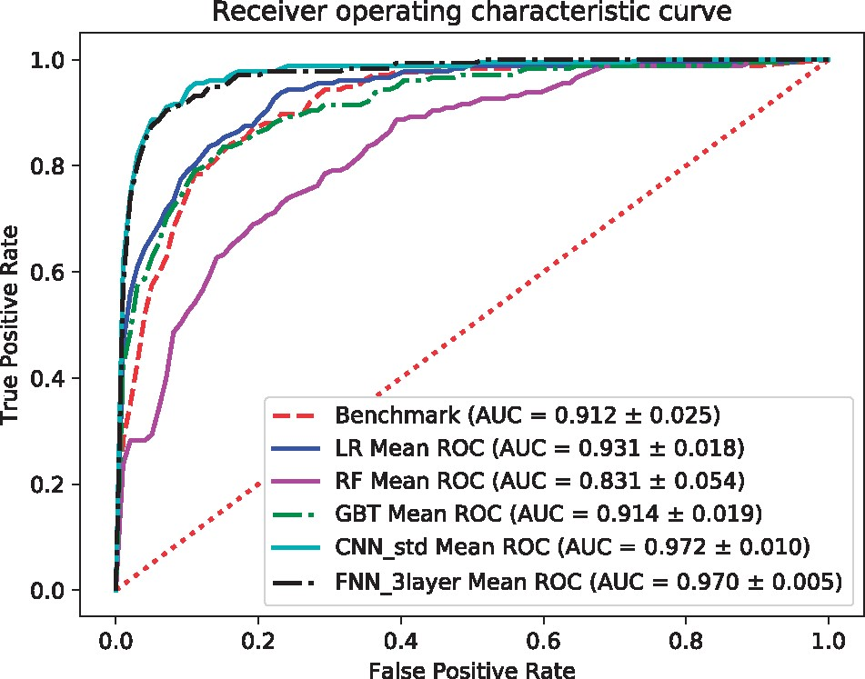
Comparison with Machine Learning Models
Each method tested and trained on the CRISPOR dataset using 5 fold cross validation.
CNN and FNN performed significantly better than the other methods.
Standard deviations of RF is among the lowest of all methods.

Slide 18
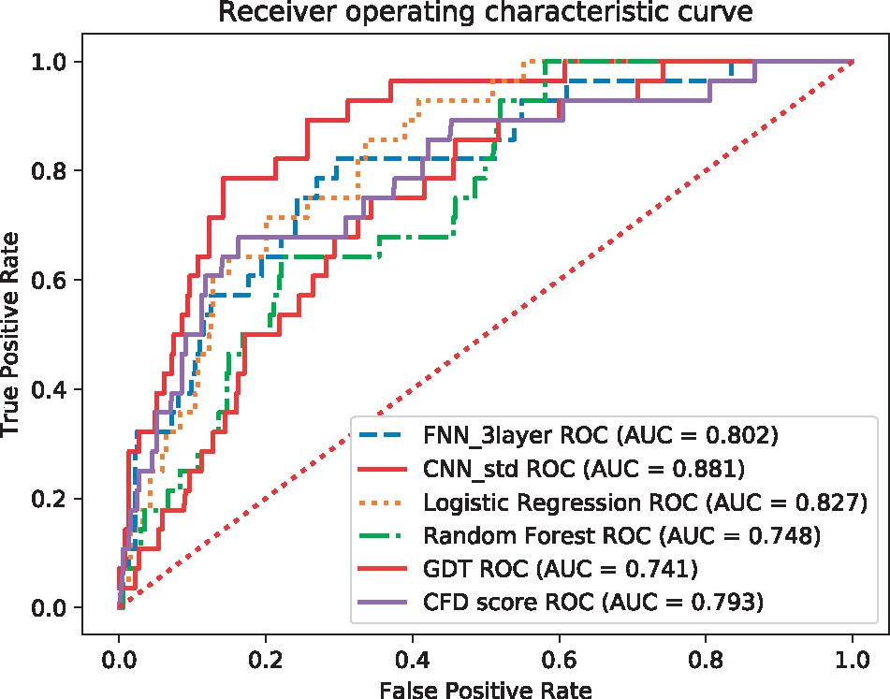
Performance on GUIDE-seq Dataset
CNN outperformed FNN on the GUIDE-seq dataset.
Authors note that although FNN has less variance, their CNN has more generalization.
For this reason, they claim their CNN outperforms the 3-Layer FNN.

Slide 19
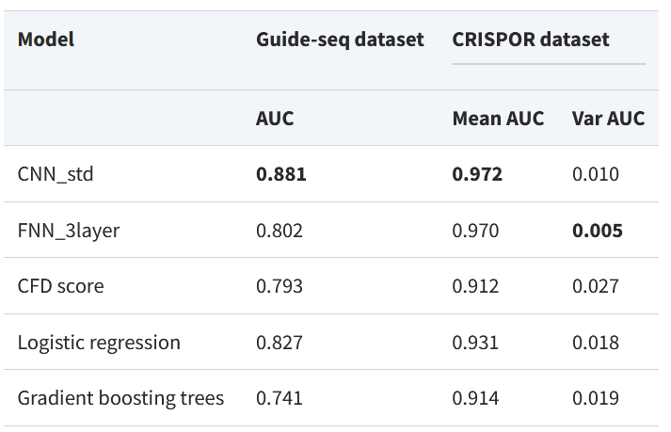
Summary

Slide 20
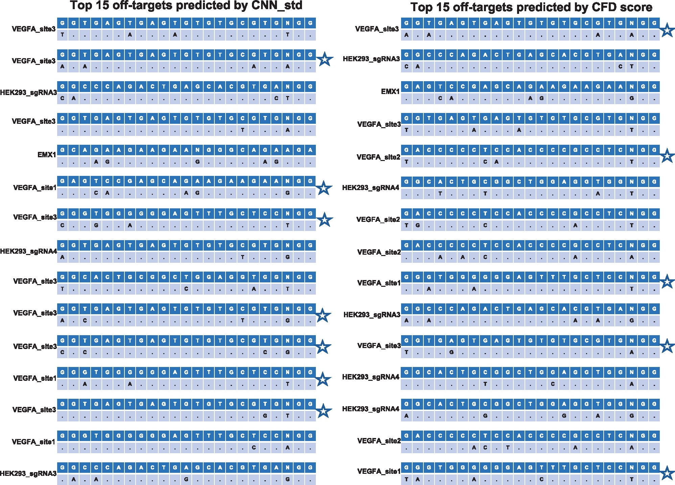
CNN vs CFD top results
Prediction results of the top 15 sgRNA-DNA sequence pairs with the highest prediction scores.
CNN got 7/15 correct while CFD got 5/15.

Slide 21
The Ethics of CRISPR

Slide 22
Pros
Cons
Eliminate disease.
Fix minor problems including colour blindness.
Increase intelligence and other aspects.
Irreversible changes to the gene pool.
It will be much easier for rich people to gain access.
It is very hard to decide when to stop.

Slide 23
Where do we draw the line?

Slide 24
The Future…
Currently we believe aging is caused by the accumulation of damage to cells and the slowing down of our bodies ability to repair these.
If we could isolate this process, theoretically we could use CRISPR to stop or reverse this process.
Humans could also be given the specific characteristics needed to survive on other planets.

Slide 25
References
Jiecong Lin, Ka-Chun Wong, Off-target predictions in CRISPR-Cas9 gene editing using deep learning, Bioinformatics, Volume 34, Issue 17, 01 September 2018, Pages i656–i663
Doench, J., Fusi, N., Sullender, M. et al. Optimized sgRNA design to maximize activity and minimize off-target effects of CRISPR-Cas9. Nat Biotechnol 34, 184–191 (2016).
Zhu, L.J., Lawrence, M., Gupta, A. et al. GUIDEseq: a bioconductor package to analyze GUIDE-Seq datasets for CRISPR-Cas nucleases. BMC Genomics 18, 379 (2017).
Haeussler, M., Schönig, K., Eckert, H. et al. Evaluation of off-target and on-target scoring algorithms and integration into the guide RNA selection tool CRISPOR. Genome Biol 17, 148 (2016).

