Slide 1
Ordered Neurons: Integrating Tree Structures Into Recurrent Neural Networks
Best paper at ICLR 2019
Mohammadali(Sobhan) Niknamian
CS886: Deep Learning and Natural Language Processing
Winter 2020

Slide 2
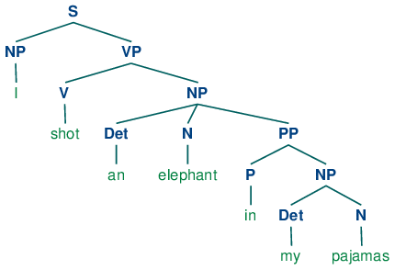
Motivation
Underlying structure of language is usually tree-like
Single words are composed to form meaningful larger units called “constituents”.
Standard LSTM architecture does not have an explicit bias towards modeling a hierarchy of constituents.

Slide 3
How to predict the latent tree structure?
Supervised Syntactic parser
This solution is limiting for several reasons:
Few languages have annotated data for training such a parser.
In some situations, syntactic rules tend to be broken (e.g. in tweets).
Languages change over time, So syntax rules may evolve.
Grammar induction: The task of learning the syntactic structure of language from raw corpora without access to expert-labeled data.
This is an open problem.

Slide 4
How to predict the latent tree structure?
Recurrent Neural Networks (RNNs)
RNNs impose a chain structure on the data.
This assumption is in conflict with the latent non-sequential structure of language.
This gives rise to problems such as:
Capturing long-term dependencies
Achieving good generalization
Handling negation
However, some evidence exist that traditional LSTMs with sufficient capacity may encode the tree structure implicitly.

Slide 5
How to predict the latent tree structure?
Proposed method: ON-LSTM
Is able to differentiate the life cycle of information stored inside each of the neurons.
High ranking neurons will store long-term information which is kept for several steps.
Low ranking neurons will store short-term information that can be rapidly forgotten.
There is no strict division between high and low ranking neurons.
Neurons are actively allocated to store long/short information during each step of processing the input.

Slide 6
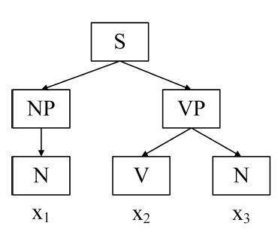
Requirements
The hidden state $h_{t}$ of our model would ideally contain information from all nodes in the path between current input $x_{t}$ and the root $S$.
Each node in the tree must be represented by a set of neurons in the hidden state.
The model should dynamically reallocate the dimensions of the hidden state to each node.

Slide 7
Ordered neurons
An inductive bias that forces neurons in the cell state of the LSTM to represent information at different time scales.
High ranking neurons contain long-term information
Low ranking neurons contain short-term information
To erase (or update) high-ranking neurons, the model should first erase (or update) all lower-ranking neurons.
The differentiation between low and high ranking neurons in learnt in a data-driven fashion and determined in each time step.

Slide 8
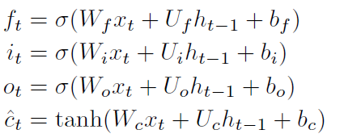
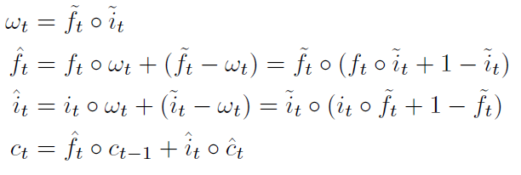
ON-LSTM: general architecture
The new model uses an architecture similar to the standard LSTM.
The only difference is in the update function of cell state $c_{t}$.

Slide 9
Activation function: cumax()
Input is a numerical vector
It is the cumulative sum of the softmax of the input vector
We could approximate this as a binary gate $g=(0,…,0, 1,…,1)$.
This binary gate splits the cell state into two segments: 0-segment and 1-segment.
The model can apply different update rules on the two segment to differentiate long/short-term information.

Slide 10
Intuition behind new update rules
We will explain this with an example:
$c_{t}=( , , , , , , , )$
${\tilde{f}}_{t}=(0, 0, 0, 1, 1, 1, 1, 1, 1)$
${\tilde{i}}_{t}=(1, 1, 1, 1, 1, 1, 0, 0, 0)$
$ω_{t}=(0, 0, 0, 1, 1, 1, 0, 0, 0)$
${\hat{f}}_{t}=(0, 0, 0, , , , 1, 1, 1)$
Short-term info
long-term info
We are done with these neurons
We want to keep these neurons
We need these neurons from the current state to be passed to future states
$$f_{t}(i:j)$$

Slide 11
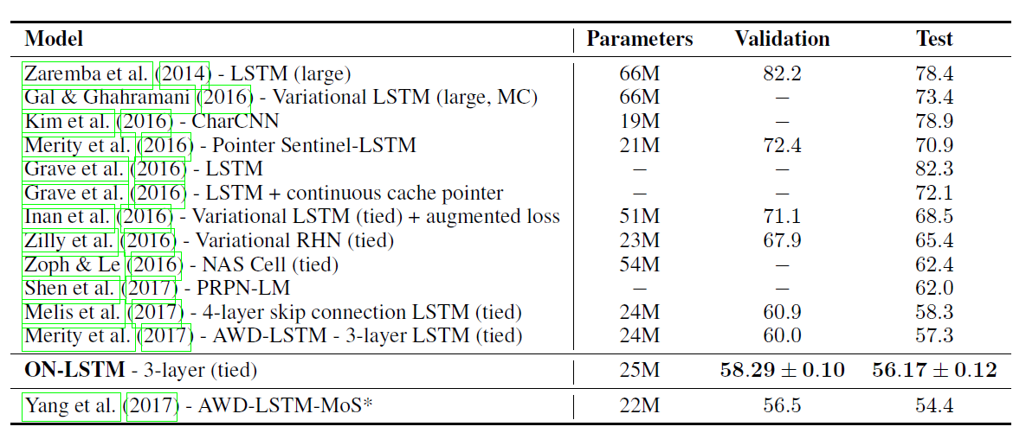
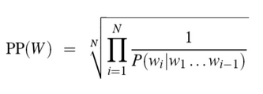
Experiment: Language Modeling
Perplexity on the Penn TreeBank (PTB) dataset.
Perplexity measures the ability of a model in predicting the next word in a sentence (lower is better).

Slide 12
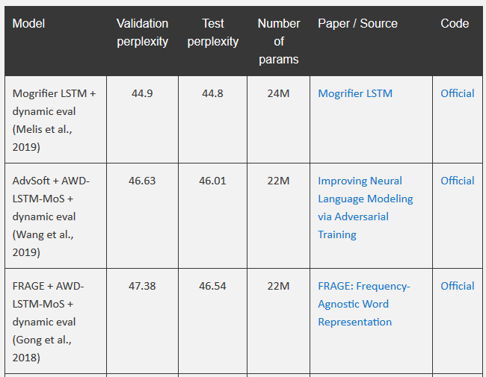
Best models based on perplexity
http://nlpprogress.com/english/language_modeling.html

Slide 13
Experiment: Unsupervised Constituency Parsing
Compares the latent tree structure induced by the model with those annotated by human experts.
Lets consider $d_{t}^{f}$ be the split point in the master forget gate ${\tilde{f}}_{t}$ in time step $t$.
We sort the $\{d_{t}^{f}$} in the decreasing order. For the first $d_{t}^{f}$ we split the sequence into constituents $(\left(x_{<i}\right), \left(x_{i}, \left(x_{>i}\right)\right))$. Then we repeat this recursively for constituents $\left(x_{<i}\right)$ and $\left(x_{>i}\right)$.

Slide 14
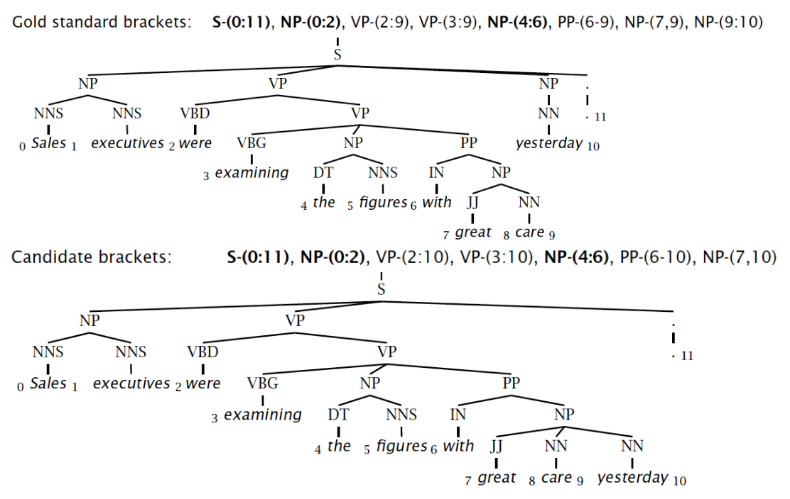
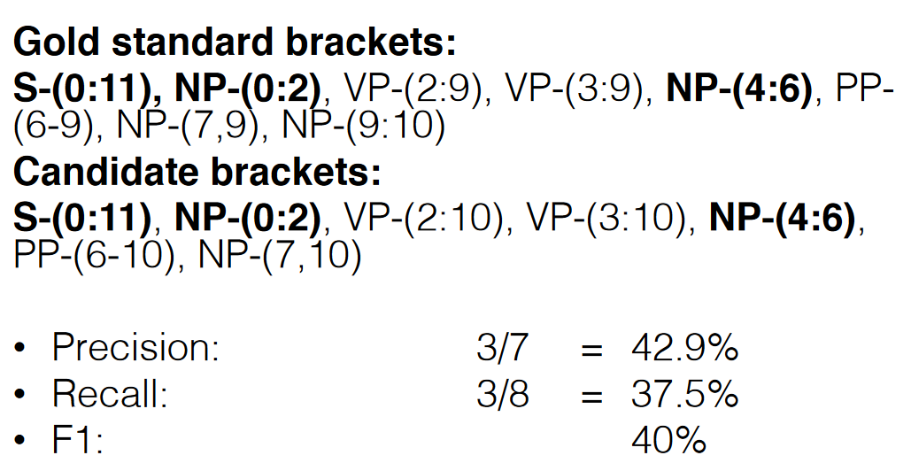
Evaluating constituency parsing

Slide 15
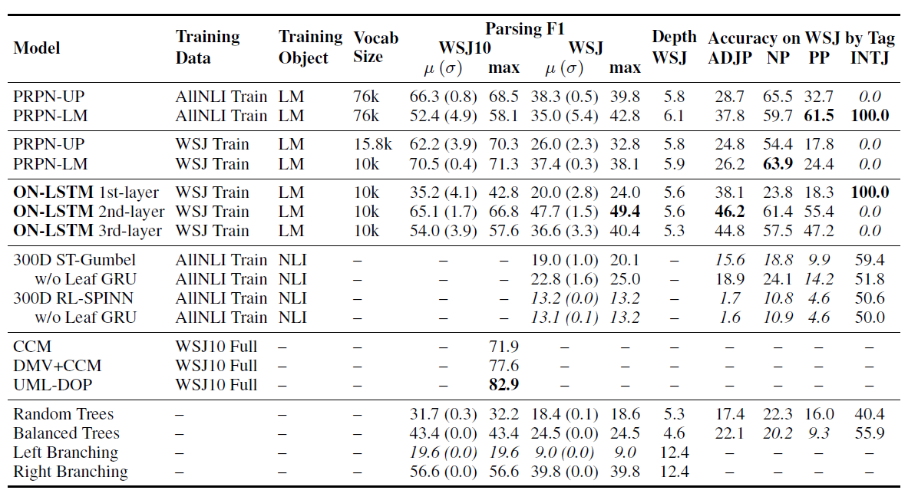
Experiment: Unsupervised Constituency parsing

Slide 16
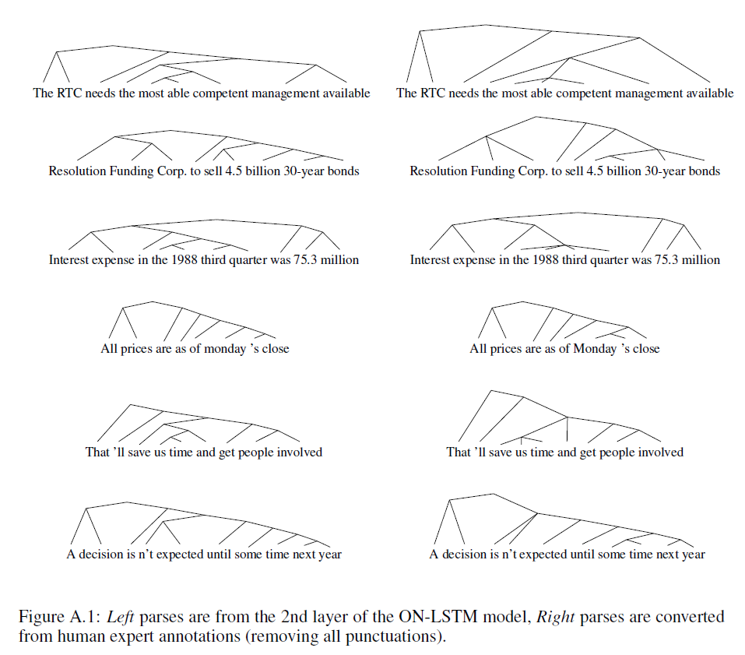
Experiment: Unsupervised Constituency parsing

Slide 17
Experiment: Targeted Syntactic Evaluation
A collection of tasks that evaluate language models along three different structure-sensitive linguistic phenomena:
Subject-verb agreement
Reflexive anaphora
Negative polarity items
Given a large number of minimally different pairs of a grammatical and an ungrammatical sentence, the model should assign higher probability to the grammatical sentence.

Slide 18
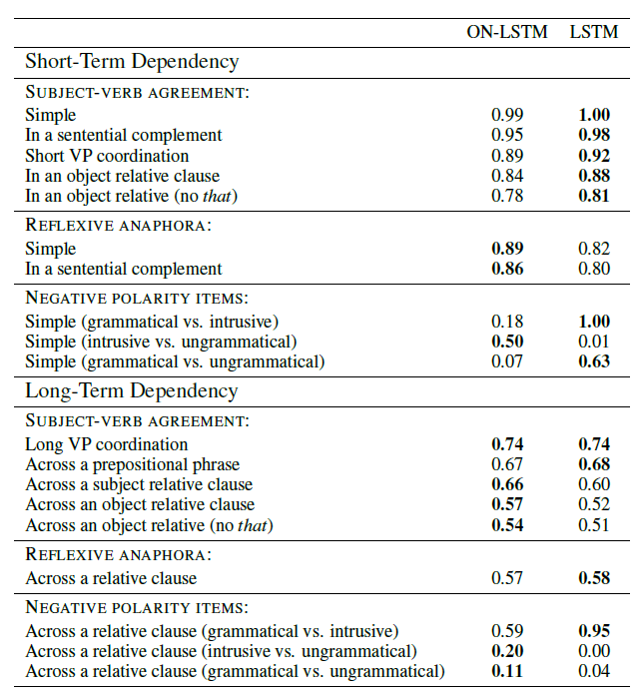
Experiment: Targeted Syntactic Evaluation
Long-term dependency means that an unrelated phrase exist between the targeted pairs of words.
The paper states that the reason standard LSTM performs better on short-term dependencies is due to the small number units in the hidden states of the ON-LSTM, which is insufficient to take into account both long and short-term information.

Slide 19
References
Shen, Yikang, Shawn Tan, Alessandro Sordoni, and Aaron Courville. "Ordered neurons: Integrating tree structures into recurrent neural networks." arXiv preprint arXiv:1810.09536 (2018).
Marvin, Rebecca, and Tal Linzen. "Targeted syntactic evaluation of language models." arXiv preprint arXiv:1808.09031 (2018).
http://www.cs.cornell.edu/courses/cs5740/2017sp/lectures/13-parsing-const.pdf

Slide 20
Thank you!

