Slide 1
Domain-specific language model pretraining for biomedical natural language processing Microsoft Research Presented by: Negar Arabzadehghahyazi

Slide 2
1.
Introduction

Slide 3
Introduction
Natural Language Processing (NLP)
pretraining large neural language models on unlabeled text
successful strategy for transfer learning

Slide 4
Introduction
I am the Prime Example!
Natural Language Processing (NLP)
pretraining large neural language models on unlabeled text
successful strategy for transfer learning
Bidirectional Encoder Representations from Transformers (BERT)

Slide 5
Introduction
I am the Prime Example!
Natural Language Processing (NLP)
pretraining large neural language models on unlabeled text
successful strategy for transfer learning
Bidirectional Encoder Representations from Transformers (BERT)
Existing pretraining language models
Newswire
Web domains
BERT
WikiPedia
BookCorpus
additional text from the Web

Slide 6
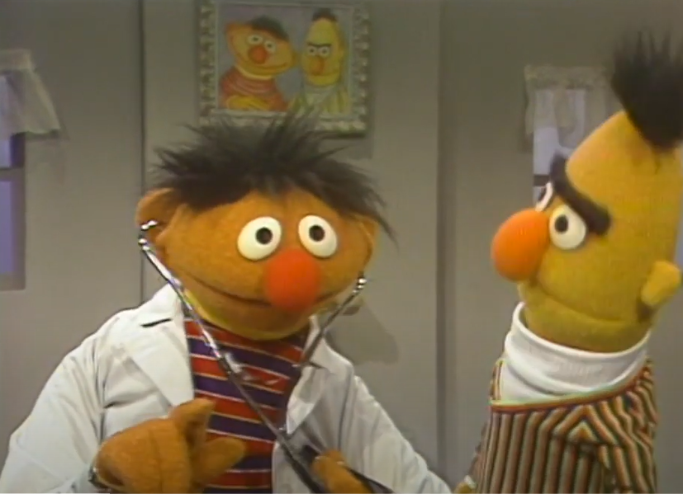
Introduction
Natural Language Processing (NLP)
Specialized domains like biomedicine
in-domain text can help over general-domain language models
out-domain text is still helpful
start domain-specific pretraining from an existing general-domain language model
Notes:
- subsequent efforts have focused on crawling additional text from the Web to power even larger-scale pretraining

Slide 7
Introduction
Natural Language Processing (NLP)
Specialized domains like biomedicine
in-domain text can help over general-domain language models
out-domain text is still helpful
start domain-specific pretraining from an existing general-domain language model
Let’s question this assumption!
Notes:
- subsequent efforts have focused on crawling additional text from the Web to power even larger-scale pretraining

Slide 8
Introduction
Natural Language Processing (NLP)
Specialized domains like biomedicine
in-domain text can help over general-domain language models
out-domain text is still helpful
start domain-specific pretraining from an existing general-domain language model
Transfer learning
Source domain = general text
Target domain = specialized text
Biomedicine
Abundant unlabeled text
Benefit by transfer from general domains is not clear
successful
relevant to the target
scarce target data
Let’s question this assumption!
Notes:
- subsequent efforts have focused on crawling additional text from the Web to power even larger-scale pretraining

Slide 9
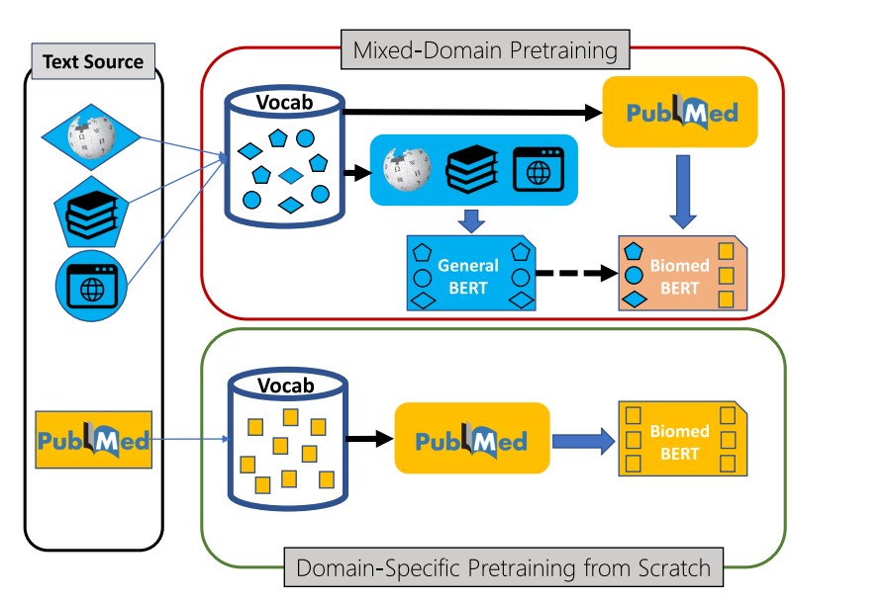
Problem Definition
Studying domain-specific pretraining and its impact on downstream applications
Notes:
PubMed® comprises more than 33 million citations for biomedical literature from MEDLINE, life science journals, and online books

Slide 10
Problem Definition
Studying domain-specific pretraining and its impact on downstream applications

Slide 11
2.
Methods

Slide 12
Input to LM: text spans
Sentences seperated by special tokes [SEP]
Out-Of-Vocabulary problem
Generating vocabs from subword unit
Byte-Pair-Encoding
greedily identify a small set of sub words that can compactly form all words in the given corpus
WordPiece
BPE variant
Instead of pair frequency, it maximizes likelihood based on the unigram language model
Vocab size :
Bert: 30K
Roberta: 50K
Vocabulary
Notes:
Shattering all words in the corpus and initializing the vocabulary with characters and delimiters
iteratively augments the vocabulary with a new subword that is most frequent in the corpus and can be formed by concatenating two existing subwords,

Slide 13
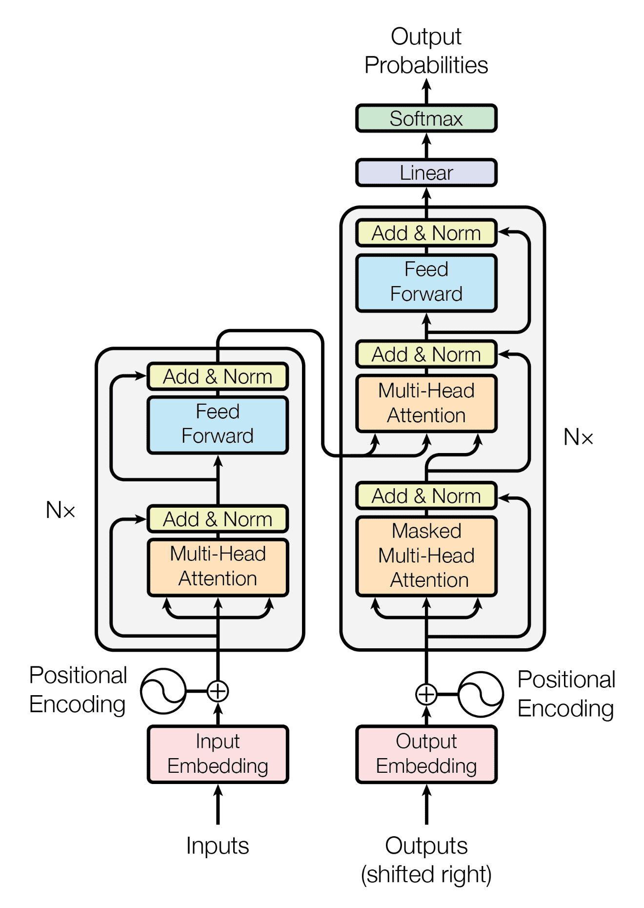
Model Architecture:
Transformer architectures
multi-layer, multi-head self-attention mechanism,
leveraging GPU-based parallel computation
Processing input sequence by lexical encoder
Token embedding
Position embedding
Segment embedding
Generating contexualized reoresentation for tokens
Notes:
The input token sequence is first processed by a lexical encoder, which combines a token embedding, a position embedding and a segment embedding by element-wise summation.
This embedding layer is then passed to multiple layers of transformer modules
In each transformer layer, a contextual representation is generated for each token by summing a non-linear transformation of the representations of all tokens in the prior layer, weighted by the attentions computed in the prior layer as the query.
The final layer outputs contextual representations for all tokens, which combine information from the whole text span.

Slide 14
Self Supervision
Masked Language Model (MLM)
Traditional language models (ngrams) – predict next token based on preceding tokens
MLM randomly replaces a subset of tokens by a special token (e.g., [MASK])
asks the language model to predict them
Next Sentence Prediction (NSP)
Determines whether one sentence follows the other in the original text

Slide 15
Self Supervision
Masked Language Model (MLM)
Traditional language models (ngrams) – predict next token based on preceding tokens
MLM randomly replaces a subset of tokens by a special token (e.g., [MASK])
asks the language model to predict them
Next Sentence Prediction (NSP)
Determines whether one sentence follows the other in the original text
Advanced Pretraining Techniques: Whole-Word Masking (WWM)
MLM selects random sub words to mask
Easy to predict the partially masked portion given the observed ones
WWM enforces the whole word to be masked if one of its sub words is chosen.
Forces the language model to capture more contextual semantic dependencies

Slide 16
Biomedical Language Model Pretraining
in-domain = biomedical text
out-domain = others
pretraining with PubMed text leads to better performance in biomedical NLP tasks
whether pretraining should include text from other domains
In-domain text in pretraining should help with domain-specific applications.

Slide 17
Biomedical Language Model Pretraining
in-domain = biomedical text
out-domain = others
pretraining with PubMed text leads to better performance in biomedical NLP tasks
whether pretraining should include text from other domains
prevailing assumption :
pretraining can always benefit from more text, including out-domain text.
None of the prior biomedical-related BERT models have been pretrained using purely biomedical
Challenge this assumption
Compare domain-specific pretraining from scratch vs mixed-domain pretraining for downstream applications.
In-domain text in pretraining should help with domain-specific applications.

Slide 18
Mixed-Domain Pretraining
BioBERT : Continual pretraining of a general-domain pretrained model
PubMed abstracts and PubMed Central (PMC) full-text articles.
BlueBERT : uses both PubMed text and de-identified clinical notes from MIMIC-II

Slide 19
Mixed-Domain Pretraining
BioBERT : Continual pretraining of a general-domain pretrained model
PubMed abstracts and PubMed Central (PMC) full-text articles.
BlueBERT : uses both PubMed text and de-identified clinical notes from MIMIC-II
Continual pretraining approach :
Advantage : Convenient
Disadvantage : vocabulary is the same as the original BERT model
vocabulary is not representative of the target biomedical domain.

Slide 20
Mixed-Domain Pretraining
BioBERT : Continual pretraining of a general-domain pretrained model
PubMed abstracts and PubMed Central (PMC) full-text articles.
BlueBERT : uses both PubMed text and de-identified clinical notes from MIMIC-II
Continual pretraining approach :
Advantage : Convenient
Disadvantage : vocabulary is the same as the original BERT model
vocabulary is not representative of the target biomedical domain.
SciBERT : generates the vocabulary and pretrains from scratch
using biomedicine and computer science as representatives for scientific literature
mixed-domain pretraining approach -- computer science text

Slide 21
Domain-Specific Pretraining from Scratch
mixed-domain pretraining approach makes sense if :
The target application domain has little text of its own
Biomedicine: has more than 30 million abstracts in PubMed,
hypothesize : domain-specific pretraining from scratch is a better strategy for biomedical LM

Slide 22
Domain-Specific Pretraining from Scratch
mixed-domain pretraining approach makes sense if :
The target application domain has little text of its own
Biomedicine: has more than 30 million abstracts in PubMed,
hypothesize : domain-specific pretraining from scratch is a better strategy for biomedical LM
Advantages of domain-specific pretraining from scratch stems :
having an in-domain vocabulary.
BERT models are forced to divert parameterization capacity and training bandwidth to model biomedical terms using fragmented subwords.
naloxone, ([na, ##lo, ##xon, ##e])
acetyltransferase ([ace, ##ty, ##lt, ##ran, ##sf, ##eras, ##e])

Slide 23
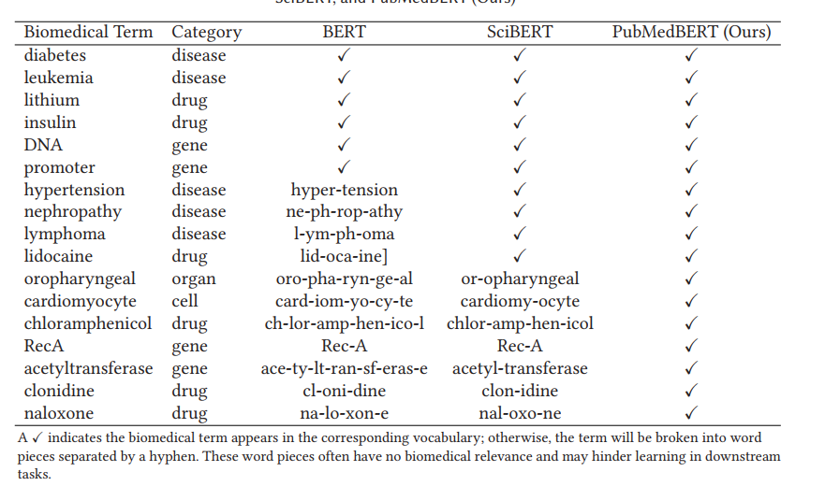
Domain-Specific Pretraining from Scratch

Slide 24
3. BLURB
A Comprehensive Benchmark for Biomedical NLP

Slide 25
BLURB
Name Entity Recognition
Biomedical Language Understanding & Reasoning Benchmark
focus on PubMed-based biomedical applications
comprehensive set of biomedical NLP tasks
from publicly available datasets
Evalauting different biomedical LM:
group the datasets by their task types,
compute the average score for each task type,
report the macro average among the task types
Question answering
Relation extraction
Sentence Similarity
Document clasification
Medical Information Extarction

Slide 26
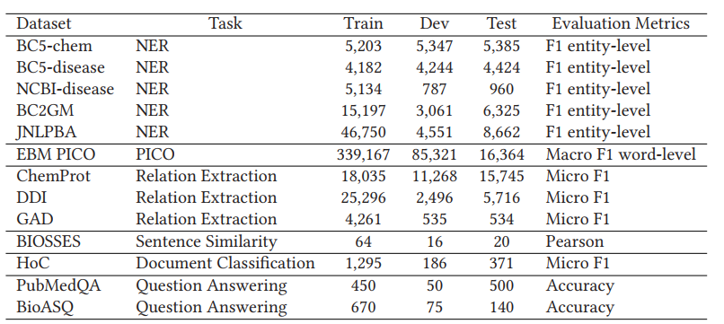
BLURB
Name Entity Recognition
Biomedical Language Understanding & Reasoning Benchmark
focus on PubMed-based biomedical applications
comprehensive set of biomedical NLP tasks
from publicly available datasets
Evalauting different biomedical LM:
group the datasets by their task types,
compute the average score for each task type,
report the macro average among the task types
Question answering
Relation extraction
Sentence Similarity
Document clasification
Medical Information Extarction

Slide 27
BLURB tasks
Name Entity Recognition
Name entity Recognition
Detecting entities
Disease, drugs, gene , molecular biology
Question answering
Relation extraction
Sentence Similarity
Document clasification
Medical Information Extarction

Slide 28
BLURB tasks
Name Entity Recognition
Name entity Recognition
Question Answering (QA)
Set of research questions with annotated label of whether the text contains the answer to the research question (yes/maybe/no).
Multiple question answering tasks annotated by biomedical experts, including yes/no
Question answering
Relation extraction
Sentence Similarity
Document clasification
Medical Information Extarction

Slide 29
BLURB tasks
Name Entity Recognition
Name entity Recognition
Question Answering (QA)
Relation Extraction
Chemical and Protein entities interactions
Drug-drug interactions
Gene-disease associations
Question answering
Relation extraction
Sentence Similarity
Document clasification
Medical Information Extarction

Slide 30
BLURB tasks
Name Entity Recognition
Name entity Recognition
Question Answering (QA)
Relation Extraction
Sentence Similarity
PubMed sentences which is annotated by five annotators
estimated similarity score in the range from 0 (no relation) to 4 (equivalent meanings)
regression task
Question answering
Relation extraction
Sentence Similarity
Document clasification
Medical Information Extarction

Slide 31
BLURB tasks
Name Entity Recognition
Name entity Recognition
Question Answering (QA)
Relation Extraction
Sentence Similarity.
Document Classification
PubMed abstracts with binary labels
each of which signifies the discussion of a specific cancer hallmark
Question answering
Relation extraction
Sentence Similarity
Document clasification
Medical Information Extarction

Slide 32
BLURB tasks
Name Entity Recognition
Name entity Recognition
Question Answering (QA)
Relation Extraction
Sentence Similarity.
Document Classification.
Evidence-based Medical Information Extraction (PICO)
Abstracts on clinical trials annotated with
Participants (e.g., diabetic patients),
Intervention (e.g., insulin),
Comparator (e.g., placebo),
Outcome (e.g., blood glucose levels)
Question answering
Relation extraction
Sentence Similarity
Document clasification
Medical Information Extarction

Slide 33
Task-Specific Fine-Tuning
A task-specific prediction model is then layered on top of contextualized representation to generate the final output for a task-specific application.
learn the task-specific model parameters
Refine the BERT model parameters by gradient descent using backpropagation.
fix the task-specific model architecture,
facilitate a head-to-head comparison among the pretrained neural language models.
Notes:
Pretrained neural language models provide a unifying foundation for learning task-specific models.
Given an input token sequence, the language model produces a sequence of vectors in the contextual representation.

Slide 34
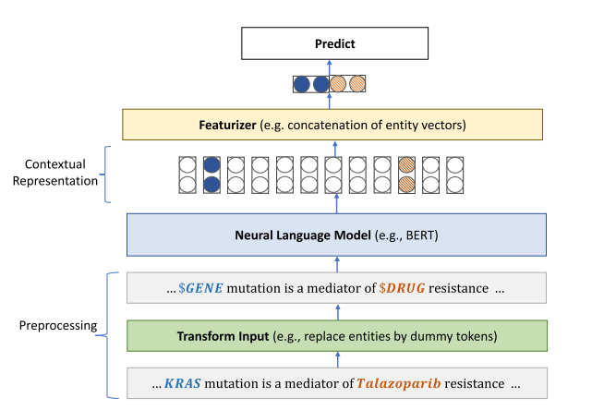
Task-Specific Fine-Tuning
General architecture of fine-tuning neural language models for downstream applications
The same fine-tuning procedure for all BERT models and tasks
Classification tasks : Cross Entropy loss
Regression tasks: Mean square error
Notes:
An input instance is first processed by a Transform Input module that performs task-specific transformations such as appending special instance marker (e.g., [CLS]) or dummifying entity mentions for relation extraction.
The transformed input is then tokenized and fed into the model.
Next, the contextual representation at the top layer is processed by a Featurizer module and then fed into the Predict module to generate the final output for a given task.
Jointly fine-tune the parameters of the task-specific prediction layer as well as the underlying neural language model.

Slide 35
Task-Specific Fine-Tuning
Task | Problem Formulation | Modeling Choices
Named Entity Recognition | Token classification | Tagging Scheme Classification Layer
Question answering | Sequence classification | Question/Text Representation Classification Layer
Relation Extraction | Sequence classification | Entity-Relation Representation Classification Layer
Sentence Similarity | Sequence Regression | Sentence Representation Regression Loss
Document Classification | Sequence classification | Document Representation Classification Layer
Evidence-based Medical Information Extraction | Token classification | Tagging Scheme Classification Layer

Slide 36
Experimental Settings
Training a biomedical language model from scratch on PubMed
Latest collection of PubMed abstracts
14 million abstracts
3.2 billion words
21 GB
Training takes about
5 days
on DGX-2 machine ( ~ 400K USD)
16 V100 GPUs

Slide 37
Experimental Settings
Summary of Pretraining Details for the Various BERT Models Used in Experiments

Slide 38
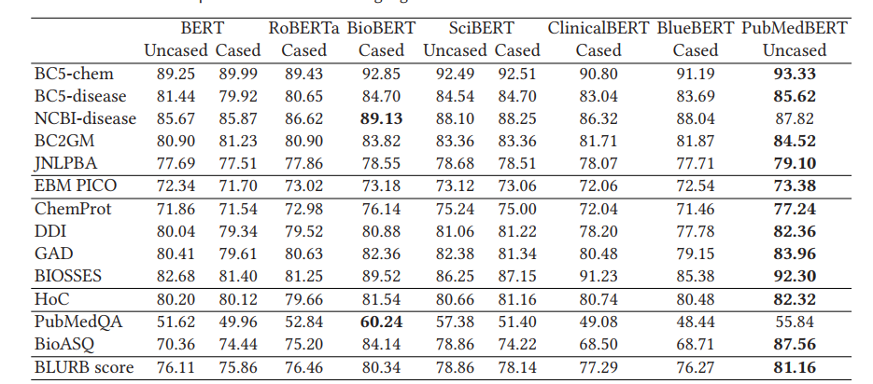
Results
conduct the same fine-tuning process using the standard task-specific model

Slide 39
Results
conduct the same fine-tuning process using the standard task-specific model

Slide 40
Results
Models using biomedical text in pretraining generally perform better.

Slide 41
Results
although the pretraining corpus is the largest for RoBERTa, its performance on biomedical NLP tasks is among the worst,

Slide 42
Results
mixing out-domain data in pretraining generally leads to worse performance

Slide 43
Results
Clinical notes are more relevant to the biomedical domain than general-domain text, however, adding them does not confer any advantage .

Slide 44
Results
Not surprisingly, BioBERT is the closest to PubMedBERT, as it also uses PubMed text for pretraining
By conducting domain-specific pretraining from scratch, including using the PubMedvocabulary, PubMedBERT is able to obtain consistent gains over BioBERT in most tasks.

Slide 45
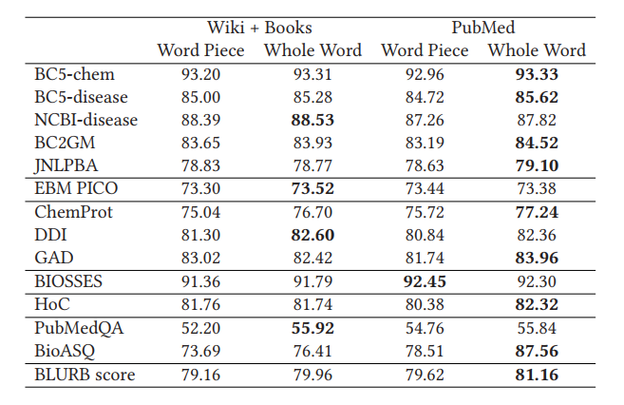
Ablation Study on Pretraining Techniques
Assessing the effect of vocabulary and WWM.
Using the original BERT vocabulary the results are significantly worse than using an in-domain vocabulary from PubMed

Slide 46
Ablation Study on Pretraining Techniques
Assessing the effect of vocabulary and WWM.
Using the original BERT vocabulary the results are significantly worse than using an in-domain vocabulary from PubMed
WWM leads to consistent improvement across the board, regardless of the vocabulary in use

Slide 47
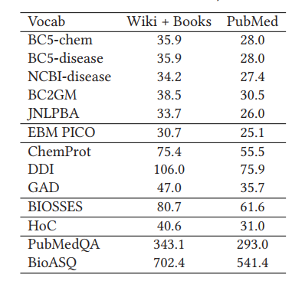
Ablation Study on Pretraining Techniques
Advantage in using an in-domain vocabulary
Shorter input
makes learning easier in downstream tasks
Average input length in wordpiece using general domain vs in domain vocabulary

Slide 48
Ablation Study on Pretraining Techniques
examples of how domain-specific pretraining with in-domain vocabulary helps correct errors from mixed-domain pretraining.
Notes:
we show the aggregate attention from the penultimate layer to the preceding layer, which tends to be most informative about the final classification.
BioBERT tends to shatter the relevant words by inheriting the general-domain vocabulary.

Slide 49
Ablation Study on Pretraining Techniques
examples of how domain-specific pretraining with in-domain vocabulary helps correct errors from mixed-domain pretraining.
Notes:
: Attention for the [CLS] token in an instance of AGONIST relation between a pair of dummified chemical and protein.
. The domain-specific vocabulary enables PubMedBERT to learn better attention patterns and make correct predictions.

Slide 50
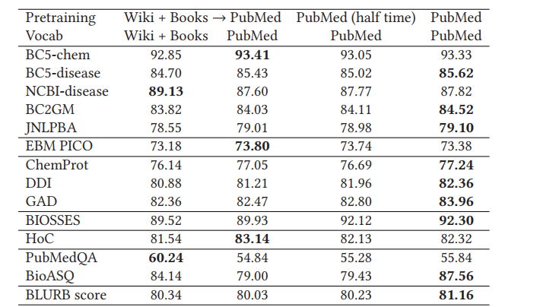
Ablation Study on Pretraining Techniques
pretraining on general-domain text
provides no benefit even if we use the in-domain vocabulary
Notes:
first column = pretraining first on the general domain and then on PubMed.
second column adopts the same continual pretraining strategy
in-domain vocabulary (from PubMed) was used,
slight degradation in performance.

Slide 51
Ablation Study on Pretraining Techniques
by conducting pretraining from scratch on PubMed
similar performance even with half of the compute
general-domain pretraining confers no advantage here in domain-specific pretraining.

Slide 52
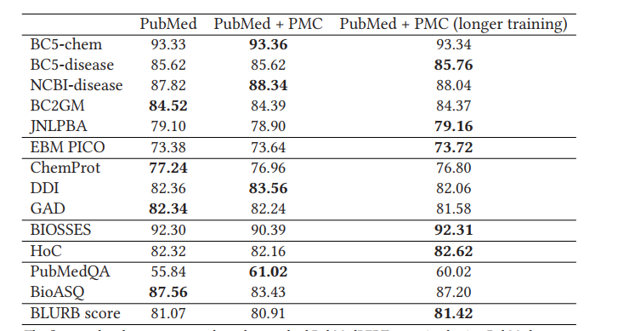
Ablation Study on Pretraining Techniques
Investigating the effect of pretrained text – amount and quality
adding full-text articles from PubMed Central (PMC)
Increased pretraining text to 16.8 billion words ( 21 GB -> 107 GB )
leads to a slight degradation in performance across the board !

Slide 53
Ablation Study on Pretraining Techniques
Investigating the effect of pretrained text – amount and quality
adding full-text articles from PubMed Central (PMC)
Increased pretraining text to 16.8 billion words ( 21 GB -> 107 GB )
leads to a slight degradation in performance across the board !
extending pretraining for 60% longer, the overall results improve and slightly outperform the standard PubMedBERT using only abstracts
full texts generally contain more noise than abstracts.
if full texts are potentially helpful, their inclusion requires additional pretraining cycles to make use of the extra information.
Notes:
improvement is somewhat mixed across the tasks, with some gaining and others losing.

Slide 54
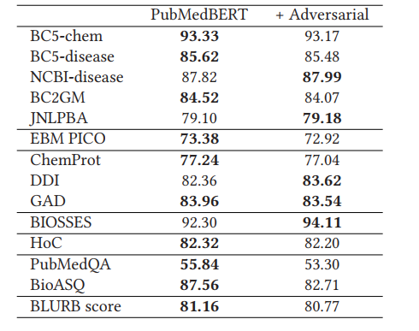
Ablation Study on Pretraining Techniques
Adversarial pretraining
effective in boosting performance in general-domain applications
adversarial pretraining in PubMedBERT
leads to a slight degradation
adversarial training is useful if the
pretraining corpus is more diverse
relatively out-domain compared to the application tasks
Notes:
Adversarial pretraining has been shown to be highly effective in boosting performance in general-domain applications

Slide 55
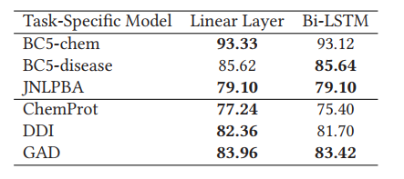
Ablation Study on Fine-tuning Methods
Study the effect of modeling choices in task-specific fine-tuning, by fixing the underlying pretrained language model to our standard PubMedBERT
With the advent of BERT models and the self-attention mechanism, the utility of explicit sequential modeling becomes questionable
The use of a bidirectional LSTM (Bi-LSTM) does not lead to any substantial gain compared to linear layer
Notes:
The top layer in the BERT model already captures many non-linear dependencies across the entire text span. Therefore, it is conceivable that even a linear layer on top can perform competitively

Slide 56
Take-away
Domain-specific pretraining from scratch substantially outperforms continual pretraining of generic language models, thus demonstrating that the prevailing assumption in support of mixed-domain pretraining is not always applicable

Slide 57
Thanks!
Any questions?
Negar Arabzadehghahyazi
Narabzad@uwaterloo.ca

