Slide 1
REFORMER: THE EFFICIENT TRANSFORMER
Ruixue Zhang

Slide 2
Challenging about Transformer
How to solve it
Locality-Sensitive Hashing Attention
Reversible Transformer
Chunking
Experimental Results

Slide 3
Challenging about Transformer
Consider the following calculation: the 0.5B parameters used in the largest reported Transformer layer account for 2GB of memory. Activations for 64K tokens with embedding size 1024 and batch size 8 account for 64K × 1K × 8 = 0.5B floats, requiring another 2GB of memory. If our memory use was only per-layer, then we should fairly easily fit a large Transformer even on sequences of length 64K on a single accelerator. But…

Slide 4
Challenging about Transformer
Memory in a model with N layers is N-times larger than in a single-layer model due to the fact that activations need to be stored for back-propagation.
Since the depth d_{ff} of intermediate feed-forward layers is often much larger than the depth d_{model} of attention activations, it accounts for a large fraction of memory use.
Attention on sequences of length L is O(L²) in both computational and memory complexity, so even for a single sequence of 64K tokens can exhaust accelerator memory.

Slide 5
Challenging about Transformer
How to solve it
Locality-Sensitive Hashing Attention
Reversible Transformer
Chunking
Experimental Results

Slide 6
How to solve it
Reversible layers, first introduced in Gomez et al. (2017), enable storing only a single copy of activations in the whole model, so the N factor disappears.
Splitting activations inside feed-forward layers and processing them in chunks removes the d_{ff} factor and saves memory inside feed-forward layers.
Approximate attention computation based on locality-sensitive hashing replaces the O(L² ) factor in attention layers with O(L) and so allows operating on long sequences.

Slide 7
Challenging about Transformer
How to solve it
Locality-Sensitive Hashing Attention
Reversible Transformer
Chunking
Experimental Results

Slide 8
Locality-Sensitive Hashing Attention
The computational and memory cost of multiplication QKᵀ (with the shape [L, L]) are both in O(L²), which is the main memory bottleneck.
But is it necessary to compute and store the full matrix QKᵀ ?

Slide 9
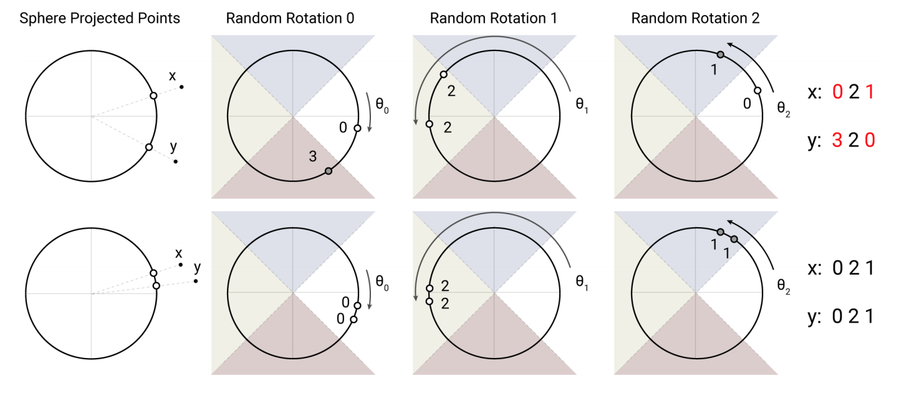
Locality-Sensitive Hashing
locality-sensitive hashing (LSH) is an algorithmic technique that hashes similar input items into the same "buckets" with high probability.

Slide 10
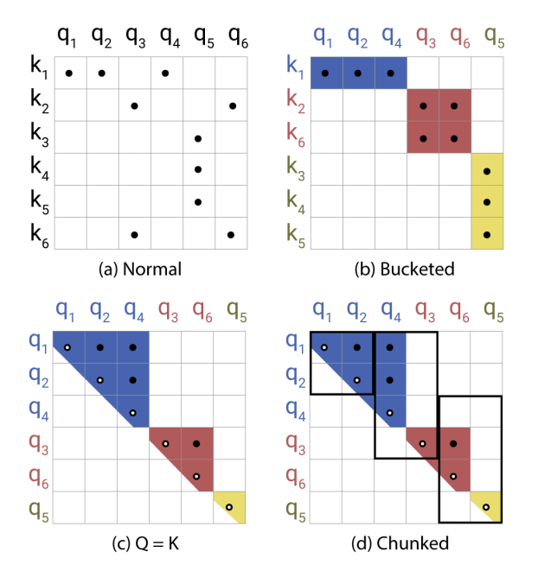
Simplified Depiction of LSH Attention
Hash buckets in this formulation tend to be uneven in size, which makes it difficult to batch across buckets. Moreover, the number of queries and the number of keys within a bucket may be unequal – in fact, it is possible for a bucket to contain many queries but no keys. To alleviate these issues, we first ensure that h(k_{j} ) = h(q_{j} ) by setting

Slide 11
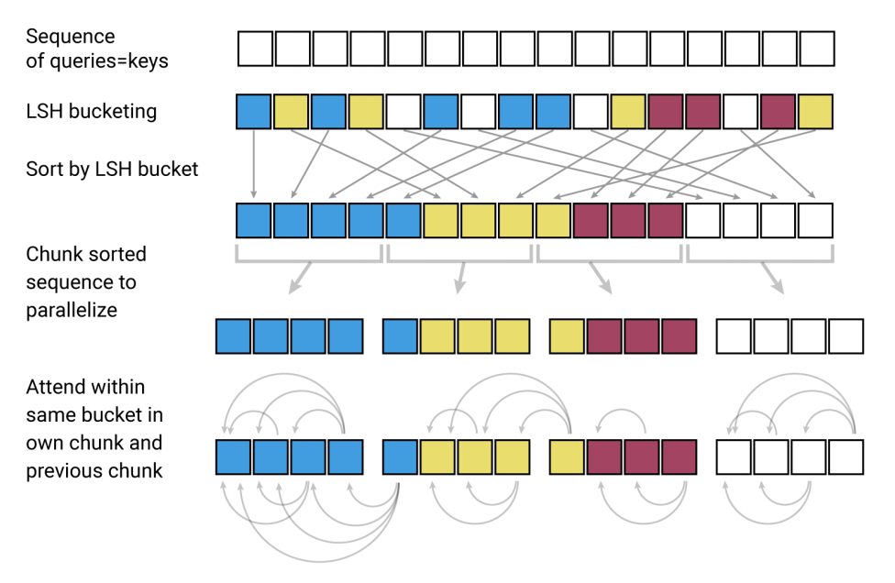
Simplified Depiction of LSH Attention

Slide 12
Challenging about Transformer
How to solve it
Locality-Sensitive Hashing Attention
Reversible Transformer
Chunking
Experimental Results

Slide 13
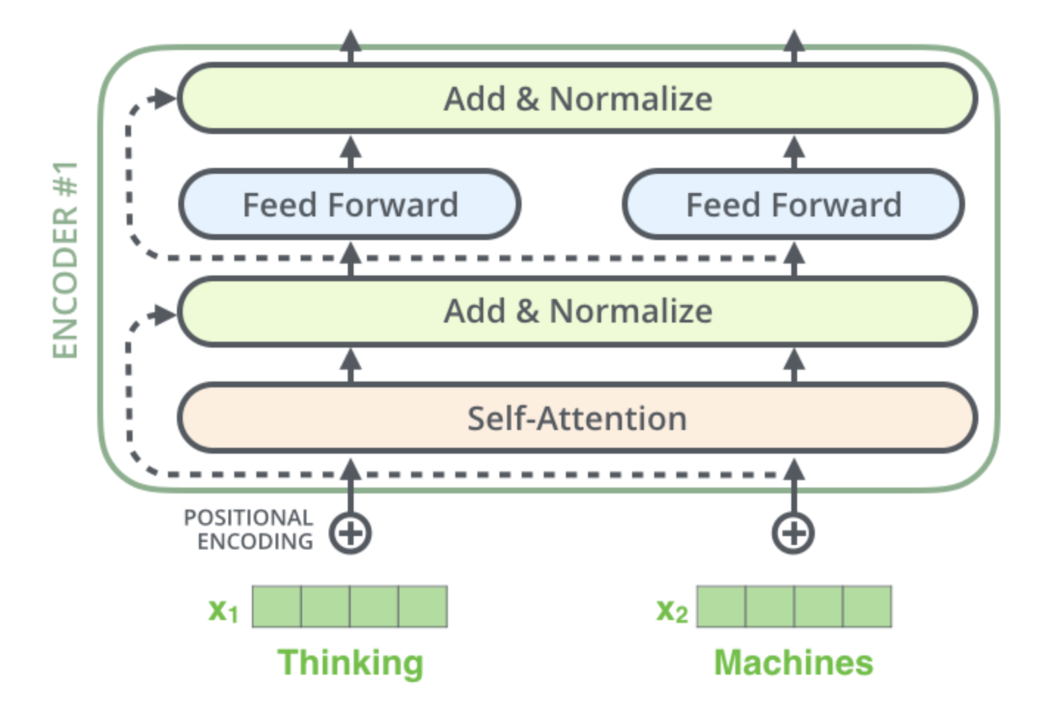
Reversible Transformer
Memory consumption in residual block is a bottleneck as one needs to store the activations in each layer in memory in order to calculate gradients during backpropagation. The memory cost is proportional to the number of units in the network.

Slide 14
Reversible Residual Networks

Slide 15
Challenging about Transformer
How to solve it
Locality-Sensitive Hashing Attention
Reversible Transformer
Chunking
Experimental Results

Slide 16
Chunking
Due to the fact that computations in feed-forward layers are independent across positions in a sequence, the computations for the forward and backward passes as well as the reverse computation can be all split into c chunks.

Slide 17
Challenging about Transformer
How to solve it
Locality-Sensitive Hashing Attention
Reversible Transformer
Chunking
Experimental Results

Slide 18
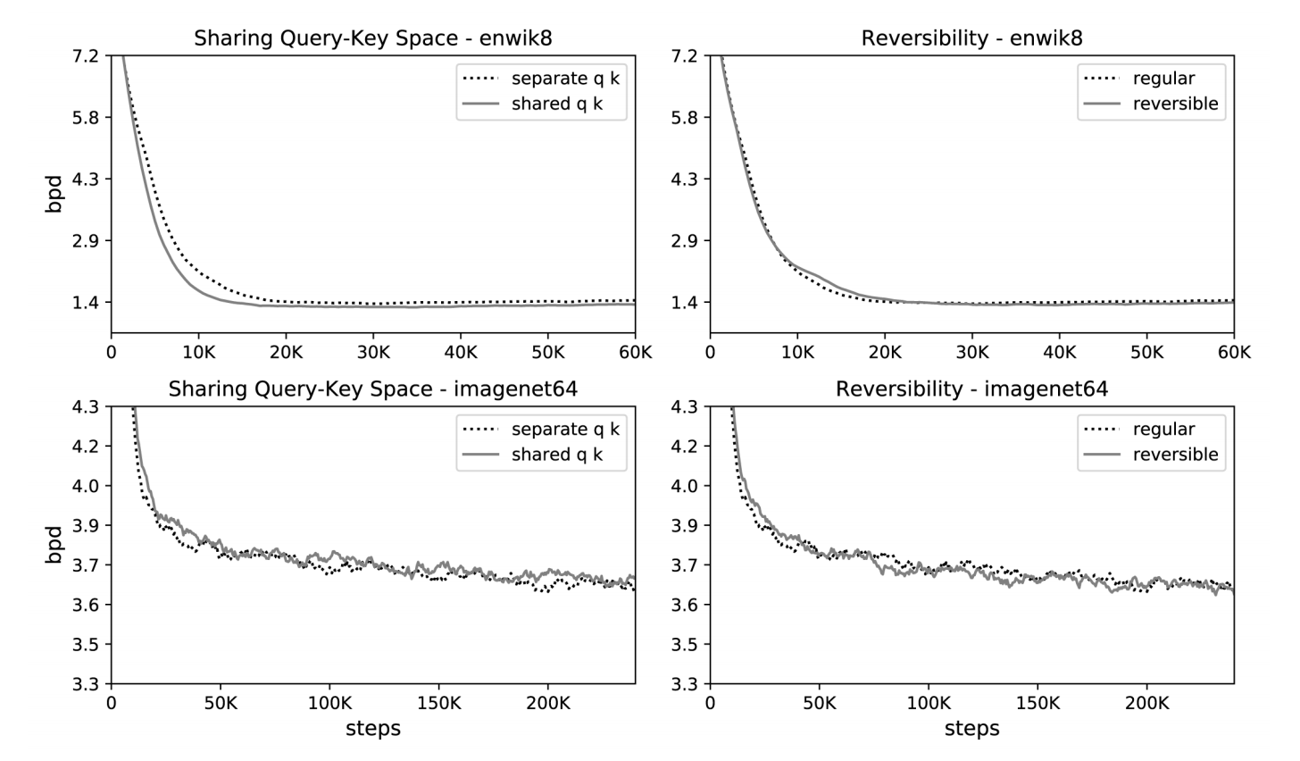
Experimental Results

Slide 19
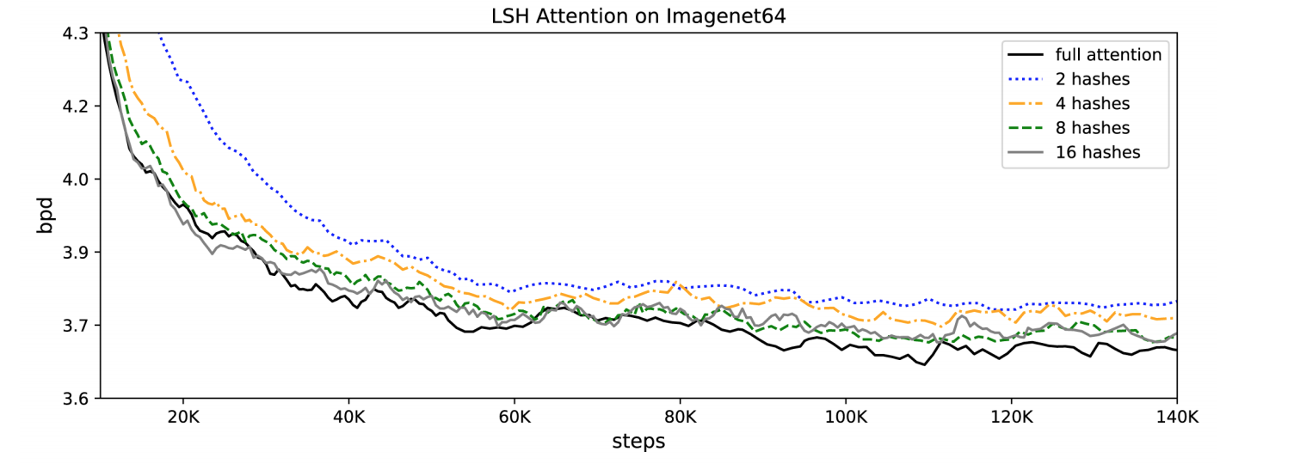
Experimental Results

Slide 20
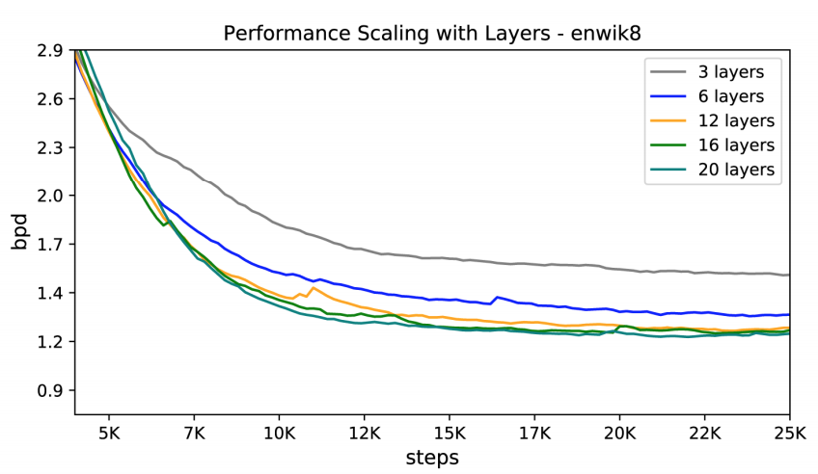
Experimental Results

Slide 21
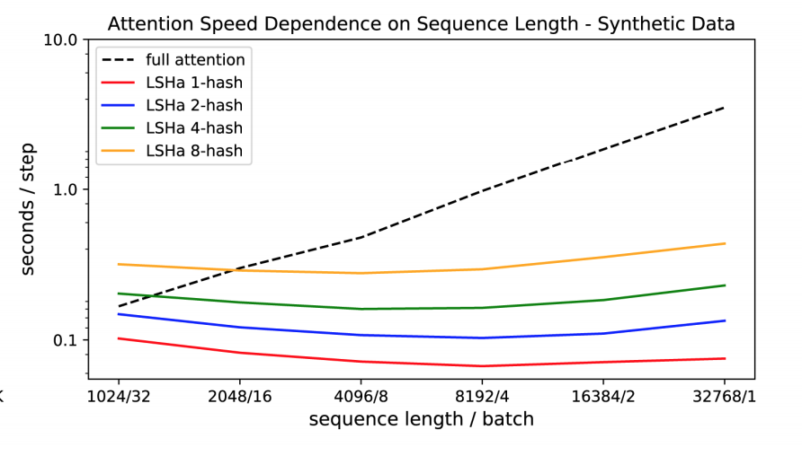
Experimental Results

Slide 22
Reference
[1] REFORMER: THE EFFICIENT TRANSFORMER
[2] https://towardsdatascience.com/illustrating-the-reformer-393575ac6ba0
[3] http://jalammar.github.io/illustrated-transformer/
[4] The Reversible Residual Network: Backpropagation Without Storing Activations

Slide 23
Thank you!

