Slide 1
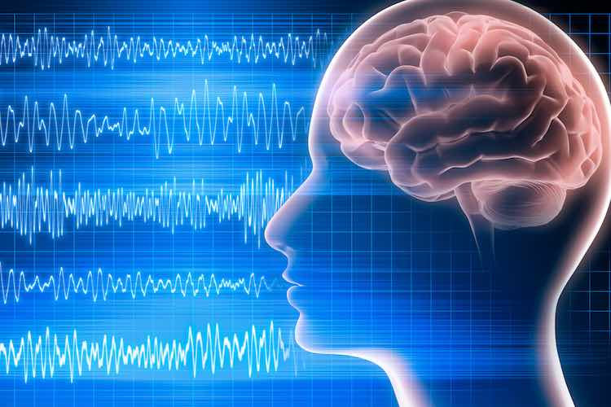
Epileptic Seizure Detection with EEG
Michael Karras,
David R. Cheriton School of Computer Science
Notes:
https://www.mydr.com.au/wp-content/uploads/2019/04/electroencephalogram_eeg.jpg

Slide 2
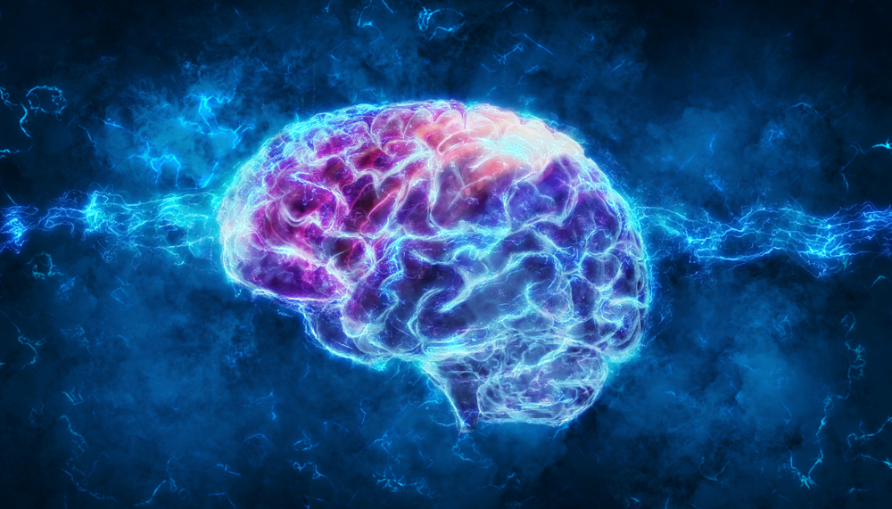
What are seizures?
A seizure is a sudden, uncontrolled electrical disturbance in the brain. It can cause changes in your behavior, movements or feelings, and in levels of consciousness.
Epilepsy is a neurological disorder where multiple unprovoked seizures occur during a person’s lifetime. The cause is mostly unknown.
Epilepsy is the second most common neurological disorder after stroke according to WHO [1] CNN paper
Notes:
https://cdn.mos.cms.futurecdn.net/Dfn655wibhLzV3mZgLQK9m.jpg

Slide 3
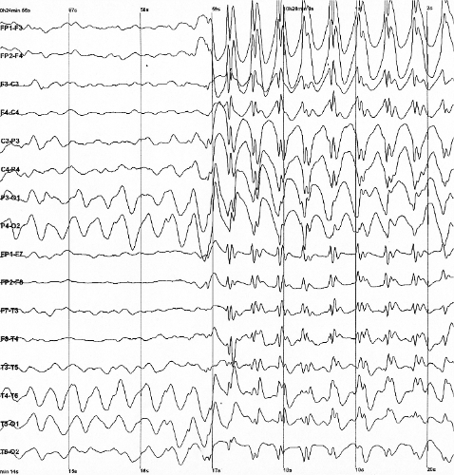
How are Seizures Currently Detected?
Electroencephalography is a way of measuring changes in voltage potential around the scalp using multiple electrodes resulting from ionic currents
The fluctuations of signals over time usually correlate with brain activity
First EEG recording
Typical electrogram
Notes:
Usually administered to check for seizures as a first response since it is fast to conduct
Pictures:
https://upload.wikimedia.org/wikipedia/commons/thumb/7/7e/1st-eeg.png/660px-1st-eeg.png
https://upload.wikimedia.org/wikipedia/commons/2/26/Spike-waves.png

Slide 4
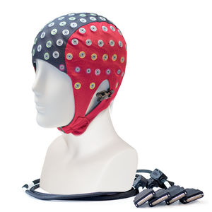
How is EEG recorded?
Electrodes are placed on the scalp in a non-invasive manner
Usually cheap to administer
Some device records the electric potentials across the scalp
Electrodes can range from 22 to 1000!
Notes:
https://img.medicalexpo.com/images_me/photo-m2/84713-17161278.jpg

Slide 5
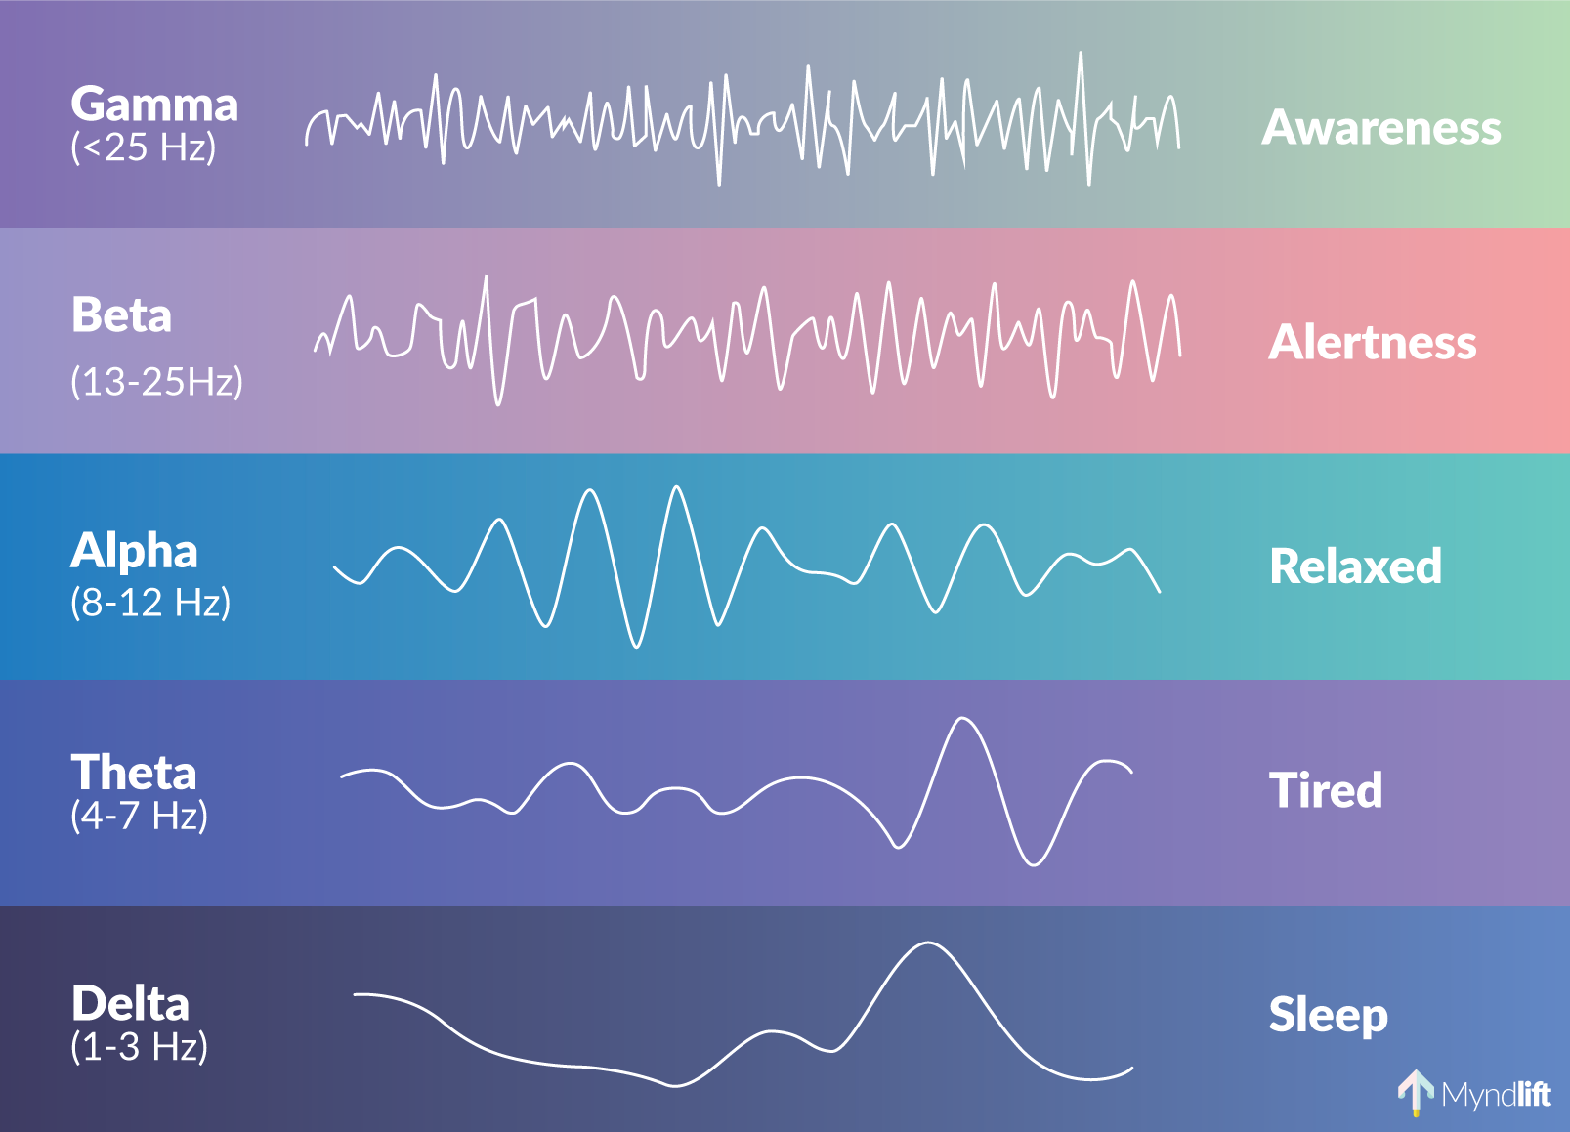
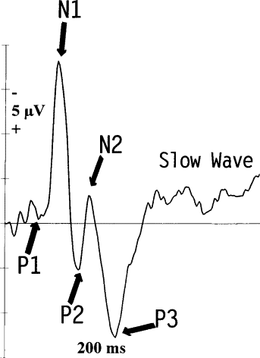
What Can We See in EEG?
Different frequencies in EEG waves are correlated with ongoing mental processes
Event-related potentials are always visible in EEG diagrams
Some artifacts such as eye blinking can appear as well
The location of the electrode matters!
Notes:
Talk about:
Classic brain waves and frequency ranges
ERP (Explain P300)
https://www.sciencedirect.com/book/9780128044902/introduction-to-eeg-and-speech-based-emotion-recognition
https://www.sciencedirect.com/science/article/pii/S016641159880023X

Slide 6
Motivation
Since seizures are electrical disturbances, EEG is usually administered as a first response to check for them [1] CNN
Neurophysiologists have been traditionally trained to study diagrams of EEG with regards to the patient’s history
However, the task is difficult and time consuming
Can we pose as an ML problem?
Need real time diagnosis
Higher accuracy
Time series problems are difficult
Notes:
Well to pose as an ML problem, we need data and models to train on them. Luckily, there is an abundance of data in this domain and multiple attempts have been made. This problem is different because it involved time series with multiple channels as opposed to images. We can think of it as financial data in multiple dimension.
https://specialtycareus.com/wp-content/uploads/Specialtycare-medical-blog-bg-day-life-neurophysiologist-scaled-900x350.jpg

Slide 7
Paper 1: Epileptic Seizure Detection Based on EEG Signals and CNN
Data: CHB-MIT (22 electrodes) and Freiburg dataset (256 electrodes).
Patient-specific
Investigations:
interictal vs preictal (Binary classification)
interictal vs ictal (Binary classification)
interictal vs ictal vs preictal (Three-way classification)
Using time versus frequency inputs to the neural network
Methodology:
Divide the data into 1 second chunks with corresponding labels
For each problem above, train and test the network on only one patient (Patient specific)
Notes:
Benchmark paper that aims to use DL to tackle the problem of seizure detection. Define ictal terms. This paper also experiments with the effectiveness of time and frequency inputs to the network, meaning the spectrogram or fourier transform vs the real waves

Slide 8
Data Collection
CHB-MIT [CHB]
Collected from 22 children (5 males, 17 females).
Recorded using the international 10-20 system of dividing the head.
Sampled at 256Hz.
Total of 432hrs of data.
Dataset is imbalanced since every person spends >= 90% of their life in the inter-ictal zone
These children were removed from their epileptic medication and then their brain waves were monitored and labelled by experts [CHB]
Notes:
This is a benchmark we will be dealing with. From children and data is labelled by experts. It is openly available

Slide 9
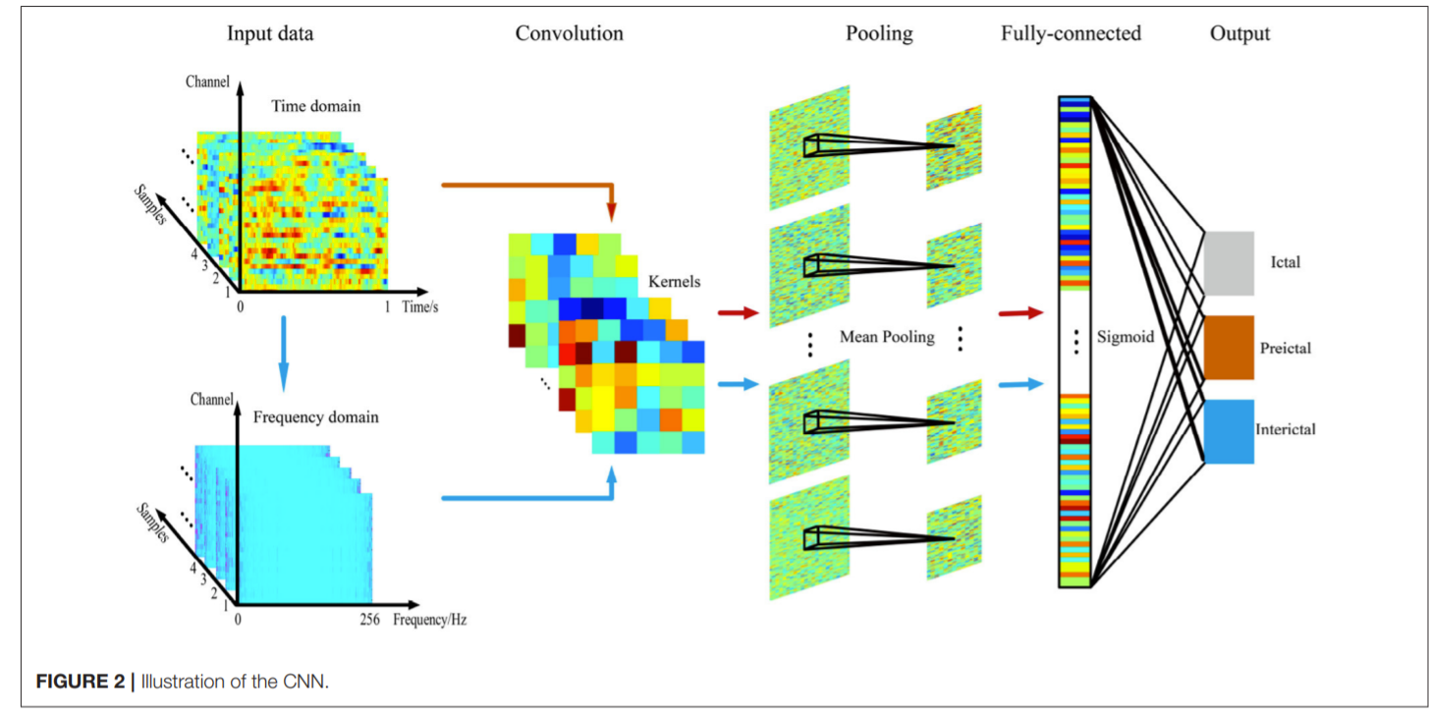
Paper 1: Epileptic Seizure Detection Based on EEG Signals and CNN
Architecture:
2D CNN layer
Max pooling
FCN
Only 3 layers were used to reduce overfitting
Input is in either time or frequency domain

Slide 10
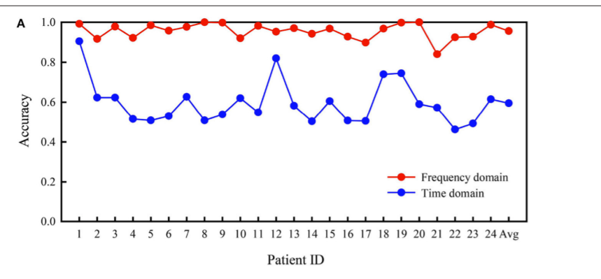
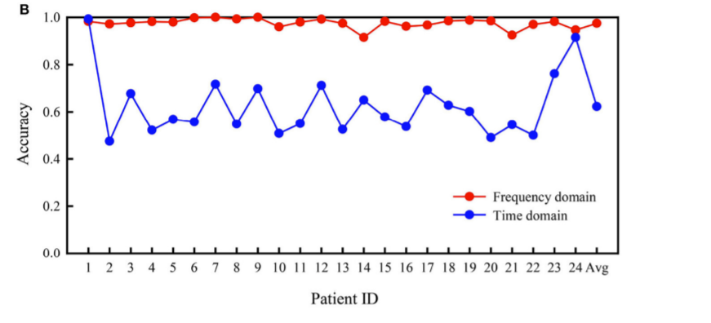
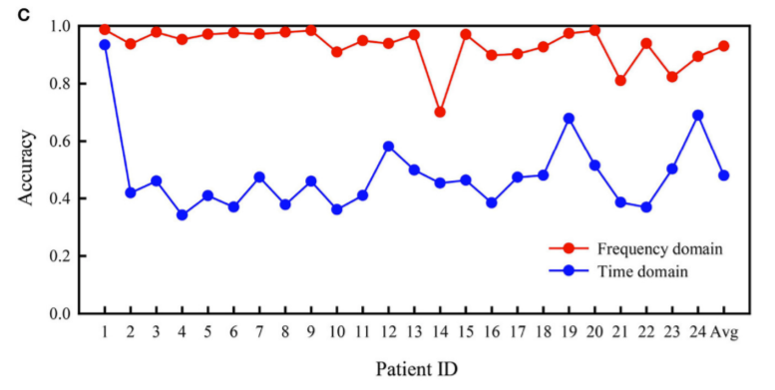
Results
A: interictal vs preictal
B: Interictal vs Ictal
C: Interictal vs preictal vs ictal
Notes:
Overall accuracy in B
Frequency versus time

Slide 11
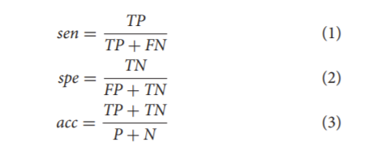
Results
Interictal vs preictal:
Accuracy: 95.6%, 59.5% (frequency, time)
Sensitivity: 94.2%, 61.8%
Specificity: 96.9%, 57.2%
Interictal vs ictal:
Accuracy: 97.5%, 62.3%
Sensitivity: 96.9%, 61.2%
Specificity: 98.1%, 63.3%
Interictal vs. Ictal vs. Preictal:
Accuracy: 93%, 47.9%

Slide 12
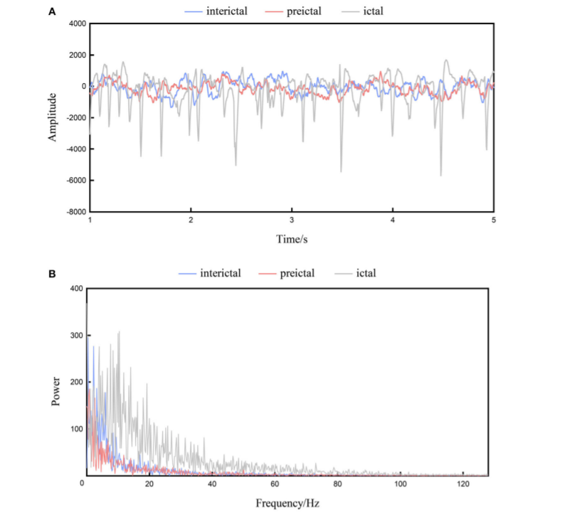
Discussion
Model Size:
Compared with other studies, this model performs as well or slightly better given that they use less parameters. For instance, the model outperformed a 13-layer DNN on the CHB-MIT dataset.
Frequency vs Time:
Frequency outperforms time significantly given this small architecture, perhaps suggesting that more important information is carried in the frequency domain. Could be related to EEG being more temporally accurate
Notes:
Pictures taken from paper

Slide 13
Discussion & Future Problems
Classification Domains:
Model performs best on interictal vs ictal and worst on three-way classification, as expected.
But what about cross-patient seizure detection?

Slide 14
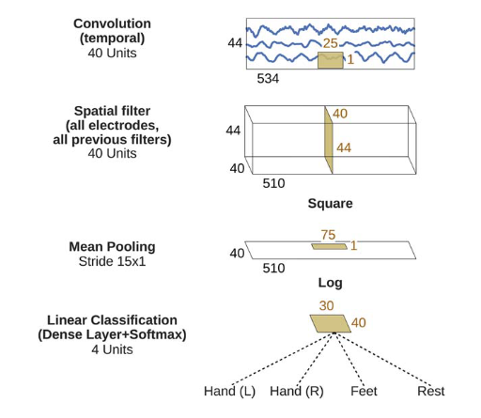
Paper2: An Effective Deep Neural Network Architecture for Cross-Subject Epileptic Seizure Detection in EEG Data
Inspiration: How can we incorporate frequency knowledge inside our neural networks in a more robust manner?
Idea: Use temporal and spatial convolutions via depth-wise convolution
Initially pioneered by EEGnet
EEGnet Architecture [5]
Notes:
The authors purposely used a kernel size of 128 to capture the lowest of frequencies from the signal
Now I have 40 frequency bands, let’s work on them all at the same time for each timestep

Slide 15
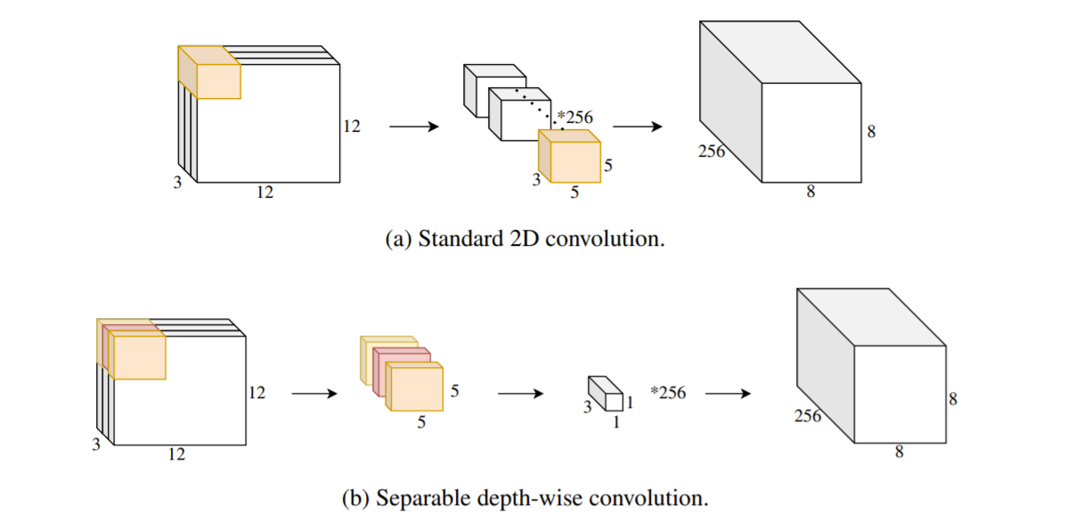
Depth-wise Convolution
Instead of a regular convolution, we use separate kernels for each channel and then stack the results
Use pointwise convolution with kernel size 1x1 to reshape the output
This reduces the needed kernel size from 256*3*5*5 to 5*5*3+3*256
Depth-wise Illustration [2]

Slide 16
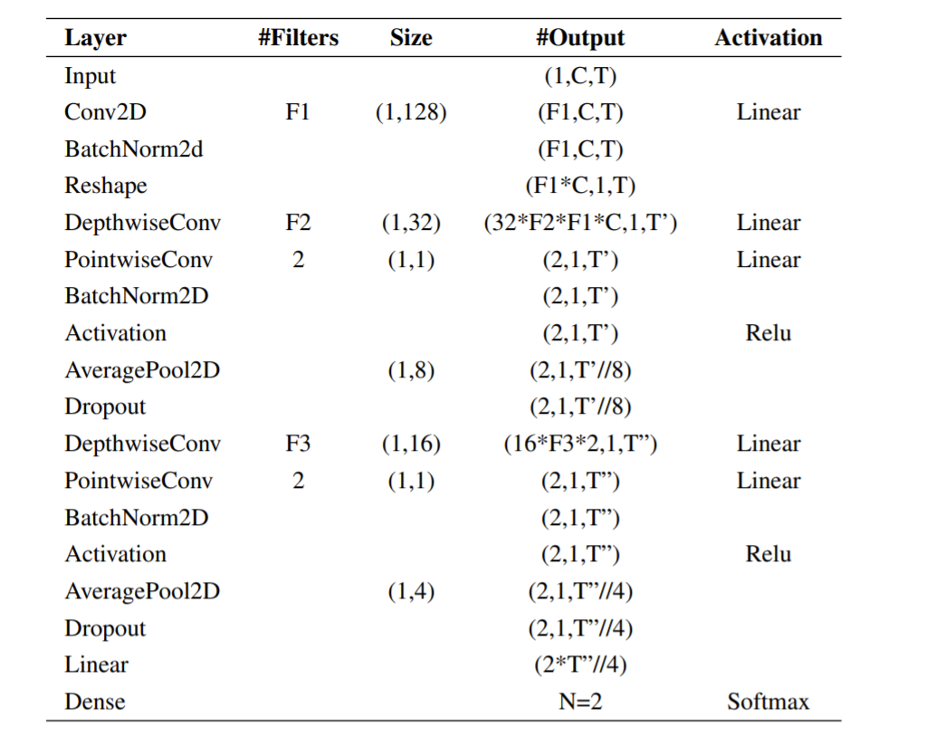
Paper2: An Effective Deep Neural Network Architecture for Cross-Subject Epileptic Seizure Detection in EEG Data
Data was pre-processed and segmented into 5 second chunks
Classification was inter-ictal vs ictal
Architecture:
First convolution with 128 kernel size to pick up frequencies
Second convolution is in the direction of channels to gather spatial data
Then a mix of layers until FCN and SoftMax

Slide 17
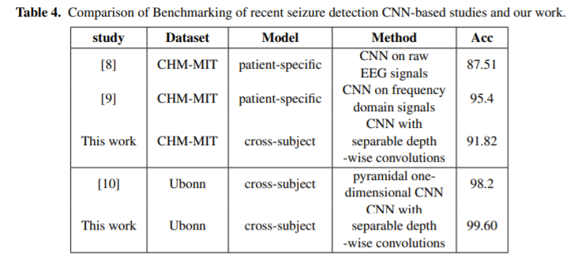
Paper2: An Effective Deep Neural Network Architecture for Cross-Subject Epileptic Seizure Detection in EEG Data
Results:
Competitive accuracy comparing to other methods
Cross-subject studies are relatively rare
The Ubonn dataset records data with 100 electrodes in an intracranial manner

Slide 18
Major Themes
Patient specific vs Cross-patient Methods
Model architecture
Feature extraction: time and frequency

Slide 19
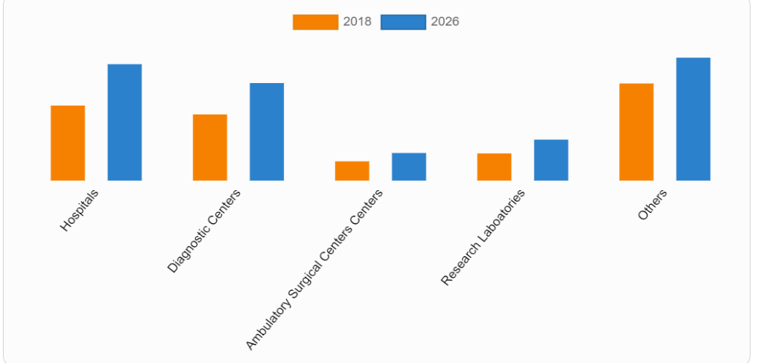
Business Potential
The “wow” factor
The “scared” factor
Muse, a startup from Toronto, raised 30M in funding
Estimated market size of $2 Billion
Hospitals are a huge consumer
Applications:
Monitoring patients in hospitals
Personal wellbeing
Research
Notes:
https://www.alliedmarketresearch.com/EEG-equipment-market#:~:text=The%20electroencephalography%20equipment%20market%20size,electrical%20signals%20of%20the%20brain.
https://neuralink.com/
https://choosemuse.com/

Slide 20
References
[1] Zhou, M., Tian, C., Cao, R., Wang, B., Niu, Y., Hu, T., ... & Xiang, J. (2018). Epileptic seizure detection based on EEG signals and CNN. Frontiers in neuroinformatics, 95.
[2] Jemal, Imene & Mitiche, Amar & Abou-Abbas, Lina & Henni, Khadidja & Mezghani, Neila. (2021). An Effective Deep Neural Network Architecture for Cross-Subject Epileptic Seizure Detection in EEG Data. 10.3233/FAIA210389.
[3] Lawhern, V. J., Solon, A. J., Waytowich, N. R., Gordon, S. M., Hung, C. P., & Lance, B. J. (2018). EEGNet: a compact convolutional neural network for EEG-based brain–computer interfaces. Journal of neural engineering, 15(5), 056013.
[4] Schirrmeister, R. T., Springenberg, J. T., Fiederer, L. D. J., Glasstetter, M., Eggensperger, K., Tangermann, M., ... & Ball, T. (2017). Deep learning with convolutional neural networks for EEG decoding and visualization. Human brain mapping, 38(11), 5391-5420.
[5] https://www.epilepsy.com/article/2014/4/revised-definition-epilepsy
(Pictures are cited in the notes)

