Slide 1
Whole-slide Image (WSI)Analysis
Deep Learning Models
Maryam Yalsavar
March,18, 2022

Slide 2
Recap
Whole-slide Image (WSI)Analysis
Whole-slide Image (WSI)
Deep Learning for Segmentation of WSI
Deep Learning for Classification of WSI
Deep Learning for Detection in WSI
Potential Deep Models for WSI

Slide 3
Whole-slide Image (WSI) Analysis
Whole-slide Image (WSI)
Deep Learning for Segmentation of WSI
Deep Learning for Detection in WSI
Deep Learning for Classification of WSI
Whole-slide Image (WSI)

Slide 4
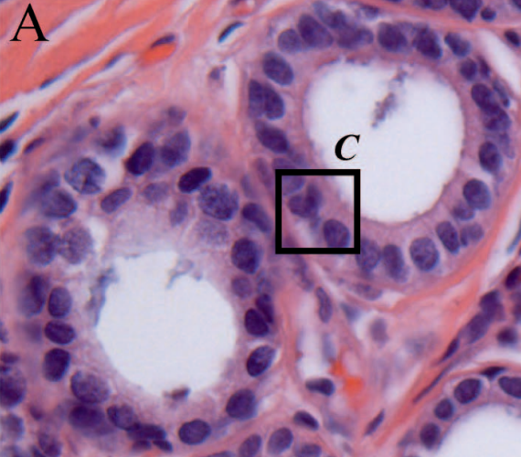
Whole-slide Image (WSI)
Whole-slide Image (WSI)
Deep Learning for Segmentation of WSI
Deep Learning for Detection in WSI
Deep Learning for Classification of WSI
Introduction
They are somehow similar to google maps.

Slide 5
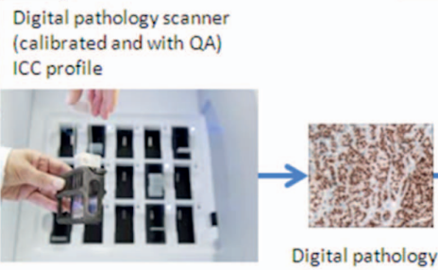
Whole-slide Image (WSI)
Introduction
Challenges
Introduction

Slide 6
Whole-slide Image (WSI)
Introduction
Challenges
Challenges
They are high resolution images (gigapixel resolution).
Background color is different for different devices that make the data different from this aspect.

Slide 7
Whole-slide Image (WSI) Analysis
Whole-slide Image (WSI)
Deep Learning for Segmentation of WSI
Deep Learning for Detection in WSI
Deep Learning for Classification of WSI
Deep Learning for Segmentation of WSI

Slide 8
Deep Learning for Segmentation of WSI
Introduction
Model
Results
Introduction
They developed a method of segmenting DCIS lesions in WSIs using a U-Net architecture
Ductal carcinoma in situ (DCIS) is a non-invasive type of breast cancer with highly variable potential of becoming invasive and affecting mortality.
Noninvasive cancer is a type of cancer that has not spread past the tissue in which it first developed. Several cancers can first appear as noninvasive.

Slide 9
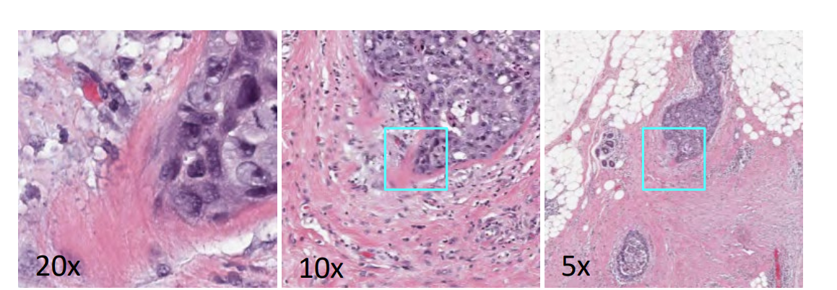
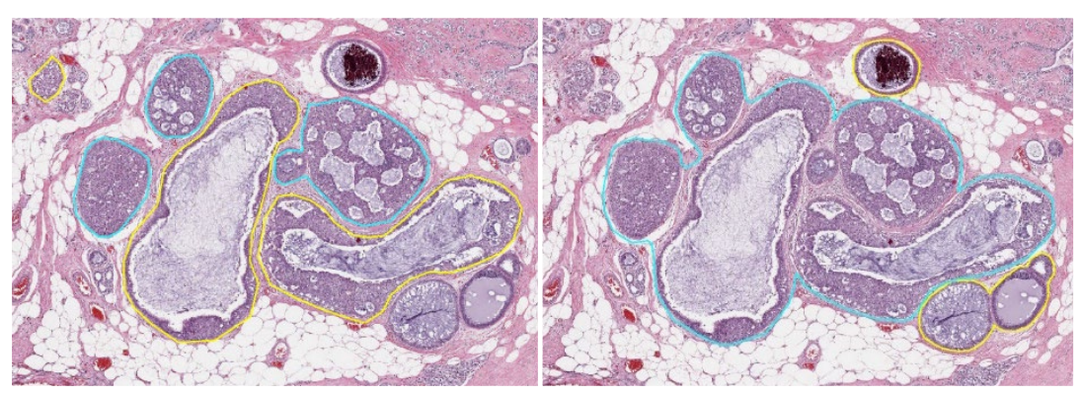
Deep Learning for Segmentation of WSI
Introduction
Model
Results
Introduction

Slide 10
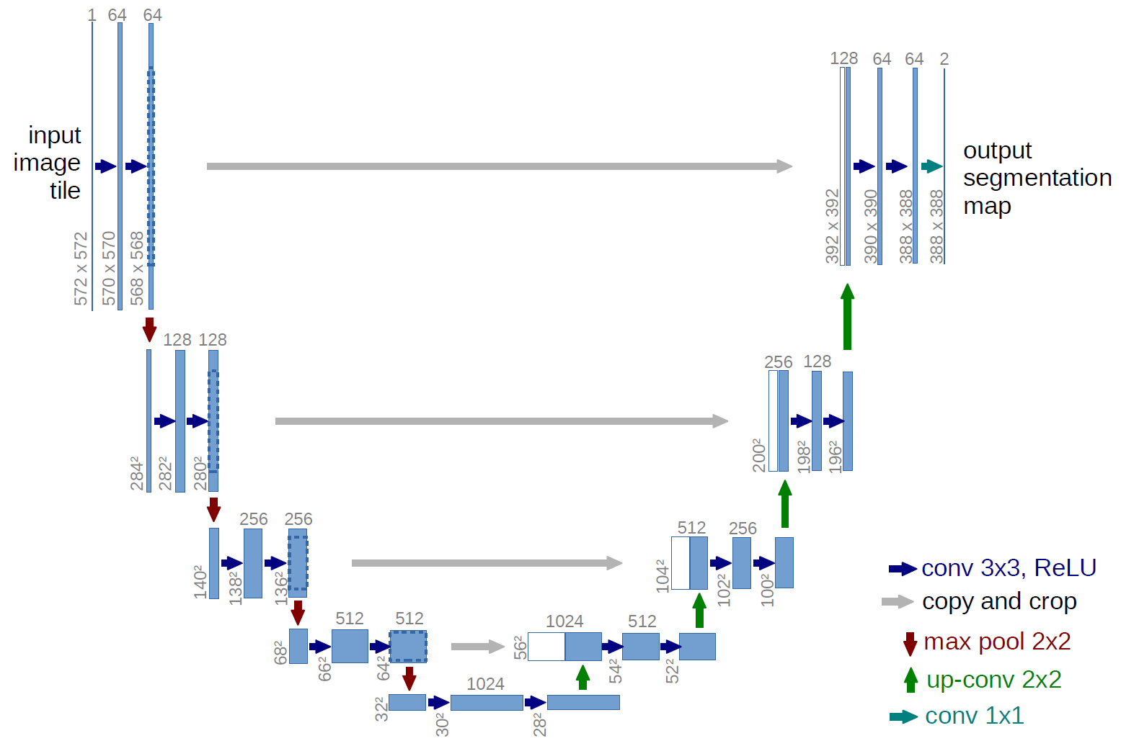
Deep Learning for Segmentation of WSI
Introduction
Model
Results
Model

Slide 11
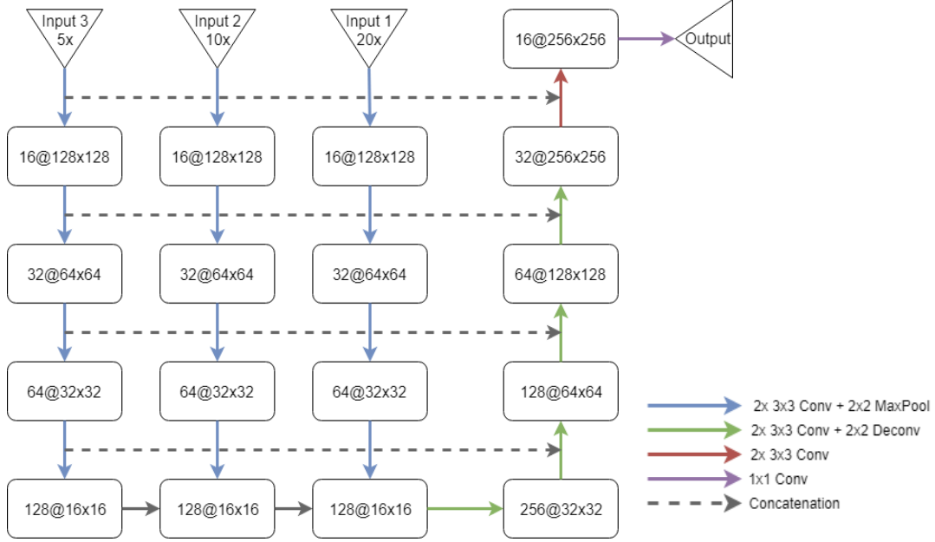
Deep Learning for Segmentation of WSI
Introduction
Model
Results
Model

Slide 12
Deep Learning for Segmentation of WSI
Introduction
Model
Results
Results

Slide 13
Whole-slide Image (WSI) Analysis
Whole-slide Image (WSI)
Deep Learning for Segmentation of WSI
Deep Learning for Detection in WSI
Deep Learning for Classification of WSI
Deep Learning for Detection in WSI

Slide 14
Deep Learning for Detection in WSI
Introduction
Data Set
Extracting Patches
Model
Introduction
They classified normal and tumor slides in histology images of lymph nodes tissue
Their method consists of two stages:
Detect possible tumor locations in the whole slide images
Extracting features to classify the slides into normal or tumorous slides

Slide 15
Deep Learning for Detection in WSI
Introduction
Data Set
Extracting Patches
Model
Data Set
They used Camelyon16 dataset
This dataset has 160 negative and 110 positive whole slide images for training, and 50 positive and 80 negative for testing.
The ground truth for the positive slides is in a form of binary mask image

Slide 16
Deep Learning for Detection in WSI
Introduction
Data Set
Extracting Patches
Model
Extracting Patches
They extracted 40K patches of 64x64x3 from both positive and negative training images equally
The positive patches are extracted from the location marked in the ground truth mask and then they are filtered
For the negative patches, no filtering is used

Slide 17
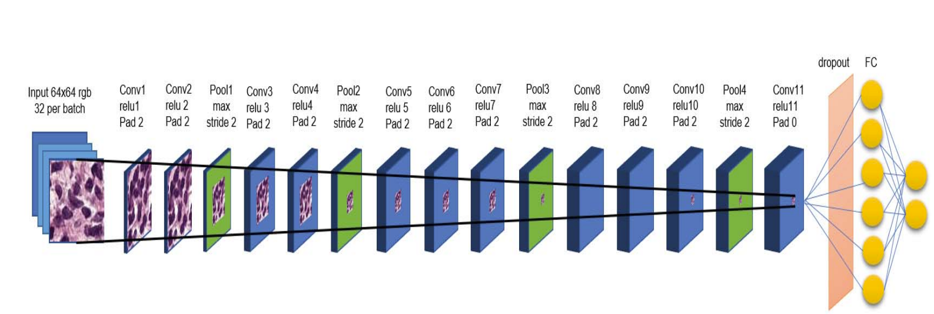
Deep Learning for Detection in WSI
Introduction
Data Set
Extracting Patches
Model
Model

Slide 18
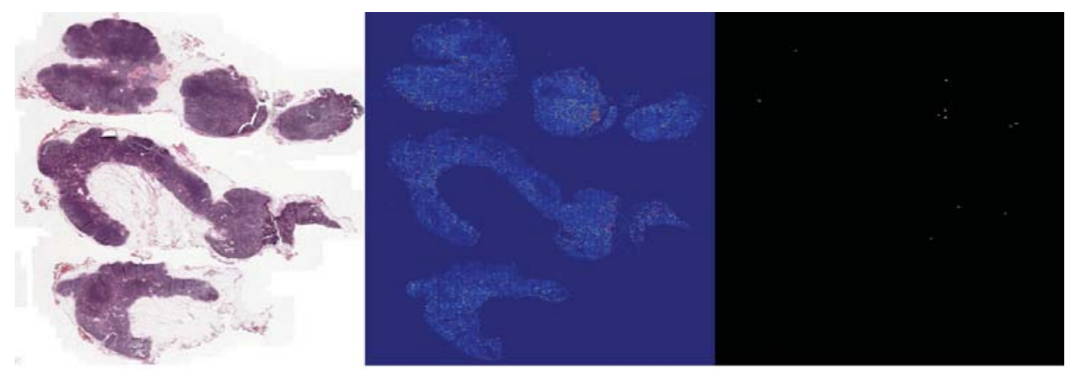
Deep Learning for Detection in WSI
Introduction
Data Set
Extracting Patches
Model
Model

Slide 19
Whole-slide Image (WSI) Analysis
Whole-slide Image (WSI)
Deep Learning for Segmentation of WSI
Deep Learning for Detection in WSI
Deep Learning for Classification of WSI
Deep Learning for Classification of WSI

Slide 20
Deep Learning for Classification of WSI
Introduction
Locating the discriminative patches
Aggregation of patch-level classification results
Results
Introduction
Using a patch level CNN can outperform an image level based one
It is computationally impossible to use image level-based CNN due to high-resolution images there
The addressed challenges in patch level classification: aggregation of patch-level classification results and existence of non discriminative patches

Slide 21
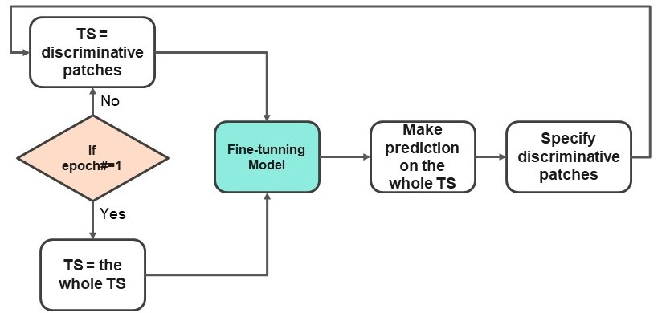
Deep Learning for Classification of WSI
Introduction
Locating the Discriminative Patches
Aggregation of Patch-level Classification Results
Results
Locating the Discriminative Patches

Slide 22
Deep Learning for Classification of WSI
Introduction
Locating the Discriminative Patches
Aggregation of Patch-level Classification Results
Results
Locating the Discriminative Patches
The discriminative patches will have $P(H_{i,j}|X)$ greater than a threshold, $T_{i,j}$.
$P(H_{i,j}|X)$is correlated with $P\left(y_{i} \right|x_{i,j} ; θ)$so patches with a smaller $P\left(y_{i} \right|x_{i,j}$; θ) will have a smaller probability to be considered as discriminative
$$T_{i,j}=\min\left(H_{i},R_{i}\right)$$

Slide 23
Deep Learning for Classification of WSI
Introduction
Locating the Discriminative Patches
Aggregation of Patch-level Classification Results
Results
Locating the Discriminative Patches
$H_{i}$is the P1-th percentile of $S_{i}$, and $R_{i}$ is the P2-th percentile of $E_{c}$
$S_{i}$and $E_{c}$are introduced as the set of $P(H_{i,j} |X)$values for all $x_{i,j}$of the i-th image and the c-th class.

Slide 24
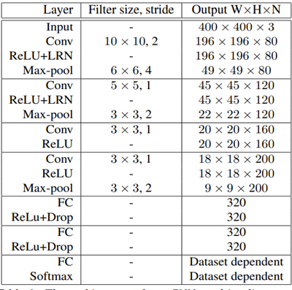
Deep Learning for Classification of WSI
Introduction
Locating the Discriminative Patches
Aggregation of Patch-level Classification Results
Results
Aggregation of Patch-level Classification Results

Slide 25
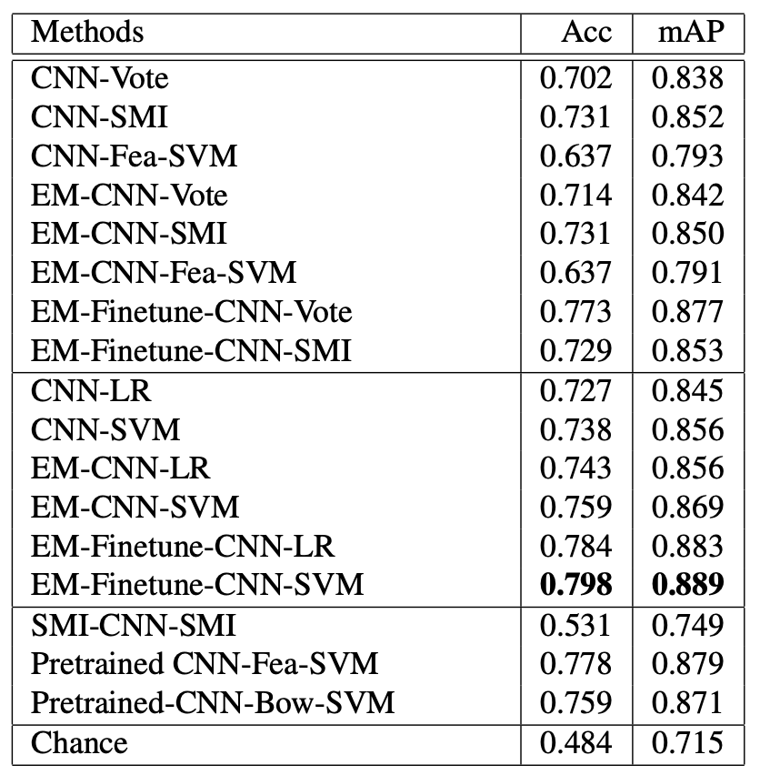
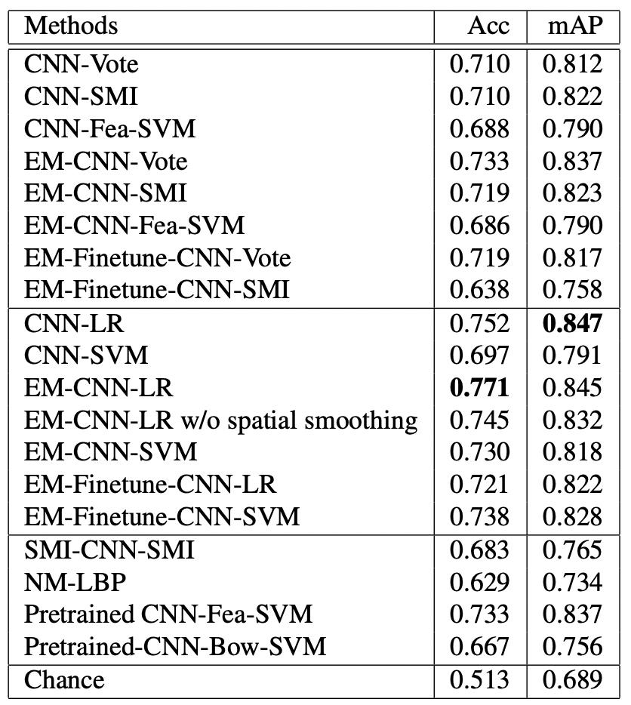
Deep Learning for Classification of WSI
Introduction
Locating the Discriminative Patches
Aggregation of Patch-level Classification Results
Results
Results
NSCLC Classification Results
Glioma Classification Results

Slide 26
Whole-slide Image (WSI) Analysis
Potential Deep Models for WSI
Potential Deep Models for WSI

Slide 27
Potential Deep Models for WSI
Deep Sets
MLP-Mixer
Deep Sets
Each instance $x_{m}$ is transformed (possibly by several layers) into some representation $φ(x_{m})$
The representations $φ(x_{m})$are added up and the output is processed using the $ρ$ network in the same manner as in any deep network

Slide 28
Potential Deep Models for WSI
Deep Sets
MLP-Mixer
Deep Sets

Slide 29
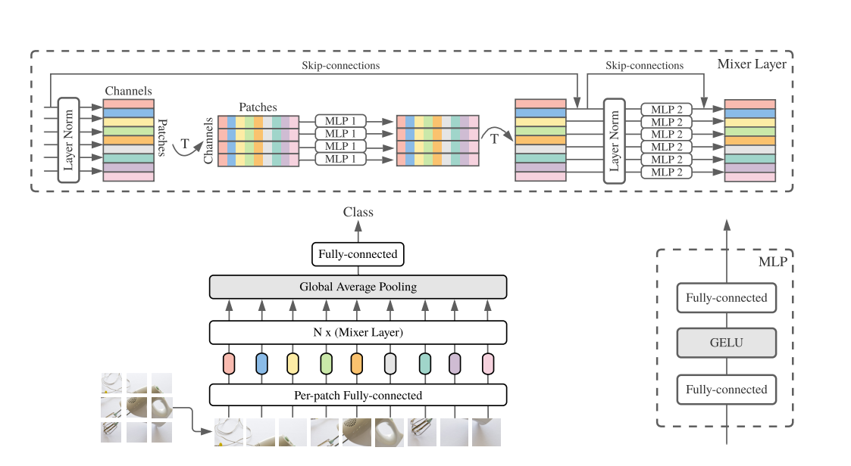
Potential Deep Models for WSI
Deep Sets
MLP-Mixer
MLP-Mixer

Slide 30
Q/A
Thanks for your attention!

Slide 31
References
Zarella MD, Bowman D, Aeffner F, Farahani N, Xthona A, Absar SF, Parwani A, Bui M, Hartman DJ. A Practical Guide to Whole Slide Imaging: A White Paper From the Digital Pathology Association. Arch Pathol Lab Med. 2019 Feb;143(2):222-234. doi: 10.5858/arpa.2018-0343-RA. Epub 2018 Oct 11. PMID: 30307746.
Seth, N., Akbar, S., Nofech-Mozes, S., Salama, S., &amp; Martel, A. L. (2019). Automated segmentation of DCIS in whole slide images. Digital Pathology, 67–74. https://doi.org/10.1007/978-3-030-23937-4_8

Slide 32
References
Hou, L., Samaras, D., Kurc, T. M., Gao, Y., Davis, J. E., &amp; Saltz, J. H. (2016). Patch-based convolutional neural network for whole slide tissue image classification. 2016 IEEE Conference on Computer Vision and Pattern Recognition (CVPR). https://doi.org/10.1109/cvpr.2016.266
M. F. Jamaluddin, M. F. A. Fauzi and F. S. Abas, "Tumor detection and whole slide classification of H&E lymph node images using convolutional neural network," 2017 IEEE International Conference on Signal and Image Processing Applications (ICSIPA), 2017, pp. 90-95, doi: 10.1109/ICSIPA.2017.8120585.

Slide 33
References
Zaheer, Manzil, Satwik Kottur, Siamak Ravanbakhsh, Barnabas Poczos, Russ R Salakhutdinov and Alexander J Smola. 2017. Deep Sets. In Advances in Neural Information Processing Systems, ed. I. Guyon, U. V. Luxburg, S. Bengio, H. Wallach, R. Fergus, S. Vishwanathan and R. Garnett. Vol. 30
Tolstikhin, Ilya, Neil Houlsby, Alexander Kolesnikov, Lucas Beyer, Xiaohua Zhai, Thomas Unterthiner, Jessica Yung, Andreas Steiner, Daniel Keysers, Jakob Uszkoreit, Mario Lucic and Alexey Dosovitskiy. 2021. “MLP-Mixer: An all-MLP Architecture for Vision.”

