Slide 1
Student Presentation: Privacy and Security in Biotech
Presenter: Lucas Fenaux

Slide 2
Overview - Papers
Ensuring privacy and security of genomic data and functionalities
End-to-end privacy preserving deep learning on multi-institutional medical imaging

Slide 3
Privacy & Security of Genomics
Necessary background
Biology
Cryptography
Privacy Attacks on Genomic Data
Secure Techniques for Genomic Data
Notes:
Outline

Slide 4
Background: DNA Sequencing

Slide 5
Background: Genome Risk
Genome characteristics
Unique
Few changes over a lifetime
Non-revocable
Reflects ethnic and relative heritage
Disease predisposition
-> Risks of genome discrimination

Slide 6
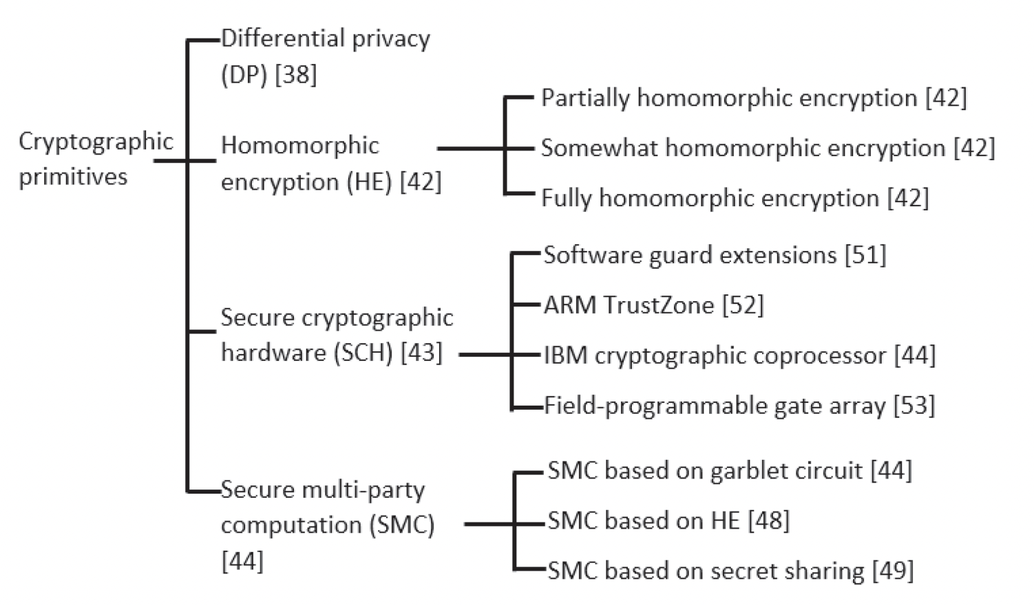
Background: Cryptography

Slide 7
Differential Privacy

Slide 8
Homomorphic Encryption
Source: https://blog.openmined.org/what-is-homomorphic-encryption/

Slide 9
Secure Cryptographic Hardware - SGX
Provides a secure enclave where neither a malicious OS or a malicious VM Manager can compromise the computation
One example: Intel’s SGX
Source: https://chrishicks.io/blog/

Slide 10
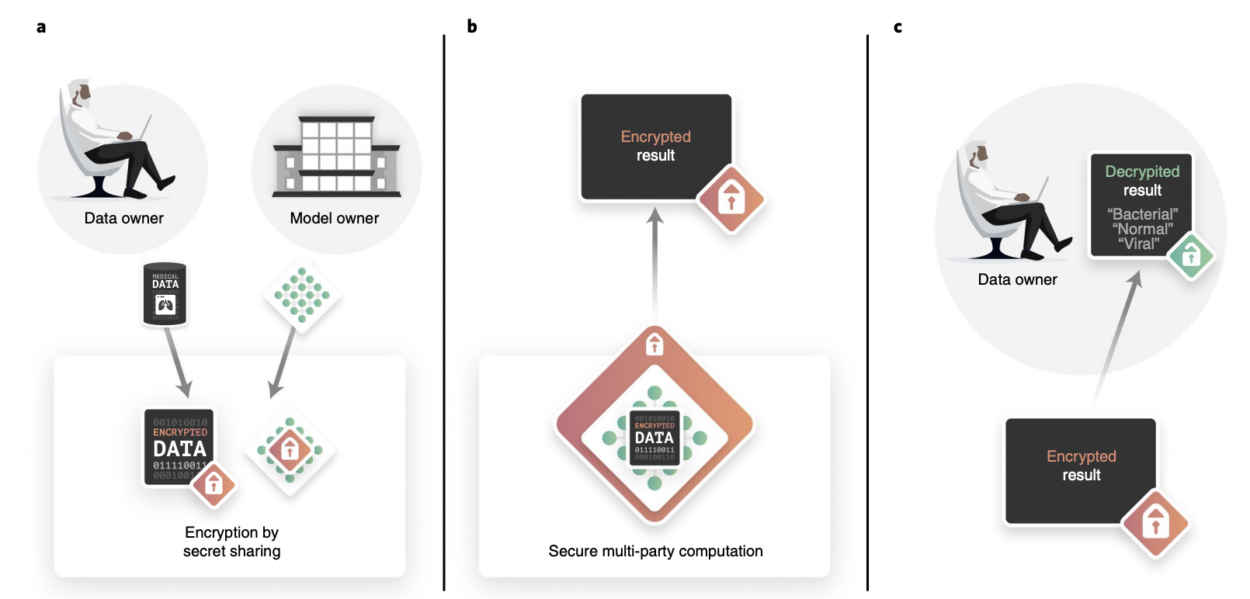
Secure Multi-Party Computation

Slide 11
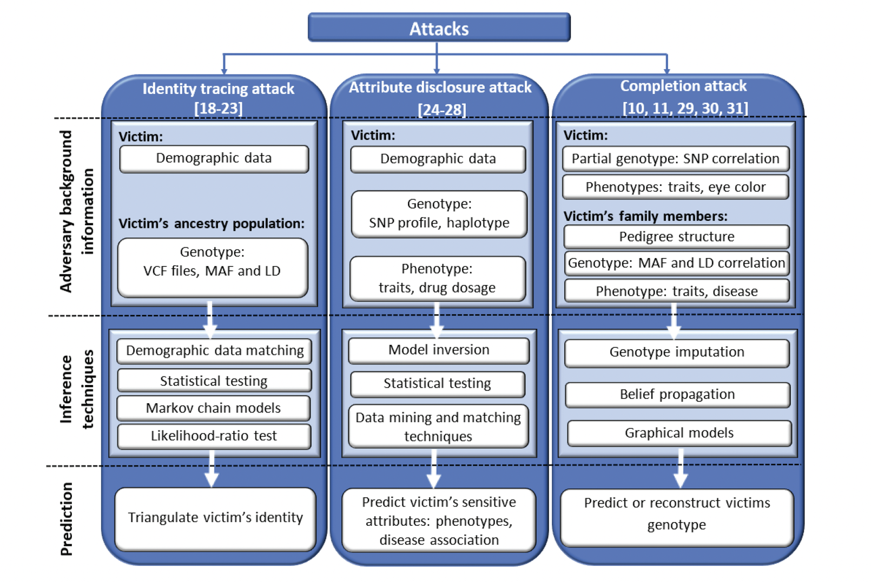
Privacy Attacks on Genomic Data
Identity Tracing
Attribute Disclosure
Completion Attacks

Slide 12
Identity Tracing
Adversary obtains anonymized or de-identified DNA
Identifies the owner using publicly available quasi-identifiers (age, sex, surname, zip-code)
These can be found on social media or public records
Examples:
Personal Genome Project participants re-identified using demographic data
Surname Inference from Y chromosomes acquired from genealogical websites combined with other metadata (age, state,…)

Slide 13
Identity Tracing
Potential Solution? Beacons (web service)
Holds a database of DNA sequences and answers yes or no queries on allele positions
Still insecure and has been attacked

Slide 14
Attribute Disclosure
Predicting sensitive attributes of the victim
Phenotypes
Disease association
Drug abuse
Attacker matches DNA sample with a public genetic study database or a Genome-Wide Association Studies (GWAS)
Takeaway: Statistics don’t hide identity (whole point of differential privacy)

Slide 15
Completion Attacks
Genomic imputation
Reconstruct the victim’s genetic information from partial DNA data or a family member’s DNA sequence using the high correlation of genomic data between family members
Breaches kin privacy
Examples:
Individual’s genome -> reconstructed his relative’s genome with statistical relationships (pairwise correlation)

Slide 16
Secure Techniques for Genomic Data
Choosing the right cryptographic primitive
Genetic testing: disease markers are tested and compared against encrypted genomes
HE for linear computation on encrypted data
SMPC for comparison
DP + SMPC to hide GWAS participants for secure computation of meta-analysis

Slide 17
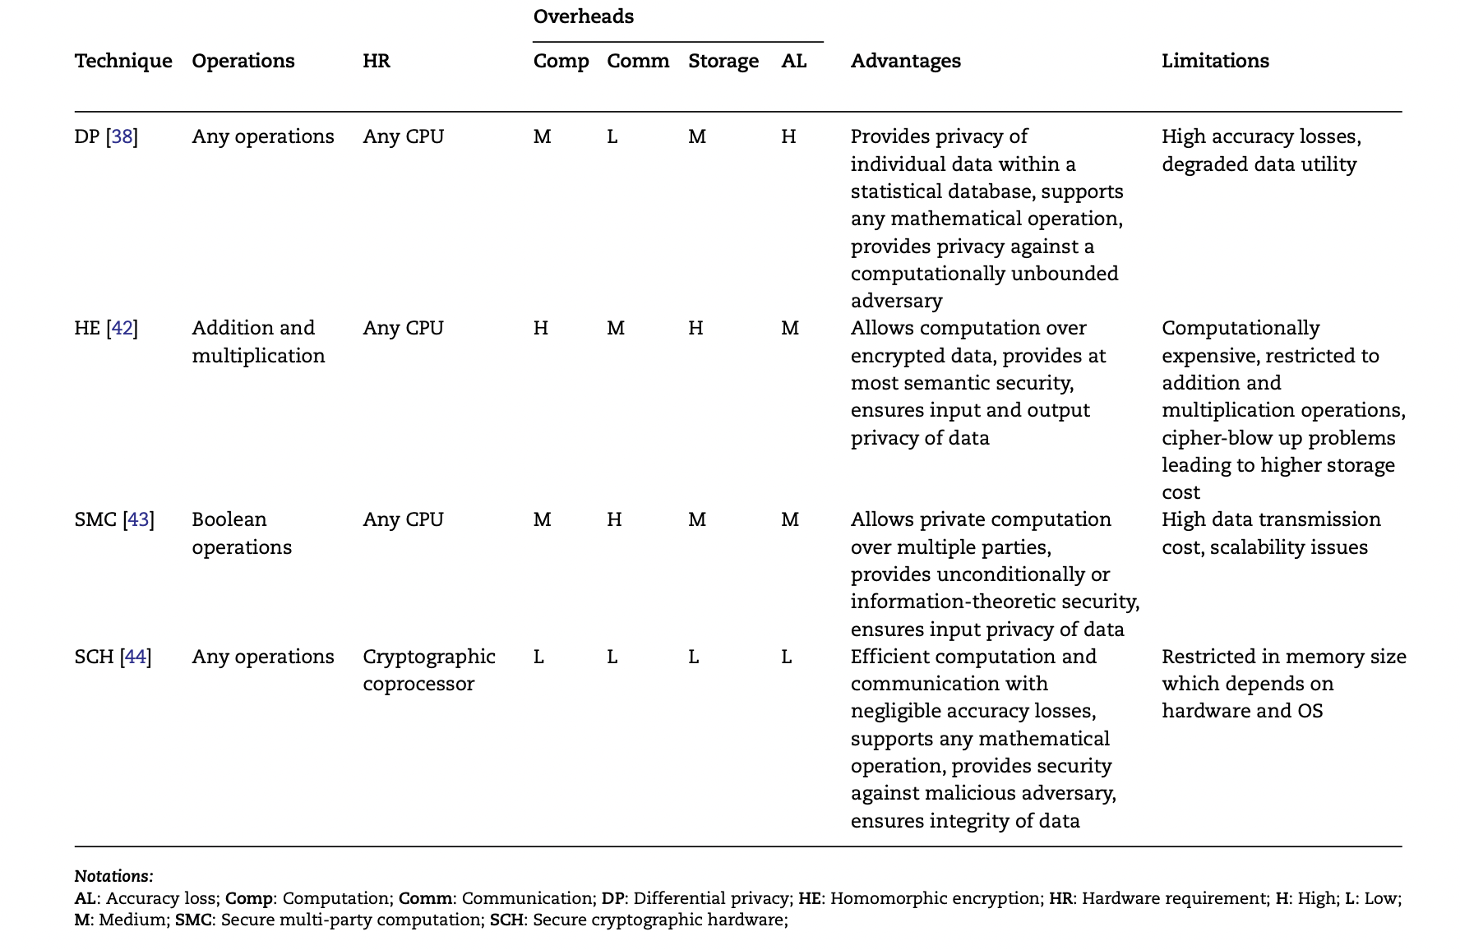

Slide 18
Secure Techniques for Genomic Data
Presented Techniques
Secure genomic aggregation
Secure Genome-Wide Association Studies (GWAS) and statistical analysis
Secure sequence comparison and matching
Secure genetic/genomic testing

Slide 19
Secure genomic aggregation
Aggregate operations (SNP or allele counts, frequencies…) are building blocks for genomic analysis
Used in: GWAS, disease susceptibility tests and paternity tests
Initially solved using HE
Slow, high computational cost & high storage cost
Improved using a secure cryptographic coprocessor (SCP)
Memory and computational power limitations
Can improve efficiency by sacrificing security and only partially encrypting the database

Slide 20
GWAS
GWAS: A Genome-wide association study is an approach used in genetics research to associate specific genetic variations with particular diseases.
Requires the genome from many different people to identify genetic markers
Disease susceptibility
Diabetes, cancer, …

Slide 21
Secure GWAS and Statistical analysis
Secure GWAS can be achieved with the use of DP
Requires the addition of DP-noise -> Lower utility but computationally achievable
Other solutions like performing principal component analysis (PCA) using SMPC paired with HE or Garbled-Circuits (GC) theoretically works
Impractical: would either take 30 years (HE) or 190PB of communication (GC) to run

Slide 22
Secure sequence comparison and matching
Well-know Dynamic Programming sequence comparison algorithms have been securely implemented
E.g.: Smith-Waterman alg. Implemented using SMPC
Computationally costly, especially for full genomes
Another study used the fact that 99.5% of the human genome is similar (and therefore not sensitive)
Only need to secure the 0.5% left
Risk of collusion when multiple third-party servers are involved

Slide 23
Secure genetic/genomic testing
Genetic testing is the examination of variations in chromosomes, genes and proteins between an individual’s genome and some biomarkers to determine certain disease risk, parentage, genealogy, etc.
At the individual level compared to GWAS which are aggregate
Securely implemented:
Disease susceptibility test
identity, paternity, genealogical tests
compatibility test (hereditary diseases)

Slide 24
Open Issues & Challenges
Gap between current approaches and their applicability
Possible in theory, practically impossible due to computation/communication requirements
Tradeoff between security and efficiency
Faster protocols usually have weaker security guarantees
Accuracy loss
E.g. Certain protocols don’t work with floating-point inputs. They need rings/fields elements -> precision loss, can lead to accuracy loss
DP offers relatively low computation/communication costs, at the cost off either security or accuracy loss

Slide 25
Conclusion & Future Work
Secure genetic/genomic analysis is still in its infancy
Many secure protocols are yet to be used/tailored to genetic/genomic analysis
Additive secret-sharing for SMPC
Would help with computational & communication costs
Advances can lead to improved personalized medicine
Loads of data required to improve personalized medicine methods
Better security -> people are more inclined to share their data -> increased data availability
More data -> improvements in ML model training

Slide 26
End-to-end privacy preserving deep learning on multi-institutional medical imaging
Multiple hospitals hold x-ray data of patients
They want to train a ML model together, but they do not want to share their data
They are all honest-but-curious (semi-honest)
The authors present PriMIA to solve this problem

Slide 27
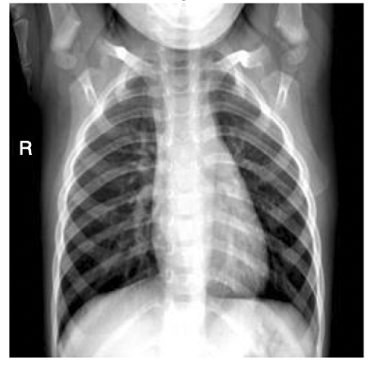
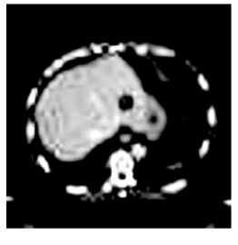
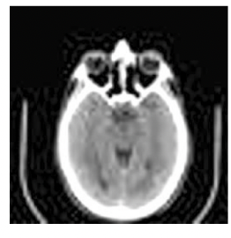
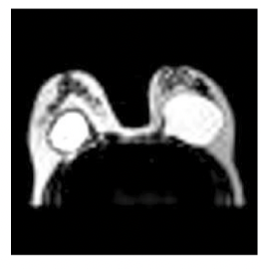
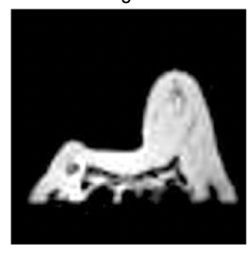
Data
X-ray image data

Slide 28
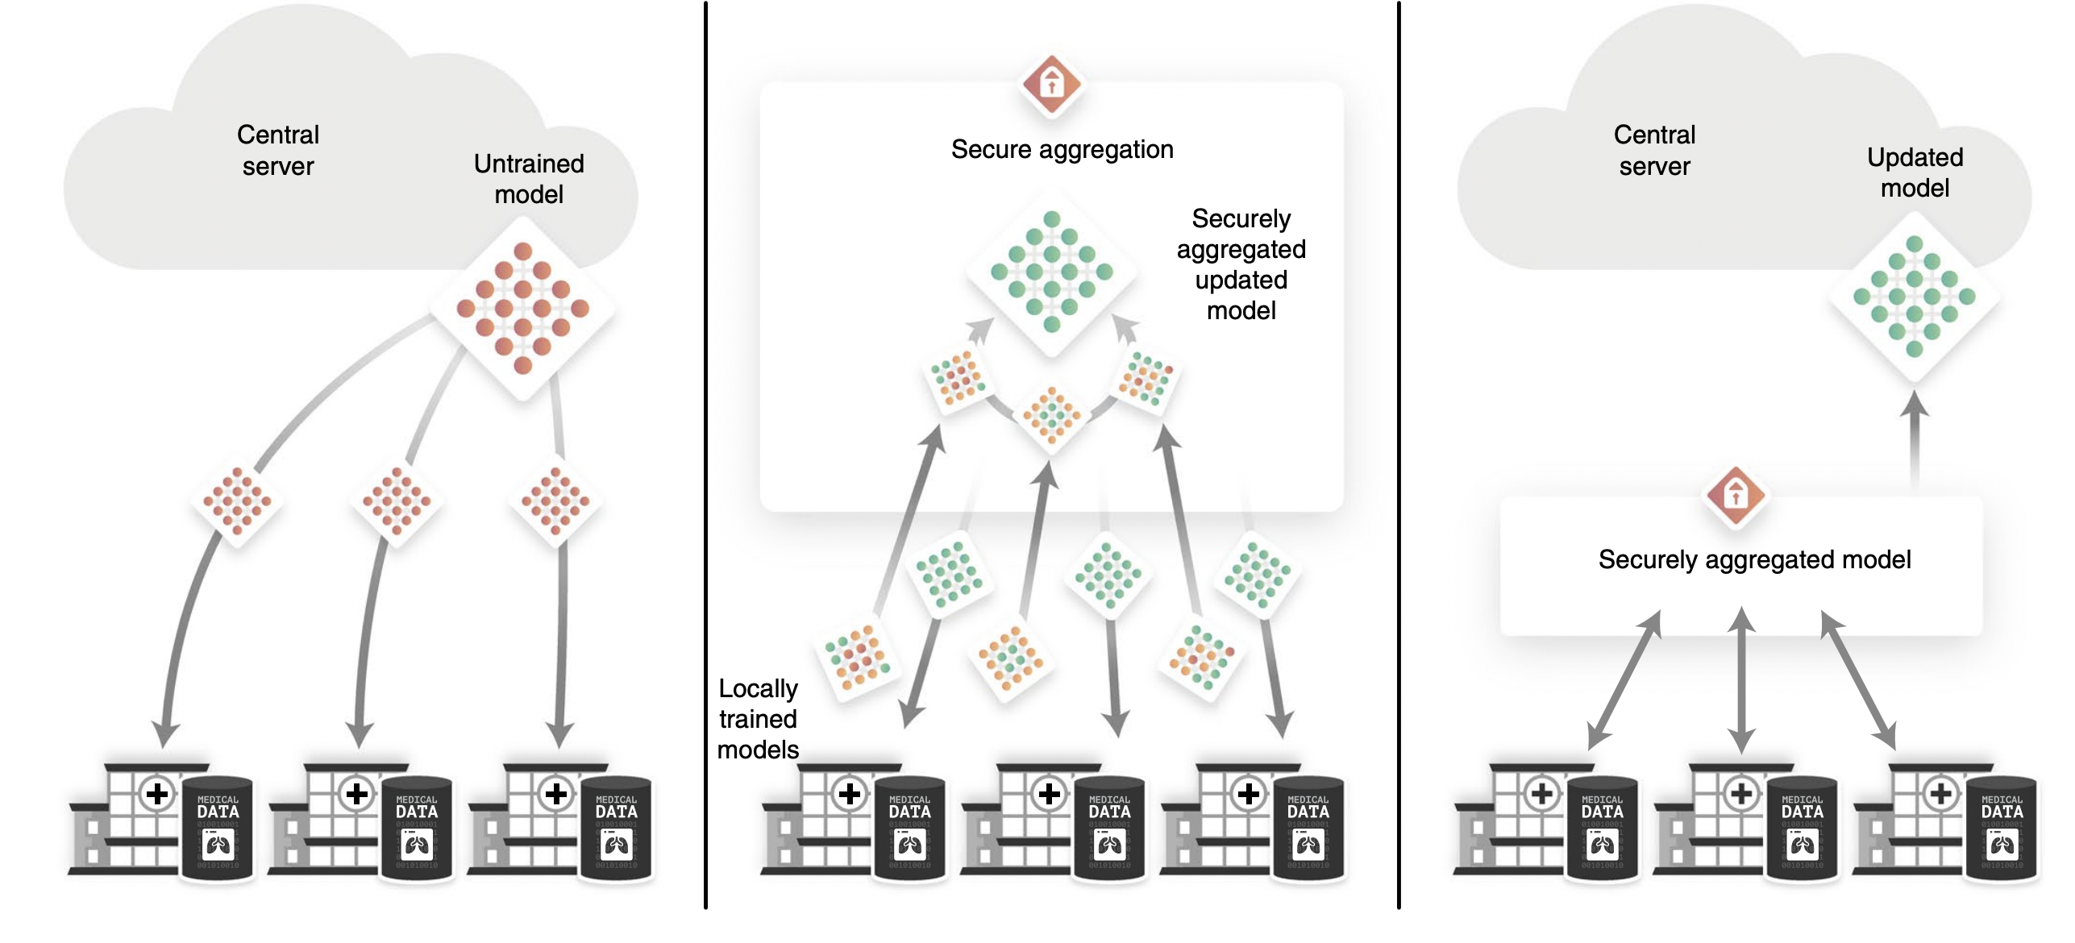
Background: Federated Learning

Slide 29
Problems
As we saw in the previous paper, anonymization is not enough:
Re-identification attacks
It can be hard to update anonymized data with new information
A patient with follow-up X-rays once the injury is healed
Gradient-based model inversion attack
Gradient-based privacy attacks
Aggregator reconstructs inputs from the provided gradients

Slide 30
Defence Techniques used by PriMIA
DP
Adding DP-noise to the gradient updates
SMPC
Secure training with SecAgg
Only the aggregated gradient is shared with the central server
Secure inference (once the model is trained)
Notes:
Cover whatever background that was not covered in the background of the previous paper that is required for this paper

Slide 31
Experiments
They tested the model accuracy when trained under multiple configurations
Key Takeaway: very small accuracy and other metric drop
Notes:
Cover whatever background that was not covered in the background of the previous paper that is required for this paper

Slide 32
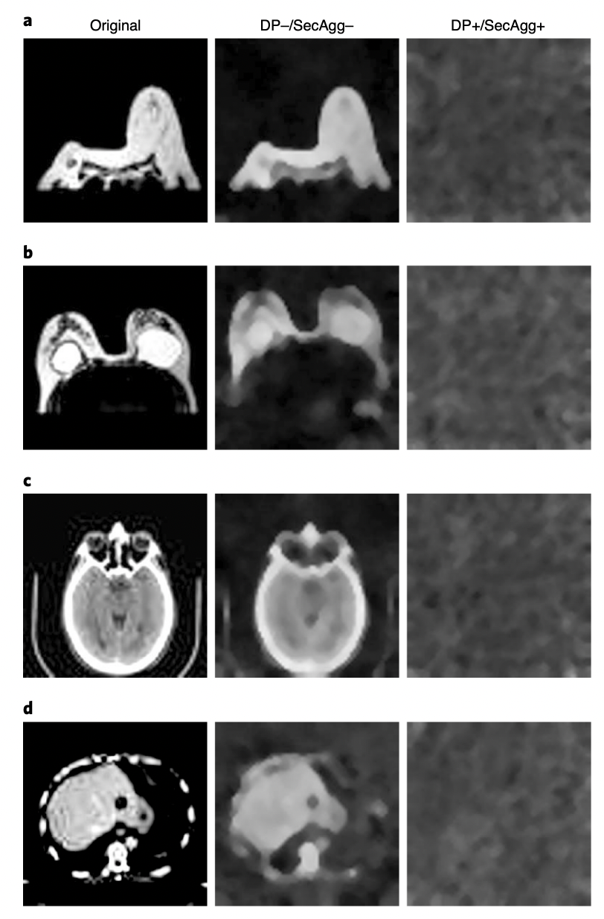
Attack Showcase
Gradient-based attacks thwarted by PriMIA
Notes:
Cover whatever background that was not covered in the background of the previous paper that is required for this paper

Slide 33
Downsides of PriMIA
Still relatively slow
Requires large $ϵ$ values for DP to retain enough utility to obtain good accuracy
They use an $ϵ$ value of 6
Less than 1 would be usually expected for real-world deployments
Notes:
Cover whatever background that was not covered in the background of the previous paper that is required for this paper

Slide 34
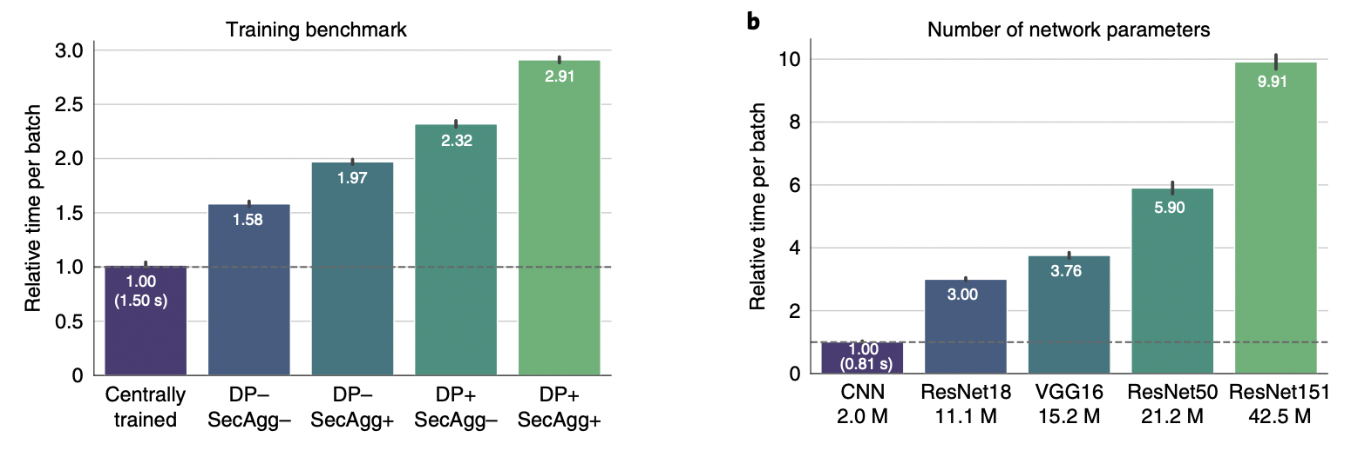
Training and Inference Benchmarking

Slide 35
Thank you

