Slide 1
Jan. 21, 2022
CS 886 Deep Learning for Biotechnology
Ming Li

Slide 2
01. Word2Vec
02. Attention / Transformers
CONTENT
03. Pretraining: GPT / BERT
04. Deep learning applications in proteomics
05. Student presentations begin

Slide 3
Pretraining: GPT-2 and BERT
03
LECTURE THREE

Slide 4
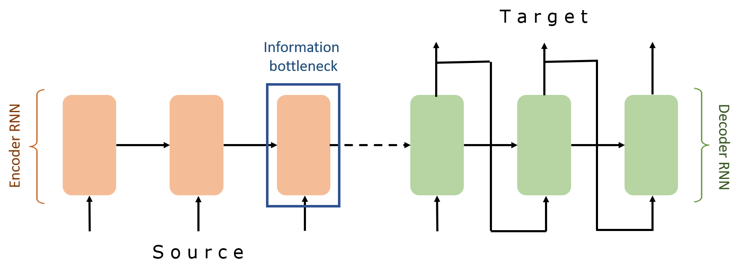
03
GPT-2, BERT
Avoiding Information bottleneck

Slide 5
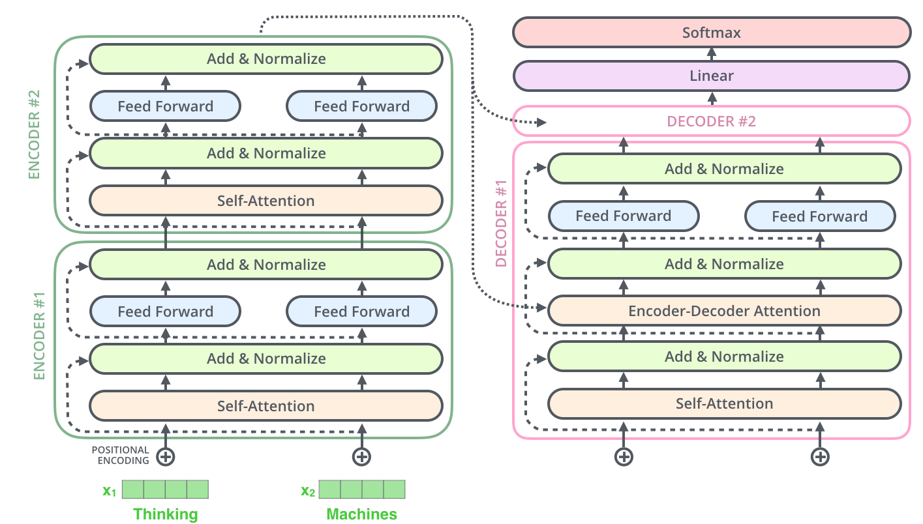
Last time we introduced transformer
03
GPT-2, BERT

Slide 6
03
GPT-2, BERT
Transformers, GPT-2, and BERT
A transformer uses Encoder stack to model input, and uses Decoder stack to model output (using input information from encoder side).
But if we do not have input, we just want to model the “next word”, we can get rid of the Encoder side of a transformer and output “next word” one by one. This gives us GPT.
If we are only interested in training a language model for the input for some other tasks, then we do not need the Decoder of the transformer, that gives us BERT.

Slide 7
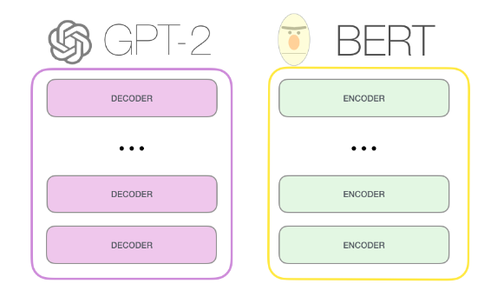
03
GPT-2, BERT

Slide 8
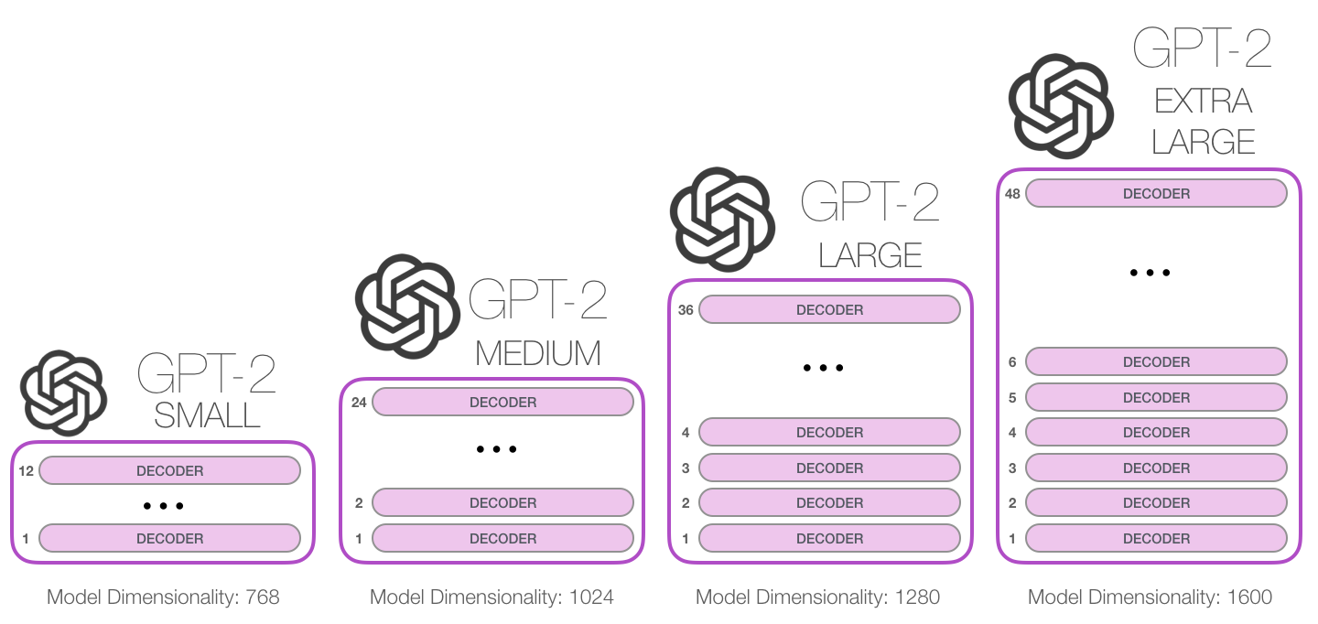
GPT-2, BERT
03
GPT released June 2018
GPT-2 released Nov. 2019 with 1.5B parameters
GPT-3: 175B parameters trained on 45TB texts
117M parameters
345M
762M
1542M

Slide 9
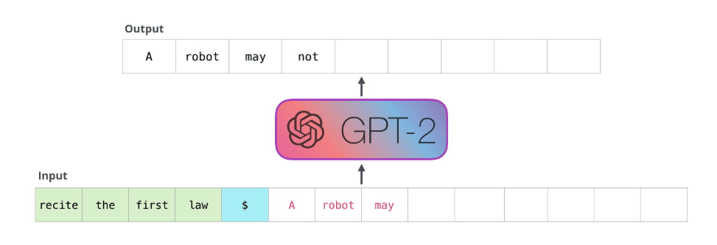
03
GPT-2, BERT
GPT-2 in action
injure
a
human
being
not
injure
a
human
being

Slide 10
03
GPT-2, BERT
Byte Pair Encoding (BPE)
Word embedding sometimes is too high level, pure character embedding too low level. For example, if we have learned
old older oldest
We might also wish the computer to infer
smart smarter smartest
But at the whole word level, this might not be so direct. Thus the idea is to break the words up into pieces like er, est, and embed frequent fragments of words.
GPT adapts this BPE scheme.

Slide 11
03
GPT-2, BERT
Byte Pair Encoding (BPE)
GPT uses BPE scheme. The subwords are calculated by:
Split word to sequence of characters (add </w> char)
Joining the highest frequency pattern.
Keep doing step 2, until it hits the pre-defined maximum number of sub-words or iterations.
Example (5, 2, 6, 3 are number of occurrences)
{‘l o w </w>’: 5, ‘l o w e r </w>’: 2, ‘n e w e s t </w>’: 6, ‘w i d e s t </w>’: 3 }
{‘l o w </w>’: 5, ‘l o w e r </w>’: 2, ‘n e w es t </w>’: 6, ‘w i d es t </w>’: 3 }
{‘l o w </w>’: 5, ‘l o w e r </w>’: 2, ‘n e w est </w>’: 6, ‘w i d est </w>’: 3 } (est freq. 9)
{‘lo w </w>’: 5, ‘lo w e r </w>’: 2, ‘n e w est</w>’: 6, ‘w i d est</w>’: 3 } (lo freq 7)
…..

Slide 12
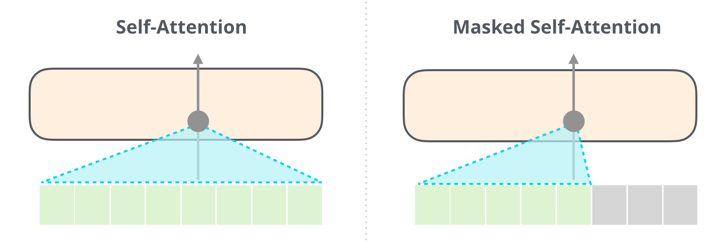
03
GPT-2, BERT
Masked Self-Attention (to compute more efficiently)

Slide 13
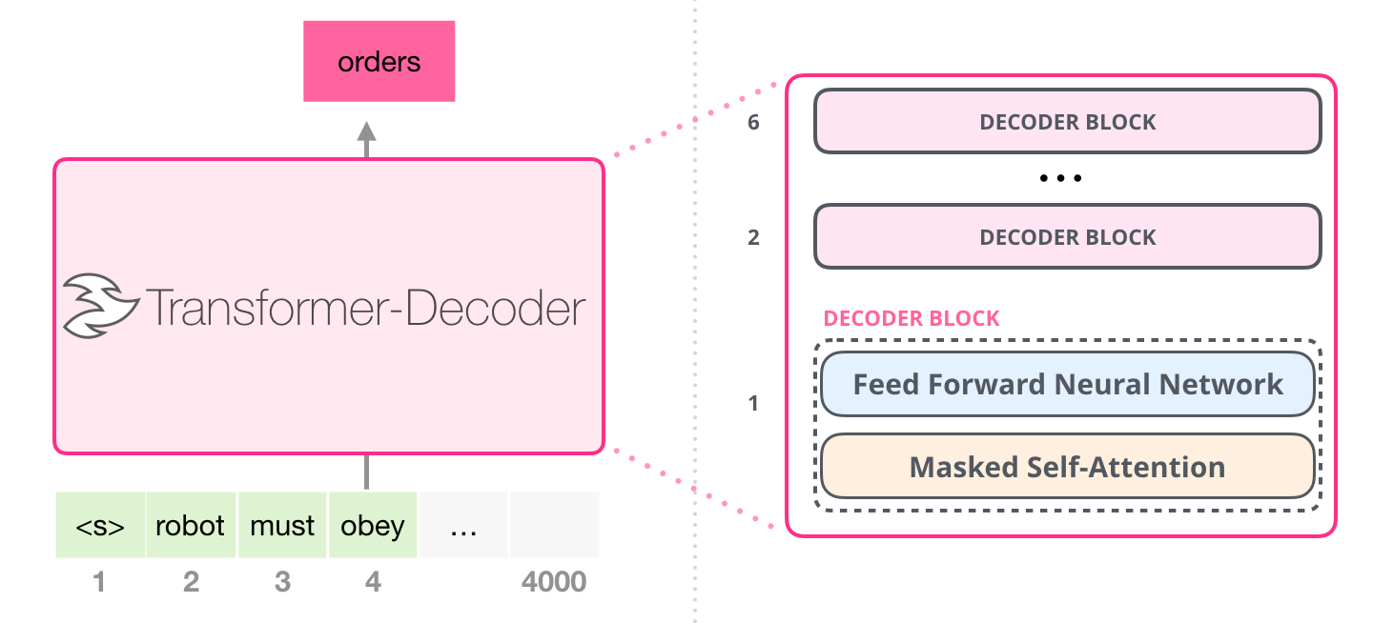
03
GPT-2, BERT
Masked Self-Attention
Note: encoder-decoder attention block is gone

Slide 14
03
GPT-2, BERT
Masked Self-Attention Calculation
Re-use previous computation results: at any step, only need to results of q, k , v related to the new output word, no need to re-compute the others. Additional computation is linear, instead of quadratic.
Note: encoder-decoder attention block is gone

Slide 15
03
GPT-2, BERT
GPT-2 fully connected network has two layers (Example for GPT-2 small)
768 is small model size

Slide 16
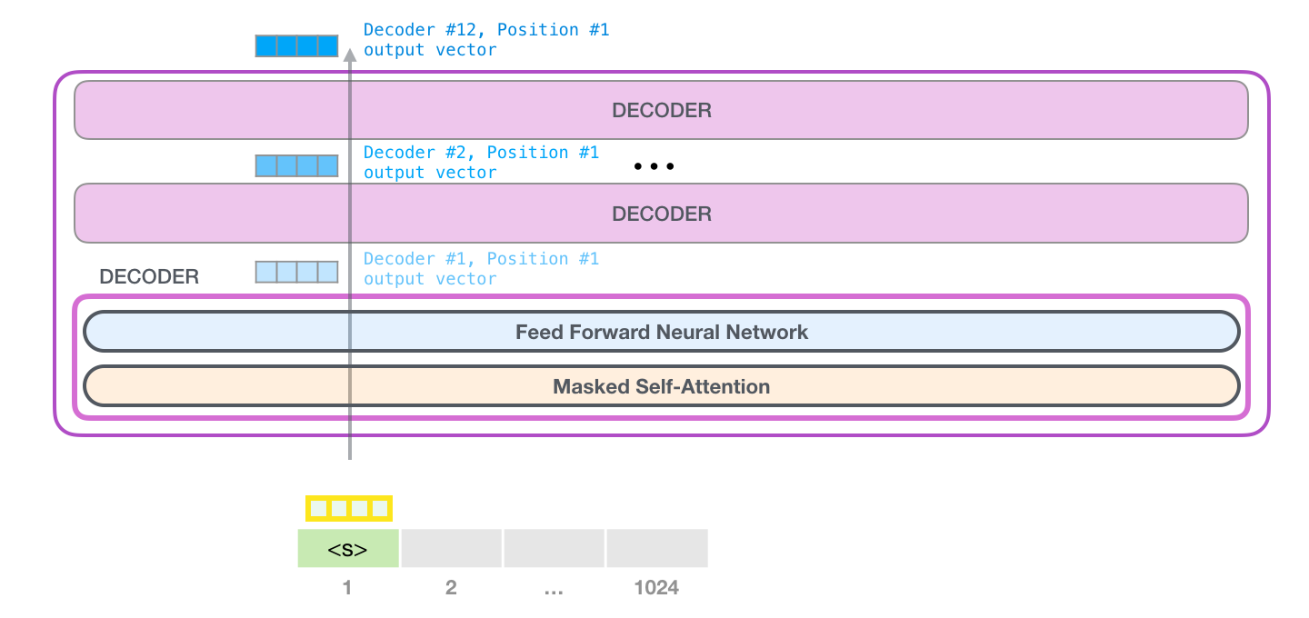
03
GPT-2, BERT
GPT-2 has a parameter top-k, so that we sample words from top k (highest probability from softmax) words for each output

Slide 17
03
GPT-2, BERT
This top-k parameter, if k=1, we would have output like:
The first time I saw the new version of the game, I was so excited. I was so excited to see the new version of the game, I was so excited to see the new version of the game, I was so excited to see the new version of the game, I was so excited to see the new version of the game, I was so excited to see the new version of the game, I was so excited to see the new version of the game, I was so excited to see the new version of the game, I was so excited to see the new version of the game, I was so excited to see the new version of the game, I was so excited to see the new version of the game, I was so excited to see the new version of the game, I was so excited to see the new version of the game, I was so excited to see the new version of the game, I was so excited to see the new version of the game, I was so excited to see the new version of the game, I was so excited to see the new version of the game,

Slide 18
03
GPT-2, BERT
GPT Training
GPT-2 uses unsupervised learning approach to training the language model.
There is no custom training for GPT-2, no separation of pre-training and fine-tuning like BERT.

Slide 19
03
GPT-2, BERT
A story generated by GPT-2
“The scientist named the population, after their distinctive horn, Ovid’s Unicorn. These four-horned, silver-white unicorns were previously unknown to science.
Now, after almost two centuries, the mystery of what sparked this odd phenomenon is finally solved.
Dr. Jorge Pérez, an evolutionary biologist from the University of La Paz, and several companions, were exploring the Andes Mountains when they found a small valley, with no other animals or humans. Pérez noticed that the valley had what appeared to be a natural fountain, surrounded by two peaks of rock and silver snow.
Pérez and the others then ventured further into the valley. `By the time we reached the top of one peak, the water looked blue, with some crystals on top,’ said Pérez.
Pérez and his friends were astonished to see the unicorn herd. These creatures could be seen from the air without having to move too much to see them – they were so close they could touch their horns."

Slide 20
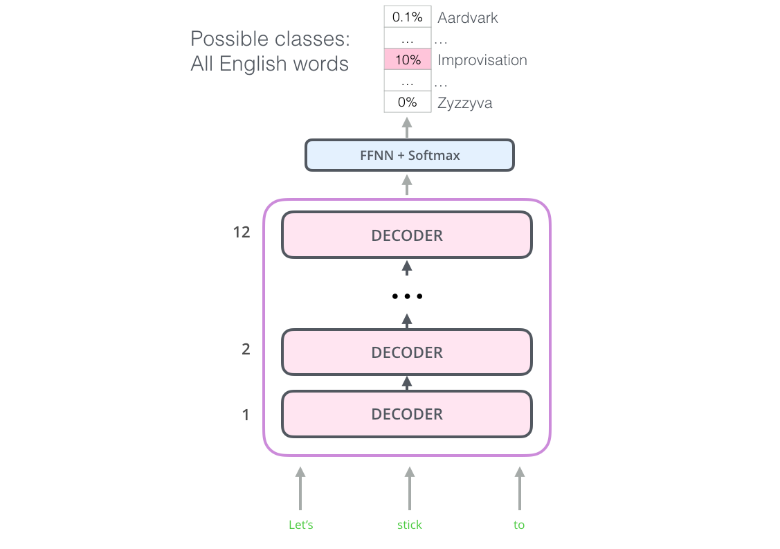
Transformer / GPT prediction
03
GPT-2, BERT

Slide 21
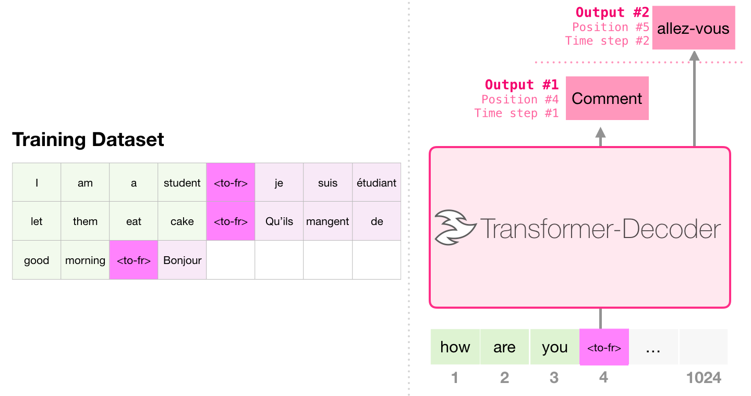
03
GPT-2, BERT
GPT-2 Application: Translation

Slide 22
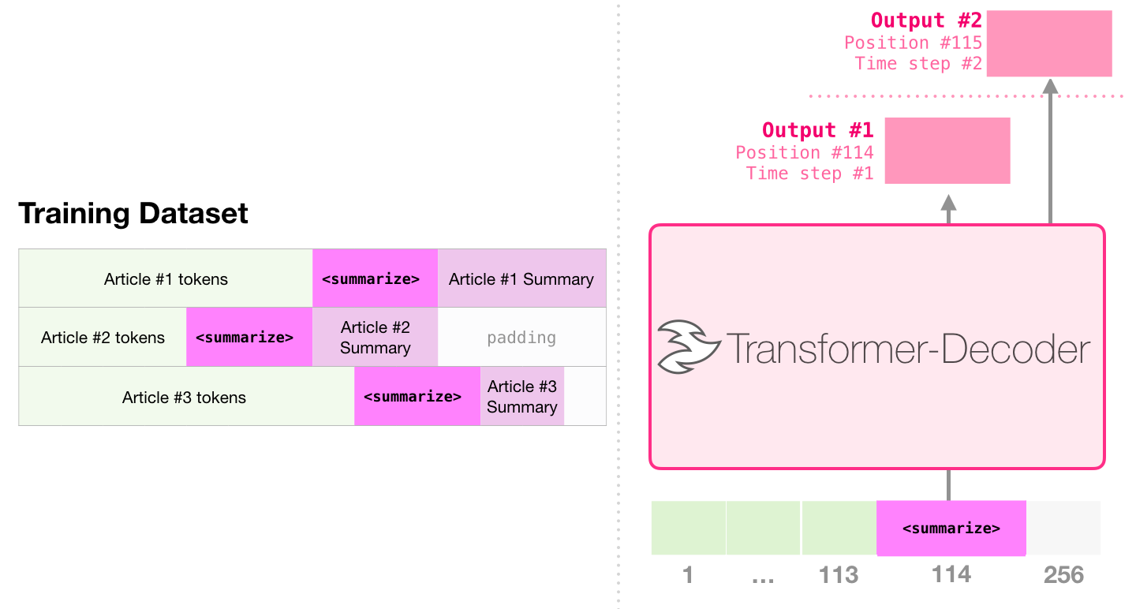
03
GPT-2, BERT
GPT-2 Application: Summarization

Slide 23
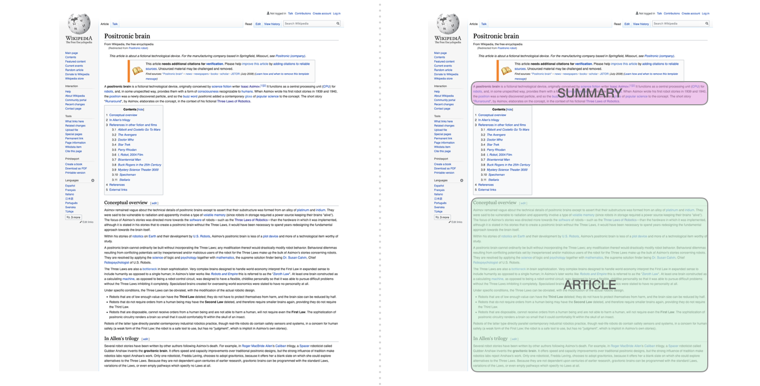
03
GPT-2, BERT
Using wikipedia data

Slide 24
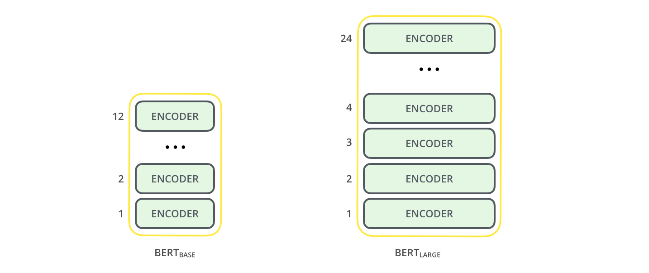
03
GPT-2, BERT
BERT (Bidirectional Encoder Representation from Transformers)

Slide 25
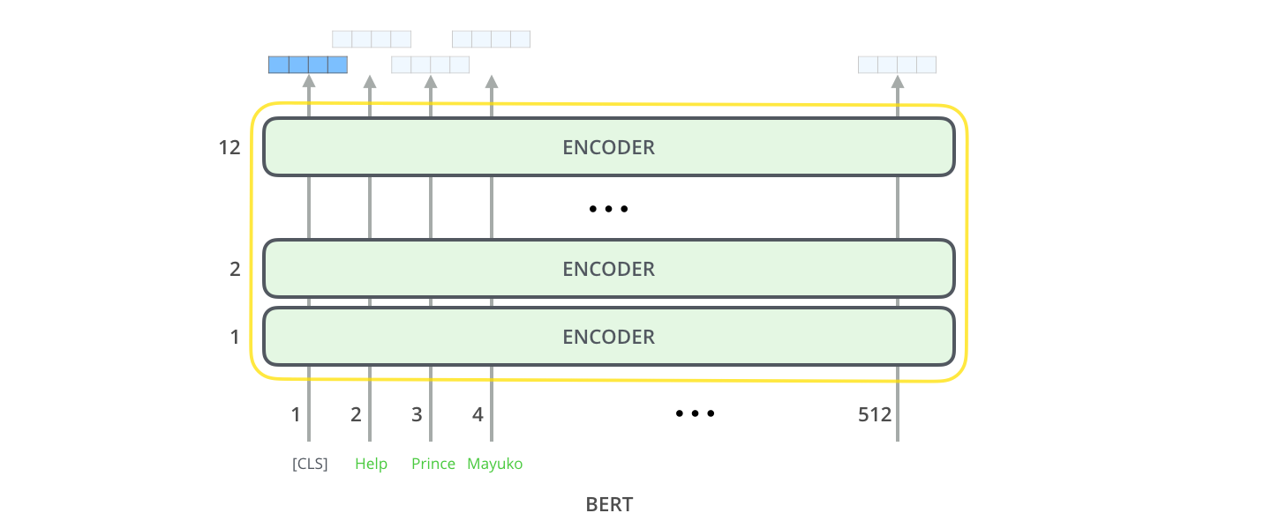
03
GPT-2, BERT
Model input dimension 512
Input and output vector size

Slide 26
03
GPT-2, BERT
BERT pretraining
ULM-FiT (2018): Pre-training ideas, transfer learning in NLP.
ELMo: Bidirectional training (LSTM)
Transformer: Although used things from left, but still missing from the right.
GPT: Use Transformer Decoder half.
BERT: Switches from Decoder to Encoder, so that it can use both sides in training and invented corresponding training tasks: masked language model

Slide 27
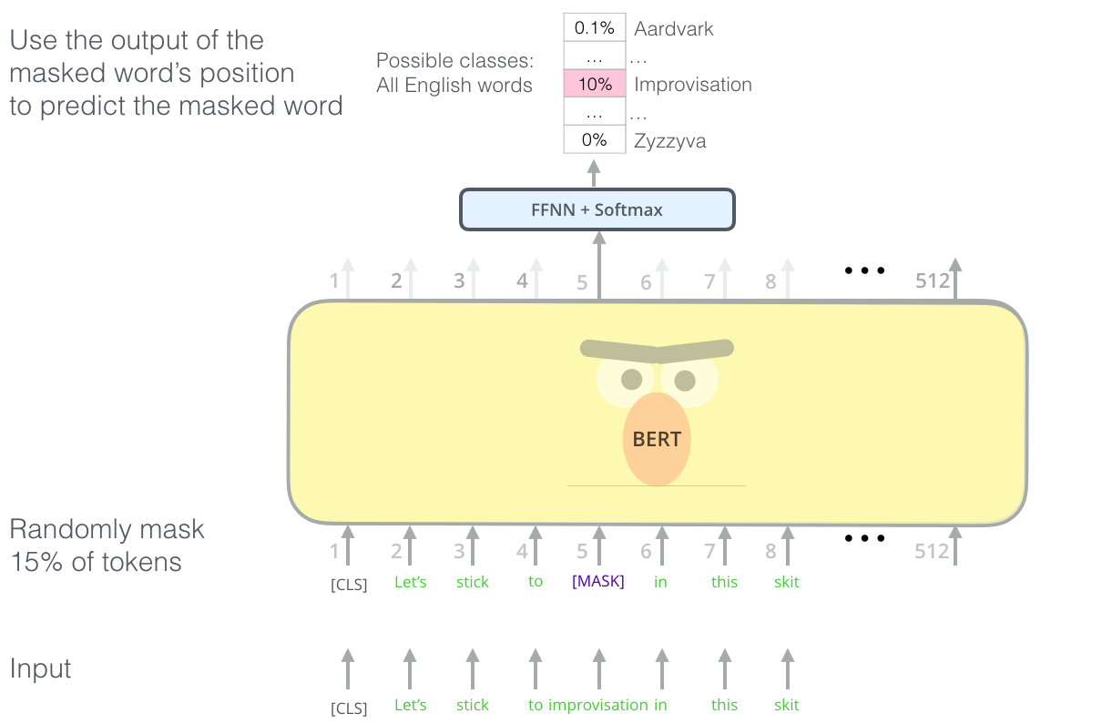
BERT Pretraining Task 1: masked words
03
GPT-2, BERT
Out of this 15%,
80% are [Mask],
10% random words
10% original words

Slide 28
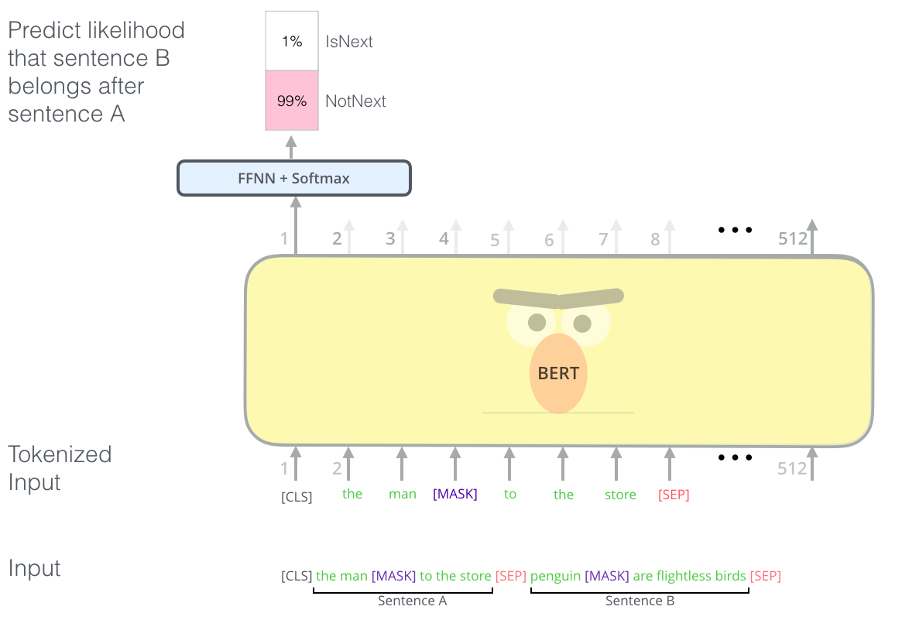
BERT Pretraining Task 2: two sentences
03
GPT-2, BERT

Slide 29
BERT Pretraining Task 2: two sentences
03
GPT-2, BERT
50% true second sentences
50% random second sentences

Slide 30
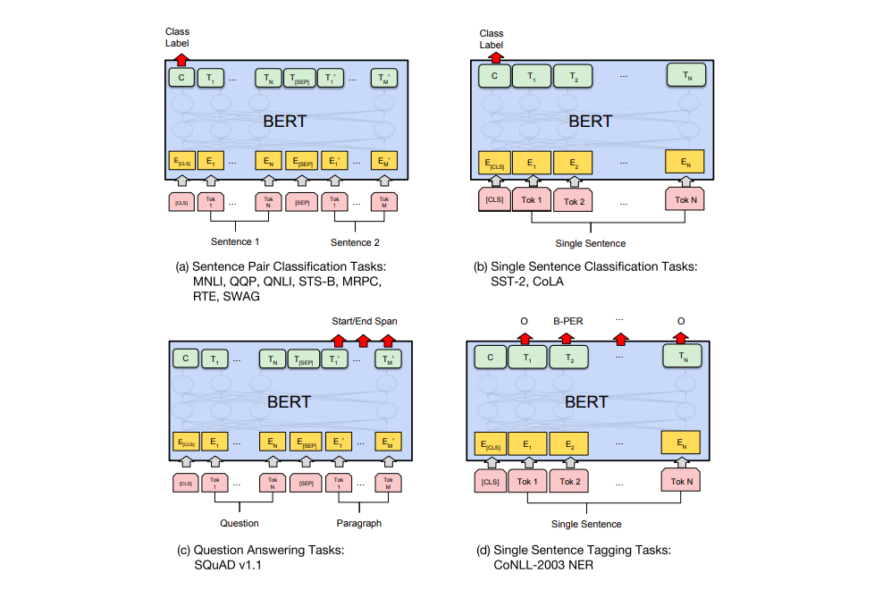
Fine-tuning BERT for other specific tasks
03
GPT-2, BERT
MNLI
QQP (Quaro Question Pairs)
Semantic equivalence)
QNLI (NL inference dataset)
STS-B (texture similarity)
MRPC (paraphrase, Microsoft)
RTE (textual entailment)
SWAG (commonsense inference)
SST-2 (sentiment)
CoLA (linguistic acceptability
SQuAD (question and answer)
SST (Stanford sentiment treebank): 215k phrases with fine-grained sentiment labels in the parse trees of 11k sentences.

Slide 31
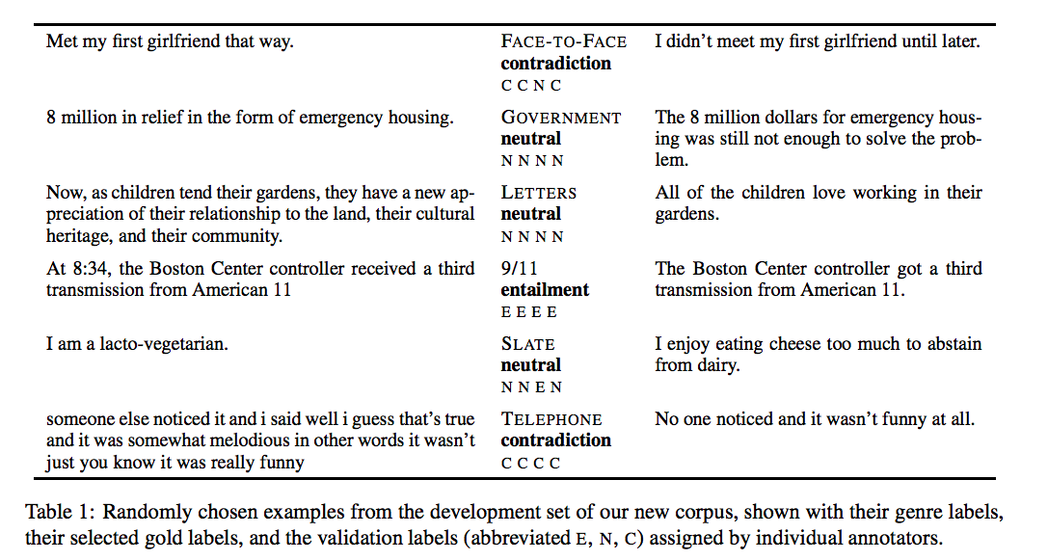
NLP Tasks: Multi-Genre Natural Lang. Inference
03
GPT-2, BERT
MNLI: 433k pairs of examples, labeled by entailment, neutral or contraction

Slide 32
GPT-2, BERT
NLP Tasks (SQuAD -- Stanford Question Answering Dataset):
03
Sample: Super Bowl 50 was an American football game to determine the champion of the National Football League (NFL) for the 2015 season. The American Football Conference (AFC) champion Denver Broncos defeated the National Football Conference (NFC) champion Carolina Panthers 24–10 to earn their third Super Bowl title. The game was played on February 7, 2016, at Levi's Stadium in the San Francisco Bay Area at Santa Clara, California. As this was the 50th Super Bowl, the league emphasized the "golden anniversary" with various gold-themed initiatives, as well as temporarily suspending the tradition of naming each Super Bowl game with Roman numerals (under which the game would have been known as "Super Bowl L"), so that the logo could prominently feature the Arabic numerals 50.
Which NFL team represented the AFC at Super Bowl 50?
Ground Truth Answers: Denver Broncos
Which NFL team represented the NFC at Super Bowl 50?
Ground Truth Answers: Carolina Panthers

Slide 33
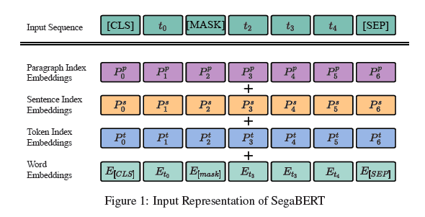
Add indices for sentences and paragraphs
SegaTron/SegaBERT
H. Bai, S. Peng, J. Lin, L. Tan, K. Xiong, W. Gao, M. Li: SgaTron: Segment-aware transformer for language modeling
and understanding. AAAI’2021

Slide 34
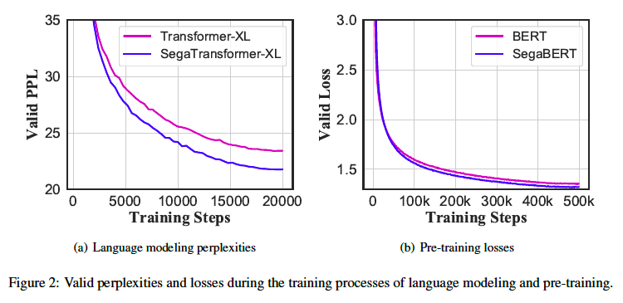
Conversion speed much faster：

Slide 35
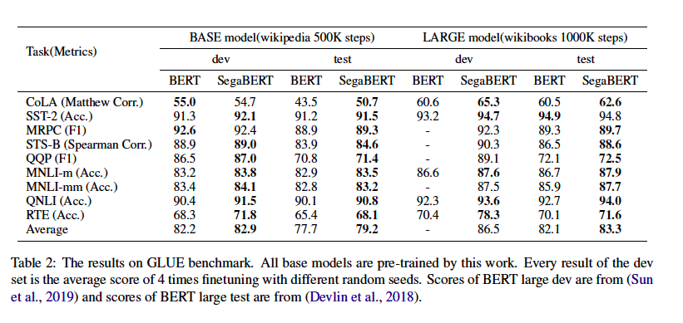
Testing on GLUE dataset
H. Bai, S. Peng, J. Lin, L. Tan, K. Xiong, W. Gao, M. Li: SgaTron: Segment-aware transformer for language modeling
and understanding. AAAI’2021
Notes:
CoLA: language acceptability, SST – sentiment, MRPC paraphrase, STS textual similarity, QQP: question paraphrase, RTE MNLI: textual entailment, NLI: question entailment.

Slide 36
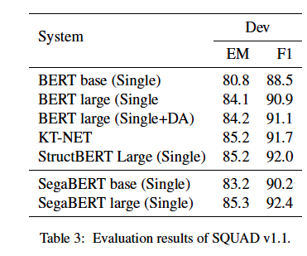
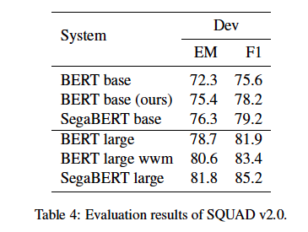
Reading comprehesion – SQUAD tasks
F1 = 2 (P*R) / (P+R), P is precision, R is recall, all in percentage, EM – exact match

Slide 37
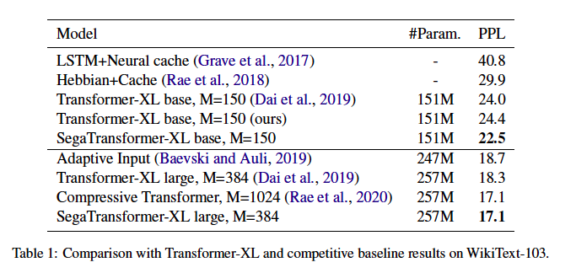
Improving Transformer-XL

Slide 38
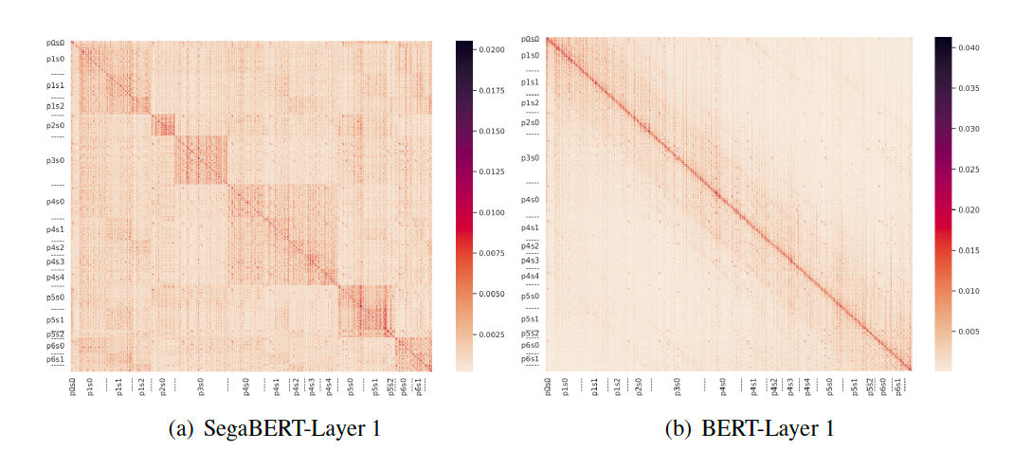
Looking at Attention

Slide 39
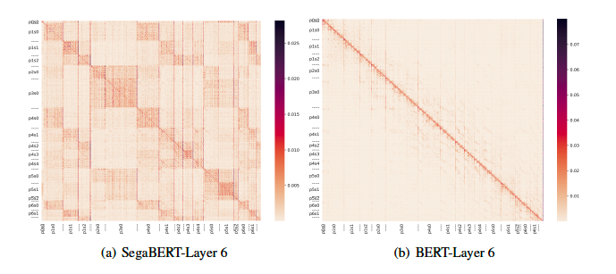
Looking at Attention

Slide 40
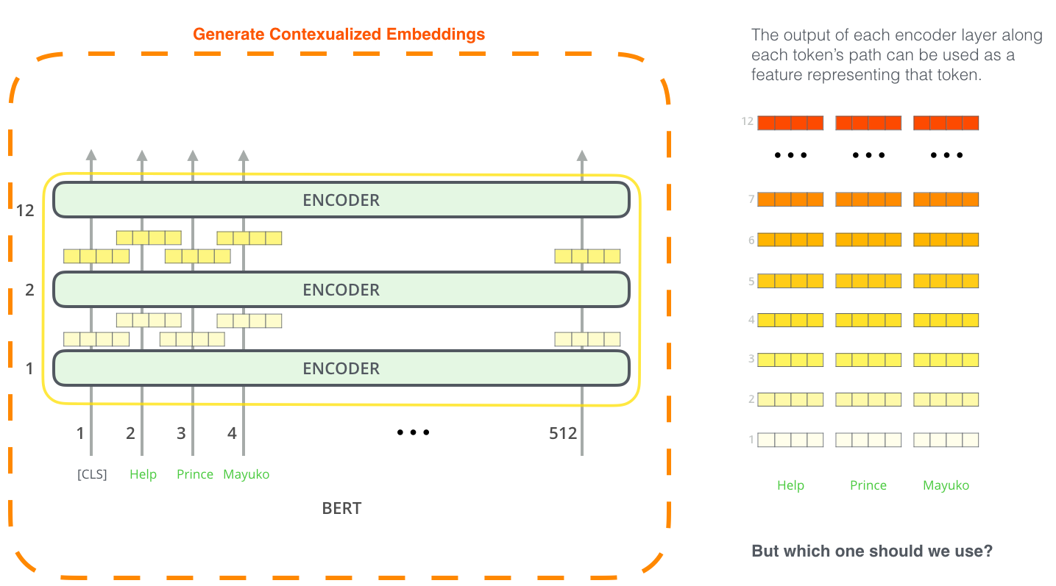
Feature Extraction
03
GPT-2, BERT
We end up with some embedding for each word related to current input
We start with independent
word embedding
at first level

Slide 41
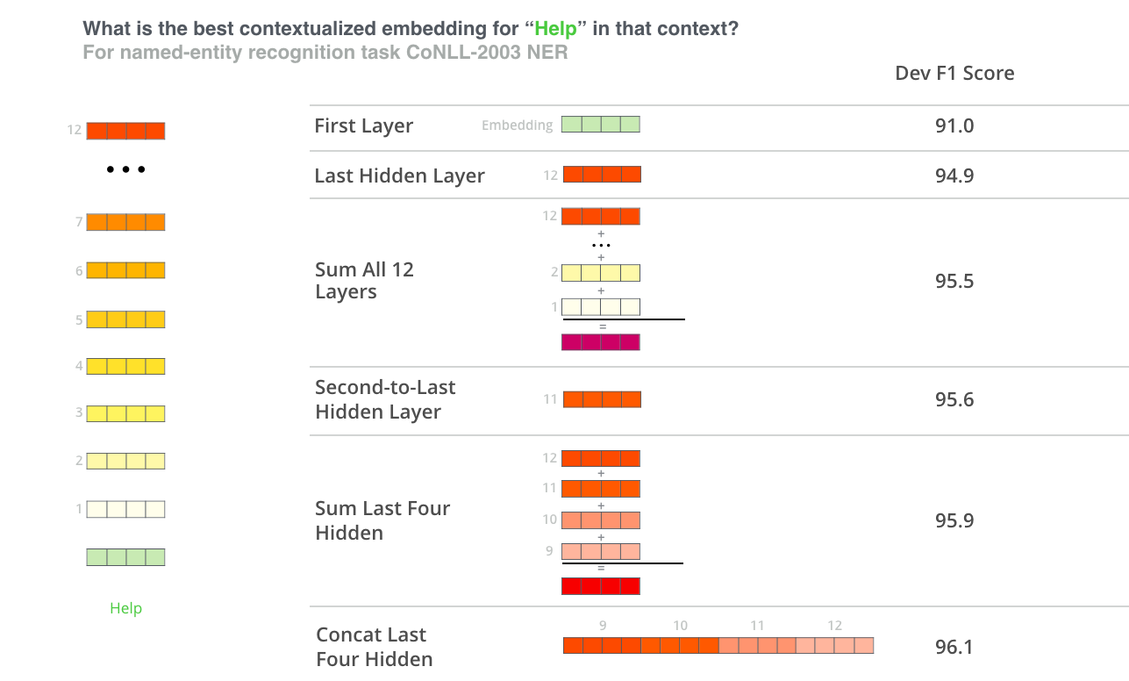
Feature Extraction, which embedding to use?
03
GPT-2, BERT

Slide 42
03
GPT-2, BERT
What we have learned
Model size matters (345 million parameters is better than 110 million parameters).
With enough training data, more training steps imply higher accuracy
Key innovation: Learning from unannotated data.
In biotechnology, we also have a lot of such data (for example meta-genomes).

Slide 43
03
GPT-2, BERT
Literature & Resources for Transformers
Resources:
OpenAI GPT-2 implementation: https://github.com/openai/gpt-2
BERT paper: J. Devlin et al, BERT, pretraining of deep bidirectional transformers for language understanding. Oct. 2018.
ELMo paper: M. Peters, et al, Deep contextualized word representation, 2018
ULM-FiT paper: Universal language model fine-tuning for text classification. J. Howeard, S. Ruder., 2018
Jay Alammar, The illustrated GPT-2, https://jalammar.github.io/illustrated-gpt2/

