Slide 1
Jan. 2022
CS 886 Deep Learning for Biotechnology
Ming Li

Slide 2
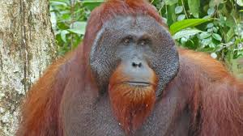
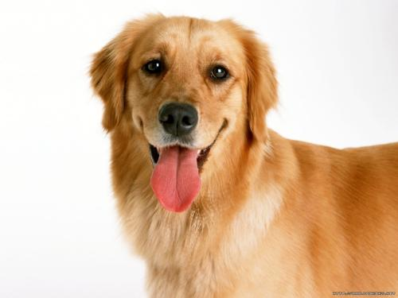
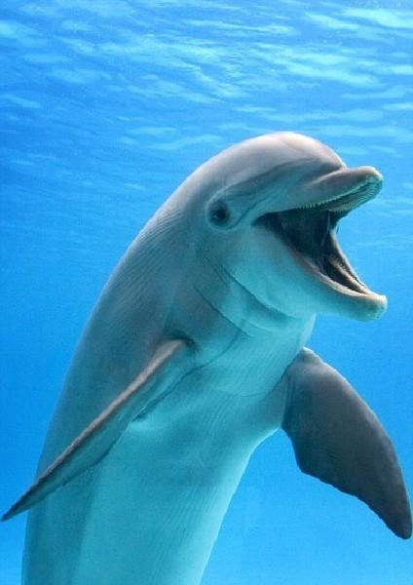
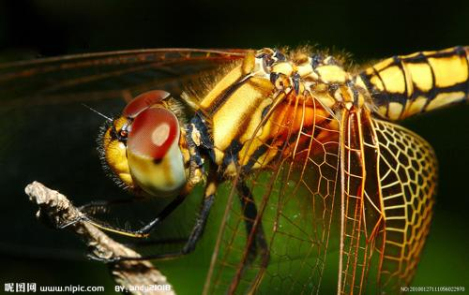
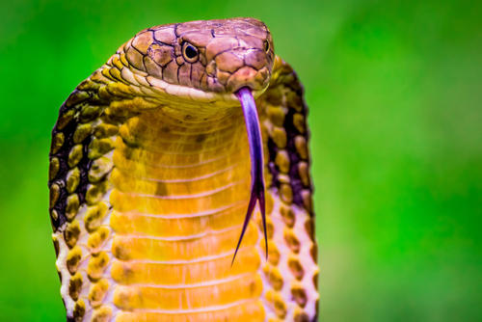
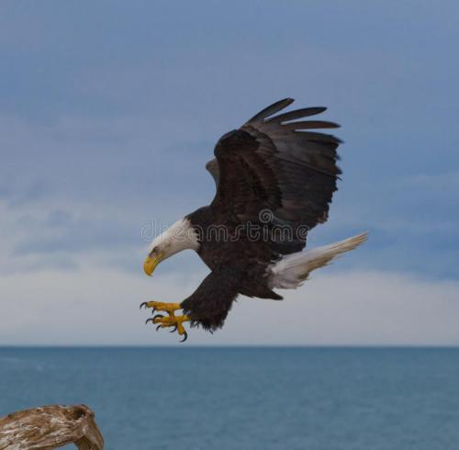
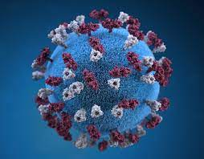
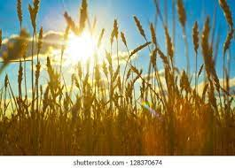
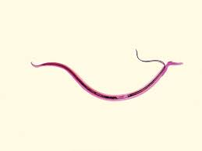
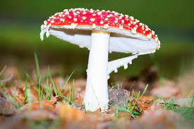
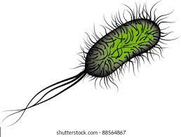
Prelude: our world
0
What do they have in common？
These are all lives encoded by DNA / RNA from 30k bases to 3B bases and more.
Genes encoded by DNA are translated to 1000s’of proteins, hence life.

Slide 3
Deep Learning
Since its invention, deep learning has changed many research fields: speech recognition, image processing, natural language processing, automatic driving, industrial control, especially biotechnology (for example, protein structure prediction). In this class, we will review applications of deep learning in biotechnology. The first few lectures will be on the necessary backgrounds of deep learning.
01. Word2Vec
02. Attention / Transformer
03. Pretraining: GPT and BERT
04. Deep learning applications in proteomics
05. Student presentations begin

Slide 4
Word2Vec: from discrete to
continuous space
01
LECTURE ONE

Slide 5
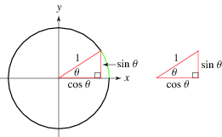
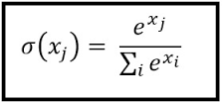
01
Word2Vec
Things you need to know:
Dot product:
a • b = ||a||||b||cos(θ_{ab})
= a₁b₁+a₂b₂+ … +a_{n}b_{n}
One can derive Cosine similarity
cos θ_{ab} = a • b / ||a||||b||
Softmax Function:
If we take an input of [1,2,3,4,1,2,3], the softmax of that is
[0.024, 0.064, 0.175, 0.475, 0.024, 0.064, 0.175].
The softmax function highlights the largest values and
suppress other values, so that they are all positive and
sum to 1.

Slide 6
01
Word2Vec
Transforming from discrete to “continuous” space
Calculus (for computing the space covered by a curve)
Word2Vec (for computing the “space” covered by the meaning of a word, or a gene, or a protein)

Slide 7
01
Word2Vec
Traditional representation of a word's meaning
Dictionary (or PDB), not too useful in computational linguistic research.
WordNet (Protein networks)
It is a graph of words, with relationships like “is-a”, synonym sets.
Problems: Depend on human labeling hence missing a lot, hard to automate this process.
3. These are all using atomic symbols: hotel, motel, equivalent to 1-hot vector:
Hotel: [0,0,0,0,0,0,0,0,1,0,0,0,0,0]
Motel: [0,0,0,0,1,0,0,0,0,0,0,0,0,0]
These are called one-hot representations. Very long: 13M (google crawl).
Example: inverted index.

Slide 8
01
Word2Vec
Problems.
There is no natural meaning of similarity,
hotel$\text{•}$ motel^{T} = 0
No inherent notion of similarity with 1-hot vectors.
They are very long too. For daily speech, 20 thousand words, 50k for machine translation, 20 thousand proteins, millions of species. Google web crawl, 13M words.

Slide 9
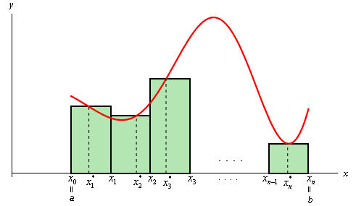
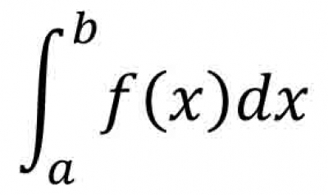
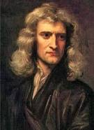
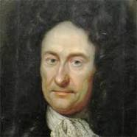
01
Word2Vec
How do we solve the problem? This is what Newton and Leibniz did for calculus:
when #rectangles → ∞

Slide 10
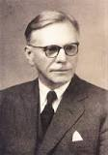
Let's do something similar:
01
Word2Vec
Use a lot of “rectangles”, a vector of numbers, to represent to approximate the meaning of a word.
What represents the meanings of a word?
“You shall know a word by the company it keeps” – J.R. Firth, 1957
Thus, our goal is to assign each word a vector such that similar words have similar vectors (by dot-product).
We will believe JR Firth and use a neural network to train (low dimension) vectors such that if two words appear together in a text each time, they should get slightly closer. This allows us to use a massive corpus without annotation! Thus, we will scan thru training data by looking at a window 2d+1 at a time, given a center word, trying to predict d words on the left and d words on the right.

Slide 11
01
Word2Vec
To design a neural network for this:
More specifically, for a center word w_{t} and “context words” w_{t’}, within a window of some fixed size say 5 (t’=t-1, … t-5, t+1, … , t+5) we use a neural network to predict all w_{t’} to maximize:
p(w_{t’}|w_{t}) = …
This has a loss function
L = 1 – p(w_{t’}|w_{t})
Thus by looking at many positions in a big corpus, we keep on adjusting these vectors to minimize this loss, we arrive at a (low dimensional) vector approximation of the meaning of each word, in the sense that if two words occur in close proximity often then we consider them similar.

Slide 12
01
Word2Vec
To design a neural network for this:
Thus the objective function is: maximize the probability of any context word given the current center word:
L’(θ) = Π _{t=1..T} Π _{d=-1..-5,1..5} P(w_{t+d} | w_{t} , θ )
Where θ is all the variables we optimize (i,e, the vectors), T=|training text|.
Taking negative logarithm (and average per word) so that we can minimize
L(θ) = - 1/T Σ_{t=1..T} Σ_{d=-1 .. -5, 1,..,5} log P(w_{t+d} | w_{t} )
Then what is P(w_{t+d} | w_{t})? We can just take their vector dot products, and then take softmax, to approximate it, letting v be the vector for word w:
L(θ) ≈ - 1/T Σ_{t=1..T} Σ_{d=-1 .. -5, 1,..,5} log Softmax (v_{t+d} • v_{t})

Slide 13
01
Word2Vec
To design a neural network for this:
Last slide:
L(θ) ≈ - 1/T Σ_{t=1..T} Σ_{d=-1 .. -5, 1,..,5} log Softmax (v_{t+d} • v_{t})
The softmax of a center word c, and a context/outside word o
Softmax(v_{o} • v_{c} ) = e^(v_{o} • v_{c}) / Σ_{k=1..V} e^(v_{k} • v_{c})
Note, the index runs over the dictionary of size V, not the whole text T.

Slide 14
01
Word2Vec
Negative Sampling in Word2Vec
In our L(θ) ≈ - 1/T Σ_{t=1..T} Σ_{d=-1 .. -5, 1,..,5} log Softmax (v_{t+d} • v_{t}) where
Softmax(v_{o} • v_{c} ) = e^(v_{o} • v_{c}) / Σ_{k=1..V} e^(v_{k} • v_{c})
Each time we have to calculate Σ_{k=1..V} e^(v_{k} • v_{c}), this is too expensive.
To overcome this, use negative sampling. The objective function: L(θ) = -1/T Σ_{t=1..T} L_{t}(θ)
L_{t}(θ) = log σ (u_{o}^{T}v_{c}) + Σ_{t=1..k} E_{j~P(w)} [log σ (- u_{j}^{T}v_{c})]
= log σ (u_{o}^{T}v_{c}) + Σ_{j~P(w)} [log σ (- u_{j}^{T}v_{c})]
Where the sigmoid function σ(x) = 1/1+e^{-x}, treated as probability for ML people. I.e. maximize the first term, taking k=10 random samples in the second term.
For sampling, we can use unigram distribution U(w) or U(w)^{3/4} for rare words.

Slide 15
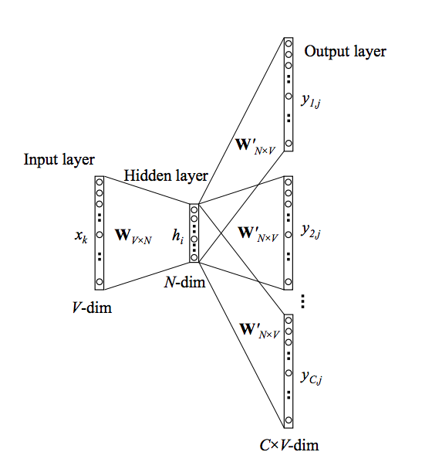
01
Word2Vec
The skip-gram model
Vocabulary size: V
Input layer: center word in 1-hot form.
k-th row of W_{VxN} is center vector of k-th word.
k-th column of W’_{NXV} is context vector of the k-th word in V. Note, each word has 2 vectors, both randomly initialized.
The output column y_{ij}, i=1..C, has 3 steps
1) Use the context word 1-hot vector to
choose its column in W’_{NxV}
2) dot product with h_{i} the center word
3) compute the softmax
C= context window size

Slide 16
01
Word2Vec
The Training of θ
We will train both W_{VxN} and W’_{NxV}
I.e. compute all vector gradients.
Thus θ is in space R^{2NV}, N is vector size, V is number of words.
L(θ) / v , for all vectors in θ.
θ = [ ]in R^{2NV}
v_{aardvark}
v_{a}
.
.
v_{zebra}
u_{aardvark}
u_{a}
.
.
u_{zebra}

Slide 17
01
Word2Vec
Gradient Descent
θ^{new} = θ^{old} – α L(θ^{old}) / / θ^{old}
Stochastic gradient descent (SGD): Just do one position (one center word and its context words) at a time.
θ = [ ]in R^{2NV}
v_{aardvark}
v_{a}
.
.
v_{zebra}
u_{aardvark}
u_{a}
.
.
u_{zebra}

Slide 18
01
Word2Vec
CBOW
What about we predict center word, given context word, opposite to the skip-gram model?
Yes, this is called Continuous Bag Of Words model in the original Word2Vec paper.

Slide 19
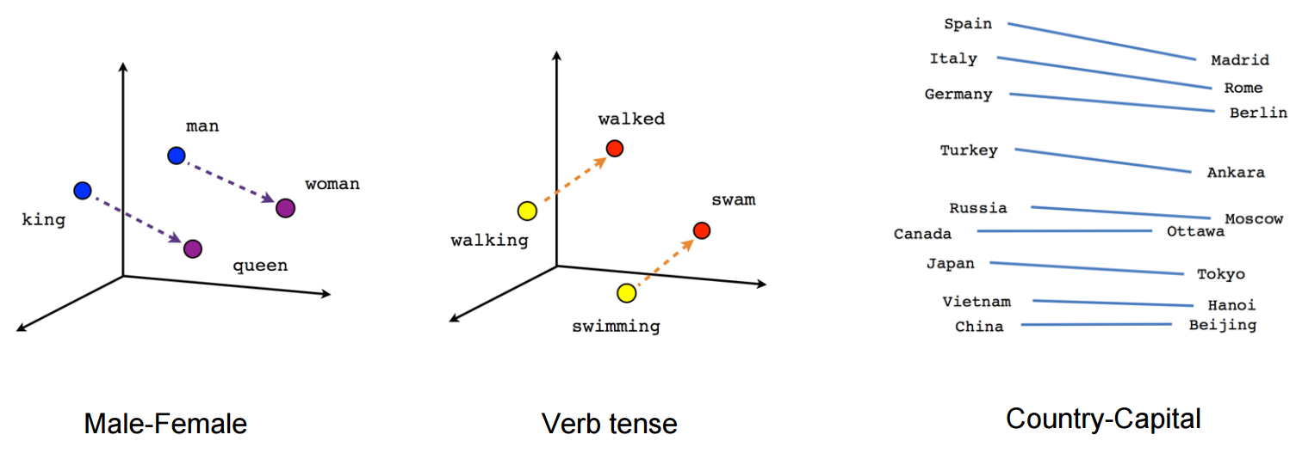
01
Word2Vec
Results

Slide 20
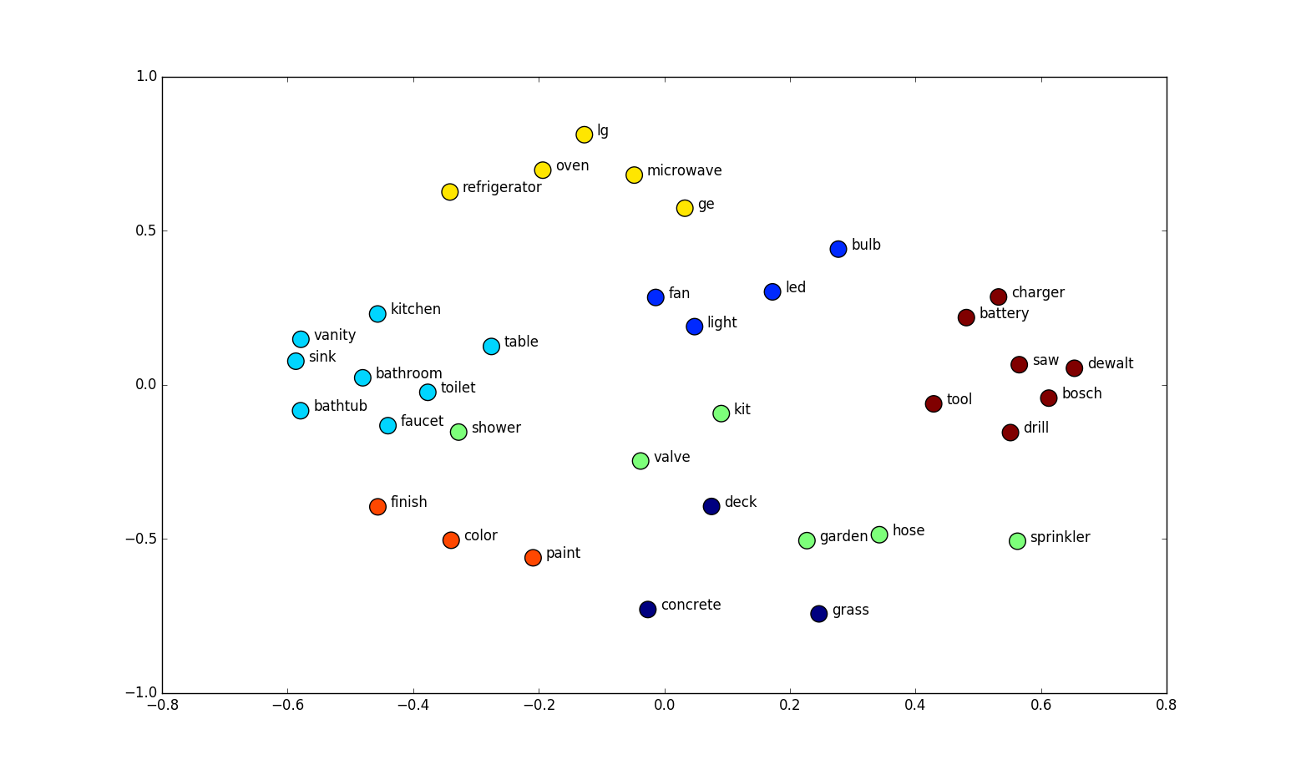
Word2Vec
Results
01

Slide 21
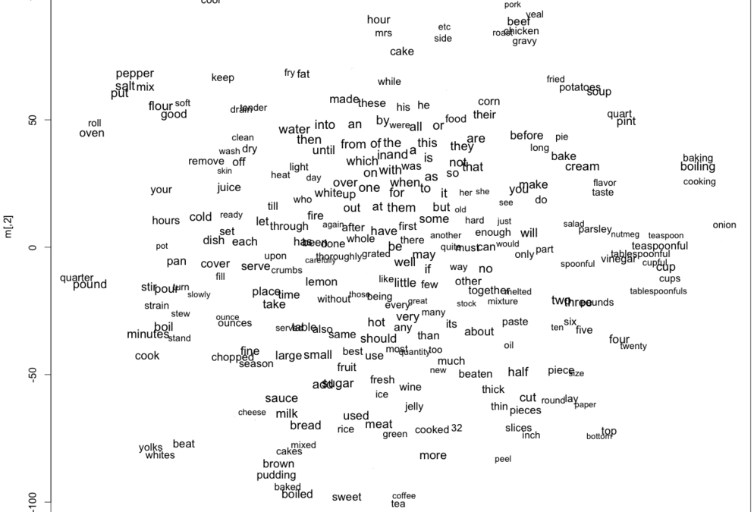
01
Word2Vec
More realistic data – not everything is perfect

Slide 22
01
Word2Vec
An interesting application in material science
Nature, July 2019 V. Tshitonya et al, “Unsupervised word embeddings capture latent knowledge from materials science literature”.
Lawrence Berkeley lab material scientists applied word embedding to 3.3 million scientific abstracts published between 1922-2018. V=500k. Vector size: 200 dimension, used skip-gram model
With no explicit insertion of chemical knowledge
Captured things like periodic table and structure-property relationship in materials:
ferromagnetic − NiFe + IrMn ≈ antiferromagnetic
Discovered new thermoelectric materials: “would be years before their discovery”.
Can you do something for proteins?

Slide 23
01
Word2Vec
Beyond Word2Vec
Co-occurrence matrix
Window based co-occurrence
Document based co-occurrence
Ignore the, he, has … frequent words.
Close proximity weigh more …
In word2vec, if a center word w appears again, we have to repeat this process. Here they are processed together. Also consider documents.
Symmetric.
SVD decomposition, this was before Word2Vec. But it is O(nm²), too slow for large data.

Slide 24
01
Word2Vec
GloVe (Global vectors model)
Combining Word2Vec and Co-occurrence matrix approaches. Minimize
L(θ) = ½ Σ_{i,j=1..W} f(P_{i,j}) (u_{i}^{T}v_{j} – log P_{i,j})²
Where, u, v vectors are still the same, P_{i,j} is the count that u_{i} and v_{j} co-occur. Essentially
This says, the more u_{i},v_{j} co-occur, the larger their dot product should be. f gets rid of too frequent occurrences.
What about these two vectors? X=U+V works.

Slide 25
01
Word2Vec
Summary
We have learned that representation is important: When you represent space under a curve by a lot of rectangles, you can approximate the curve, hence calculus; When you represent a word by a vector, other close-in-meaning words can take nearby vectors, measured by “cosine” distance.
When a representation (short vectors) of an object allows similarity measures, we can easily design neural network (or other approaches) to represent words that are close in meanings in close vicinities.

Slide 26
01
Word2Vec
Literature & Resources for Word2Vec
Bengio et al, 2003, A neural probabilistic language model.
Collobert & Weston 2008, NLP (almost) from scratch
Mikolov et al 2013, word2vec paper
Pennington Socher, Manning, GloVe paper, 2014
Rohde et al 2005 (SVD paper) An improved model of semantics similarity based on lexical co-occurrence.
Plus thousands more.
Resources:
https://mccormickml.com/2016/04/27/word2vec-resources/
https://github.com/clulab/nlp-reading-group/wiki/Word2Vec-Resources

Slide 27
01
Word2Vec
Project Ideas
Similar to V. Tshitonya et al's work, can you explore all biological literature and find interesting facts such as protein-protein interaction or biological name identity resolution?
Can we use word-embedding to embed genomes (for example, shatter genomes into pieces as "words”, but train one vector for each genome) hence cluster species to build phylogeny to decide their evolutionary history, similar to [1,2]. You can start with mitochondrial genomes, or virus genomes (such as different species of covid-19, for this you can add in other factors such as geographical, time), or bacteria genomes.
1. M. Li, J. Badger, X. Chen, S. Kwong, P. Kearney, H. Zhang, An information-based sequence distance and its application to whole
mitochondrial genome phylogeny, Bioinformatics, 17:2(2001), 149-154.
2. C.H. Bennett, M. Li and B. Ma, Chain letters and evolutionary histories. Scientific American, 288:6(June 2003) (feature article), 76-81.

Slide 28
Attention and Transformers
02
LECTURE TWO

