Slide 1
What Does BERT Learn?
Probing deep language models to understand how language is encoded
Presented by Kira Selby

Slide 2
Relevant papers
Alexis Conneau, German Kruszewski, Guillaume Lample, Loic Barrault, and Marco Baroni. 2018. What you can cram into a single $&#* vector: Probing sentence embeddings for linguistic properties. In Proceedings of ACL.
Ian Tenney, Patrick Xia, Berlin Chen, Alex Wang, Adam Poliak, R Thomas McCoy, Najoung Kim, Benjamin Van Durme, Sam Bowman, Dipanjan Das, and Ellie Pavlick. 2019. What do you learn from context? probing for sentence structure in contextualized word representations. In International Conference on Learning Representations
Tenney, I., Das, D. and Pavlick, E., 2019. BERT rediscovers the classical NLP pipeline. arXiv preprint arXiv:1905.05950.
Jawahar, G., Sagot, B. and Seddah, D., 2019, July. What does BERT learn about the structure of language?.

Slide 3
Probing
Probing tasks: Classification problems focusing on simple linguistic properties of words of sentences. (Conneau et al, 2018)
Examples: sentence length, tree depth, tense,
Consider training a simple classifier to perform these tasks, given embeddings or model hidden states as inputs
By comparing results across models or layers with identical classifiers, we can diagnose how effectively they learn linguistic structure

Slide 4
Sentence Embeddings
The pre-BERT world

Slide 5
Sentence Embeddings
Conneau et al proposed a set of probing tasks for examining the information learned by sentence embeddings
They applied these tasks to sentence embedding models with BiLSTM and GatedConv architectures, trained with a variety of algorithms (SkipThought, AutoEncoding, etc…)

Slide 6
Probing Tasks
Surface Information:
SentLen: Number of words in a sentence
WC (Word Content): Presence or absence of a word
Syntactic Information:
BShift (Bigram Shift): Sensitivity to legal word orders – i.e. swapping adjacent words
TreeDepth: Depth of hierarchical relationships in the sentence – longest path from node to leaf
TopConst (Top Constituents): Classify top constituents below root node
“[Then] [very dark gray letters on a black screen] [appeared] [.]” = ADVP NP VP
Semantic Information:
Tense: Tense of main-clause verb
SubjNum (Subject Number): Number of the subject of the main clause
ObjNum (Object Number): Number of the object of the main clause
SOMO (Semantic Odd-Man-Out): Replace a random noun or verb with another that has comparable bigram frequency
CoordInv (Coordinate Inversion): Invert order of clauses in sentences containing two coordinate clauses
“They might be only memories, but I can still feel each one” -> “I can still feel each one, but they might only be memories”

Slide 7
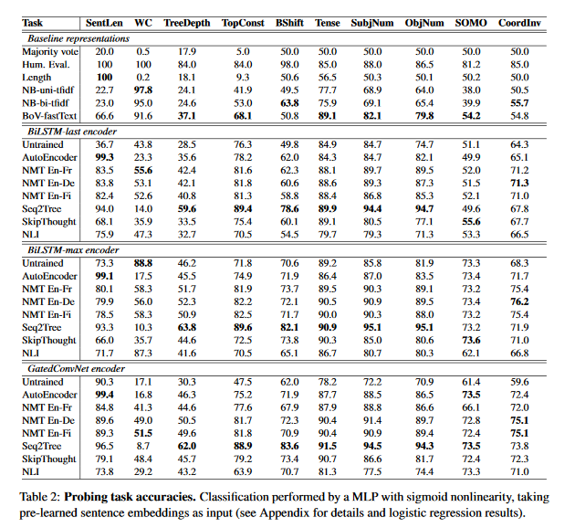

Slide 8
Takeaways
Bag of Vectors is a very strong baseline for such a simple model, but is still beaten by a trained encoder
Untrained models (effectively random projections of word vectors) do surprisingly well on many tasks
Good encoders do broadly well across tasks, but fall significantly short of human evaluation
The best models can still achieve reasonable accuracy even on semantically challenging tasks like SOMO and CoordInv

Slide 9
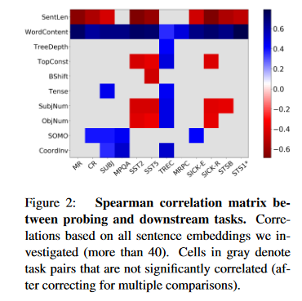
Downstream Tasks
Conneau et al measured the correlation between success at probing tasks and results on downstream tasks
Classification tasks (SentEval suite – MR, CR, SUBJ, MPQA, SST2, SST5, TREC)
NLI (SICK-E)
Semantic relatedness (SICK-R, STSB)
Paraphrase detection (MRPC)
Semantic textual similarity (STS)
WC is positively correlated with all tasks
SentLen is negatively correlated with almost all tasks
SOMO and CoordInv also have many positive correlations

Slide 10
Pretrained Contextual Representations
BERT, GPT, ELMo, and more

Slide 11
Edge Probing
Tenney et al used similar methods to study the contextual representations generated by pretrained transformer models such as BERT
Task Formulation: Consider a sentence represented as tokens $T=\left[t_{0},t_{1},…,t_{n}\right]$, as well as a labelled “edge” $\left\{s^{(1)},s^{(2)},L\right\}$
$s^{(1)}=[i^{\left(1\right)},j^{\left(1\right)})$ is a “span” representing a subset $\left[t_{i^{(1)}},…,t_{j^{(1)}−1}\right]$ of the sentence
L is a task-specific label
They use labeling tasks derived from classical (pre-deep learning) NLP pipelines
Part-of-speech tagging, coreference resolution, dependency parsing, etc…

Slide 12
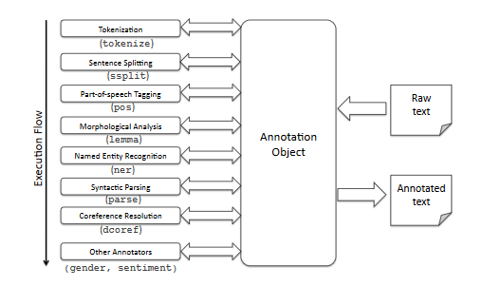
Figure: Control flow of the Stanford CoreNLP Toolkit for annotating raw text input

Slide 13
Labelling Tasks
Part-of-speech Tagging: assigning tags (noun, verb, adjective, etc…) to tokens in a sentence
Constituent Labeling: grouping tokens which constitute a noun phrase, verb phrase, etc…
Dependency Labeling: label relationships between tokens (e.g. subject-object)
Named Entity Labeling: Predict the entity type of named entities (e.g. is it a person, a location, organization, etc…)
Semantic Role Labeling: Label predicate-argument structure
Coreference: Label which tokens in a sentence refer to the same entity
Relation Classification: Classify relationships between entities

Slide 14
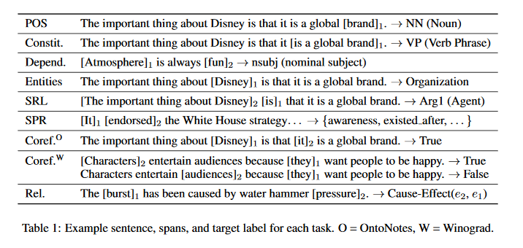

Slide 15
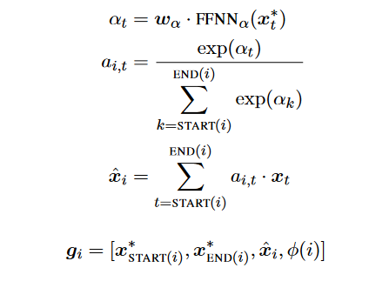
BERT Representations
They use a pooling mechanism over the representations of words within the span
An attention mechanism computes a summary vector of the span, which is concatenated to the representations of the first and last word

Slide 16
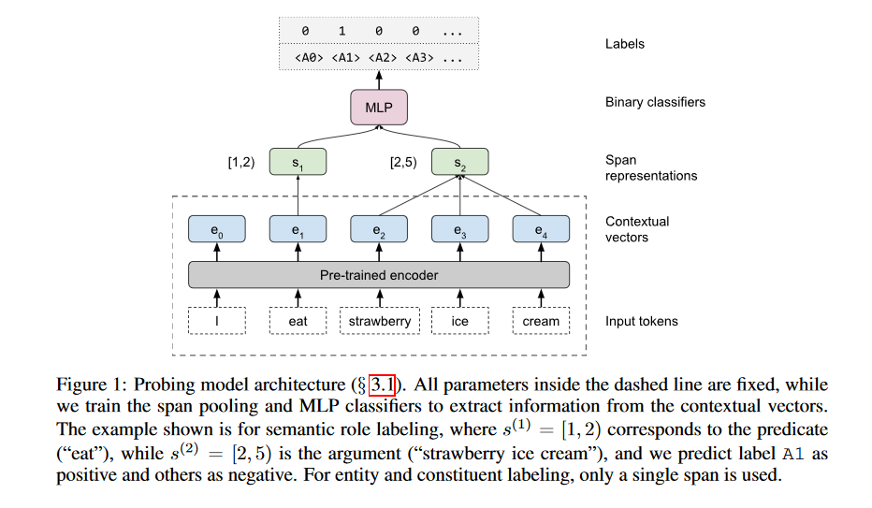

Slide 17
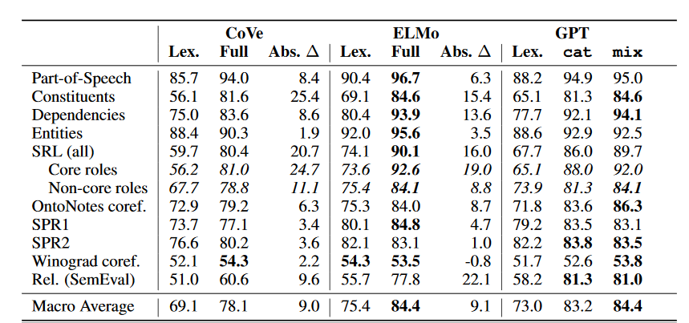

Slide 18
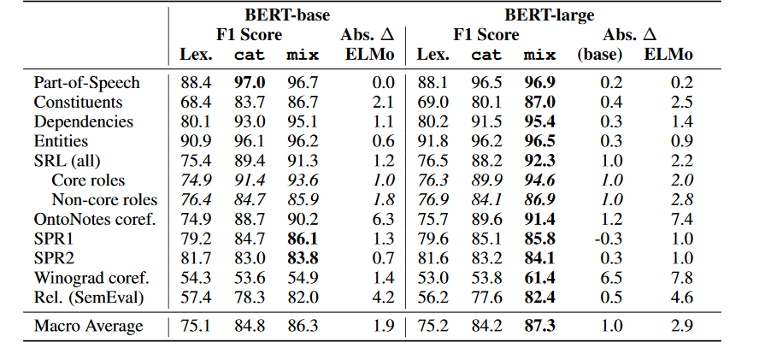

Slide 19
Inside BERT
Learning layer by layer

Slide 20
Probing Layers
Tenney et al (2019) use their edge probing technique on mixtures of BERT vectors across layers and sentences in a similar way to ELMo (Peters et al)
They used a pooling mechanism across the first k layers with trained per-layer weights to construct per-token representations which were then input to the classifier
The evaluation was performed cumulatively on the first k layers, for each k from 1 to L

Slide 21
Metrics
To analyze which layers were most important, Tenney et al defined a center-of-gravity metric representing the average layer attended to for a task:
They also define a differential score, to capture how much each additional layer adds to the task performance
From the differential score, Tenney et al calculate a form of expectation, to represent the expected layer at which the probing model will correctly identify the example for the task at hand

Slide 22
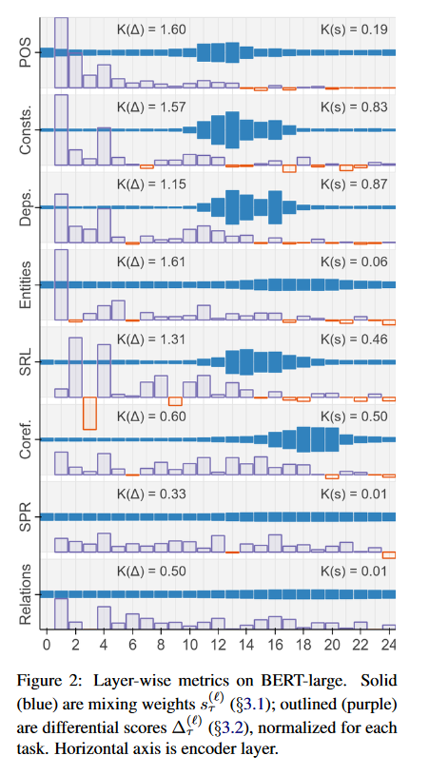
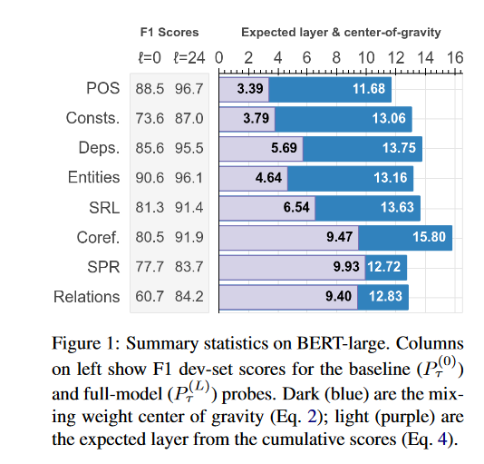

Slide 23
Bert Rediscovers the Classical NLP Pipeline!
Syntactic information appears earlier in the network, where high level information appears at later layers
Syntactic information is localized to a few layers, whereas semantic information is spread across the network
The order in which information is discovered by the network approximately matches the order in which processing happens in a classical NLP pipeline
In some cases, however, the network is able to resolve semantic and syntatic properties in a different order – revising an earlier mistake once new information is found

Slide 24
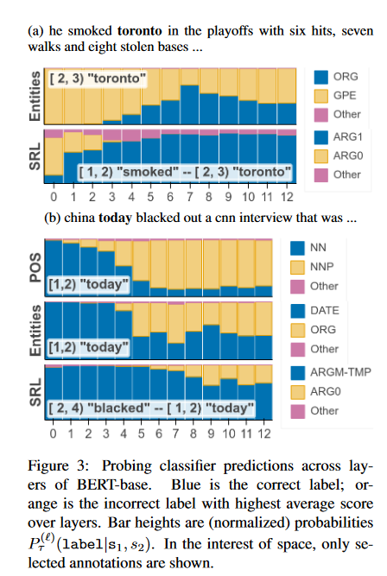
Examples
“toronto” is initially mislabelled as a city, but once the network identifies the semantic role it correctly recognizes it as an organization
“today” is initially mislabelled as a time/date, until later the model recognizes it as a proper noun and updates its semantic role accordingly

Slide 25
Another approach
Jawahar et al (2019) probe the representation of the [CLS] token at the start of the sentence at each layer of BERT using the probing tasks of Conneau et al (2018) (SentLen, WC, etc…)
They use the SentEval toolkit to find the optimal probing classifier (following Conneau et al)
They also test each layer on subject-verb agreement, controlling for the number of attractors

Slide 26
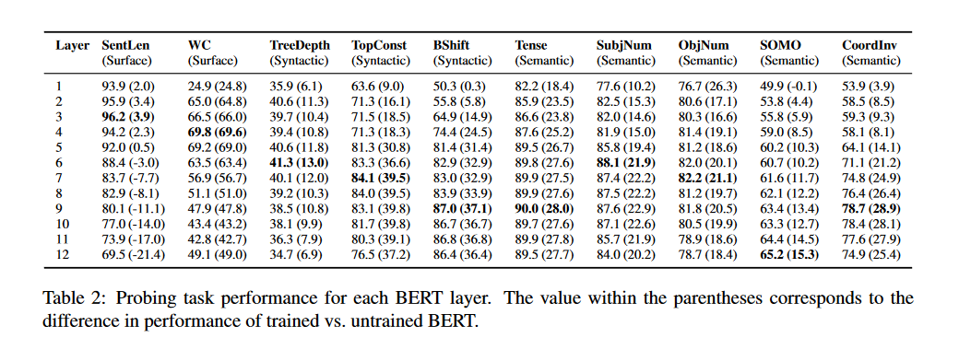

Slide 27
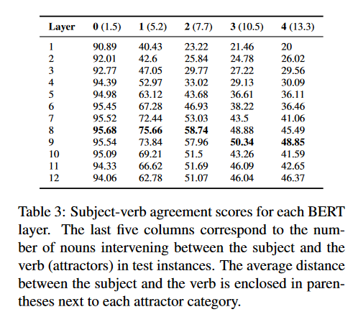

Slide 28
Results
Surprisingly, BERT layers do not perform significantly better than Conneau et al’s sentence encoders
The sentence embeddings win by a large margin on simple tasks such as SentLen, and WC, as well as many syntactic tasks such as TreeDepth
BERT layers outperform the sentence embeddings on Bshift and CoordInv
Deeper layers are more successful at more abstract tasks
Early layers capture surface information, middle layers capture syntax and later layers capture semantics
Middle layers do best on SVA, though deeper layers perform better with more attractors

Slide 29
Conclusion

Slide 30
Conclusions
Contextual embeddings such as BERT learn representations that are helpful for many syntactic tasks
BERT encodes information in a way reminiscent of a classical NLP pipeline, with earlier layers encoding information earlier in the pipeline
Early layers are better predictors of simpler linguistic information, while deeper layers capture semantics

