Slide 1
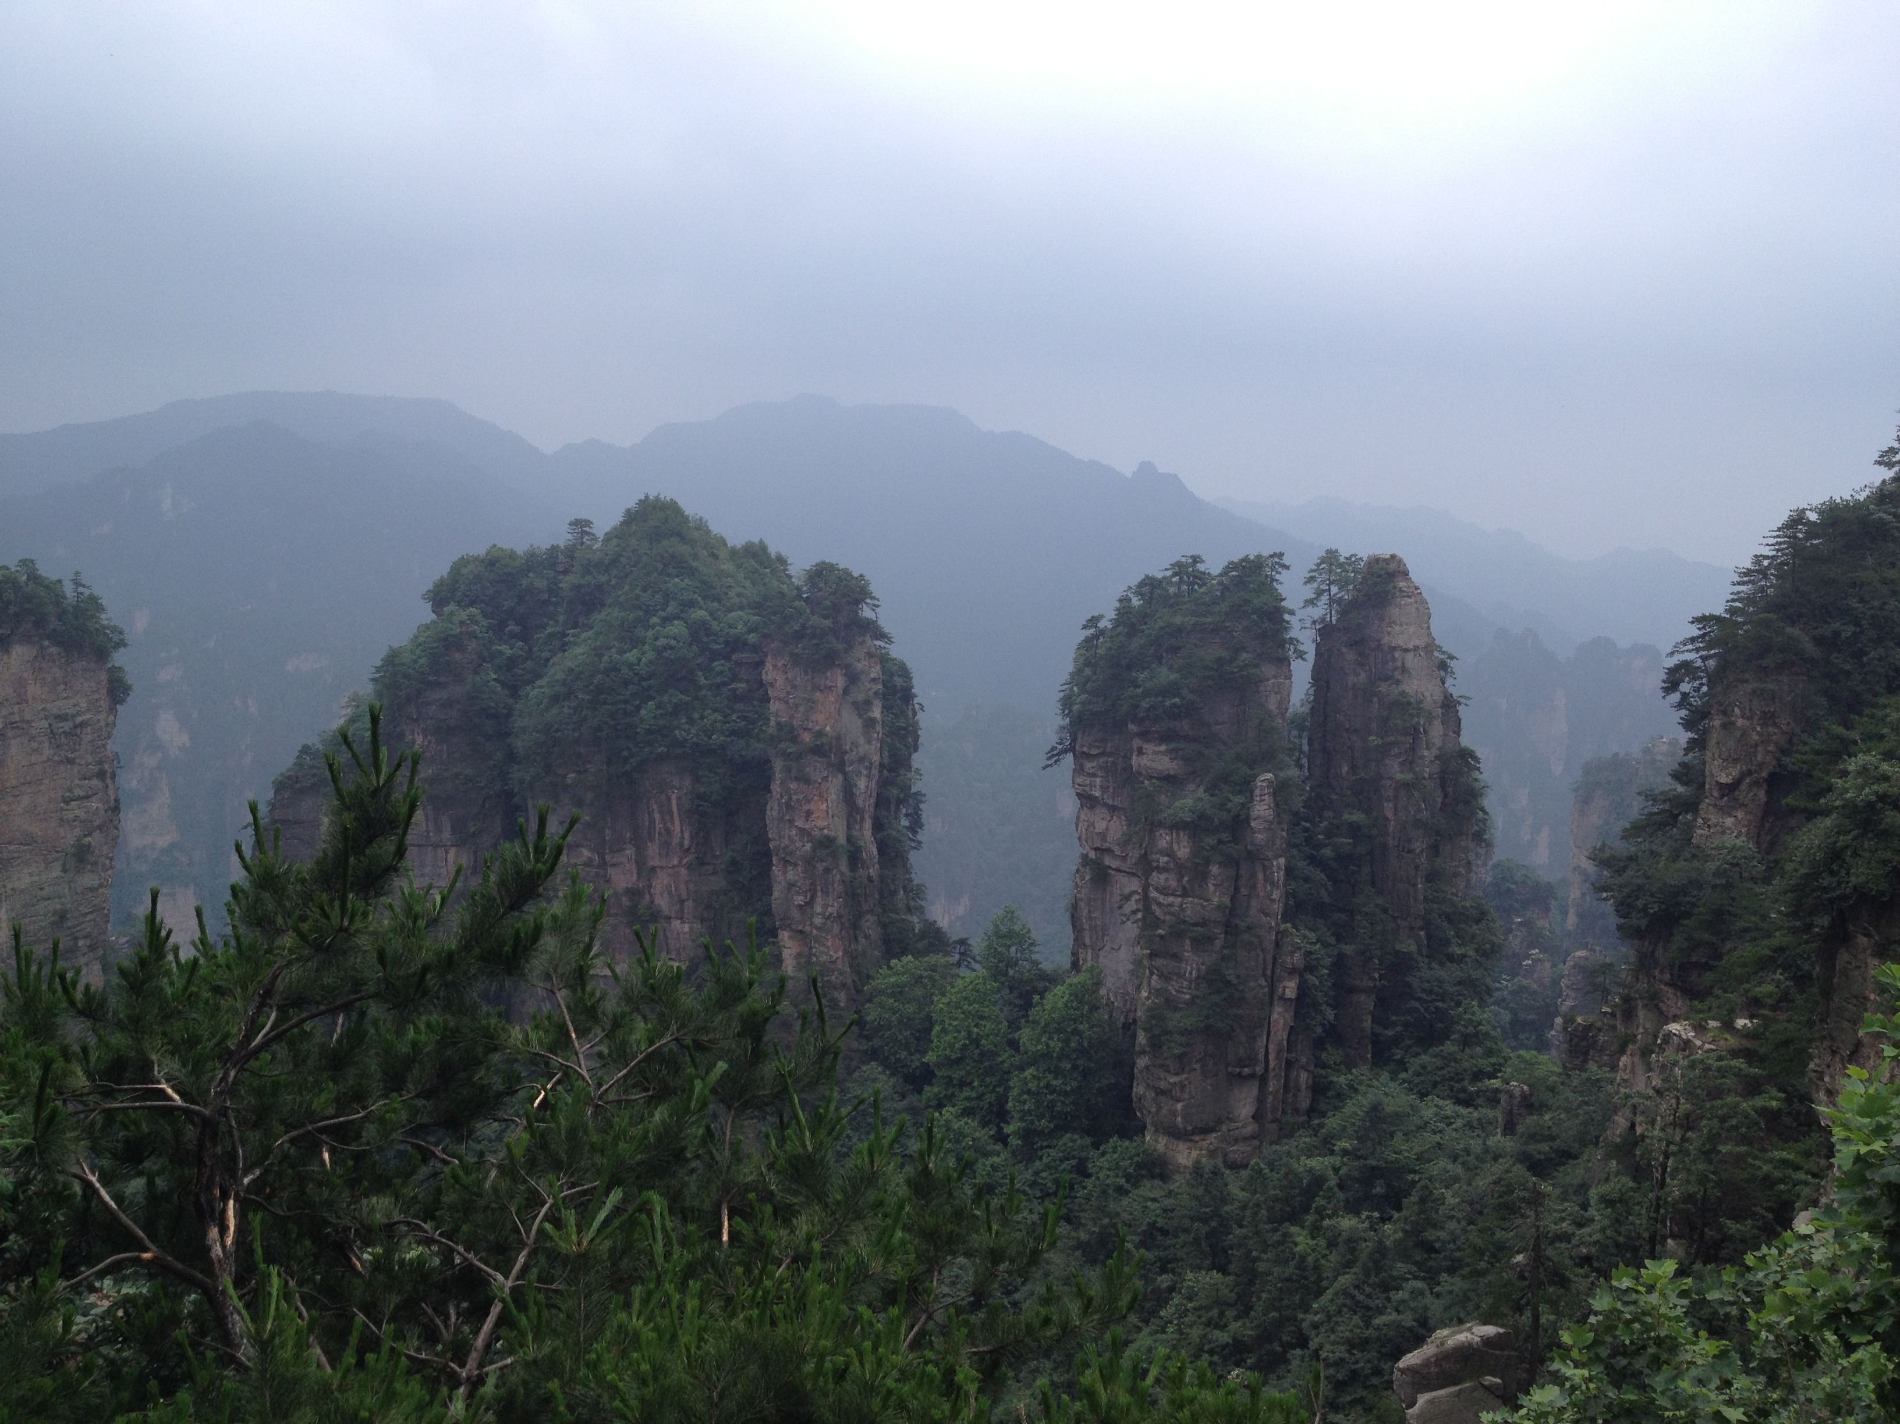

Slide 2
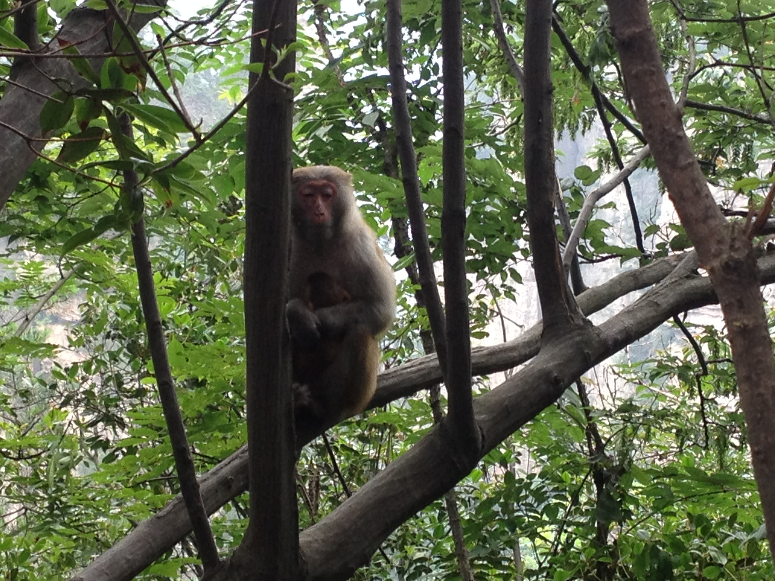

Slide 3
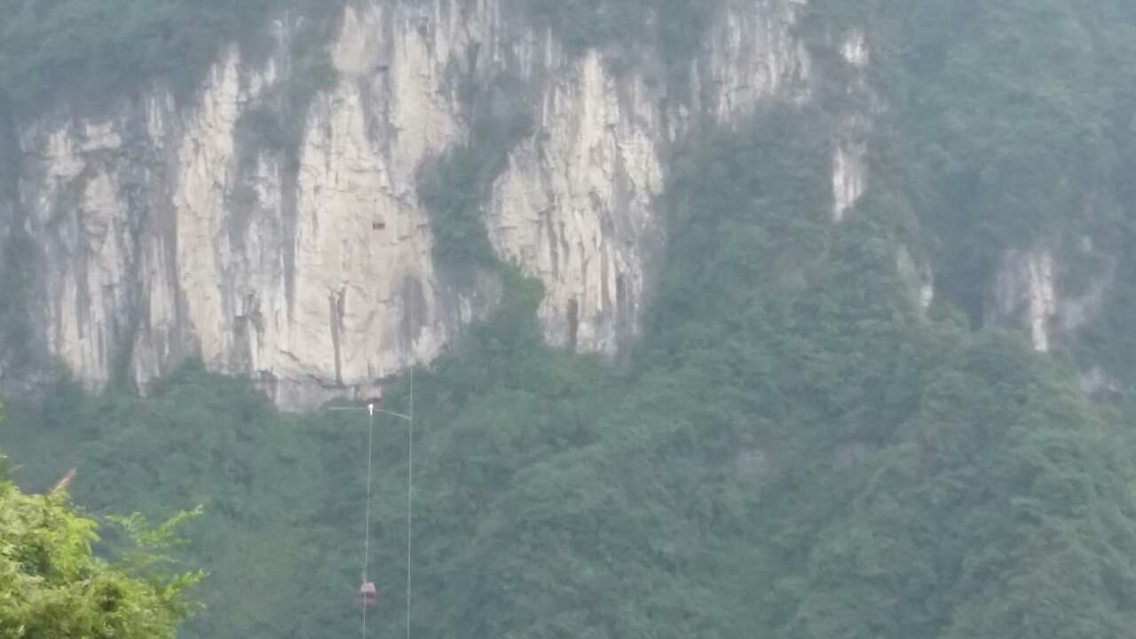

Slide 4
Approximating Semantics
AAIM, Vancouver, 2014, July 9
Ming Li
University of Waterloo
Notes:
First given at AAAC’2011 – Taiwan, 2011, April. (Tsinghua University in Taiwan), then revised for Wilfred Laurier 100 yr conf in July, 2011, then revised for DS2011, Oct 4, 2011. Then revised Dec 2011 for Solomonoff conference. Then changed April 16, 2012 for UW colloquium. Then at SharcNet. What do frogs eat with their hamburgers – French flies. Why do gorillas have big nostrils? (because they have big fingers) What has 4 wheels and flies (pick up truck hauling manures) Then at Huawei Sept 5, 2013.

Slide 5
Semantics and semantic distance are not well defined, perhaps cannot be defined (just like the concept of “computation”).
In (most) NLP applications, we do not really care about “semantics” of a query, but it is sufficient to know “semantic distance” from the query to another query that has an answer.
We will propose a theory of approximating the “semantic distance” (whatever it is) such that our approximation is “better than” any other approximation.

Slide 6
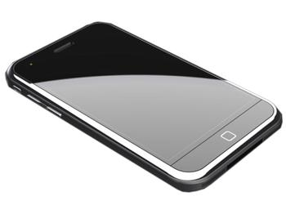
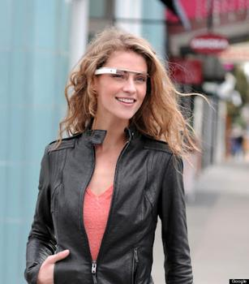
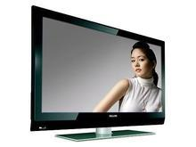
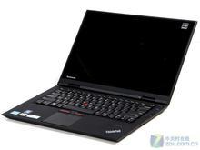
In the 20th century, we have invented hi-tech: Phones, TVs, Laptops
They will disappear in the 21 century
Replacing them: Natural User Interface

Slide 7
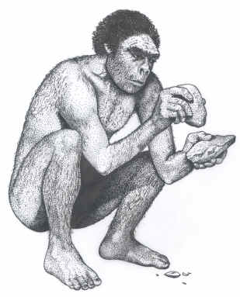
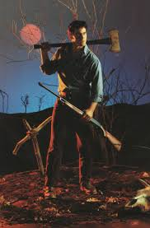
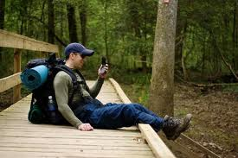
For 3 million years, our hands have been tied up by tools.
It is time to free them, again.

Slide 8
But the reality is not here yet
Let’s ask Siri
  What do fish eat?
  What does a cat eat?
What is the problem?

Slide 9
Problem 1: keywords vs templates
If you use keywords, like Siri, then you make mistakes like: “What do fish eat? → seafood”
If you use templates, like Evi, then you have trouble with even slight variations: “Who is da prime minister of Canada?”
We need to calculate the “distance” from a query to other queries with known answer.

Slide 10
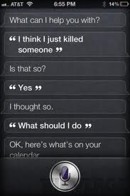
Problem 2: Domain classification
How can we prevent the mix up?
Ideally: we need to define a “distance”
It should satisfy triangle inequality etc
What do fish eat?
Phone
Weather
Restaurant
Music
GPS
Calendar
Time
General
search
Hotels
News
SMS
Email

Slide 11
Problem 3: What I said vs what it heard
In CACM, July 2013
How to improve speech recognition system in our QA domain?
Solution:
  Use 40 million user asked questions, set Q.
  Given voice recognition result {q₁,q₂,q₃}, we wish to find q, s.t.:
{q₁,q₂,q₃} ⬄ q ⬄ Q
is minimized.
How to define the distances?

Slide 12
Prob. 4: What it translates to vs what I meant
In CACM, July 2013
Translation systems are not ready for QA.
  蚂蚁几条腿? Google: Ants several legs.
  How do we improve it for special QA domain?
Solution:
  Use 40 million user asked questions, set Q.
  Given the translation result q₁, we find q, s.t.:
q₁ ⬄ q ⬄ Q
is minimized.
How do we define the distance?

Slide 13
Talk plan
Derive “Information Distance” to approximate the undefined semantic distance.
Apply it to solve problems 1-4.

Slide 14
Traditional approach:
We could apply one of the 21 statistical measures studied in [Tan et al: Selecting the right interestingness measure for association patterns, KDD’02], but why?
We could use one of the traditional edit or Hamming distances, but why?
What makes most sense is “closeness in semantics” or call it “semantic distance”, but this cannot be mathematically defined.
A related interesting study to match in “latent space”（Li Hang). Our work actually gives a theoretical interpretation to this approach.

Slide 15

What is a “distance”?
In physical space:
What is the distance between two information carrying entities: web-pages, genomes, abstract concepts, books, vertical domains, a question and an answer?
We want a theory:
  Derived from the first principles;
  Provably better than “all” other theories;
  Usable.

Slide 16


The classical approaches do not work
For all the distances we know: Euclidean distance, Hamming distance (sum of # of pixels that differ), nothing works. For example, they do not reflect our intuition on:
But from where shall we start?
We will start from first principles of physics and make no more assumptions. We wish to derive a general theory of information distance.
Austria
Byelorussia 1991-95

Slide 17
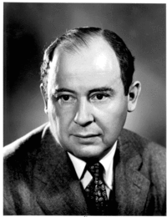
Thermodynamics of Computing
Heat Dissipation
Input
Compute
Output
Von Neumann, 1950
Physical Law: 1kT is needed to (irreversibly) process 1 bit.
Landauer

Slide 18
Reversible computation is free
A billiard ball computer.
Input
Output
A
A AND B
0
1
1
0
0
1
1
1
0
0
0
1
1
1
A
billiard
ball
computer
B AND NOT A
A AND NOT B
B
A AND B

Slide 19
Deriving the theory …
Cost of conversion between x and y is:
E(x,y) = smallest number of bits needed to
convert reversibly between x and y.
x
p
y
Fundamental Theorem:
E(x,y) = max{ K(x|y), K(y|x) }
Bennett, Gacs, Li, Vitanyi, Zurek, STOC’93. IEEE Trans-IT 1998

Slide 20
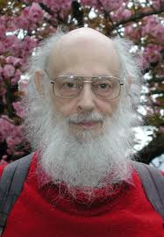
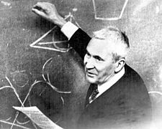

Kolmogorov complexity
Kolmogorov complexity was invented in the 1960’s by Solomonoff, Kolmogorov, and Chaitin.
Kolmogorov complexity of a string x condition on y, K(x|y), is the length of shortest program that given y prints x. K(x) = K(x|ε).
If K(x) ≥ |x|, then we say x is random.
Notes:
Similar talk was given in Taiwan AAAC, 2011, April.

Slide 21
Proving E(x,y) ≤ max{K(x|y),K(y|x)}.
Proof. Define graph G={XUY, E}, and let k₁=K(x|y), k₂=K(y|x), assuming k₁≤k₂
  where X={0,1}*x{0}
  and Y={0,1}*x{1}
E={{u,v}: u in X, v in Y, K(u|v)≤k₁, K(v|u)≤k₂}
X: ● ● ● ● ● ● …
Y: ○ ○ ○ ○ ○ ○ …
We can partition E into at most 2^{k₂+2} matchings.
  For each (u,v) in E, node u has most 2^{k₂+1} edges hence belonging to at most 2^{k₂+1} matchings, similarly node v belongs to at most 2^{k₁+2} matchings. Thus, edge (u,v) can be put in an unused matching.
Program P: has k₂,i, where M_{i} contains edge (x,y)
  Generate M_{i} (by enumeration)
  From M_{i},x ➔ y, from M_{i},y ➔ x. QED
degree≤2^{k₂+1}
M₁
M₂
degree≤2^{k₁+1}

Slide 22
Information distance:
D(x,y) = max{K(x|y),K(y|x)}
Theorem: For any other “reasonable” D’, there is a constant C, such that for all x, y,
D(x,y) ≤ D’(x,y) + C

Slide 23
Interpretations
Thus Information distance covers all computable distances like: edit distance, all 21 distances in Tan paper.
What we really want is “Semantic Distance”. But what is it? Like the concept of “computable”, Nobody knows.
  There are works, such as latent matching, trying to use it (in search context).
  But as long as it is a computable approach, it is dominated by information distance.
Let’s make a bold approximation:
Information Distance ≈ Semantic Distance

Slide 24
Relationship
Information Distance
Dominates
Traditional Distances
Semantic Distance
Any computable
version of semantic
distance

Slide 25
Problem 1. Template variation
What is weather like in HK tomorrow?
What is weather in HK tomorrow?
Tomorrow what is weather like in Hong Kong?
In HK what will be weather like tomorrow?
How is weather in Hong Kong tomorrow?
I wish to know the weather in HK tomorrow?
They all mean the same –
and they have very small information distance to each other!

Slide 26
Semantic Encoding
Thus, we are implementing an information distance encoding system. Example:
  “In HK”: position change, log4=2 bits. Fredericton to Waterloo, 1 bit using wordnet
  “will be” vs “is”: 1 bit.
  “Hi,” contains no information: 0 bits.
Anything with small information distance gets the same answer.
The complete encoder involves: Hoffman coding, Shannon Fano codes, Arithmetic codes, and involves Yago, Wordnet concept ontology.
In HK what will be weather like tomorrow?
Hi, what is weather like in Waterloo tomorrow?

Slide 27
Problem 2. Domain Classification
Weather domain positive/negative samples:
  What should I wear today?
  May I wear a T-shirt today?
  What was the temperature 2 weeks ago?
  Shall I bring an umbrella today?
  Do I need suncream tomorrow?
  What is the temperature on the surface of the Sun?
  How hot is the sun
  Should I wear warm clothes today?
  What is the weather like last Christmas?

Slide 28
To build up a weather domain systematically
Clusters:
What is the weather like [location phrase] ?
What is the temp [time phrase] [location phrase] ?
We have obtained 40
million questions, Q
Keywords: weather, city, time,
rain, temperature, hot, cold,
wind, snow, umbrella, T-shirt,
API(Weather)
6000 questions extracted from Q:
What is the weather like?
What is the weather like today?
What is the weather like in Paris?
What is the temperature today?
What is the temperature in Paris?
There are ~3000 negative examples:
What is the temperature of the sun?
What is the temperature of the boiling water?

Slide 29

Comparison of RSVP, Siri, S-Voice on 100 typical weather “related” questions:
What weather is good for an apple tree?
What is the temperature on Jupiter?

Slide 30
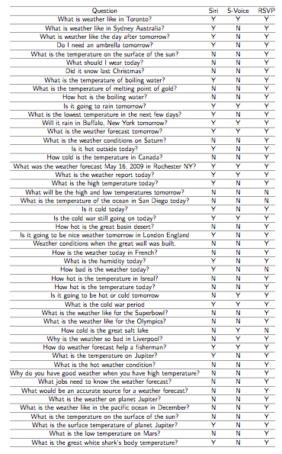

Slide 31
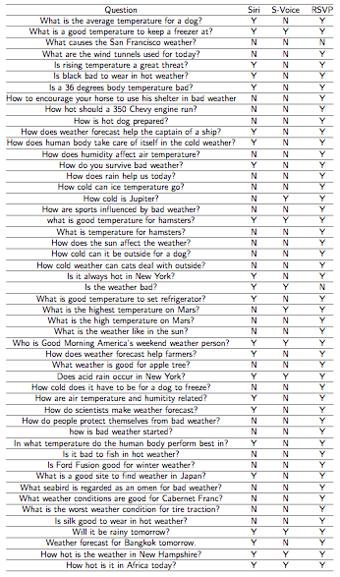

Slide 32
Problem 3. Speech improvement
Comm. ACM, July, 2013
Original question: Are there any known aliens?
Voice recognition result
  Are there any loans deviance
  Are there any loans aliens
  Are there any known deviance
RSVP outputs: “Are there any known aliens”，via minimizing the following with semantic encoding:
{q₁,q₂,q₃} ⬄ q ⬄ Q

Slide 33
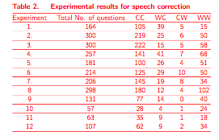
Experiments summary

Slide 34
Problem 4. Translation
Comm. of ACM, July, 2013, pp 70-77
Using information distance via semantic encoding, we can now also minimize:
q₁ ⬄ q ⬄ Q
从深圳到北京坐飞机多长时间？
  Google translation: Fly from Shenzhen to Beijing how long?
  Bing Translation: From Shenzhen to Beijing by plane to how long?
  RSVP translation: How long （does it take） to fly from Shenzhen to Beijing
恐龙是什么时候灭绝的？
  Google: Dinosaur extinction when?
  RSVP: When did the dinosaurs extinct?

Slide 35

Translation experiments:

Slide 36
Importance of Translated Search
Smartphone Trend: 2011 Q2, 2012 Q2 2013 Q2
US: 24M 24.2 M 32.9M
China: 24M 44.4 M 88.1M
Can we reach these people?

Slide 37
RSVP: Natural language QA Engine
Originally, for cross language SMS service:
  Funded by Canada’s IDRC, for developing world
  Natural language question answering.
  For people who are not on the internet.
Then the project has evolved to a full fledged cross-language QA search engine.

Slide 38
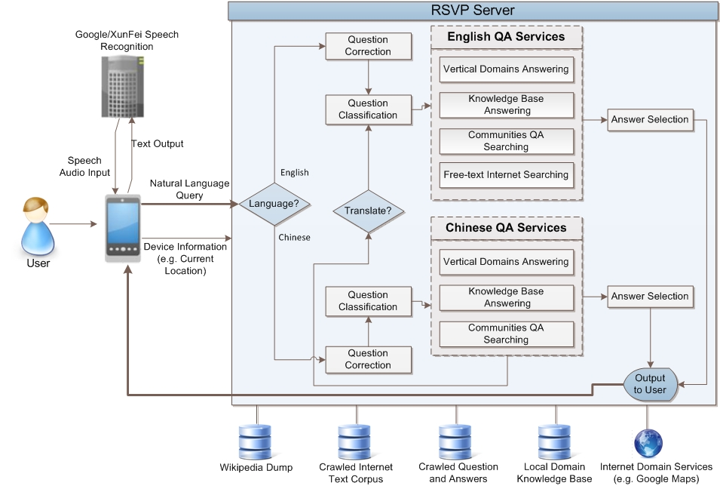
RSVP QA Engine Architecture

Slide 39
A typical “personal assistant” system
General Search Q*
Phone
Music
GPS
Weather
Calendar
Time
Hotel
Food
News
Email
SMS

Slide 40
RSVP QA System
English Domains
  General search
  Weather
  Time
  Restaurants
  Map
  Gas price
  Stock price
  News
  Movie theatres
Chinese domains
  通用搜索
  跨语言搜索(英文wikipedia）
  天气
  问菜价
  地图导航
  计算、单位转换
  成语
  音乐
  字典: 歹+珍的右边是什么字？
  股市
  新闻
  菜谱
  诗歌,文学
  航班信息
  日历，农历，车牌，IP地址，笑话，翻译，等

Slide 41
It features
1. A general QA system in both English and Chinese, with good coverage.
  Convert into an English / Chinese Siri type of systems quickly.
  Compared to Siri or S-Voice, the system is based on a theoretical background.
  Answers many more questions in Chinese. E.g.
  多伦多人口是多少？
  有多少人住在多伦多？

Slide 42
2. Unique cross language search
  Translated answer in Chinese. E.g
  问： 多伦多市长是谁？
  回答：多伦多 。。。 罗布 福特。
  via English wikipedia.
  Allows extension to other foreign languages quickly.

Slide 43
3. A compiler and classifier that is based on a good theory, that allows
  Learning new domains when there is data
  Quick generation of new domains when there is no data in two ways:
    Similar domain learning / inference
    User generated conversation domains

Slide 44
Human Computation
  We are building a natural language based weather app for the Chinese Central Weather Bureau.
  We are building a natural language based map app for Chinese Bureau of Surveying and Mapping (Tianditu), as well as for NavInfo for car navigation.

Slide 45
Let me described the weather app
Already 18 million users.
Only official and unique Data:
  3 KM grid data, so that you could ask: will it rain at the Beijing airport?
  Historical data, so that you could ask: did it rain last Christmas? Or, what is the average temp on July 16th in Beijing?
  Disastrous weather warning: we are the only agency to issue such warnings.
Instant weather – NLP allows us to collect data to be collected from the users by conversation.
Animation, no button.

Slide 46
Conclusion
We have described
  A proposal to use information distance to approximate semantics.
  A working prototype system partially based on this theory.
Case Study: Taobao (Alibaba) shopping assistant
  100 million users, $200 billion USD revenue.
  Thousands of domains
  Each domain such as “skin care products” will need an experienced team for 1-2 months.
  Our information theoretic approach allows two things:
    Similar domain learning – generating similar new domains by semantic encoding. E.g. men clothing domain to female clothing.
    Domain owner generating conversation examples, we provide all possible variations automatically. Thus the customers can generate domains on their own!

Slide 47
Collaborators:
Information distance: C. Bennett, P. Gacs, P. Vitanyi, W. Zurek
RSVP system: K. Xiong, G.Y. Feng, A.Q. Cui, HC. Qin, B. Ma, J.B. Wang, Y. Tang, D. Wang, X.Y. Zhu, Y.H. Chen, A. Lin, Hang Li, Qiang Yang.
Financial support: Canada’s IDRC, PDA, Killam Prize, C4-POP, CFI, NSERC, Huawei Corp.

