Slide 1
Bert QA – Attention on Steroids
Shreyance Jain
MMath Computer Science (Coursework)
University of Waterloo

Slide 2
Introduction
This paper extends the BERT model with an emphasis on directed co-attention to obtain better performance
Tackles the QA problem which is one of the most popular in NLP (SQUAD 2.0)
Other networks such as BIDAF, BERT and QANET have attempted to understand the SQUAD dataset.
BERT was chosen as the baseline – contextual embeddings and global attention- faster than RNN
Tested the limits of applying attention to BERT improving network’s performance on the SQUAD 2.0 Dataset

Slide 3
Motivation
BERT applies attention to the concatenation of the query and context vectors and thus attends to these vectors in a global fashion
Propose BERTQA which adds Context to Query(C2Q) and Query to Context(Q2C) in addition to localized feature extraction via 1D convolution
Inspiration for the modifications were derived from BIDAF and QANET models
BIDAF is an LSTM based network that uses character, word, and contextual embeddings which are fed through C2Q and Q2C layers. Final logits are derived from separate Start and End Output layers as opposed to BERT
QANET model – fully feedforward network that emphasizes the use of convolutions to capture the local structure of the text

Slide 4
Methods
Directed co-attention via C2Q and Q2C from BIDAF
Localized Feature Extraction by 1D convolutions to add local information to co-attention based on QANET model
Applied what was learnt to the BERT large model

Slide 5
Directed Co-attention
Base BERT network – 12 encoder blocks
Encoder blocks contain multi-head attention and a feed-forward network . Each head of the multi-head attention attends to the concat(context,query) – Global attention input
The output of each transformer encoder is fed into the net layer, creating an attention hierarchy
BERTQA uses directed co-attention between query and context as opposed to their concatenation
7 directed co-attention blocks inserted between BERT embeddings and the final layer before loss calculation

Slide 6
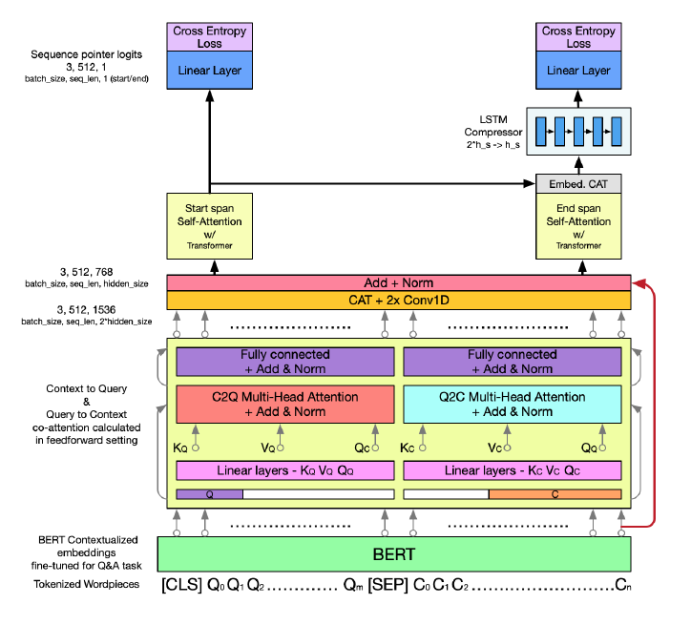
Proposed C2Q and Q2C directed co-attention architecture

Slide 7
Directed co-attention
BERT embeddings are masked to produce separate query and context embedding vectors
$$E_{q}=E ∗m_{q}$$
$$E_{c}= E ∗m_{c}$$
E – contextualized embeddings derived from BERT, m is the mask and q and c are query and context resp.
$E_{q}$ and $E_{c}$ are projected through linear layers to obtain key, value and query vectors
$$P_{x}=W_{P}E_{x}^{T}+b_{P}$$
$$∀P∈Q,K,V and x ∈q,c$$

Slide 8
Directed co-attention
The Q,K,V vectors are used in scaled dot product attention to create C2Q and Q2C attention vectors
$$Q2C Coattention\left(Q,K,V\right)=softmax\left(\frac{Q_{q}K_{c}^{T}}{\sqrt{d_{k}}}\right)V_{c}$$
$$C2Q Coattention\left(Q,K,V\right)=softmax\left(\frac{Q_{c}K_{q}^{T}}{\sqrt{d_{k}}}\right)V_{q}$$
The C2Q attention vector is summed with the query input via skip connection
The Q2C attention vector is summed with the context input via skip connection
Each sum vector is then pushed through a fully connected block and added to the output via another skip connection followed by a layer wise normalization

Slide 9
Directed co-attention
This results in 3D C2Q and Q2C vectors which are concatenated along the embedding dimension
This is combined by 2 1D convolutions to create final 3D vector representing the combination of C2Q and Q2C attention
2 Convolutional layers are used so that the dimension is reduced gradually
This vector goes to the final attention head to perform self attention pre-processing for the start logit and end logit prediction layer
Start logit – linear layer
End logit – output of LSTM (concatenation of start span and end span embeddings as an input)

Slide 10
Localized Feature Extraction
Convolutional feature extraction to add localized information to the concatenation input
4 convolutional layers added
Input – BERT embeddings
Outputs were added to the outputs of multi head attention layers
Co-attention + Local information -> hierarchical understanding of the question and the context
The convolutions extract local features within the question and context to add localized info
Notes:
By itself, BERT provides information about
the question and context as a unit, while the coattention extracts information from both the question and context relative to each other.
The convolutions extract local features within the question
and context to add localized information to the attention and embedding meanings

Slide 11
SQUAD 2.0 Dataset
Stanford Question Answering Dataset (SQuAD) is a reading comprehension dataset, consisting of questions posed by crowd-workers on a set of Wikipedia articles, where the answer to every question is a segment of text, or span, from the corresponding reading passage, or the question might be unanswerable.
SQuAD2.0 combines the 100,000 questions in SQuAD1.1 with over 50,000 unanswerable questions written adversarially by crowd-workers to look like answerable ones

Slide 12
Data Augmentation
A lot of syntactic and grammatical variance in the questions of SQUAD 2.0 dataset
Augment dataset by paraphrasing the questions
Back translation using Google Cloud Translation (NMT) API to translate the sentence form English to French and then do a back translation to English
3 different versions – 35%, 50% and 100% augmentation
Notes:
To help our network generalize
better to these variations we decided to augment the dataset by paraphrasing the questions in the SQuAD training set.

Slide 13
BERT Large and Ensembling
Applied co-attention and localized feature extraction to the large BERT model
BERT large requires a large batch size to get good performance
Bath size was chosen a 6 and used a gradient accumulation of 3 so that only 2 examples were on the GPU at a time
Learning rate from 1.1e-5 to 1.5e-5 works best for the large model
Model Configurations; BS=Batch Size, GA = Gradient Accumulation, LR = Learning Rate

Slide 14
Results and Analysis
The results verify the hypothesis that adding layers of attention improves its performance
C2Q/Q2C network improves No Answer F1 score and a symmetric decrease in Has Answer F1 score
The skip connections improve the score by adding BERT embeddings
The transformer skip connection provides minimal gains while adding overhead
Notes:
Exact match. This metric measures the percentage of predictions that match any one of the ground truth answers exactly.
F1 and EM scores obtained for the experiments on the base model. The first
column reports the base BERT baseline scores, while the second reports the results for the C2Q/Q2C
attention addition. The two skip columns report scores for the skip connection connecting the BERT embedding layer to the co-attention output (Simple Skip) and the scores for the same skip connection containing a Transformer block (Transformer Skip). The final column presents the result of the localized feature extraction added inside the C2Q/Q2C architecture
The C2Q/Q2C network attends the context relative to the query and vice versa instead of as a concatenated whole.
The skip connections improved the scores
further by adding the BERT embeddings back in to the coattention vectors and providing information that may have been lost by the C2Q/Q2C network in addition to providing a convenient path for backpropagation to the BERT embedding layers.
Therefore, we built the final convolutional experiments on the Simple Skip architecture. The localized feature extraction within the coattention network produced the best results in the base model, but prevented an improvement in our modified BERT large model.

Slide 15
Results and Analysis
Model 1 shows that 35% augmented dataset helps training compared to other models
Highly augmented models (50%) did not perform well due to noisy data
LSTM Model combines the start logit and end embeddings for input to end logit linear layer successfully
Ensemble model is the best for No Ans F1
Notes:
Each of the models built on BERT large used our augmented dataset in addition to the coattention architecture, simple skip connection, and separate start and end logit logic.
It seems that adding too much augmented data reduces the F1 because the augmented data is noisy relative to the original data.
The ensemble model performed the best by far due to a significant increase in the no answer F1 which can be attributed to the ensembling method
which is biased towards models that predict no answer.

Slide 16
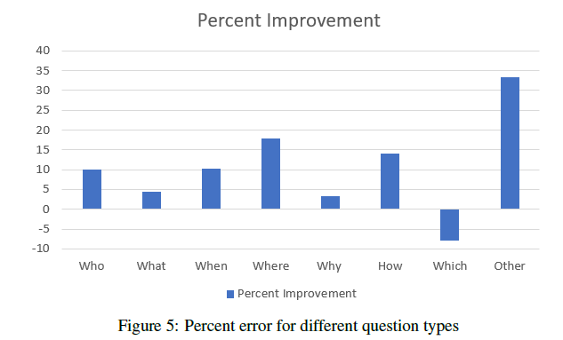
Analysis
Model performs better across all questions except Which?
Due to Data Augmentation What was replaced by Which and vice versa
The questions in the two classes are mixed and accurate analysis is not possible
Notes:
In the case of ”Which” questions, our model goes wrong 69 times where as the baseline model goes wrong 64 times, a very small numeric difference. However,
for the ”What” questions the baseline model produces incorrect outputs for 776 examples while our model produces 30 fewer incorrect outputs.

Slide 17
Notes:
an example question & answers correctly while the BERT large model answers incorrectly. It seems that the BERT large model combined the
words spirit and Christian to answer this question even thought the word spirit belongs to martial and the word Christian belongs to piety. Our model was able to keep the paired words together and realize that the question has no answer. We believe that our model was able to get the correct answer
because of the co-attention which can keep the words paired together correctly.

Slide 18
Summary
Novel Architecture scheme – Directed co-attention and Localized Feature Extraction
Data Augmentation with NMT Backtranslation
Ensemble model gives a 3.5 improvement over BERT large
Ablation studies using different architectures, skip connections and augmented datasets
SQUAD 2.Q dataset helps improve performance by mimicking the natural variance in questions present in the SQUAD 2.0 dataset
BertQA produces a significant improvement in the No Answer F1 by being able to maintain associations between words via coattention

Slide 19
Future Work
Improve on the quality of data augmentation to limit noise
Recent architectures like Transformer-XL – (better Has Answer F1 performance)
Pre-train C2Q and Q2C layers similar to BERT to learn deeper language semantics

Slide 20
Questions?

