Slide 1
Deep Neural Net Scenery Generation
Adam Schunk

Slide 2
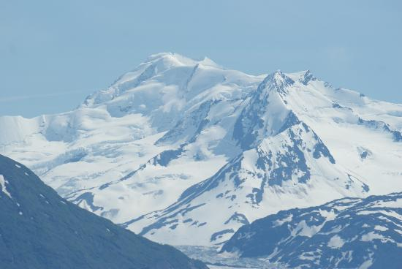
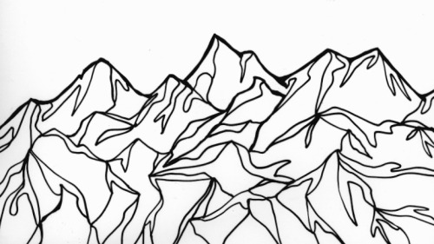
Motivation
Notes:
Many systems have been developed to turn text into images
Want to be able to turn sketches into nicely rendered images
This has been done for items, such as handbags etc.
This application is mainly aesthetic
However if it were applied to something such as profile sketching it could be quite useful

Slide 3
Examples
Notes:
This has been done a lot for indoor images (bedroom dataset shown in class)
Adding detail has an effect on the outcome

Slide 4
Image Generation
Two main components to current image generation deep learning networks
Convolution (CNN)
Adversarial (GAN)
The combination of these two methods is DCGAN
Notes:
These two types of networks can be used separately separate
DCGAN was recently developed

Slide 5
Convolutional Networks
Notes:
(Brief recap)
Operate by alternating between convolutional layers and pooling layers
Works well with any problem that involves grouping (letters into words, pixels into sub-images)

Slide 6
Convolution and Pooling layers
Convolutional layers
Extract features from the images by applying filters
These filters are learned by the network itself
Pooling layers
Provide translational invariance
Reduces the number of nodes in the network improving training time
Notes:
Size and number of filters is manually defined, however the internal structure of each is determined by the network
Can either be used to make an input larger or smaller by sampling, but making the input smaller is more common
Attempts to make use of the structure of images and is location independent (does not care about shift)
This method assumes that nearby pixels are related to each other so fewer weights are needed overall
This is done at every layer so these networks are generally easier to train

Slide 7
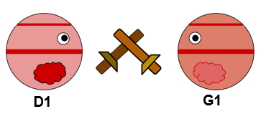
Adversarial Networks (GANs)
Implemented by creating two neural networks that compete against each other in a zero-sum game.
One network generates data while the other attempts to discriminate between the generated data and ground truth
Notes:
Zero sum meaning that for one side to win, the other must lose an equal amount. Thus there is no cooperation
In these systems both networks are generally trying to learn the same thing, however you want the generator to win in the end.
That being said you still want the discriminator to put up a fight

Slide 8
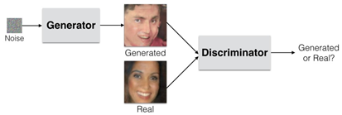
Deep Convolutional Generative Adversarial Networks (DCGANs)
Combination of GAN and CNN
Generator tries to fool Discriminator with realistic fake pictures
Pictures are generated based on the assumption of an underlying PDF for the dataset
Notes:
Brief review (already did this in class)
This is the adversarial part of GAN
The generator and discriminator essentially train each other
Discriminator trained to separate real and fake images
Generator trained to create realistic fake images
For this to work the assumption has to be made that there is an underlying PDF for the image set

Slide 9
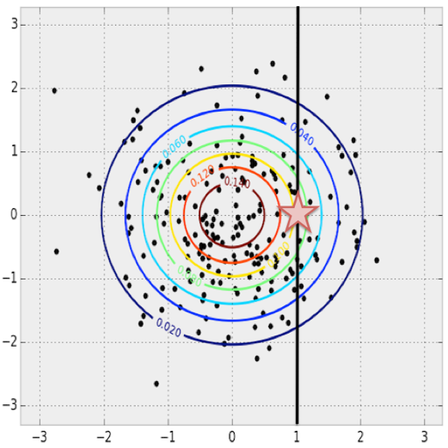
K-dimensional PDF
Break down the PDF into one dimension per pixel
Probabilities for each dimension can be maximized based on the values of the other dimensions
Notes:
Given any x (pixel 1) value you can find the maximum likelihood y (pixel 2) value
This is a particularly uninteresting scenario (gaussian distribution)
Leads to a “most likely image” because of global max

Slide 10
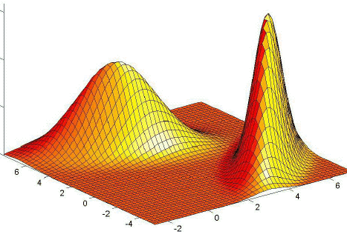
Fake Image Generation
Slightly more complicated PDF yields more possible outcomes
By starting at any point on the graph you can attempt to converge to a local maximum
Notes:
Computing this is hard, so we just sample it
This is what allows us to start with a partially completed image
If we start with a sketch it should fall somewhere in that distribution and lead us to a local maximum
This is what the generator is trying to learn to produce realistic fake images and what the discriminator is trying to learn to tell the fake images from real ones

Slide 11
DCGAN Weaknesses
If the discriminator has a specific weakness then the generator can learn only that.
PDF’s of image datasets can be extremely complex leading the generator to only learn a small portion of it.
A powerful discriminator might make it very difficult for the generator to learn
Notes:
Certain features might trick the discriminator and thus break the generator if it is not trained well
Generator could only end up exploring one section of the PDF as it is not trying to find ALL solutions to fool the discriminator.
If the discriminator is too strong then it can be difficult for the generator to ever fool it.
Generator will not learn about anything sub-par

Slide 12
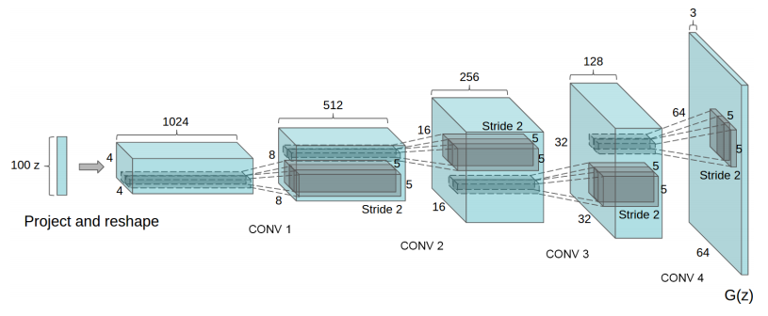
Current Method: Model
DCGAN is trained on sample images
ReLU is used as the activation function for every layer in the generator
The discriminator uses leaky ReLU
Notes:
Want to move on to landscapes if this proves successful
The number and size of the layers has been changing

Slide 13
Current Method: Data
US Adult Faces Database
Contains 10,000 images
Faces are from multiple angles and backgrounds
Will switch the dataset once I have a working system with faces
Notes:
Initially I wanted to start of with landscapes, however there are a lot more databases of faces

Slide 14
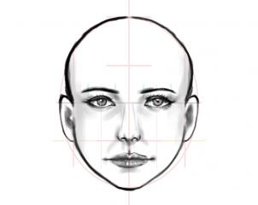
Current Model: Results
Notes:
Take in a random sketch from a google search

Slide 15
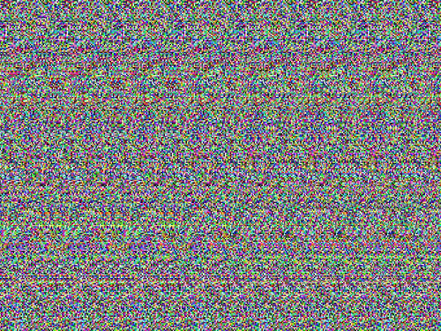
Current Model: Results
Notes:
Lots of random noise
Potential issues:
Shape of DCGAN network
Attempted to implement from scratch – there’s a lot of documentation on this type of thing
Should follow that for my next attempt

Slide 16
Related Work
Recurrent adversarial networks (GRAN)
Style and Structure GAN (S²-GAN) for 3D modeling
Notes:
Since I do not have any interesting results I thought I would show some people who do

Slide 17
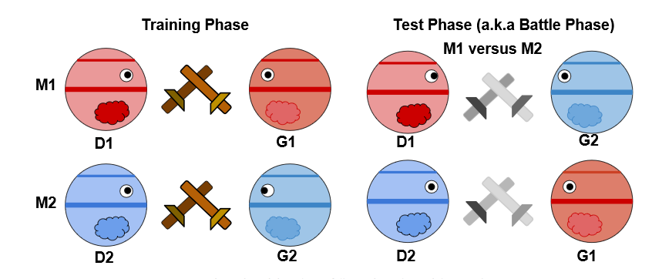
Recurrent Adversarial Networks
Proposes adding a recurrent aspect to the generator in a traditional GAN
Developed a new way to evaluate the performance of different GANs
Notes:
Talk a little about recurrent networks
Generator takes a !sequence! of noise samples as input
Training phase has wooden swords and the test phase has metal ones XD
In the past GANs were evaluated by looking at nearest neighbors in training data, or by hand
Each generator now tries to fool the other team’s discriminator

Slide 18
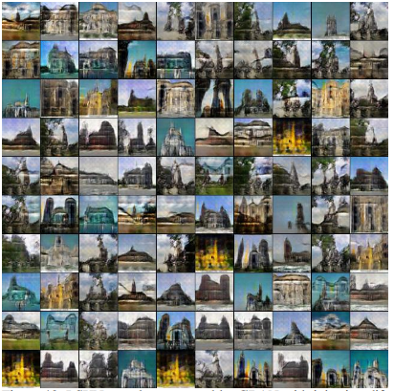

Slide 19
S²-GAN
Attempts to incorporate GAN into computer vision
Contains two separate GANs
Structure GAN: Generates surface norms
Style Gan: Maps images onto those surfaces
Notes:
Surface norms are generally fuzzy and the style does not always line up

Slide 20
S²-GAN
Unfortunately the style GAN was not able to fully follow the contours generated of the Structure GAN
To fix this each generated image is used to re-construct the surface normal map
If the generated image is real enough, the result should be accurate

Slide 21
Notes:
Images with the new norm constraint and without

Slide 22
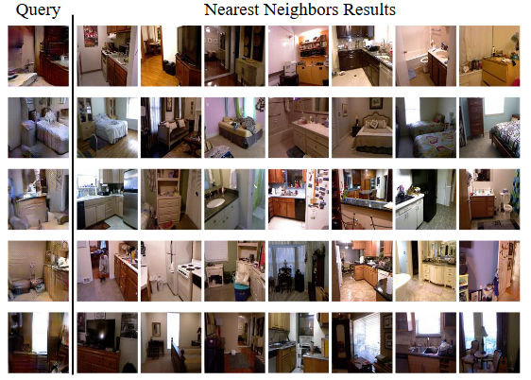
Notes:
Left is images generated by the network, right is the nearest neighbor in the dataset

Slide 23
Questions?

Slide 24
References
Im, Daniel Jiwoong, et al. "Generating images with recurrent adversarial networks." arXiv preprint arXiv:1602.05110 (2016).
Wang, Xiaolong, and Abhinav Gupta. "Generative image modeling using style and structure adversarial networks." European Conference on Computer Vision. Springer International Publishing, 2016.
http://bamos.github.io/2016/08/09/deep-completion/
https://filebox.ece.vt.edu/~jbhuang/teaching/ece6554/sp17/lectures/GAN-topic.pdf

