Slide 1
Predictive Flow Scheduling using Deep Learning
ELAHEH JALALPOUR

Slide 2
Outline
Introduction
Dataset
Deep learning as solution
Implementation and Evaluation
Related Work
Conclusion

Slide 3
Outline
Introduction
Dataset
Deep learning as solution
Implementation and Evaluation
Related Work
Conclusion

Slide 4
Flow Scheduling
Wide area network bandwidth
Example: WAN bandwidth inter-datacenter network
Constrained
Expensive
We want to maximum link utilization

Slide 5
Flow Scheduling
  Traffic flow
  A stream of packets coming from a source towards a destination
  Sharing a link among the traffic flows
  The aggregate rate of flows can be bigger than the capacity of the shared link
  An scheduler controls the rate at the traffic source using rate limiters
Scheduler
A
RL
Shared Link
B
RL
D
C
RL
E
The goal is to share the link among the flows to achieve maximum link capacity utilization
RL
Rate Limiter

Slide 6










Flow Scheduling – Continue
$$\max{\frac{1}{T}\sum_{t}{\sum_{i}{u_{i}^{t}}}}$$
Subject to:
$$∀t:∀i:u_{i}^{t}≤x_{i}^{t}$$
$$∀t:\sum_{i}{u_{i}^{t}}≤C$$
Shared Link
$$u_{i}$$
$$i$$
$$x_{i}$$
$$C$$
$$C$$
Link Capacity
$$u_{i}$$
Bandwidth utilization of flow $i$
$$x_{i}$$
Allocated bandwidth to flow $i$

Slide 7


Challenges
The bandwidth utilization of flows are unknown ($u_{i}^{t}$ is unknown)
$$\max{\frac{1}{T}\sum_{t}{\sum_{i}{u_{i}^{t}}}}$$
Subject to:
$$∀t:∀i:u_{i}^{t}≤x_{i}^{t}$$
$$∀t:\sum_{i}{u_{i}^{t}}≤C$$

Slide 8
Outline
Introduction
Dataset
Deep learning as solution
Implementation and Evaluation
Related Work
Conclusion

Slide 9
Dataset
Collected traffic from a real environment
The traffic over a single link
Start-Time | Duration | Total-Bytes | Source-Address | Source-Port | Destination-Address | Destination-Port

Slide 10
Dataset
Normalized between 0 and 1 as input

Slide 11
Outline
Introduction
Dataset
Deep learning as solution
Implementation and Evaluation
Related Work
Conclusion

Slide 12
Why Deep Learning?
Knowing the traffic pattern can lead to better flow scheduling

Slide 13
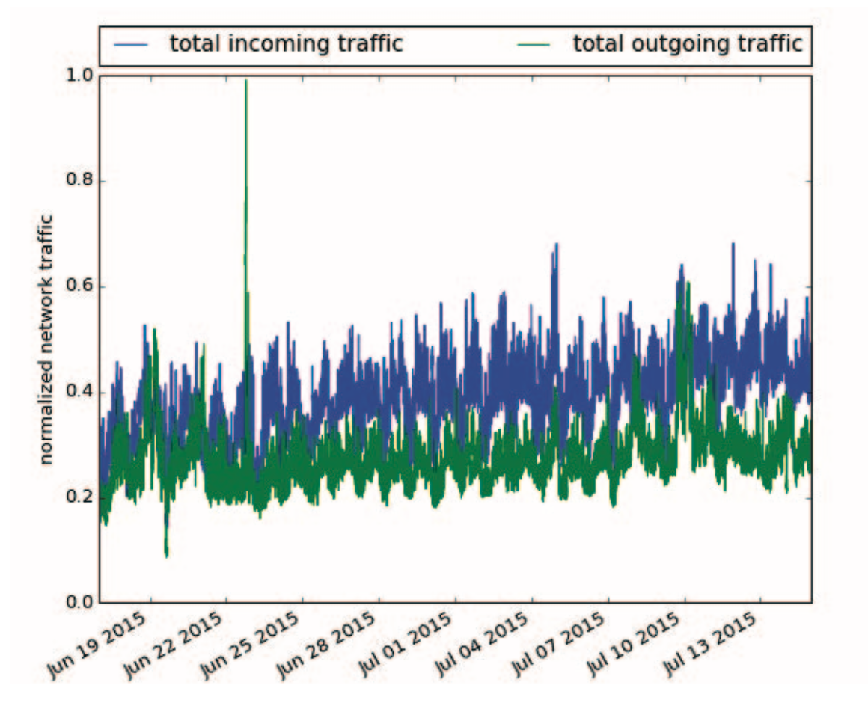
Why Deep Learning?
Traffic in the inter-DC networks often has a periodic pattern over time. Hourly/Daily
There is no unique traffic model to explain all traffic behavior
Some of traffic models
Poisson distribution
Pareto distribution process
Markov and embedded Markov models
Y. Li, H. Liu, W. Yang, D. Hu and W. Xu, "Inter-data-center network traffic prediction with elephant flows," NOMS 2016 - 2016 IEEE/IFIP Network Operations and Management Symposium, Istanbul, 2016, pp. 206-213

Slide 14
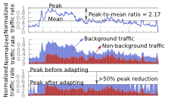
Why Deep Learning?
Traffic types
Interactive services
Elastic services
Background services
Notes:
We have three types of traffics in inter-dc networks:
Interactive services are in the critical path of end user experience
one DC contacts another in the process of responding to a user request
highly sensitive to loss and delay
Elastic services are not in the critical path of user experience
replicating a data update to another DC
requires delivery within a few seconds or minutes
Background services conduct maintenance activities
copying all the data of a service to another DC
bandwidth hungry
it has no explicit deadline or a long deadline

Slide 15
Outline
Introduction
Dataset
Deep learning as solution
Implementation and Evaluation
Related Work
Conclusion

Slide 16
Our Solution
Application of deep learning to
Predict traffic behavior
Schedule network flows
Utilizing the the traffic prediction to schedule network flows

Slide 17
Predict Traffic Behavior
LSTM to learn the traffic pattern
Techniques
LSTM for Regression Using the Window Method
  Multiple, recent time steps are used to make the prediction for the next time step
  Phrasing the past observations as separate input features
LSTM for Regression with Time Steps
  Using the past observations as time steps of one input feature

Slide 18
Train LSTM for Traffic Prediction
LSTM neural network
  input : 100 time step traffic volumes
  output : next step traffic volume
Hyper-parameters:
  learning rate: 0.001
  batch-size: 10

Slide 19
Results of Traffic Prediction

Slide 20
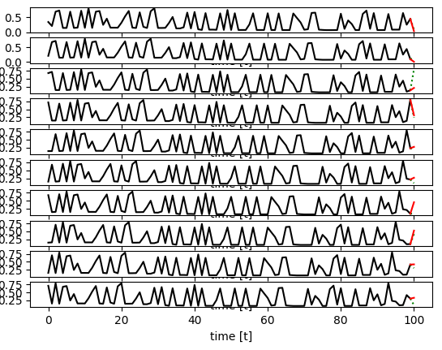
Results of Traffic Prediction

Slide 21
Scheduling Network Flows
Using Reinforcement learning to schedule network flows
Input: Bandwidth demands of flow in the last timestamp
Output: Bandwidth allocation to each flow
Reward: Link utilization

Slide 22
Reinforcement Learning for Flow Scheduling
Techniques
Vanilla policy-gradient
  One reward signal at the end of a long episode
  Does not work for continuous action space
Actor-critic policy-gradient

Slide 23
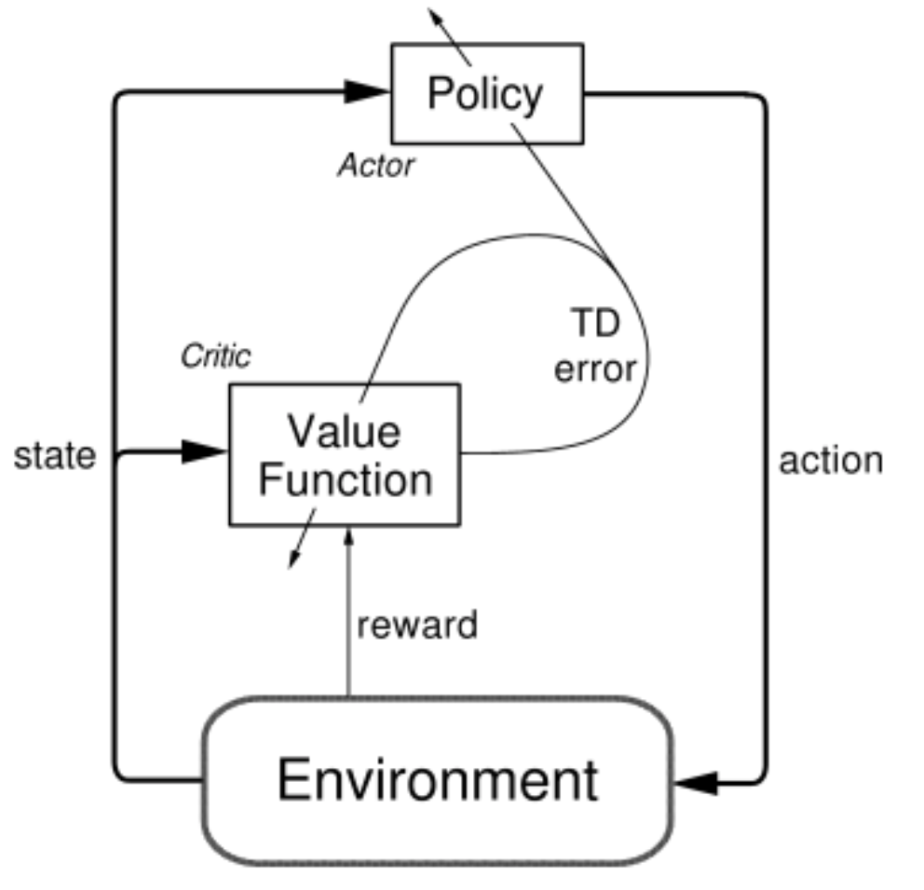
Actor Critic Policy Gradient (DDPG)
  Approximate both the value function and the policy
  Model-free
  Off-policy
  Replay buffer
Notes:
approximate both the value function and the policy
model-free
make no effort to learn the underlying dynamics that govern how an agent interacts with the environment
off-policy
use another network the same as policy and update it every T second
Replay buffer
store experiences <state,action,reward,next state> in a buffer and sample minibatches from it to train the network

Slide 24
Train and Testing DDPG
Hyper-parameters
Baseline
Step per episode = 200
Learning rates
  Actor: 0.001
  Critic: 0.0001
Greedy algorithm :
increase the allocation by a

Slide 25
Results of Flow Scheduling

Slide 26
Step three (In progress)
One agent for each flow group
Input: [link wastage of the last timestamp, total demand of the flow group in the last time stamp, total utilization of the flow group]
Output: prediction of the demand of the flow group
Reward: difference between the demand and the utilization ( penalize)

Slide 27
Future work
Add more features for the flow groups
separate different flow group’s behavior by giving ports and ips as embedded features
the actual ip and port numbers does not have any correlation, embedding form of them shows their relations

Slide 28
Outline
Introduction
dataset
Deep learning as solution
Implementation and Evaluation
Related Work
Conclusion

Slide 29
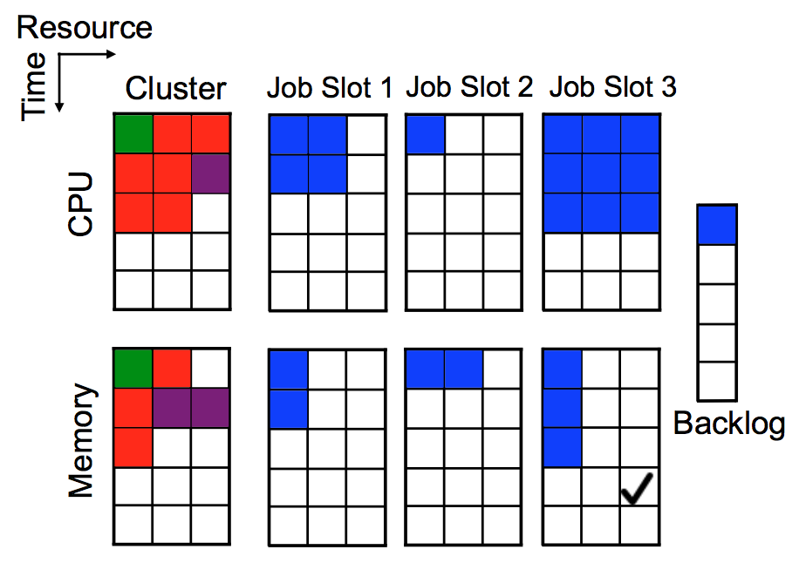
Related work
Job Scheduling in compute clusters
  SJF(shortest job first)
  Tetris scheduling heuristic [1]
  DeepRM [2] – a deep learning approach
  Agent learn interesting strategies like leave space empty for
future small jobs
[1] Robert Grandl, Ganesh Ananthanarayanan, Srikanth Kandula, Sriram Rao, and Aditya Akella. 2014. Multi-resource packing for cluster schedulers. SIGCOMM Comput. Commun. Rev. 44, 4 (August 2014), 455-466. DOI: https://doi.org/10.1145/2740070.2626334
[2] Hongzi Mao, Mohammad Alizadeh, Ishai Menache, and Srikanth Kandula. 2016. Resource Management with Deep Reinforcement Learning. In Proceedings of the 15th ACM Workshop on Hot Topics in Networks (HotNets '16). ACM, New York, NY, USA, 50-56. DOI: https://doi.org/10.1145/3005745.3005750

Slide 30
Outline
Introduction
dataset
Deep learning as solution
Implementation and Evaluation
Related Work
Conclusion

