Slide 1
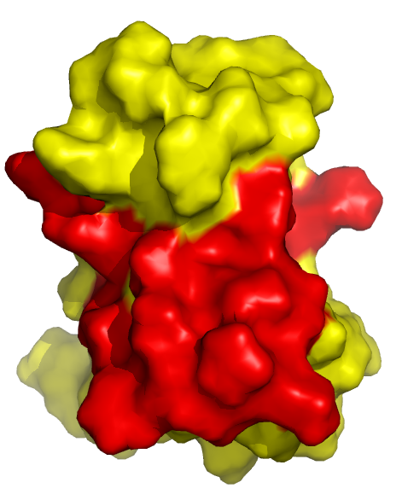
Deep Learning for Modelling of Protein-Protein and Protein-Ligand Interactions
(with applications in drug discovery)
Chris West,
David R. Cheriton School of Computer Science

Slide 2
Preliminary Assumptions:
I will try to build up all necessary concepts with minimal assumptions, but I assume you have some basic knowledge in:
Protein structure and Function
Deep -Learning
CNNs
Should be ~25 minutes long, feel free to ask questions throughout or else at the end

Slide 3
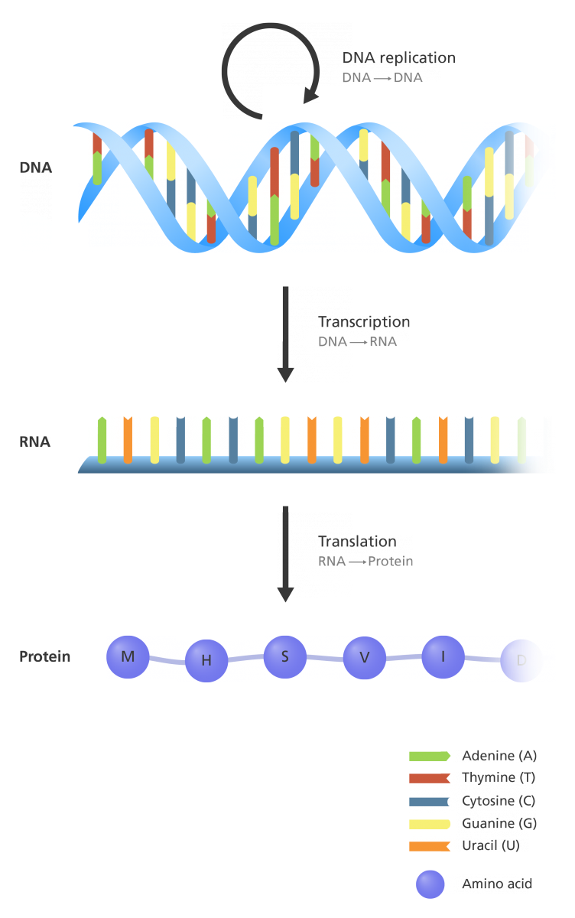
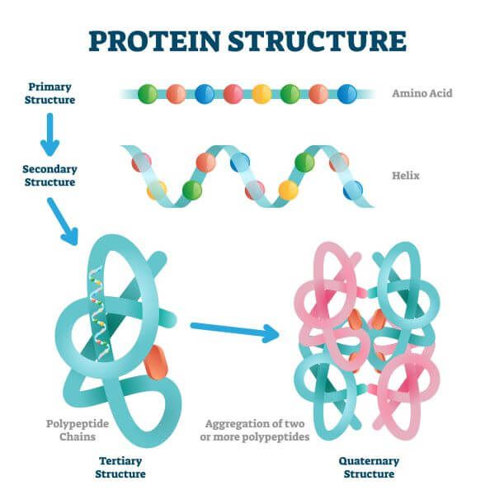
Biology Background
Central Dogma of Biology:
DNA -> RNA -> Protein
Protein Structure:
Primary
Secondary
Tertiary
Quaternary
For proteins: structure determines function

Slide 4
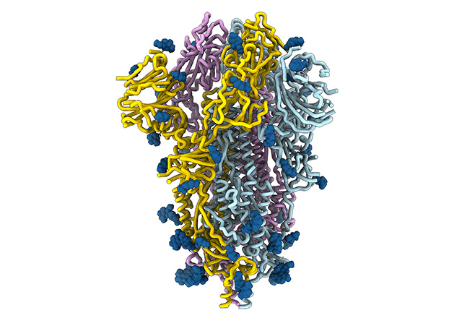
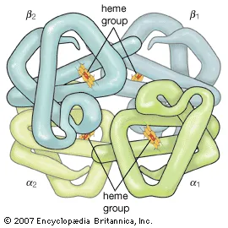
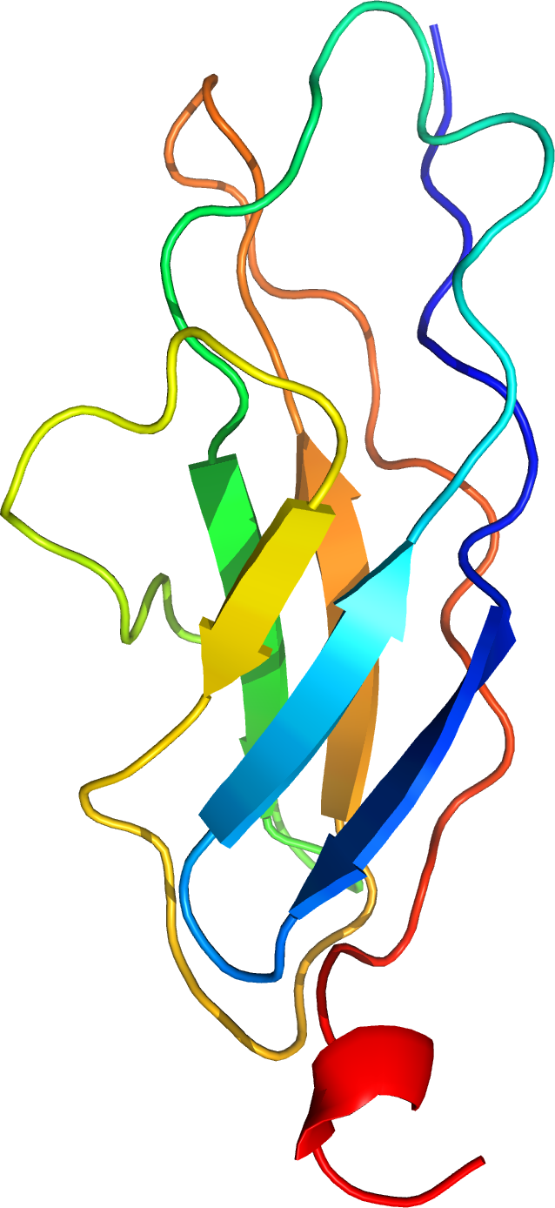
Biology Background
Structure determines function

Slide 5
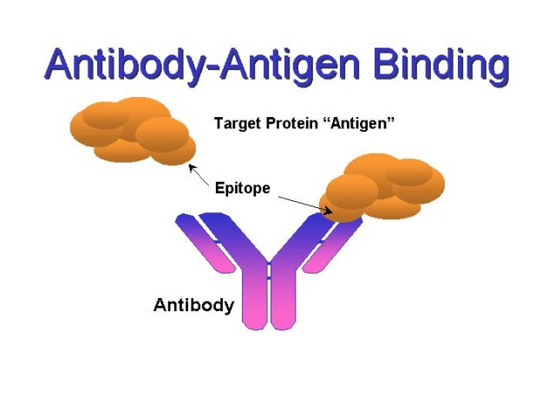
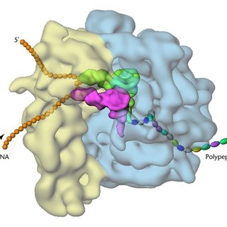
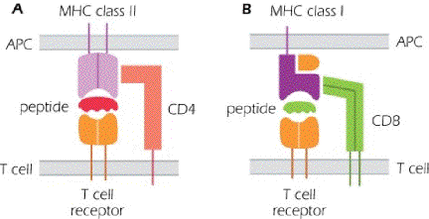
Biology Background
Protein-Protein-Interactions (PPI):
Usually (but not always) non-covalent and reversible

Slide 6
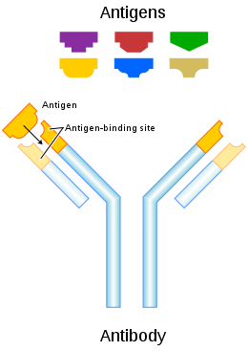
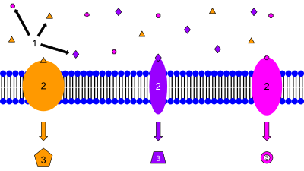
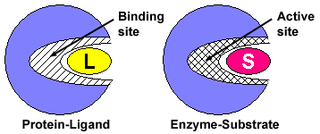
Biology Background
Protein-Ligand-Interactions (PLI):
Ligand is not necessarily a protein

Slide 7
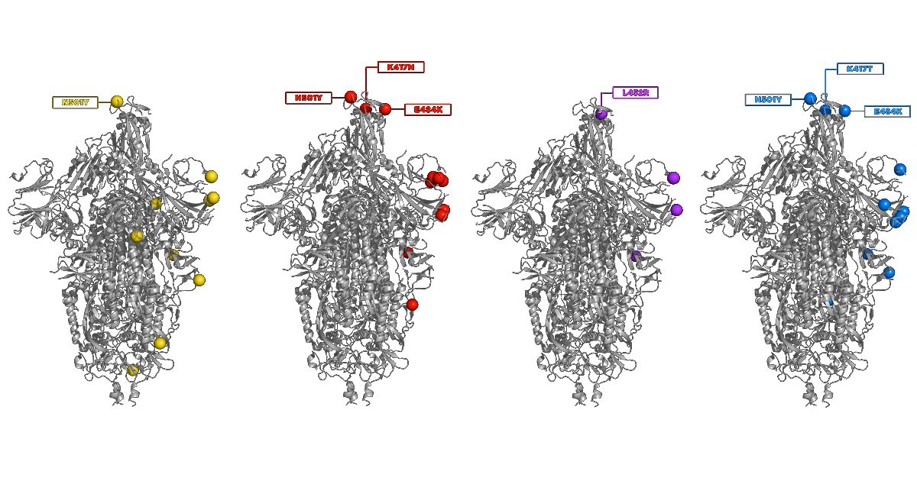
Biology Background
What’s common in both PPI and PLI:
Purpose is achieved at specific interaction sites on the protein(s)
Usually called active sites in the context of enzymes and/or PLI
Interaction is highly specific, hard to predict and sensitive to change
Clearly, modelling PPI/PLI is of interest

Slide 8
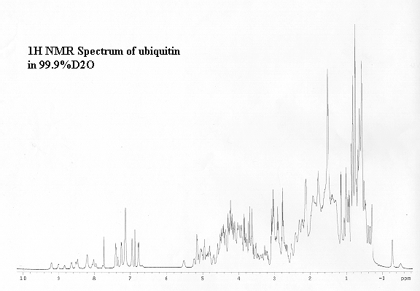
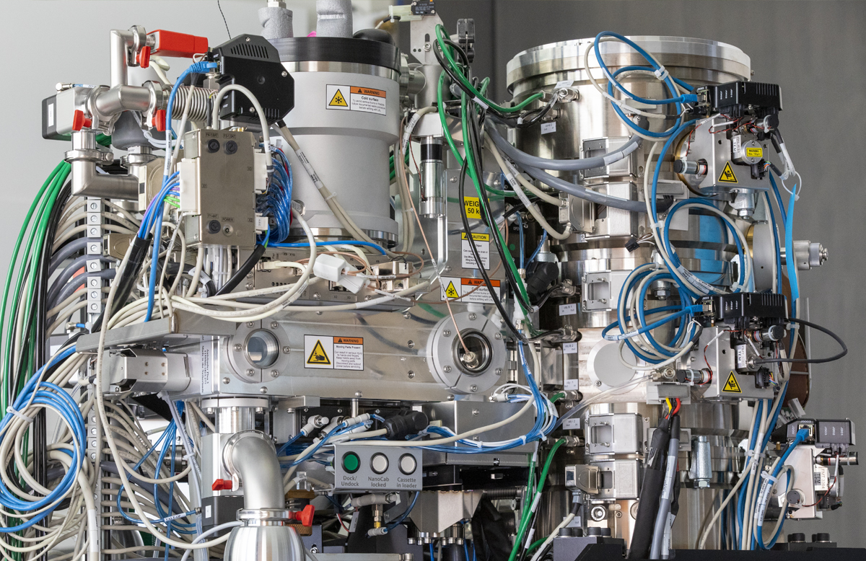
How do we Model PPI/PLI?
First: we are not talking about folding
(Thank you to Yonghan for covering this topic)
Instead, assume we already have structure (absolute position, torsion angles, PDB file, etc.)
Co-crystallization + NMR
Co-CryoEM
Brute force docking simulation

Slide 9
Relevant Literature
PatchDock (2500 Citations)
Brute-force “Jigsaw” matching of complementary geometric features on PPI or PPL (ex. Concave + Convex)
Even with speed-ups, its still slow (One-to-One)
SiteEngine
Similar to PatchDock, except it also uses electrochemical features
Other More Recent Approaches:
“Flexible” docking, Special Energy Functions
“Fragment Search + Genetic Algorithms”, Atomic
These approaches are OK but still low-throughput; can we do better?
Of course! We are computer scientists :)

Slide 10
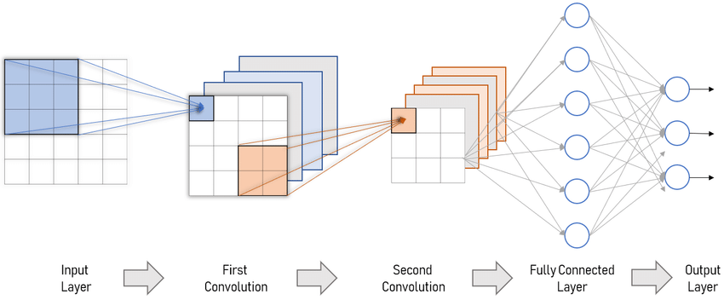
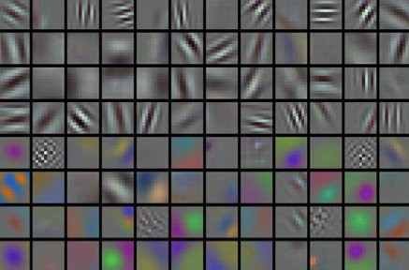
Deep-Learning Background
Convolutional Neural Nets (CNNs)
A more-sophisticated approach to extracting / learning features from complex data (images, text, etc.)
Reminder: Convolution captures information in a small area called a filter/kernel (spatial/temporal dependencies)
Useful tool for Segmentation, Classification, etc.
Why does this apply to our problem?

Slide 11
Paper
Deciphering interaction fingerprints from protein molecular surfaces using geometric deep learning, Gainza et al. Nature Methods 2020
Each area on a protein surface has a unique “fingerprint” (Ma-SIF: Molecular Surface Interaction Fingerprinting)
Utilize Geometric CNNs as an abstract feature extractor
Geometric DL: Deep-Learning on surfaces
Learn to associate feature descriptor “fingerprints” with certain outcomes:
1) Ligand-Pocket Similarity (Ma-SIF ligand)
2) Protein-Protein Site Prediction (Ma-SIF site)
3) Ultrafast Scanning (Ma-SIF search)
Key takeaway: reducing complexity of brute force simulation by learning associations and representations

Slide 12
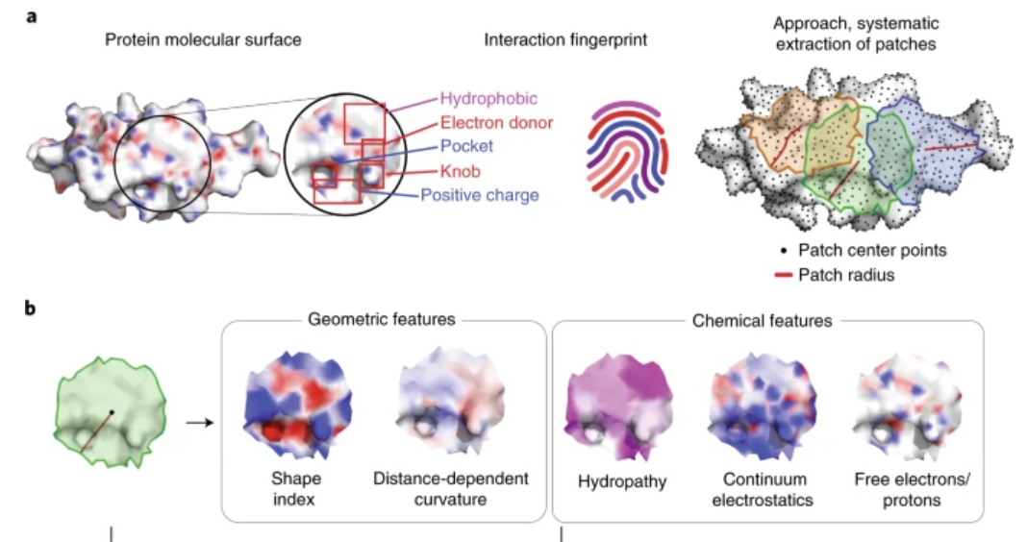
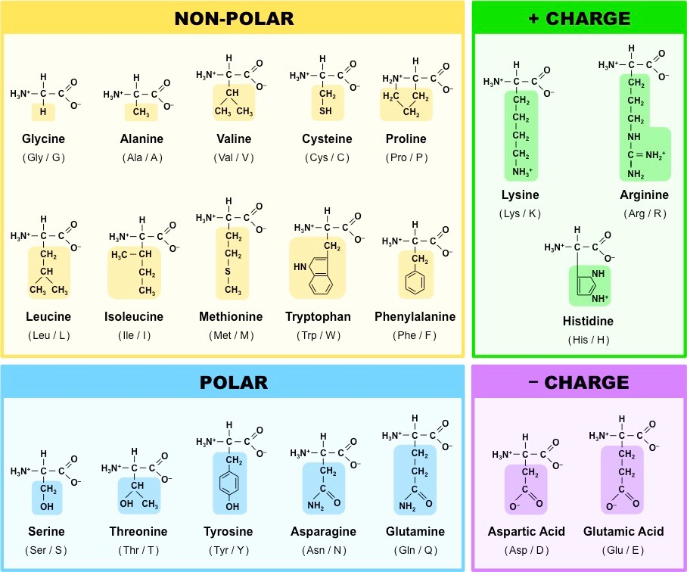
Paper
Localize the important surface features of a protein into geodesic patches

Slide 13
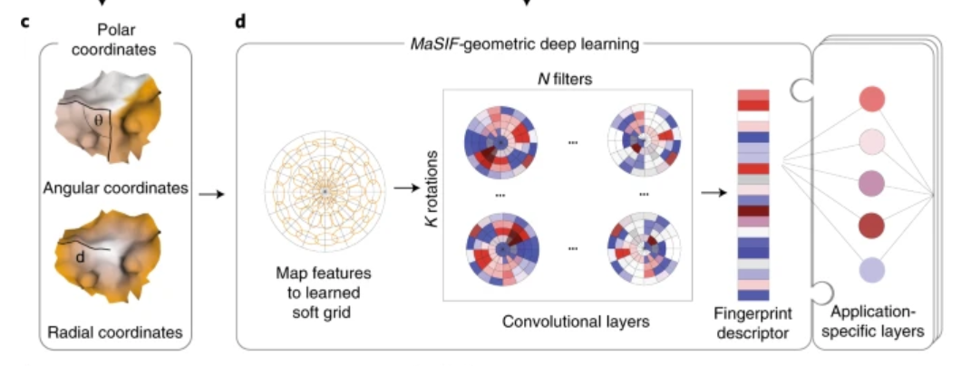
Paper
Use Radial CNNs to learn fingerprint descriptors for each patch on a protein’s surface
Radial kernel is applied to a single patch on a single feature with k rotations
Kernels are trained end-to-end for each application (but can be reused)

Slide 14
Paper
Ma-SIF Ligand (PLI)
Predict the relative binding of several common ligands (ADP, NADP, etc.)
Classification Task
"MaSIF-ligand can infer the correct cofactor in two proteins with the same fold based purely on surface features, without explicit consideration of the underlying amino acids or sequence-based signatures."

Slide 15
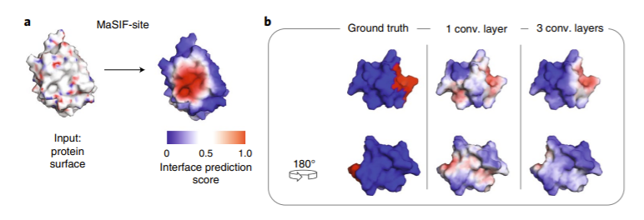
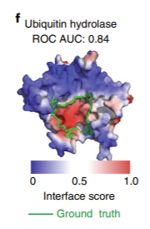
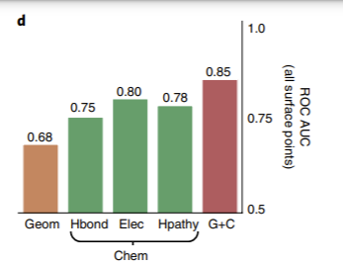
Paper
Ma-SIF Site (PPI)
Interesting; takes a fingerprint and outputs score of being part of a PPI
Looks for more general features that indicate site activity rather than specificity for one substrate
Novel; feature ablation shows that electrostatic interactions are most important for predicting binding

Slide 16
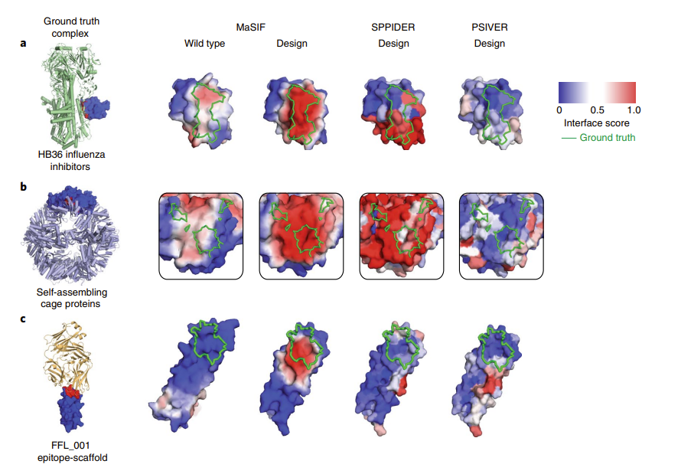
Paper
Ma-SIF Site (PPI) - Validation
Artificially-designed proteins with high affinity compared to wild-type
Ma-SIF Site correctly predicts binding pocket placement and affinity

Slide 17
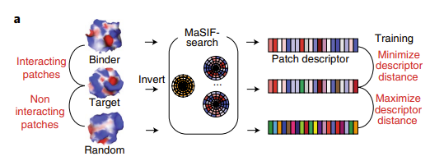
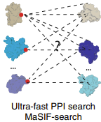
Paper
Ma-SIF Search (Ultrafast Scanning)
Feature embedding gives us massive complexity reduction
Nearest-neighbors on multitudes of proteins to look for binding similarities, OR
“Jigsaw-Puzzle” approach:
Invert fingerprint descriptor and look for matching pairs
One-One binder-target now One-Many or Many-Many!
Decoy Test: 1000x Speedup vs PatchDock

Slide 18
Implications
Massive complexity reduction allows for high-throughput drug-design and screening:
Protein Data Bank (PDB) has 160 000+ structures
Screening peptides for possible activity against somatic/viral/bacterial targets
Designing custom drugs (antibodies) for each patient
Generate antibody external structures, OR
Directly generate fingerprints, and
screen for activity, then reverse-engineer custom antibody to match fingerprint
Could use genetic algorithms from promising fingerprints

Slide 19
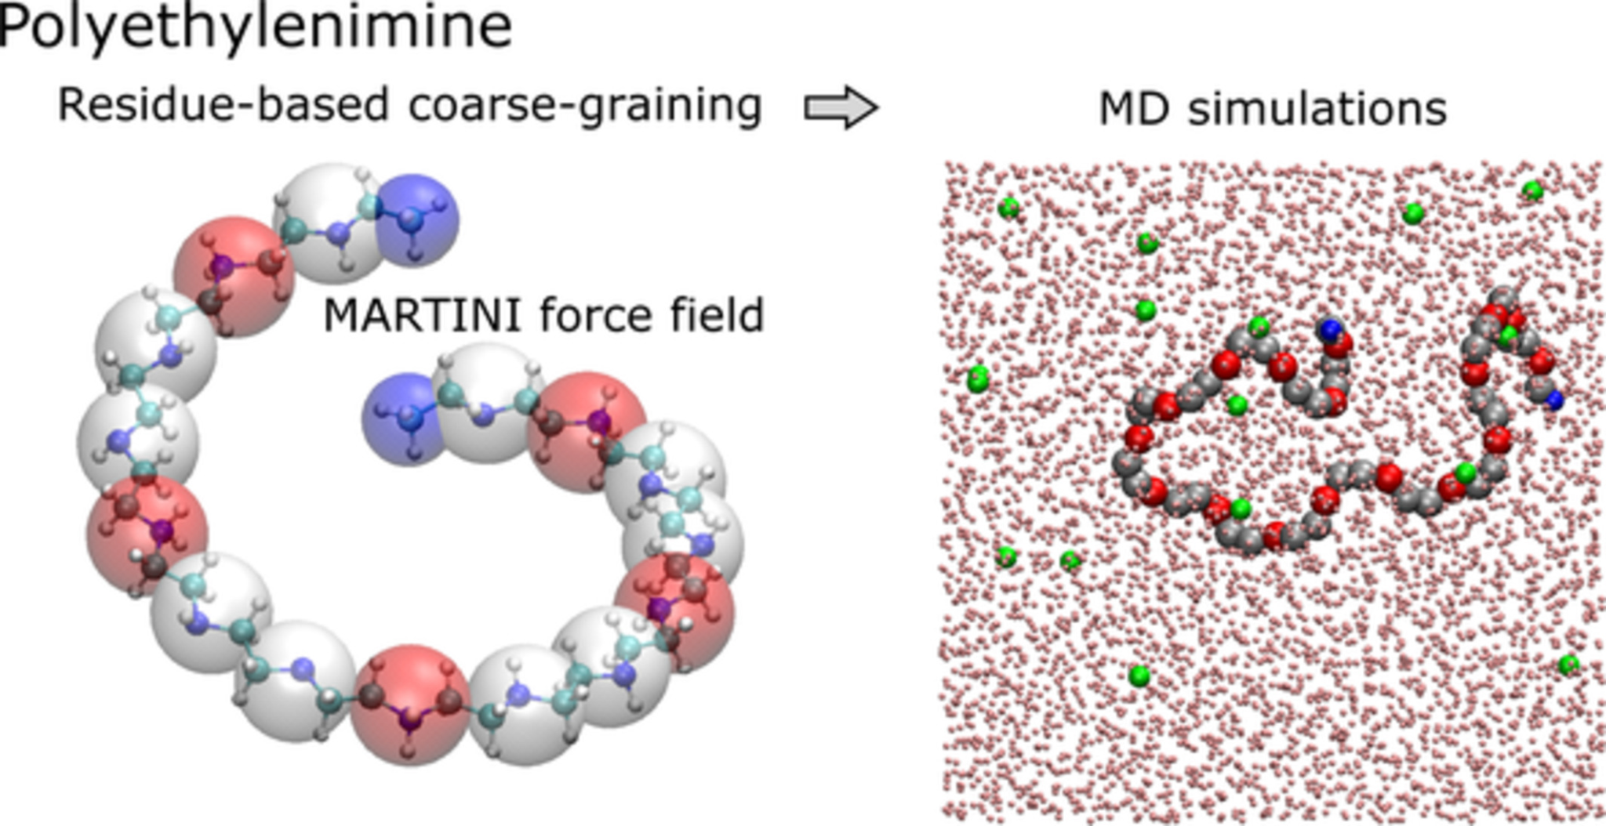
Further Work
Perspectives on High-Throughput Ligand/Protein Docking With Martini MD Simulations, 2021
Martini-Force-Field
Can capture protein flexibility and solvent behaviour
Easier for Protein + Non-Protein Interactions
Better modelling of thermodynamics and kinetics
Recent approaches have “atomic” level accuracy while still being relatively coarse
Allows us to scale up to high-throughput

Slide 20
Bibliography
https://www.nature.com/articles/s41592-019-0666-6
http://bioinfo3d.cs.tau.ac.il/SiteEngine/
https://bioinfo3d.cs.tau.ac.il/PatchDock/
https://pubmed.ncbi.nlm.nih.gov/16488145/
https://pubmed.ncbi.nlm.nih.gov/9126849/
https://www.nature.com/articles/nprot.2016.169
https://www.ncbi.nlm.nih.gov/pmc/articles/PMC4783878/
https://mizuguchilab.org/PSIVER/
https://sppider.cchmc.org/
https://www.frontiersin.org/articles/10.3389/fmolb.2021.657222/full
http://citeseerx.ist.psu.edu/viewdoc/download?doi=10.1.1.469.1629&rep=rep1&type=pdf
All graphics can be sourced upon request

