Slide 1
Matrix Factorization
Jan. 27, 2020
Bowen Yang

Slide 2
01. Background
02. Problem set up & PMI
CONTENT
03. SVD & Matrix Factorization
04. SGNS recap
05. Unifying Word2Vec and MF
06. Some experiment results
07. Recommendation Systems

Slide 3
Background:
Large advances in contextualized word embeddings since 2018
ELMO and BERT
Considerable memory and hardware requirements:
12GB of GPU RAMs required to fine-tune BERT-base
24MB required to store 10,000 300-dimensional word embeddings
Still need standard algorithms that generate pre-trained word embeddings

Slide 4
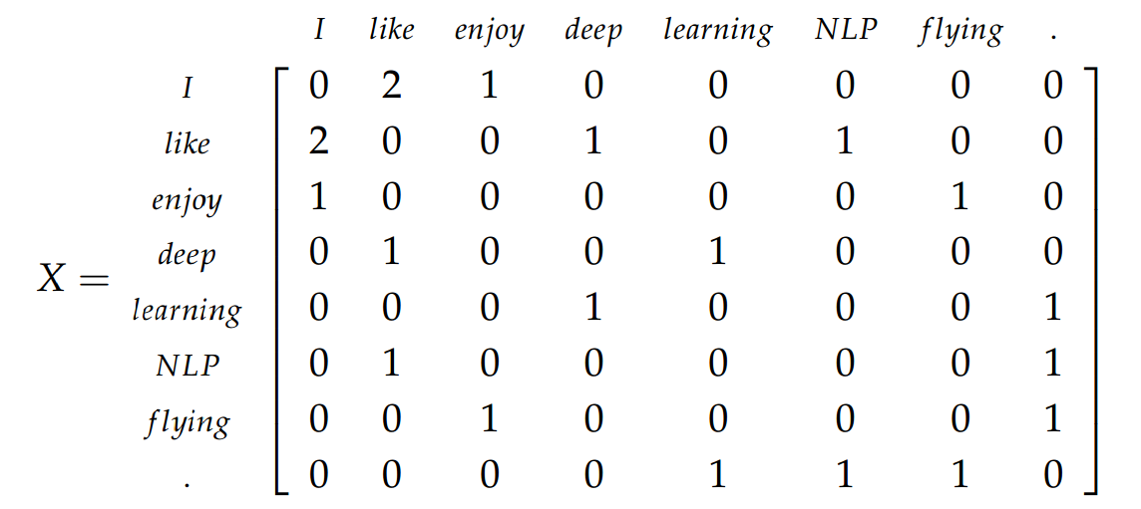
Problem:
Build co-occurrence matrix of words.
Set up objective function that maximize performance

Slide 5
PMI (Pointwise mutual information):
Measures how far the observations obtained on a word-context pair is from what would be expected if the words were independent of each other.
Ex. “front”& “desk" will have a high PMI
Fill in entries of co-occurrence matrix with PMI(x, y)

Slide 6
PMI (Pointwise mutual information):
P(i,j): probability of co-occurrence of word i and word j
P(x): probability of i occurring

Slide 7
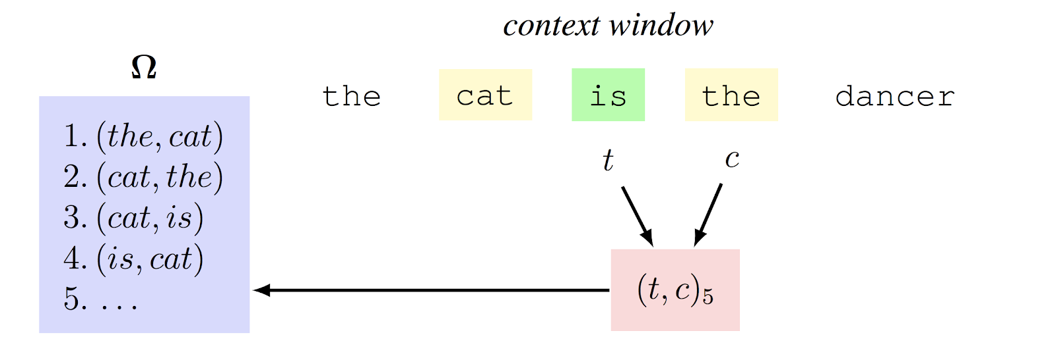
PMI (Pointwise mutual information):
Given a corpus, we define a context window of size w
Expected size, N = w * len(corpus) * 2, very large
(Hadoop, Spark, CS651)

Slide 8
Note that PMI(0) = - infinity
Introduce PPMI(i, j) = max( PMI(i, j), 0 )
It intuitively makes sense to discard the negativities in associated contexts. Humans can easily understand that the positive correlation between “Canada” and “Snow”. However, the negative association between "Canada” and “Desert" seem hard to grasp.

Slide 9
PMI (Pointwise mutual information):
Nij = # of co-occurrence
Marginalize we get Ni and Nj (occurrence of word)
P(i , j) = Nij / N
P(i) = Ni /N
P(j) = Nj / N
PMI(i , j) = log( P(i , j) / (P(i) * P(j)) ) = log( N*Nij / Ni*Nj)

Slide 10
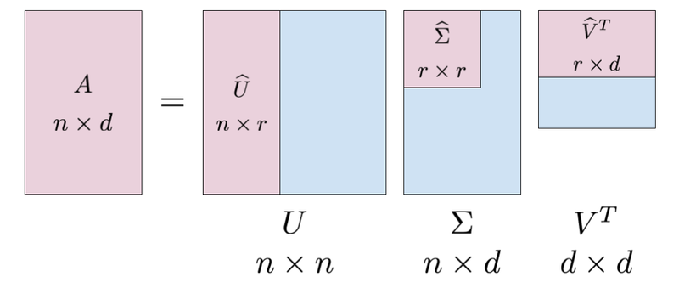
SVD (Singular Value Decomposition):
SVD factorizes M into the product of three matrices U · Σ · V >, where U and V are orthonormal and Σ is a diagonal matrix of singular values. Let Σd be the diagonal matrix formed from the top d singular values, and let Ud and Vd be the matrices produced by selecting the corresponding columns from U and V

Slide 11
SVD example:

Slide 12
The matrix M = U ·Σ ·V is the matrix of rank d that best approximates the original matrix M, in the sense that it minimizes the approximation errors
It is a common approach in the NLP literature to factorize the PPMI matrix M(PPMI) with SVD, and then taking the rows of W(SVD) = U · Σ and C(SVD) = V as word and context representations, respectively. However, using the rows of W(SVD) as word representations consistently under-perform the W(SGNS) embeddings derived from SGNS when evaluated on semantic tasks as we’ll see later on.
Computationally expensive. O(min(mn^2,m^2n))

Slide 13
Recap of Skip-Gram with Negative Sampling (SGNS):
Goal: Avoid performing expensive softmax operation over the entire vocabulary.
Negative Sampling:
We negatively sample K context word indices n from the distribution U, K is usually chosen between 5 and 15
We want to maximize the dot product between w and c and minimize the dot product between w and k randomly sampled words that does not appear in the context.

Slide 14
Recap of Skip-Gram with Negative Sampling (SGNS):
This shows that SGNS does not actually make any predictions at all, unlike the standard diagram. Fundamentally, this model and the loss function above depict exactly what happens to the embeddings at every step of sampling in the stochastic gradient descent.

Slide 15
Unifying Word2Vec with Matrix Factorization:
Loss function for SGNS over the entire corpus (t, c) of omega.
t: center word embedding
c: context word embedding

Slide 16
Unifying Word2Vec with Matrix Factorization:
Loss function for SGNS over the entire corpus (t, c) of omega.
t: center word embedding
c: context word embedding
At each step of the learning process, W_t will receive exactly ( K + 1 ) upgrades from C_n, C_c. Therefore, the higher the value of K, the faster the training will get.

Slide 17
Unifying Word2Vec with Matrix Factorization:
Aggregate this loss function over the entire corpus.
(i,j) will be drawn as a positive sample exactly Nij times
we will see term i exactly Ni times, negatively sample a context j according to its probability in U, that is, according to the probability Nj / N, we will draw k negative samples at every step.
= k * Ni * Nj / N

Slide 18
Unifying Word2Vec with Matrix Factorization:
This non-convex loss function can be very easily implemented in any automatic differentiation toolkit (such as TensorFlow) with solvers like Adam.
We are effectively doing matrix factorization on a square matrix.
Take the derivative W.R.T. the dot product, we get:

Slide 19
Unifying Word2Vec with Matrix Factorization:
Set the gradient to zero, if the model’s (i,j) dot product is equal to log (N*Nij / k*Ni*Nj), the derivative will be zero, and the model will have reached a local optimum.
Recall that PMI(i , j) = log( P(i , j) / (P(i) * P(j)) ) = log( N*Nij / Ni*Nj).
We reach the local optimum point when w*c = PMI(i, j) – log(k).
And we are effectively factorizing the matrix M with each entry equal to PMI(i, j) – log(k).
In the original paper this objective is named as shifted positive pointwise mutual information (SPPMI).

Slide 20
Empirical results:
On the word similarity task, SPPMI yields better results than SGNS, and SVD improves even more. But performance difference is small. Also notice that SGNS generally works better with higher values of k, whereas SPPMI and SVD prefer lower values of k. This may be due to the fact that only positive values are retained, and high values of k may cause too much loss of information.
The analogies task shows different behavior. First, SVD does not perform as well as SGNS and SPPMI. More interestingly, in the syntactic analogies dataset, SGNS significantly outperforms the rest. Depends highly on context words. We conjecture that SGNS performs better on this task because its training procedure gives more influence to frequent pairs, as opposed to SVD’s objective, which gives the same weight to all matrix cells.

Slide 21
Matrix Factorization in recommendation systems:
Alternating Least Squares
r: observed value at index u, i
Xu: Latent vector at row u (user u)
Yi: Latent vector at column i (item i)

Slide 22
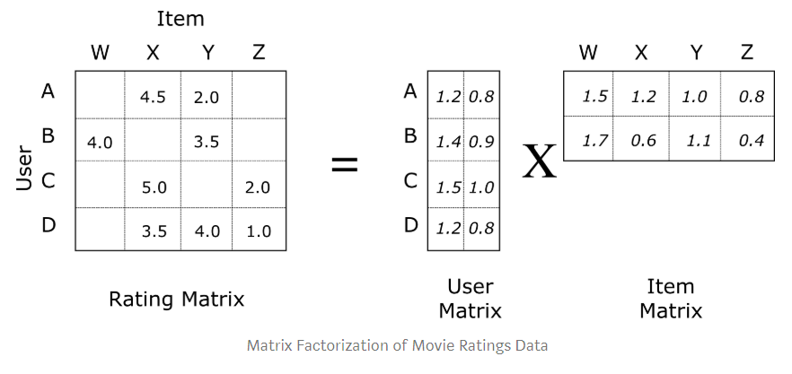
Matrix Factorization:

Slide 23
Matrix Factorization:
Easy to implement
Latent vectors can be normalized and stored (real time)
Approximate Nearest Neighbors, Pseudo Inverse

