Slide 1
RoBERTa: A Robustly Optimized BERT Pretraining Approach
Yinhan Liu, Myle Ott, Naman Goyal, Jingfei Du, Mandar Joshi, Danqi Chen, Omer Levy, Mike Lewis, Luke Zettlemoyer, Veselin Stoyanov
Facebook AI & University of Washington
Presented by: Bin Zhan
CS 886: Deep Learning for NLP
Notes:
Good afternoon everyone. My name is Bin. I am a coursework master student in computer science, and the courses I have taken are related to machine learning.
Today I am going to talk about a robustly optimized BERT pretraining approach, RoBERTa.
It was introduced by Facebook and University of Washington in 2019 (two thousand nineteen).

Slide 2
Introduction
BERT was significantly undertrained, and it can perform much better.
This paper introduces a set of important BERT design choices, training strategies, and alternatives that lead to better downstream task performance.
RoBERTa combines these improvements and achieves state-of-the-art results on the widely used NLP benchmark.
 | RoBERTa | BERT
Masking Strategy | Dynamic Masking | Static Masking
Model Input Format | Full-sentences | Segment-pair
Next Sentence Pred. | No | Yes
Training Data Size | 160 GB | 13 GB
Batch Size | 8000 sequences | 256 sequences
Training Steps | 500 K | 1 M
Notes:
BERT is a revolutionary technique that achieved state-of-the-art results on a range of natural language understanding tasks. It becomes popular both as a research baseline and as a backbone architecture.
However, the author of RoBERTa thought that BERT was significantly undertrained, and it can perform much better.
This paper introduces a set of important BERT design choices, training strategies, and alternatives that lead to better downstream task performance.
RoBERTa combines these improvements and achieves state-of-the-art results on widely used NLP benchmark.

Slide 3
Outline
Introduction
Training Procedure Analysis
Dynamic masking
Model input format
Remove next sentence prediction
More Data, Larger Batch Size, and Train Longer
Results
References
Notes:
Here is the outline. We will focus on training procedure analysis.
I am going to talk about dynamic masking, model input format, remove next sentence prediction, and more data, larger batch size, and train longer.
Remember, the training procedure analyses are based on BERT. The final product combined with all of these advantages is RoBERTa.

Slide 4
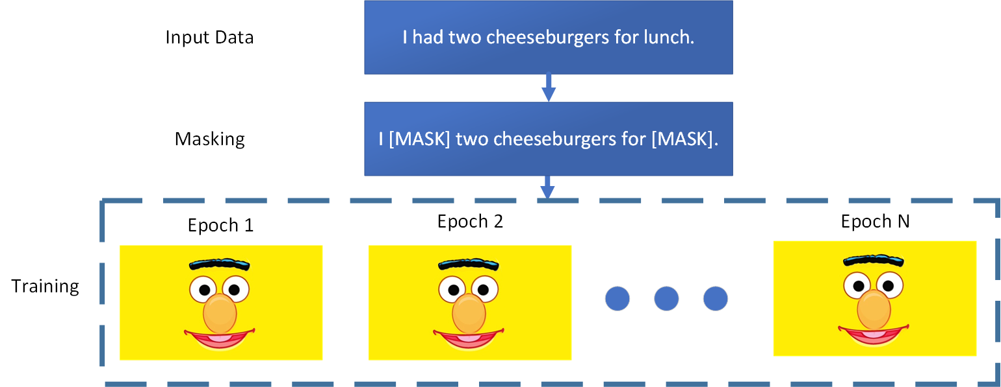
Dynamic Masking
Static masking is masking input sequence only once during data preprocessing.
Notes:
Firstly, let’s talk about static masking and how BERT originally implements it.
Static masking is to mask input sequence ONLY ONCE during data preprocessing.
As the diagram shows, the masking pattern won’t change in every epoch.

Slide 5
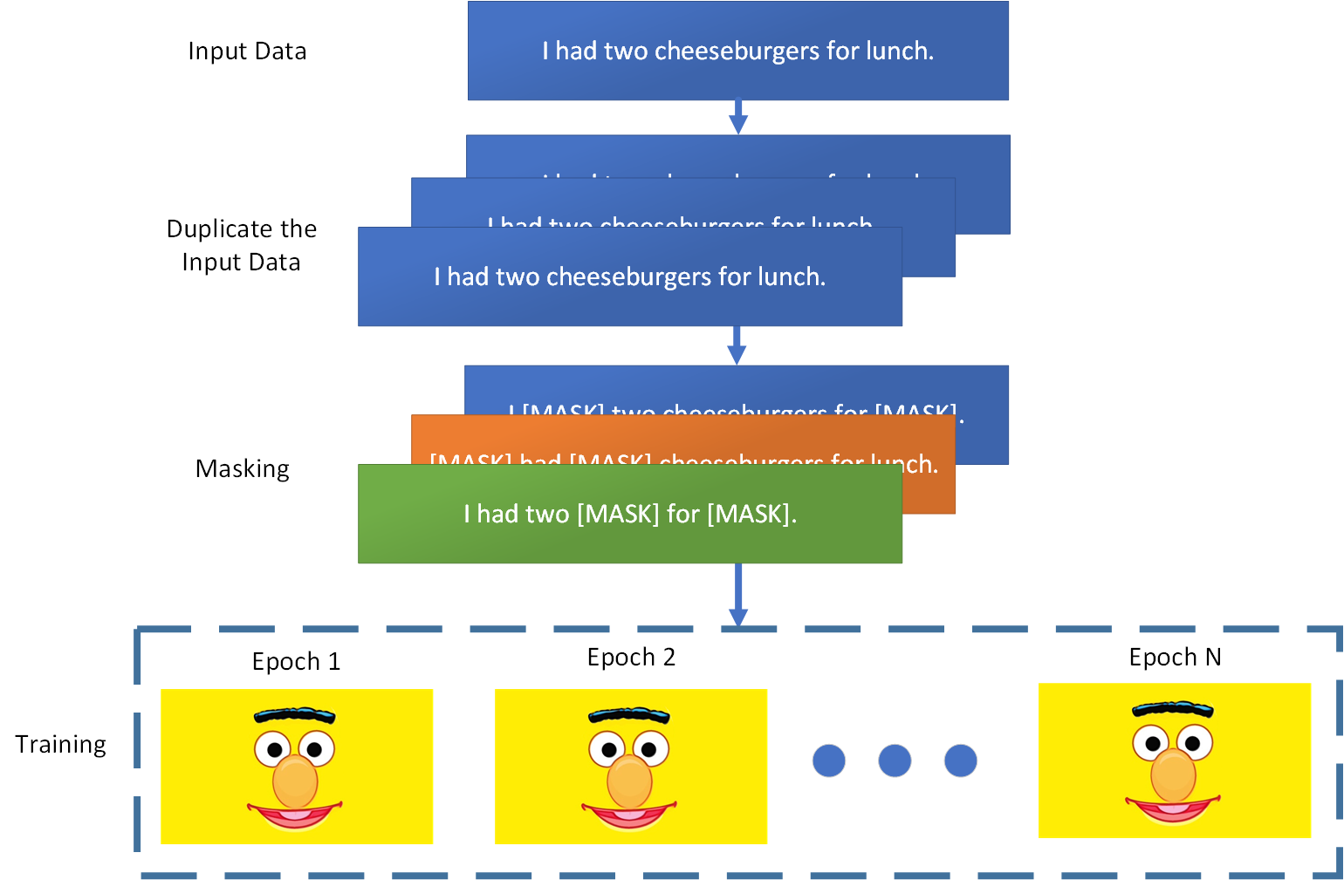
Dynamic Masking
BERT implemented static masking by duplicating input data 10 times.
so each input sequence is masking in 10 different ways.
During 40 epochs of training, each input sequence was seen 4 times with same mask.
Notes:
To avoid using the same masking pattern for each training instance every epoch, BERT originally implemented static masking by duplicating input data 10 times, so that each sequence is masked in 10 different ways over 40 epochs of training.
During the 40 epochs of training, each input sequence was seen 4 times with same mask.

Slide 6
Dynamic Masking
Dynamic masking generates new masking pattern every epoch.
Notes:
Now, dynamic masking is a masking strategy that generates new masking pattern every epoch.
As the diagram shows, the input sequences are masked randomly in every epoch.
This becomes crucial when pretraining for more steps or with larger datasets.

Slide 7
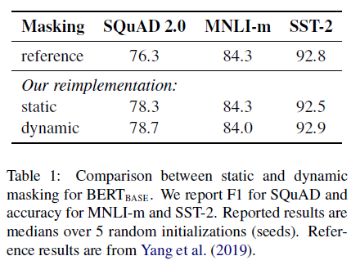
Dynamic Masking – Results
Compare between re-implementation with static masking and dynamic masking. Reference is results of BERTbase from Yang et al. (2019).
Notes:
Here is a table compares the original BERT results to the re-implementation with either static or dynamic masking.
The re-implementation with static masking performs similar to the original BERT model, and dynamic masking is slightly better than static masking.
The rest of the experiments will use dynamic masking.

Slide 8
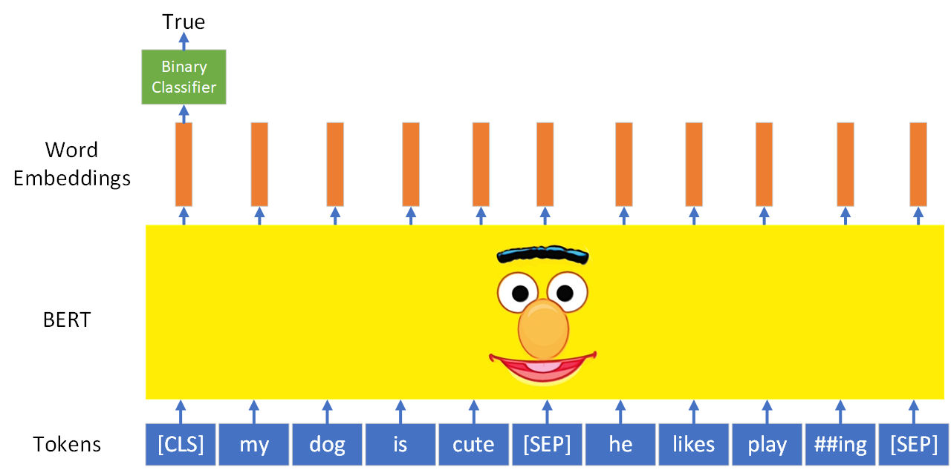
Next Sentence Prediction
Next Sentence Prediction (NSP) is a task that making a decision whether sentence B is the actual next sentence that follows sentence A or not.
Notes:
Before talking about model input format, let me review next sentence prediction.
In the original BERT pretraining procedure, the model observes two concatenated document segments, which are either sampled from the same document or from distinct documents.
In the next slides, I will compare several alternative training formats with and without next sentence prediction.

Slide 9
Model Input Format
Segment-pair + NSP: Each input has a pair of segments. It is the original input format used in BERT with the NSP loss.
The total combined length of input must be less than 512 tokens.
Notes:
The first input format is segment-pair plus next sentence prediction. It is the original input format used in BERT.
Each input has a pair of segments, and each segment contains multiple natural sentences, but the total combined length must be less than 512 (five hundred and twelve) tokens.

Slide 10
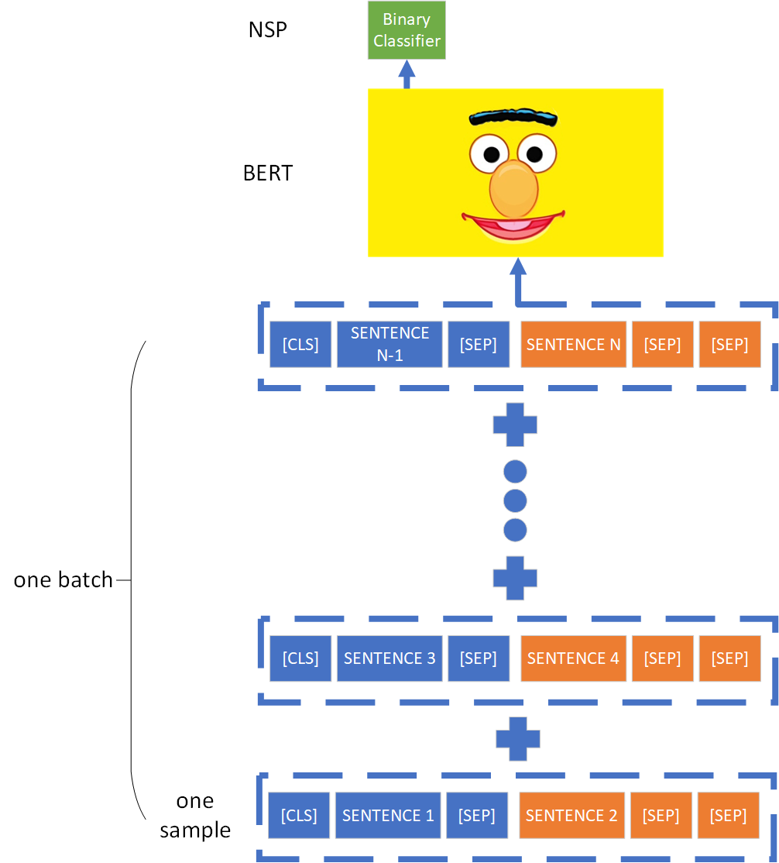
Model Input Format
Sentence-pair + NSP: Each input contains a pair of sentences.
Increase the batch size so the total number of tokens remains similar to segment-pair+NSP.
Notes:
The second input format is sentence-pair plus next sentence prediction.
As the diagram shows, each input contains a pair of natural sentences, either sampled from a contiguous portion of one document or from separate documents.
Since these inputs are significantly shorter than 512 (five hundred and twelve) tokens, we increase the batch size so that the total number of tokens remains similar to segment-pair format.

Slide 11
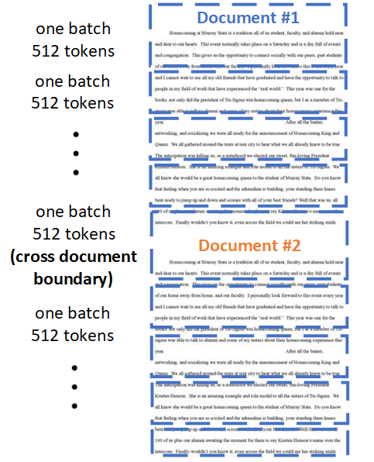
Model Input Format
Full-sentences: Each input is packed with full sentences sampled contiguously from one or more documents.
The total length of input is at most 512 tokens.
Inputs may cross document boundaries.
Notes:
The third input format is full-sentences.
As the diagram shows, each input is packed with full sentences sampled contiguously from one or more documents such that the total length is at most 512 (five-hundred and twelve) tokens.
When reach the end of one document, we begin sampling sentences from the next document and add an extra separator token between documents.
There is no next sentence prediction in this format.

Slide 12
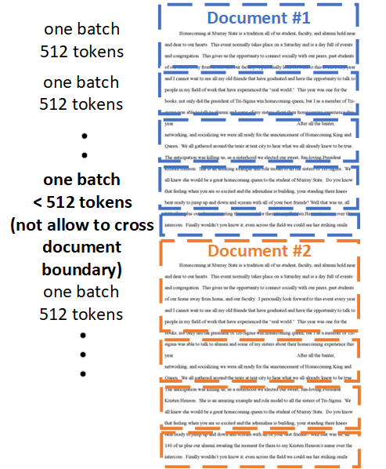
Model Input Format
Doc-sentences: Similarly to full-sentences.
Inputs may not cross document boundaries.
Dynamically increase the batch size since the length of input near the document boundary may less than 512 tokens.
Notes:
The last input format is document-sentences. It is similar to full-sentences format, but sampling may not cross document boundaries.
Inputs sampled near the end of a document may be shorter than 512 (five hundred and twelve) tokens, so we dynamically increase the batch size in these cases to achieve a similar number of total tokens as full-sentences format.
There is also no next sentence prediction in this format.

Slide 13
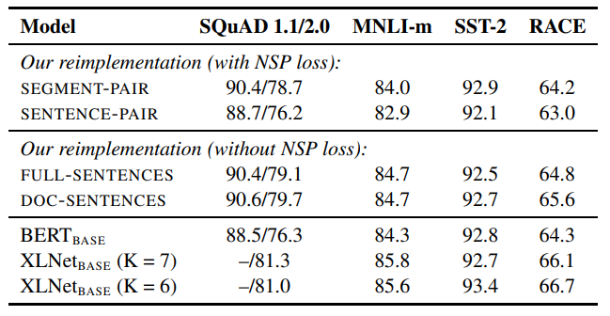
Model Input Format – Results
Using individual sentences hurts performance on downstream tasks.
Removing the NSP task slightly improves downstream task performance.
Restricting sequences from a single document performs slightly better than sequences form multiple documents.
Notes:
Here is a table shows results for the four different input format.
The first setting in the table compares the original segment-pair format to the sentence-pair format. Both formats have the next sentence prediction task. It shows that using individual sentences in next sentence prediction objective hurts performance on downstream tasks because the model is not able to learn long-range dependencies.
The second setting in the table compares training without next sentence prediction and training with blocks of text from a single document.
It shows that this setting performs better than the original BERT results, and removing next sentence prediction slightly improves downstream task performance.
Finally, restricting sequences to come from a single document performs slightly better than packing sequences from multiple documents.
However, because the document-sentences format results in varied batch sizes, the rest of the experiments use full-sentences format for fair comparison with related work.

Slide 14
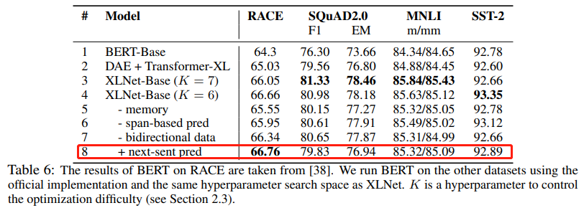
About Removing Next Sentence Prediction
A model benefits from longer full-length contexts.
Conditioning on unrelated context from another document adds noise to masked language model.
In XLNet (Yang et al. , 2019), it also shows that adding NSP task does not lead to an improvement.
Notes:
Here are three reasons why next sentence prediction may hurt downstream task performance.
Firstly, a model benefits from longer full-length contexts.
And then, conditioning on unrelated context from another document adds noise to masked language model.
And here is a table from XLNet paper shows that adding next sentence prediction doesn’t lead to any improvement.

Slide 15
More Data, Larger Batch Size, and Train Longer
More Data
Books Corpus + English Wikipedia (16 GB)
CC-News (76 GB)
OpenWebText (38 GB)
Stories (30 GB)
Total = 160 GB
Notes:
Now. It is the brutal way to improve BERT. More data, larger batch size, and train it longer.
RoBERTa is training with 160 (one hundred and sixty) gigabyte data, compare to 13 (thirteen) gigabyte data which BERT originally used.

Slide 16
More Data, Larger Batch Size, and Train Longer
BERTbase was originally trained for 1 million steps with a batch size of 256 sequences.
It is equivalent in computational cost to training for
125K steps with a batch size of 2K.
31K steps with a batch size of 8K.
Notes:
BERT was originally trained for 1 million steps with a batch size of 256 (two hundred and fifty-six) sequences.
It is equivalent in computational cost to training for 31,000 (thirty-one thousands) steps with a batch size of 8,000 (eight thousands) sequences.
Of course, RoBERTa trained for 500,000 (five hundred thousands) steps with a batch size of 8,000 (eight thousands) sequences, and it performs better than BERT.

Slide 17
RoBERTa - A Robustly Optimized BERT Pretraining Approach
Notes:
Now combine these improvements, it is RoBERTa!
Specifically, RoBERTa is trained with dynamic masking, full-sentences format without next sentence prediction, more data, large batch, and more steps.

Slide 18
Results
Notes:
Here are the GLUE results.
As you can see, in the first setting, RoBERTa achieves state-of-the-art results on all of the GLUE tasks.
Crucially, RoBERTa uses the same masked language modeling objective and architecture as BERT, yet consistently performs better than both BERT and XLNet.
In the second setting, while many submissions to the GLUE leaderboard depend on multi-task finetuning, RoBERTa depends only on single-task finetuning and still achieve the best score in average.

Slide 19
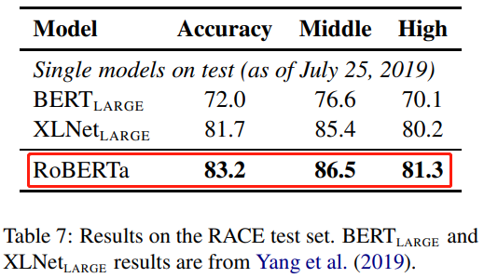
Results
Notes:
Here are the results on SQuAD and RACE.
At the left, it is the table of SQuAD results. On the SQuAD first development set, RoBERTa matches the state-of-the-art results. Also, On the SQuAD second development set, RoBERTa achieves a new state-of-the-art, improving over XLNet.
Results from the RACE test sets are presented at the right. Also, RoBERTa achieves state-of-the-art results on both middle-school and high-school settings.

Slide 20
References
Liu, Yinhan, et al. "Roberta: A robustly optimized bert pretraining approach." arXiv preprint arXiv:1907.11692 (2019).
Devlin, Jacob, et al. "Bert: Pre-training of deep bidirectional transformers for language understanding." arXiv preprint arXiv:1810.04805 (2018).
Yang, Zhilin, et al. "Xlnet: Generalized autoregressive pretraining for language understanding." Advances in neural information processing systems. 2019.
Joshi, Mandar, et al. "Spanbert: Improving pre-training by representing and predicting spans." arXiv preprint arXiv:1907.10529 (2019).
Radford, Alec, et al. "Language models are unsupervised multitask learners." OpenAI Blog 1.8 (2019): 9.

Slide 21
THANKS FOR YOUR ATTENTION
Q & A

