Slide 1
Emotion-Cause Extraction Focused on paper: Title: Emotion-Cause Pair Extraction: A New Task to Emotion Analysis in Texts(ACL 2019). Authors: Rui Xia, Zixiang Ding School of Computer Science and Engineering
Presented by Ali Saheb Pasand
CS886: Deep Learning and NLP (Winter 2020)
Instructor: Professor Ming Li

Slide 2
Contents
Task Definition and Motivation
Previous Work
Emotion-Cause Pair Extraction: A New Task to Emotion Analysis in Texts
Motivation
Contribution
Task Definition
Methodology
Step 1:
Independent Multi-task Learning
Interactive Multi-task Learning
Step 2
Results
Ideas for future work
References

Slide 3
Task Definition and Motivation
Task Definition (Emotion Cause Extraction):
Given a paragraph annotated with an emotion (In the above example Angry), find the clause(s) which contain the reason and cause behind that emotion.
Challenges:
Annotating a paragraph is not an easy task (Multiple emotions, confusing emotion …)
The paper that will be presented has addressed this issue
There may be some clauses which can be considered as a cause but can not be extracted properly even by a human(“He didn’t” in the example).
A proper dataset is not available in English (The benchmark dataset is Chinese)
Cause
Angry
When the driver made a sexist comment about women’s driving, I asked him to take it back and apologize. He didn’t; I yelled at him and forced him to pull-over.

Slide 4
Task Definition and Motivation
Motivation:
Analyzing sentiment of reviews better. In other words, instead of finding only the sentiment of a review, we can automatically find the reason behind satisfaction or dissatisfaction.
By performing this task on daily life conversations, we can program chatbots which are aware of the effect of any sentence on the emotion of the client. This will lead to chatbots which can cause a desired emotion.

Slide 5
Previous Work (Word-level)
2010
Lee et al., A text-driven rule-based system for emotion cause detection.
2013
Alena Neviarouskaya and Masaki Aono. Extracting causes of emotions from text.
2014
Wei yuan Li and Hua Xu. 2014. Text-based emotion classification using emotion cause extraction.
Rule based methods
Machine learning based methods
Gao et al., Emotion cause detection for Chinese micro-blogs based on ecocc model.
Ghazi et al., Detecting emotion stimuli in emotion-bearing sentences.
2015
Gao et al., A rule based approach to emotion cause detection for Chinese micro-blogs.
Song and Meng, Detecting concept-level emotion cause in microblogging.
2017
Yada et al., A bootstrap method for automatic rule acquisition on emotion cause extraction.

Slide 6
Previous Work (Clause-level)
2010
Chen et al., Emotion cause detection with linguistic constructions.
2011
Russo et al., Emocause: an easy-adaptable approach to emotion cause contexts.
2014
Gui et al., Emotion cause detection with linguistic construction in Chinese weibo text.
2016
Gui et al., Event-driven emotion cause extraction with corpus construction.
Gui et al., Emotion cause extraction, a challenging task with corpus construction.
Xu et al., An ensemble approach for emotion cause detection with event extraction and multi-kernel SVMs.
2017
Gui et al., A question answering approach to emotion cause extraction.
2018
Li et al., A co-attention neural network model for emotion cause analysis with emotional context awareness.
Yu et al., Multiple level hierarchical network-based clause selection for emotion cause extraction
2019
Xu et al., Extracting emotion causes using learning to rank methods from an information retrieval perspective

Slide 7
Emotion-Cause Pair Extraction: A New Task to Emotion Analysis in Texts(ACL 2019).
Authors: Rui Xia, Zixiang Ding School of Computer Science and Engineering

Slide 8
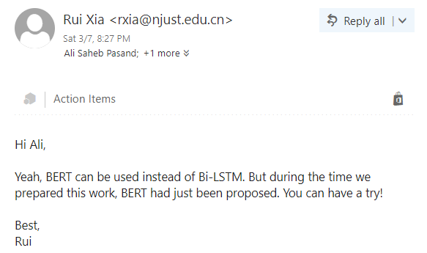
Motivation Behind Choosing this Paper
It has been accepted recently but they have used bi-LSTM. There were two possibilities before I contacted authors:
They have tried more sophisticated models such as BERT, … and have not got a result which justifies the complexity of training those models.
They have not tried those models; therefore, using those models on this task may lead to a better paper.
The paper received an Outstanding Paper award at ACL 2019.
They have changed the task in a way that an annotated dataset is not required anymore (their method performs as good as methods which require emotion annotation before causal clauses can be identified)
Response of one of the authors
to my email

Slide 9
Contributions
Proposed a new task (Emotion Cause Pair Extraction instead of ECE)
It does not depend on the annotation of emotion before extracting cause
It can be applied better to real-world scenarios
(Mentioned by authors as contribution) a two-step framework. First performs individual emotion extraction and cause extraction and then finds valid pairs of extracted clauses.
Presenter note: Using two-step framework may not be a good idea as errors in each step will propagate to the next one.
Constructed a new dataset (in simplified Chinese) which is suitable for this new task.

Slide 10
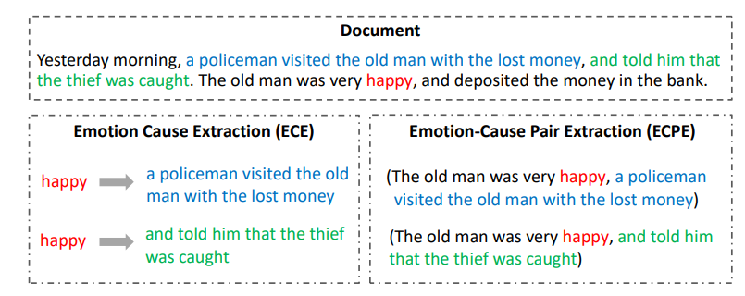
Task Definition
Annotation
For this task, in contrast with the one mentioned previously, an annotated dataset is not required.
Goal: Finding all pairs of emotion clause and cause clause in a given paragraph; without any further information or label.

Slide 11
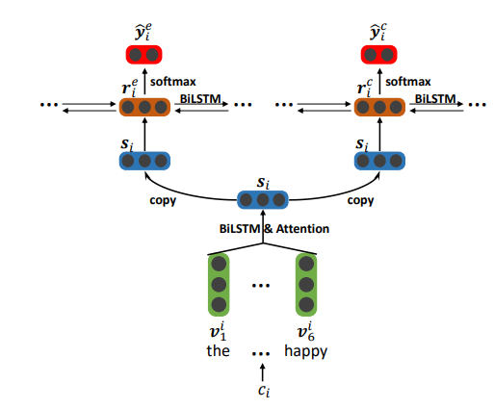
Methodology
Step 1: Independent Multi-task Learning
Document contains multiple clauses:
$$d=[c_{1}, c_{2}, …, c_{|d|}]$$
Each clause $c_{i}$ contains multiple words:
$$c_{i}=[w_{i, 1}, w_{i, 2}, …, w_{i, |c_{i}|}]$$
The lower layer:
consists of a set of word-level Bi-LSTM modules, each of which corresponds to one clause.
The hidden state of the $j$th word in the $i$th clause $h_{i, j}$ is obtained based on a bi-directional LSTM.
Attention mechanism is then adopt to get a clause representation $s_{i}$

Slide 12
Methodology
Step 1: Independent Multi-task Learning
The upper layer:
consists of two components:
Emotion extraction
Cause extraction
Each component is a clause-level Bi-LSTM which receives the independent clause representations $[s_{1}, s_{2}, …, s_{\left|d\right|}]$obtained at the lower layer as inputs.
The hidden states of two component Bi-LSTM, $r_{i}^{e}$ and $r_{i}^{c}$, can be viewed as the context-aware representation of clause $c_{i}$ , and finally feed to the softmax layer for emotion prediction and cause predication:
The loss of model is:
$$\left\{\begin{aligned}{\hat{y}}_{i}^{e}=softmax(W^{e}r_{i}^{e}+b^{e}) \\ {\hat{y}}_{i}^{c}=softmax(W^{c}r_{i}^{c}+b^{c})\end{aligned}\right.$$
In their code they also have done
$L_{2}$ norm Regularization on W and b
$$L^{p}=λL^{e}+\left(1−λ\right)L^{c}$$

Slide 13
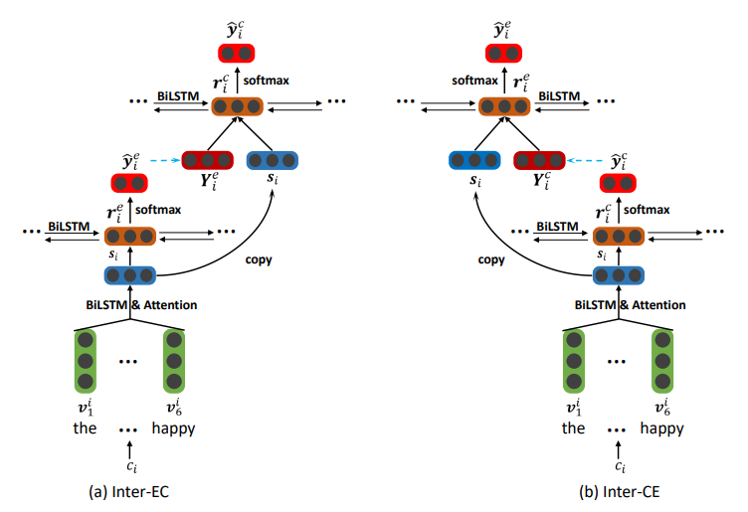
Methodology
Step 1: Interactive Multi-task Learning
Motivation:
1. Emotion extraction and Cause extraction are not mutually independent
2. Providing emotions can help better discover the causes; also, knowing causes may also help more accurately extract emotions
(a) Inter-EC: uses emotion extraction to improve
(b) Inter-CE: uses cause extraction to enhance emotion extraction

Slide 14
Methodology
Step 1: Interactive Multi-task Learning
Inter-EC:
Compared with Independent Multi-task Learning, the lower layer of Inter-EC is unchanged
the upper layer consists of two components, which are used to make predictions for emotion extraction task and cause extraction task in an interactive manner
The first component takes the independent clause representations obtained at the lower layer as inputs for emotion extraction.
Another component takes ($s_{1} ⊕Y_{1}^{e}, s_{2} ⊕ Y_{2}^{e} , …, s_{\left|d\right|} ⊕ Y_{\left|d\right|}^{e}$) as inputs for cause extraction.
The loss of model is the same as the previous method

Slide 15
Methodology
Step 2: Emotion-Cause Pairing and Filtering
After Step 1, a set of emotions $E = \{c_{1}^{e} , · · · , c_{m}^{e}\}$and a set of cause clauses $C = \{c_{1}^{c} , · · · , c_{n}^{c}\}$will be obtained. The goal of Step 2 is then to pair the two sets and construct a set of emotion-cause pairs with causal relationship.
By using Cartesian product to E and C, set of all possible pairs will be obtained:
$P_{all} = \{· · · ,(c_{i}^{e} , c_{j}^{c} ), · · ·\}$
Each pair in $P_{all}$ can be represented by a feature vector composed of three kinds of features
$$X_{(c_{i}^{e}, c_{j}^{c})}=[s_{i}^{e}, s_{j}^{c}, v^{d}]$$
$$s^{e}, s^{c}are representations of the emotion caluse and cause clause$$
$$v^{d} represents the distances between the two clauses$$

Slide 16
Methodology
Step 2: Emotion-Cause Pairing and Filtering
A Logistic regression model is then trained to detect for each candidate pair ($c_{i}^{e}$, $c_{j}^{c}$), whether $c_{i}^{e}$ and $c_{j}^{c}$ have a causal relationship:
$${\hat{y}}_{(c_{i}^{e}, c_{j}^{c})}←δ(θ^{T}X_{(c_{i}^{e}, c_{j}^{c})})$$
Where:
$${\hat{y}}_{(c_{i}^{e}, c_{j}^{c})}=\left\{\begin{aligned}1 if\left(c_{i}^{e}, c_{j}^{c}\right) is a pair with causal relationship \\ 0 if\left(c_{i}^{e}, c_{j}^{c}\right) is a pair without causal relationship\end{aligned}\right.$$

Slide 17
Results
Dataset:
They have altered benchmark dataset for ECE to be suitable for ECPE task:
They have merged the documents with the same text content into one document,
and labeled each emotion, cause pair in this document
Metrics:
$$P=\frac{\sum{Correct Pairs}}{\sum{Proposed pairs}}$$
$$R=\frac{\sum{Correct Pairs}}{\sum{annotated pairs}}$$
$$F1=\frac{2×P×R}{P+R}$$

Slide 18
Results
Indep, Inter-EC Comparison:
1. Inter- EC works better on the ECPE task as well as the two
sub-tasks.
2. Improvements are mainly in the recall rate on the cause
extraction task.
This shows that the predictions of emotion extraction are helpful
to cause extraction. In addition, the performance of emotion
extraction also improved, which indicates that
the supervision from cause extraction is also beneficial
for emotion extraction.

Slide 19
Results
Indep, Inter-EC Comparison:
Inter-CE works better on the ECPE task compared to Indep.
The improvements are mainly in the precision score on the emotion extraction task.
This shows that the predictions of cause extraction are beneficial
to emotion extraction and proves the effectiveness
of Inter-CE.
Inter-EC, Inter-CE Comparison:
Improvement of Inter-EC is in cause extraction.
Improvement of Inter-CE is in emotion extraction
This shows that emotion and cause are mutually indicative.
Improvement of Inter-EC on the cause extraction task are much more
Than improvement of Inter-CE on the emotion task.

Slide 20
Results
Although Inter-EC performs better than Indep, it is far poorer than
Inter-EC-Bound. We can draw the same conclusion when comparing Inter-
CE-Bound and Inter-CE.
An obvious observation is that the F1 scores
of all models on the ECPE task are significantly
improved by adopting the pair filter. By introducing the pair filter,
some of the candidate emotion-cause pairs are filtered out, which may result in a decrease in the recall rate and an increase in precision. the precision scores of almost all models are greatly improved (more than 7%),
in contrast, the recall rates drop very little (less
than 1%)

Slide 21
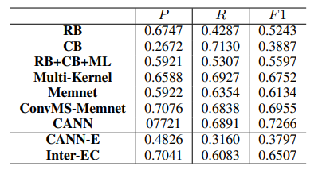
Results
RB is a rule-based method with manually defined linguistic rules (Lee et al., 2010).
CB is a method based on common-sense knowledge (Russo et al., 2011).
RB+CB+ML uses rules and facts in a knowledge base as features and a traditional SVM classifier for classification (Chen et al., 2010).
Multi-kernel uses the multi-kernel method to identify the cause (Gui et al., 2016a).
Memnet denotes a deep memory network proposed by Gui et al. (2017).
ConvMS-Memnet is a convolutional multiple-slot deep memory network proposed by Gui et al. (2017).
CANN denotes a co-attention neural network model proposed in Li et al. (2018).
Inter-EC method (Only cause extraction) comparison to other methods

Slide 22
Ideas for Future Work
The new task proposed by the authors has a high potential for future work. Some possible paths for future work are as the following:
Since using Bi-LSTM has helped to achieve better results, hypothetically, using models such as BERT will help to obtain better representation of clause by considering bi-directional context in a more sophisticated manner. Based on this hypothesis, replacing all Bi-LSTM networks with BERT may improve results.
The proposed two-step framework may not be a proper method for achieving a good accuracy in this task. The reason is that error in each step will be propagated to the next step and will ruin the total result. A better method might be considering the task as a question answering task and feeding all pairs of clauses to a deep bi-directional model which can detect if a pair has causal relationship or not.
There is no proper dataset in English for this task. An important contribution would be gathering a dataset for performing this task in English.

Slide 23
References
Xia, Rui, and Zixiang Ding. "Emotion-cause pair extraction: a new task to emotion analysis in texts." arXiv preprint arXiv:1906.01267 (2019).
Lee, Sophia Yat Mei, Ying Chen, and Chu-Ren Huang. "A text-driven rule-based system for emotion cause detection." Proceedings of the NAACL HLT 2010 Workshop on Computational Approaches to Analysis and Generation of Emotion in Text. Association for Computational Linguistics, 2010.
Gui, Lin, et al. "A question answering approach to emotion cause extraction." arXiv preprint arXiv:1708.05482 (2017).
Li, Xiangju, et al. "A co-attention neural network model for emotion cause analysis with emotional context awareness." Proceedings of the 2018 Conference on Empirical Methods in Natural Language Processing. 2018.

