Slide 1
Anatomy of a Market Failure: The Psychology of Ineffective Altruism
November 2, 2022
Sam Johnson
University of Waterloo, Dept of Psychology

Slide 2
A little about me
DICE Lab (Decision, Inference, and Cognitive Economics) (lab name under renovation)
Current research interests:
“Sense-making” heuristics and intuitive theories
Johnson, S.G.B., Valenti, J.J., & Keil, F.C. (2019). Simplicity and complexity preferences in causal explanation: An opponent heuristic account. Cognitive Psychology, 113, 101222.
Decision-making under risk/uncertainty and over time
Johnson, S.G.B., Bilovich, A., & Tuckett, D. (in press). Conviction narrative theory: A theory of choice under radical uncertainty. Behavioral & Brain Sciences.
Moral judgment and decision-making
(Papers on today’s reading list)
“Cognitive science of society”
Johnson, S.G.B., Zhang, J., & Keil, F.C. (2022). Win–win denial: The psychological underpinnings of zero-sum thinking. Journal of Experimental Psychology: General, 151, 455–474.
Methods
Mainly experiments, with some modeling (esp. agent-based)

Slide 3
Annual global giving: ~ $700,000,000,000
How much is $700 billion?
Eradicating malaria: $90–120 billion (Gates Foundation)
Ending world hunger: $7–265 billion annually (IFPRI)
Reducing CO₂ emissions by 2/3: $200–360 billion annually (McKinsey)

Slide 4
Altruistic acts vary widely in effectiveness
Why haven’t these things happened?
$350 million AI research institute
$150 million student center

Slide 5
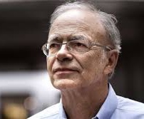
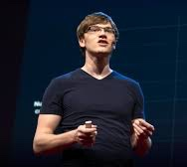
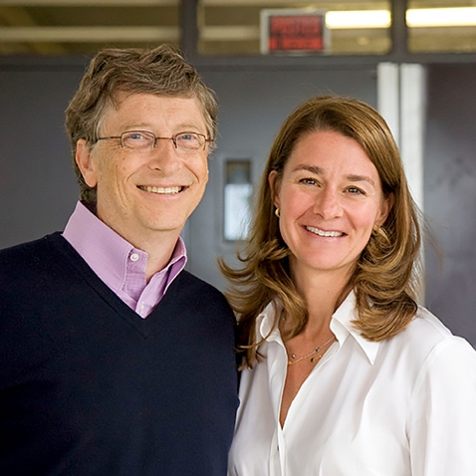
Effective altruism
A philosophical movement devoted to solving world problems by channeling resources more effectively
Peter Singer
Will MacAskill
Bill & Melinda Gates

Slide 6
Three principles
Benefit principle: Maximize benefits, not sacrifice
Specialization principle: Seek your comparative advantage
Offsetting principle: Balance costs and benefits

Slide 7
Why do people donate?
To do good (utilitarianism)
To feel good (“warm glow”)
To look good (signaling)

Slide 8
Possible sources of ineffective altruism
To do good (utilitarianism)
Donors may be misinformed, biased, or deny that some causes are objectively “better” than others (e.g., Berman et al., 2018)
To feel good (“warm glow”)
Ineffective donations might nonetheless feel good (e.g., Small et al., 2007)
To look good (signaling)
What looks good may diverge from what does good (this talk)

Slide 9
Signaling motives are powerful
Donations to public organizations are rarely anonymous (Glazer & Konrad, 1996)
Donors typically give the minimum to be publicly listed in a given category (Harbaugh, 1998)
People are less generous when they believe their motives will be perceived as extrinsic (Ariely, Bracha, & Meier, 2009)
Environmentally conscious behaviors are motivated by status (Griskevicius Tybur, & Van den Bergh, 2010)

Slide 10
The $700,000,000,000 question: Does doing the most good look the most good?
If so, then signaling motives are aligned with utilitarianism
Fabulous news! We can all go home.
If not, this will produce market failures
We need to understand the reputational incentives

Slide 11
Theories of moral judgment
Traditional dichotomy: Utilitarianism vs. deontology
(Baron & Ritov, 2009; Conway & Gawronski, 2013; Greene et al., 2008; among many others)
Newer approach: Character-based accounts (Goodwin et al., 2014; Uhlmann et al., 2015)
Acts are praiseworthy/blameworthy to the extent they provide positive/negative diagnostic information about moral character
Evolutionary grounding: Reputation-tracking (Nowak & Sigmund, 2005)
Cognitive grounding: Sense-making

Slide 12
Sense-making problems are ubiquitous in everyday life…
Just a Rough Patch
Deep Differences
Explanations
Choices
Divorce
Spousal Arguments
Will things get better?
Marriage Counseling
Evidence
Predictions

Slide 13
Sense-making problems are ubiquitous in everyday life…
Like a Nasty Flu
Like the Bubonic Plague
Explanations
Choices
Lockdown
Epidemiological& Virological Data
Deaths
Herd Immunity Strategy
Evidence
Predictions

Slide 14
…and much of our minds are devoted to solving them…
Causes
Kinds
Mental States
3D World
Meaning
The Past
Effects
Features
Behaviors
2D Retinal Data
Utterances
Memory Traces
Fodor & Pylyshyn (1981); Lombrozo (2016); Murphy & Medin (1985);
Gopnik & Wellman (1992); Grice (1989); Johnson & Sherman (1990); Von Helmholtz (1867)
Prediction
Choice

Slide 15
…because their solutions govern our actions.
Causes
Kinds
Mental States
3D World
Meaning
The Past
Predictions
Choices
Anderson (1990); Malt et al. (1995); Murphy & Ross (1994); Sloman (2005)
Prediction
Choice

Slide 16
‘Cognition as sense-making’ view
1. Sense-making requires solving seemingly impossible problems
2. Sense-making relies on fallible yet sensible principles
3. These principles are used across cognition
4. Sense-making has an affective phenomenology
Johnson, Bilovich, & Tuckett (in press). Conviction narrative theory: A theory of choice under radical uncertainty. Behavioral & Brain Sciences.

Slide 17
Moral judgment as explanatory inference
Moral Character
Observed Actions
Predictions about Future Actions
Choice to Approach or Avoid

Slide 18
Moral action as explanatory signaling
Moral Character
Observed Actions
Predictions about Future Actions
Choice to Approach or Avoid
Chosen Actions

Slide 19
Three principles?
Benefit principle: Maximize benefits, not sacrifice
Part 1: Dimensions of altruism
Specialization principle: Seek your comparative advantage
Part 2: Time and money donations
Offsetting principle: Balance costs and benefits
Part 3: Moral accounting

Slide 20
Three principles?
Benefit principle: Maximize benefits, not sacrifice
Part 1: Dimensions of altruism
Specialization principle: Seek your comparative advantage
Part 2: Time and money donations
Offsetting principle: Balance costs and benefits
Part 3: Moral accounting

Slide 21
Why do we admire altruists?
…because their acts produce social benefits?
Utilitarian judgments
…because their acts require personal costs?
Under direct control
Easier to observe
Hard to “fake”
Personal Cost
Praise
Social Benefit

Slide 22
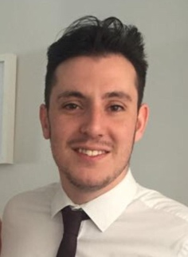
Part 1: Studies
Do we praise based on costs or benefits?
Character inferences about corporate philanthropy?
Blocking character inferences?
Can people use benefits to infer costs?
Do people care about benefits parochially?
Johnson (working paper). Dimensions of altruism.
Shine, Simonyan, & Johnson (in prep). Do consumers care how effective CSR initiatives are?

Slide 23
Do we praise based on costs or benefits?
Julia decided to make a donation to charity. She donated [$20 / $200 / $2000] to a charity focused on international health. Her donation was used to cure [a child’s / 10 children's] blindness in Ethiopia.
Rob decided to make a donation to charity. He donated [$12.50 / $125 / $1250] to a charity focused on disaster relief. His donation was used to provide basic shelter to [10 / 100] people for one month after a hurricane in Guatemala.
Design: 2 (Low vs High Benefits) x 3 (Low vs Medium vs High Costs) [between]
Items: 1 of 4
Measures: Character, Praise
Participants: N=600 MTurk workers (original + replication study)

Slide 24
Do we praise based on costs or benefits?
Please rate the moral praiseworthiness of Julia’s action.
Please rate Julia’s moral character.
***
***
ns
ns
Personal Cost

Slide 25
Do we praise based on costs or benefits?
***
ns
***
ns
Bars represent fixed effect coefficients for condition in a multilevel model with random intercepts for participant, item, and study (original or replication)

Slide 26
Part 1: Studies
Do we praise based on costs or benefits?
Character inferences about corporate philanthropy?
Do people care about benefits parochially?
Blocking character inferences?
Can people use benefits to infer costs?

Slide 27
Character inferences about corporate philanthropy?
Habbad Enterprises is a small business with 30 employees based in Lorain, OH. Habbad Enterprises decided to make a donation to charity. They donated [$3,000 / $90,000] to a charity focused on international health. Their donation was used to prevent malaria in [2 / 60] small Nigerian villages.
Design: 2 (Low vs High Benefits) x 2 (Low vs High Costs) [between]
Items: 1 of 4
Measures: Character, Praise, Purchase Intention
Participants: N=300 MTurk workers

Slide 28
Character inferences about corporate philanthropy?
**
Does this information change your willingness to purchase products from Habbad Enterprises? (0 = no more likely; 10 = much more likely)
**
ns
ns
**
Please rate the moral character of Habbad Enterprises. (0–10)
Please rate the moral praiseworthiness of Habbad Enterprises’ action (0–10)
ns

Slide 29
Character inferences about corporate philanthropy?
95% CI on serial path: 0.02 to 0.21
Character
0.75***
Praise
0.57***
0.25**
0.50**
(0.16)
Purchase Intention
Cost

Slide 30
Part 1: Studies
Do we praise based on costs or benefits?
Character inferences about corporate philanthropy? Yes
Do people care about benefits parochially?
Blocking character inferences?
Can people use benefits to infer costs?

Slide 31
Do people care about benefits parochially?
Rob decided to make a donation to charity. He donated [$12.50 / $125 / $1250] to a charity focused on disaster relief in the United States. His donation was used to provide basic shelter to [10 / 100] people for one month after a hurricane in South Carolina.
Design: 2 (Low vs High Benefits) x 3 (Low vs Medium vs High Costs) [between]
Items: 1 of 4
Measures: Character, Praise
Participants: N=599 MTurk workers (original + replication study)

Slide 32
Do people care about benefits parochially?
***
ns
***
*
Bars represent fixed effect coefficients for condition in a multilevel model with random intercepts for participant, item, and study (original or replication)

Slide 33
Part 1: Studies
Do we praise based on costs or benefits?
Character inferences about corporate philanthropy? Yes
Do people care about benefits parochially? Maybe a little
Blocking character inferences?
Can people use benefits to infer costs?

Slide 34
Blocking character inferences?
Rob works as a receptionist, earning about $31,000 per year. He donates about 30% of his salary each year to a variety of charitable causes.
One of the donations Rob decided to make this year was [$12.50 / $125 / $1250] to a charity focused on disaster relief. His donation was used to provide basic shelter to [10 / 100] people for one month after a hurricane in Guatemala.
Design: 2 (Low vs High Benefits) x 3 (Low vs Medium vs High Costs) [between]
Items: 1 of 4
Measures: Character, Praise
Participants: N=600 MTurk workers (original + replication study)

Slide 35
Blocking character inferences?
***
***
*
ns
*
ns
ns
ns
Bars represent fixed effect coefficients for condition in a multilevel model with random intercepts for participant, item, and study (original or replication)

Slide 36
Blocking character inferences?
95% CIs on indirect path:
Original (No Cue): 0.10 to 0.36
With Reputational Cue: –0.05 to 0.12
Character Information
Character Judgments
–0.19*
0.51***
0.26***
Personal
Cost
0.52***
(0.19**)
Praise Judgments

Slide 37
Part 1: Studies
Do we praise based on costs or benefits?
Character inferences about corporate philanthropy? Yes
Do people care about benefits parochially? Maybe a little
Blocking character inferences? Shifts attention from costs
Can people use benefits to infer costs?

Slide 38
Can people use benefits to infer costs?
Rob decided to make a donation to a charity focused on disaster relief. His donation was used to provide basic shelter to [10 / 100] people for one month after a hurricane in Guatemala.
Design: 2 (Low vs High Benefits) [between]
Items: 1 of 4
Measures: Benefit, Cost, Character, Praise
Participants: N=600 MTurk workers

Slide 39
Can people use benefits to infer costs?
**
**
**
Compared to other donations, do you think Rob’s donation was relatively effective or ineffective in helping people? (0–10)
Compared to other donations, do you think that Rob’s donation required him to make a relatively high or low personal sacrifice? (0–10)
°
Bars represent fixed effect coefficients for condition in a multilevel model with random intercepts for participant and item.

Slide 40
Can people use benefits to infer costs?
**
**
**
°
Bars represent fixed effect coefficients for condition in a multilevel model with random intercepts for participant and item.

Slide 41
Part 1: Studies
Do we praise based on costs or benefits?
Character inferences about corporate philanthropy? Yes
Do people care about benefits parochially? Maybe a little
Blocking character inferences? Shifts attention from costs
Can people use benefits to infer costs? Yes

Slide 42
Part 1: Further Results
Effectiveness information used more:
When effectiveness information is more comparable
For judgments of “warm glow” (1st person) vs reputation (3rd person)
When effectiveness signals competence
For donations of time (rather than money)
For large (rather than small) companies
When companies are highly involved in the implementation

Slide 43
Anatomy of a Market Failure: Post Mortem, Part 1
Reputation-signaling is not aligned with utilitarianism
Costs weighed highly; benefits weighed minimally
Incentives similar for individuals and firms
What can we do?
Prioritizing domestic donations unlikely to help
Making benefits more salient than costs
Encouraging comparison shopping among charities (e.g., Givewell)

Slide 44
Three principles?
Benefit principle: Maximize benefits, not sacrifice
Part 1: Dimensions of altruism
Specialization principle: Seek your comparative advantage
Part 2: Time and money donations
Offsetting principle: Balance costs and benefits
Part 3: Moral accounting

Slide 45
How can Gordon do the most good?
Donating time
Gordon:
– Takes a week off
– Helps build homes
– Roofs 1/10 of a house
Donating money
Gordon:
– Gives 1 week’s salary
– Hires a team of carpenters…
… who roof 10 houses
The power of specialization and trade

Slide 46
How can Gordon maximize his reputation?
Time is more central to self-identity compared to money (Gino & Mogilner, 2014; Mogilner & Aaker, 2009; Reed et al., 2007, 2016; Shaddy & Shah, 2018)
Thus, even equating objective costs, the subjective costs of time-donation would be seen as greater, signaling greater emotional investment
Since emotional investment is a character cue (Barasch et al., 2014), time-donors should be seen as more praiseworthy

Slide 47
Part 2: Studies
Do donors of time or money receive more moral credit?
How does signaling translate into choices?
Reframing money as time?
Johnson & Park (2021). Moral signaling through donations of money and time. OBHDP.

Slide 48
Do donors of time or money receive more moral credit?
Megan and Kate both work in Columbus, Ohio, and earn about $70,000 per year.
– Megan volunteered for one week with Build a Dream, a charity that transports people to Nepal to build houses for villagers.
– Kate donated $1350 to Care Builders, a charity that hires local carpenters to build houses for villagers in Nepal.
Design: Within-subjects
Measures: Praise, Emotional Investment, Character, Benefit
Items: 4 of 4
Participants: N=200 MTurk workers

Slide 49
Which of these two acts do you think was more morally praiseworthy? (–5 to 5)
***

Slide 50
Who do you think cares more about people in Nepal? (–5 to 5)
***
***

Slide 51
Who do you think has stronger moral character? (–5 to 5)
***
***
***

Slide 52
Which of these two acts do you think resulted in greater benefit to people in Nepal? (–5 to 5)
***
***
***
º

Slide 53
Part 2: Studies
Do donors of time or money receive more moral credit?
How does signaling translate into choices?
Reframing money as time?

Slide 54
Great Moral Character
Choice to
Donate Time
Time Donation
More Likely to be Cooperative
More Likely to Approach
Choice to
Donate Money
Decent Moral Character
Money Donation
Less Likely to be Cooperative
Less Likely to Approach

Slide 55
Time vs money donations: Moral character signaling
Social Context
Affiliation vs Dominance Goal
(Date vs. Business Meeting; b/w-Subjects)
95% CIs on indirect path:
–1 SD: –0.35 to 0.38
+1 SD: 0.06 to 0.83
Signaling
Motive
Morality
Power
Sophistication
Third-Party Perceptions
(Morality)
Signaling
Motive (Morality)
0.05º
Donation Decision
Time vs Money
1.65***
0.13
Social Context
Donation Decision
Third-Party Perceptions
Morality
Power
Sophistication
(0.94º)
N=500 MTurk workers

Slide 56
Part 2: Studies
Do donors of time or money receive more moral credit?
How does signaling translate into choices?
Donors sensitive to social context and their own judgments of signals
Reframing money as time?

Slide 57
Reframing money as time?
Megan and Kate both work in Columbus, OH and earn $20 per hour. They both made contributions to a charity called Build a Dream, which helps build houses for the homeless.
Default
Reframed
Megan pledged to donate 10 hours of her time to volunteer with Build a Dream.
Megan pledged to donate $200 worth of her time to Build a Dream. This amounted to volunteering for 10 hours.
Time-Donation
Kate pledged to donate $200 of her income to Build a Dream.
Kate pledged to donate 10 hours' worth of her income to Build a Dream. This amounted to a cash donation of $200.
Money-Donation
Design: 2x2 within-subjects (Def/Def, Def/Ref, Ref/Def, Ref/Ref) across 4 items
Measures: Praise, Emotional Investment, Character
Participants: N=200 MTurk workers

Slide 58
Reframing money as time?
Megan pledged to donate $200 worth of her time to Build a Dream. This amounted to volunteering for 10 hours.
Megan pledged to donate 10 hours of her time to volunteer with Build a Dream.
Kate pledged to donate 10 hours' worth of her income to Build a Dream. This amounted to a cash donation of $200.
Kate pledged to donate $200 of her income to Build a Dream.

Slide 59
Part 2: Studies
Do donors of time or money receive more moral credit?
How does signaling translate into choices?
Donors sensitive to social context and their own judgments of signals
Reframing money as time?
Can attenuate the bias

Slide 60
Part 2: Further Results
Replication of basic effect
Eliciting participants’ time/money trade-offs
Controlling objective costs and benefits more tightly
Effects linked to diffs in “time = self” lay theory (rs from .19 to .34)
Volunteering is a stronger predictor of interpersonal attraction and interest in hiring

Slide 61
Anatomy of a Market Failure: Post Mortem, Part 2
Reputation-signaling incentives inefficient time donations
This happens even though people understand money-donations actually help more people!
What can be done?
Reframing money-donations in terms of time
Encourage specialization in volunteering

Slide 62
Three principles?
Benefit principle: Maximize benefits, not sacrifice
Part 1: Dimensions of altruism
Specialization principle: Seek your comparative advantage
Part 2: Time and money donations
Offsetting principle: Balance costs and benefits
Part 3: Moral accounting

Slide 63
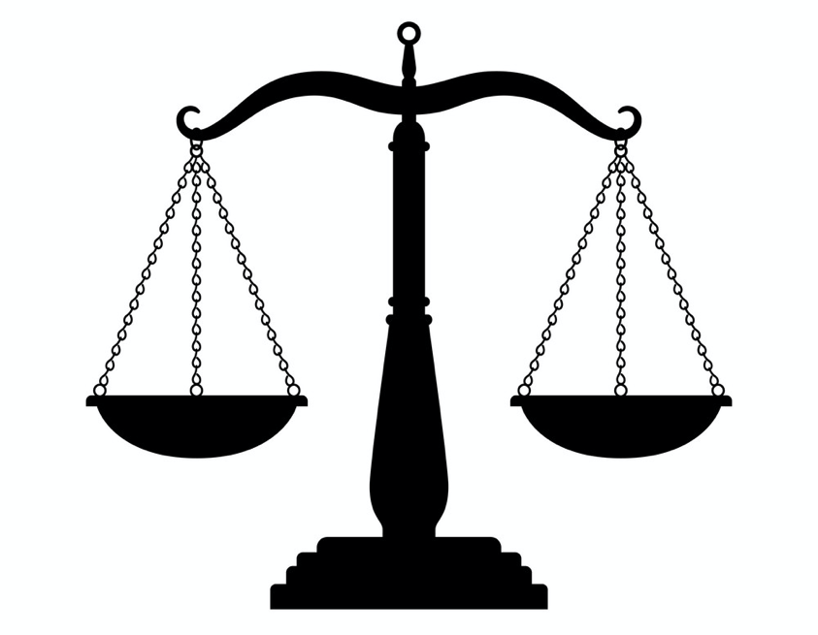
We are all saints and sinners
Business, public policy, and everyday life require us to balance “rights” and “wrongs”
Flight from London to NYC
Adds 0.83 tons of CO₂
Paying to plant 5 trees ($15)
Removes 0.83 tons of CO₂
Donating $4 to prevent animal cruelty
5 meals including meat
Avoiding 5 hours of work
Putting in 5 extra hours

Slide 64
How do people add up rights and wrongs?
Utilitarian theories
People do a cost/benefit trade-off
Deontological theories
People don’t believe moral offsets are possible
Character-based theories
Depends on what information is provided about moral character
Predictions can be derived from person perception literature

Slide 65
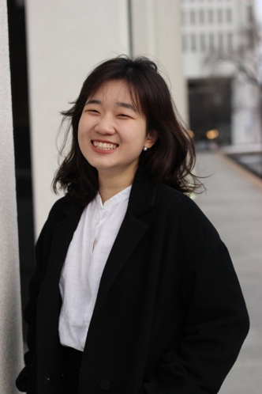
Part 3: Studies
What are the rules of moral accounting?
Rule 1: Partial offsetting
Rule 2: Diminishing sensitivity
Rule 3: Temporal asymmetry
Rule 4: Act congruency
Johnson & Ahn (2021). Principles of moral accounting. Cognition.

Slide 66
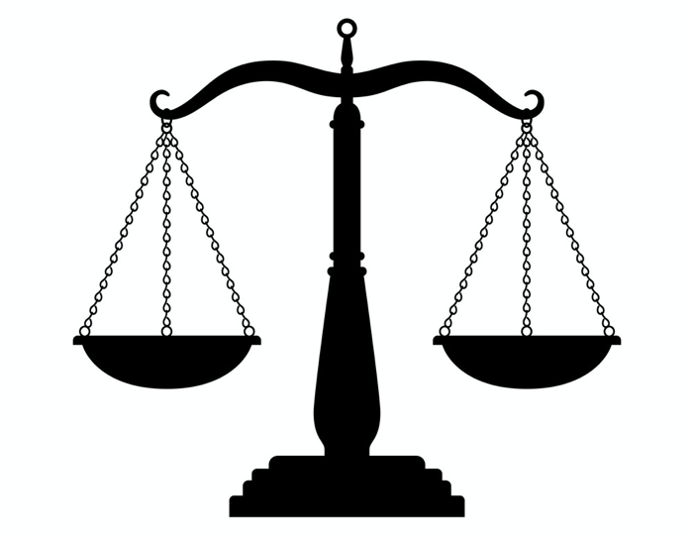
Rule 1: Partial Offsetting
Equivalent “rights” and “wrongs” do not fully offset
Follows from negativity bias in person perception (Skowronski & Carlston, 1989)
Flight from London to NYC
0.83 tons of CO₂
Paying to plant 5 trees ($15)
Removes 0.83 tons of CO₂
Objective harm neutralized
…but “wrongs” loom larger

Slide 67
Rule 1: Partial Offsetting
Harm-Only
Design: Within-subjects
Measure: Praise/Blame
Items: 10 of 10 (balanced with condition)
Participants: N=100 MTurk workers
Last week, Riley used around five pounds of non-renewable, plastic products, such as straws and plastic bags.
Offset
***
Last week, Riley used around five pounds of non-renewable, plastic products, such as straws and plastic bags. Five pounds of plastic waste can be cleaned up for $9. Knowing this, Riley donates $9 to the Ocean Cleanup project to offset the amount of plastic they produced.
***
***

Slide 68
Rule 2: Diminishing Sensitivity
Bigger “rights” have diminishing returns in offsetting “wrongs”
Follows from person perception findings that negative trait information can only be outweighed by large, repeated injections of positive trait information (Birnbaum, 1973; Schweitzer et al., 2006)
Paying to plant 5 trees ($15)
Removes 0.83 tons of CO₂
Flight from London to NYC
Adds 0.83 tons of CO₂
Paying to plant 10 trees ($30)
Removes 1.66 tons of CO₂
Objective harm more than neutralized with a double-offset
…but may be little morally better than a single-offset

Slide 69
Rule 2: Diminishing Sensitivity
Last week, Riley used around five pounds of non-renewable, plastic products, such as straws and plastic bags. Five pounds of plastic waste can be cleaned up for $9.
Single-Offset
Double-Offset
Knowing this, Riley donates $9 to the Ocean Cleanup project to offset the amount of plastic they produced – the amount needed to offset the trash produced.
Knowing this, Riley donates $18 to the Ocean Cleanup project to more-than-offset the amount of plastic they produced – twice the amount needed to offset the trash produced.
Design: Within-subjects
Measures: Character (T1 = before offset; T2 = after offset); Praise/Blame
Items: 10 of 10 (balanced with condition)
Participants: N=99 MTurk workers

Slide 70
Rule 2: Diminishing Sensitivity
Neutral character

Slide 71
Rule 3: Temporal Asymmetry
“Rights” have greater offsetting power after (vs. before) “wrongs”
Evidence for both licensing and offsetting in behavior (Merritt et al., 2010; Tangney et al., 2007) Person perception literature mixed – both primacy and recency (Anderon & Hubert, 1963; Lockhart et al., 2010)
Flight from London to NYC
Adds 0.83 tons of CO₂
Paying to plant 5 trees ($15)
Removes 0.83 tons of CO₂
Paying to plant 5 trees ($15)
Removes 0.83 tons of CO₂
Flight from London to NYC
Adds 0.83 tons of CO₂
Objective harm equal in both cases
…but harms may loom larger when they come after (signaling “licensing” behavior)

Slide 72
Rule 3: Temporal Asymmetry
Offset
Licensing
Last week, Riley used around five pounds of non-renewable, plastic products, such as straws and plastic bags.
Five pounds of plastic waste can be cleaned up for $9. This week, Riley donates $9 to the Ocean Cleanup project, since this donation offsets last week’s plastic consumption.
Last week, Riley donated $9 to the Ocean Cleanup project. Five pounds of plastic waste can be cleaned up for $9.
This week, Riley uses around five pounds of non-renewable, plastic products, such as straws and plastic bags, since this plastic consumption was offset by last week’s donation.
Design: Within-subjects
Measures: Character (T1 = after first act; T2 = after second act); Praise/Blame
Items: 10 of 10 (balanced with condition)
Participants: N=99 MTurk workers

Slide 73
Rule 3: Temporal Asymmetry
Neutral character

Slide 74
Rule 4: Act Congruency
“Rights” have greater offsetting power for similar “wrongs”
People may keep separate ‘moral accounts’ for different categories of actions (cf. Thaler, 1985)
By Rule 1, black accounts would not fully offset red accounts
Neutralizing carbon emissions
Neutralizing methane emissions
Buying coffee for a stranger
Flight from London to NYC
Adds 0.83 tons of CO₂
Equal amounts of good (social utility) in all cases
…but dissimilar offsets may be less effective

Slide 75
Rule 4: Act Congruency
Last week, Riley used around five pounds of non-renewable, plastic products, such as straws and plastic bags, which can cause damage to the oceans.
High Congruency
Medium Congruency
Low Congruency
Later, Riley donates $9 to the Ocean Cleanup project, which helps clean up plastic in the ocean.
Later, Riley donates $9 to the Ocean Cleanup project, which helps clean up oil spills.
Later, Riley participates as a volunteer during election day.
Design: Within-subjects
Measures: Character (T1 = before offset; T2 = after offset); Praise/Blame
Items: 10 of 10 (balanced with condition)
Participants: N=150 MTurk workers

Slide 76
Rule 4: Act Congruency
Neutral character

Slide 77
Part 3: Studies
What are the rules of moral accounting?
Rule 1: Partial offsetting
Rule 2: Diminishing sensitivity
Rule 3: Temporal asymmetry
Rule 4: Act congruency

Slide 78
Part 3: Further Results
Differences in character inferences explain variance across items and people
Manipulating character shifts blame for offsetting behavior
Direct manipulations of character
Abstract/concrete framing
Emotional motivation (guilt or shame)

Slide 79
Anatomy of a Market Failure: Post Mortem, Part 3
Reputation-signaling incentivizes a suboptimal degree of offsetting
Good news is that partial offsetting is possible
What can be done?
More than offsetting?
Offsetting after rather than before a harm is done?
Emphasizing similarity between offset and harm

Slide 80
Three principles
Benefit principle: Maximize benefits, not sacrifice
Reputation tracks sacrifice
Specialization principle: Seek your comparative advantage
Reputation enhanced from inefficient time-donations
Offsetting principle: Balance costs and benefits
Reputational returns from offsets are modest

Slide 81
Why aren’t donations more effective?
A cornucopia of cognitive biases
Psychic numbing (Small et al., 2007)
Perceived subjectivity of charity (Berman et al., 2018)
Overhead aversion (Gneezy et al., 2014)
Parochialism (Bruneau et al., 2017)
Diversification bias (Baron & Szymanska, 2011)
Zero-sum thinking (Johnson, Zhang, & Keil, 2021; Newman & Cain, 2014)

Slide 82
Why aren’t donations more effective?
But donors may also respond rationally to reputational incentives
The market for charity is a market for reputation, and reputation does not follow the dictates of utilitarianism
This can amplify cognitive biases
To develop solutions, we need to understand the problems
Making effective donations pay reputational dividends
Psychological workarounds
Making benefits more salient than costs
Reframing money donations as time donations
Harnessing the psychology of moral accounting

Slide 83
Future work in this vein
More empirical questions about the “cognitive science of society”
Why do people often “diversify” charitable donations?
How do people think about their obligations to future generations?
Why do most people distrust markets relative to economists?
Understanding and modeling “virtue psychology”
Virtue judgment as a heuristic for decoding (cooperative) behavior
Virtuous action as a means of encoding behavior to others
How does virtuous behavior become internalized?

Slide 84
Thanks!
Aaron Shine
Yvetta Simonyan
samuel.johnson@warwick.ac.uk
Jaye Ahn
Seo Young Park

