Slide 1
Need More Information in the Structure (back on track with vEB)
Keep max, min (total values) and empty flag in each structure
To find predecessor(x)
Look at leaf H(x) in high(x)
we can decide
if min(high(x)) > x or does not exist
then look for predecessor in high structure
(max descendant of predecessor(H(x))
else look in low structure of high(x)

Slide 2
Insertions
if no elements in low structure of x, insert in high structure
and mark as a single in low(x)
else if just 1 element low structure of x insert it and x
into low structure of x
{Note, “special insertions”… into an otherwise
empty structure so O(lg lg u) time, no recursion}
else perhaps update max and min at high(x) and insert in low x
“Deletions similar”

Slide 3
Space
Looks like Θ(u) “words” of lg u bits each, so Θ(u lg u) bits … well up from a bit vector

Slide 4
Space
Looks like Θ(u) “words” of lg u bits each, so Θ(u lg u) bits … well up from a bit vector
Observe that as we get “down into” the structure the range gets smaller, so if range is r we only need lg r bits for a max/min/etc.
Careful, we may need to represent full value of a max/min through several nodes. This can probably reduce total space to Θ(u), with work and difficulty.
Easier approach …

Slide 5
Use a Lawnmower
The entire structure uses Θ(u lg u) bits at lg u levels

Slide 6
Use a Lawnmower
The entire structure uses Θ(u lg u) bits at lg u levels
Use this for all but the bottom lg lg u levels
taking Θ(u) bits
and u/lg u bit vectors each of length lg u for
the low levels
Simple bit tricks handle this low level, in O(1) time, on word sized bit vectors.
So still O(lg lg u) time

Slide 7
Space Allocation for vEB
How do we lay this out in memory?
We could ignore the issue and just have pointers all over.
This would be fine when the number of elements present is small
But adds a nontrivial factor when n is quite large.
We want to be able to navigate by calculation

Slide 8
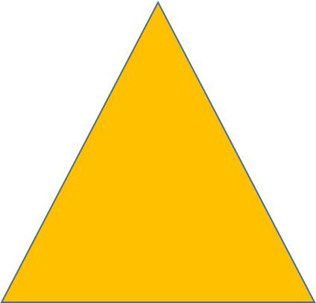
Space Allocation for vEB
How do we lay this out in memory?
Do it by the recursive approach suggested
0
1 2
3 6 9 12
4 5 7 8 10 11 13 14
240
29 254

Slide 9
Can we do better than Θ(lg lg u)?
Not really, under “the usual model”
Mehlhorn et al ( SIAM J on Comp 1988) prove this on a
pointer machine and have extended it to the RAM

Slide 10
Can we do better than Θ(lg lg u)?
Not really, under “the usual model”
Mehlhorn et al ( SIAM J on Comp 1988) prove this on a
pointer machine and have extended it to the RAM
Is there some other “reasonable” model where one can?
Brodnik, Carlsson, Karlsson and Munro, Worst Case, Constant Time Priority Queue SODA 2001.
What’s the catch?

Slide 11
Another Model: Rambo
Random Access Machine with Byte Overlap
model of Mike Fredman and Dan Willard
Several words can share bits:

Slide 12
Can we do better under this model?
Consider elements at bottom an internal node is flagged if it has a descendant
lg u bit RAMBO word at leaf
Can find lowest
ancestor in
O(1) time

Slide 13
The vEB Stratified Tree
Internal node keeps track of
“outside” bottom
elements
0 1 2 3 4 5 6 7 8 9 10 11 12 13 14 15

Slide 14
A Problem
Any individual leaf may be referred to by many ancestors
So one insertion/deletion can require up to 2lg u reference changes
Modify the approach

Slide 15
Split Tagged Tree
Keep track of left / right
inside leaf … if different
from parent’s
Each leaf can be referred to by at most two ancestors

Slide 16
So what do we have?
Each leaf to root path corresponds to a word of Rambo memory with a bit on
Constant time “extended priority queue” … two memory accesses for search, three for update on our Rambo memory model
How much space do we need?
2u + O(lg u) bits of ordinary RAM
u bits of RAMBO memory in a particular configuration (Yggdrasil)
and it has been implemented in hardware

Slide 17
So what do we have?
Constant time “extended priority queue” … two memory accesses for search, three for update on our Rambo memory model
How much space do we need?
2u + O(lg u) bits of ordinary RAM
u bits of RAMBO memory in a particular configuration (Yggdrasil)
and it has been implemented in hardware
“Subsequently”, despite paper dates, similar approach used by Brodnik, Carlsson and Pink for fast routing lookups

