Slide 1
Visual Cryptography
P D'Arco, R De Prisco
SECITC 2016, LNCS vol. 10006.
CS 858 Paper Presentation
Presented by: Thomas Lu
Department of Computer Science

Slide 2
Introduction – What is Visual Cryptography?
Introduced by Naor and Shamir in 1994
Similar to threshold schemes discussed in class
The secret is an image and the shares are black and white pixelated transparency images that get overlaid to reveal the secret image; no math or cryptographic tools are required for reconstruction
This paper focuses on black and white secrets, but more recent papers deal with colour
Not having enough transparencies or shares will result in not knowing anything about the image, while having enough will allow reconstructing something close to the original image
The key difference here is the goal is the create a visual approximation, this gives some leeway on how the shares can be constructed

Slide 3
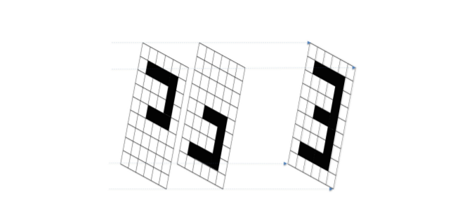
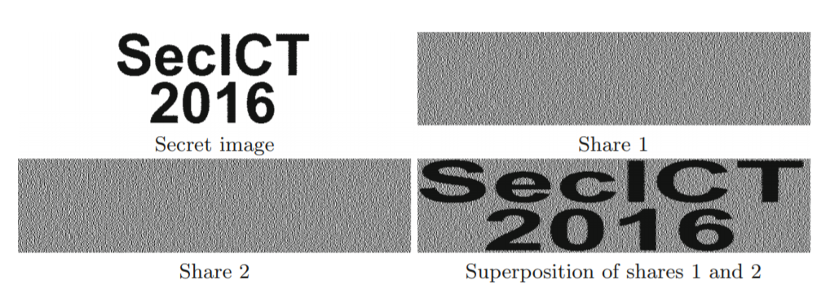
Superposing transparencies
Images are superimposed such that a final pixel is black if any of the underlying pixels are black. “Or” operation.
Simply splitting up the pixels in the original image does not work. It gives partial information about the secret image.
Using the human visual system as part of the reconstruction process, it suffices to construct a noisy approximation that is still recognizable.
This allows us to “hide” information for security

Slide 4
Approach
2 main approaches, consider 2 share case:
Naor and Shamir
Convert each pixel to collection of m subpixels
Black pixel will convert to more black subpixels than a white pixel, visually distinguishable
Kafri and Keren
Each black pixel becomes one of each black and white pixel, each white pixel becomes randomly both black or white
50% chance of each pixel in each share being black or white
All black pixels become black, 50% chance of white pixel being white -> some error but still visually intelligible

Slide 5
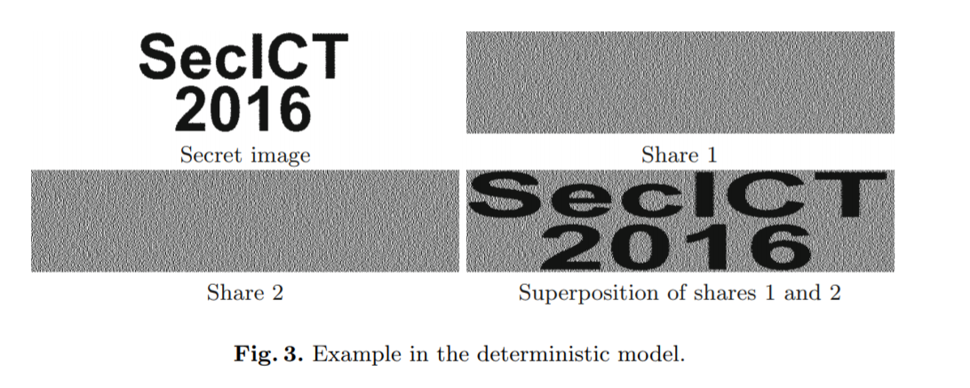
Deterministic Model
Naor and Shamir
Each pixel expanded into m ≥ 2 subpixels (transparencies and reconstruction always larger than original)
Contrast defined by 2 thresholds: l, m with 0 ≤ l < h ≤ m
A white secret pixel will correspond to at most l black subpixels in the reconstructed image, maximal darkness of a white pixel
A black secret pixel will correspond to at least h black subpixels in the reconstructed image, minimum darkness of a black pixel
Deterministic in that original secret image can be exactly determined based on thresholds in reconstruction

Slide 6
Random Grid Model
Kafri and Keren
No pixel expansion required, size is preserved
Uses random black and white pixels to construct the secret image
Probabilistic because errors occur, some percentage of white pixels are reconstructed incorrectly as black, but original image is still visually intelligible

Slide 7
Probabilistic Model
Introduced by Yang, generalized by Cimato et al.
Briefly mentioned in the paper, mix of deterministic and random grid
Pixel expansion of m ≥ 1 subpixels, and 2 thresholds: l, m with 0 ≤ l < h ≤ m
Thresholds are only needed to be achieved with high probability
Depending on parameters, equivalent to previous two models at the extremes
m = 1 is the random grid model
m ≥ 2 and 100% thresholding probability is the deterministic model

Slide 8
Visual Cryptography Schemes
The previous models can all be described by a common framework
P = (1, 2, .., n) set of n parties
VCS, visual cryptography scheme, method of encoding secret image I into n shares, associating each pixel with m subpixels for each of n shares
Distribution matrix M, n x m matrix, where row i corresponds to the m subpixels assigned to share i to represent some pixel
Superposing consists of taking an “or” operation over the matrix
A VCS is specified by 2 sets of distribution matrices
C_{w} = {M_{W}¹, M_{W}², …, M_{W}^{r0}} , C_{B} = {M_{B}¹, M_{B}², …, M_{B}^{r1}}
For each pixel, a dealer selects a distribution scheme randomly based on the color of the original pixel, and distributes each row to the corresponding share

Slide 9
Visual Cryptography Schemes
An access structure A = (Q, F) is a specification of whether each of the subsets of P, that are qualified, Q, or forbidden F
In most cases this is a thresholding structure with Q consisting of all subsets of at least k, and F consisting of all subsets of at most k-1 (similar to threshold schemes discussed in class)
Denote M_{P} as a submatrix consisting of rows corresponding with participants in P
Sup(M) is the superposition of shares represented in M, Sup(M_{P}) represents the superposition of shares of just participants in P
Given a vector v, w(v) is the Hamming weight of v, or the number of black pixels in a superposed vector v

Slide 10
Visual Cryptography Schemes
Note that many schemes consist of matrices that are permutations, so each collection can be identified by a base matrix B_{W}, B_{B} rather than with the entire set of distribution matrices. Thus the security properties need only be verified once and will hold through permutations.

Slide 11
VCS for Deterministic Model
A (Q,F) deterministic VCS S consists of two collections of distribution matrices C_{W}, C_{B} and two threshold integers l, m with 0 ≤ l < h ≤ m, with the following conditions:
Reconstructability. For any qualified set Q, w(Sup(B_{W,Q})) ≤ l for white pixels and w(Sup(B_{B,Q})) ≥ h for black pixels
Security. For any forbidden set F, B_{W,F} and B_{B,F} are indistinguishable up to a permutation. No information can be gained about the secret image.

Slide 12
VCS for Random Grid Model
Contrast is defined by average light transmission:
For a subset of pixels G, λ(G) = #white-pixels(G)/#pixels(G)
Let white(R) be the region in the reconstructed image that corresponds to white pixels in the secret image
Let black(R) be the region in the reconstructed image that corresponds to black pixels in the secret image
Let λ_{W}(R) = λ(white(R)) be the ratio of white pixels in the region in the reconstructed image corresponding to white pixels in the secret image
Let λ_{B}(R) = λ(black(R)) be the ratio of white pixels in the region in the reconstructed image corresponding to black pixels in the secret image

Slide 13
VCS for Random Grid Model
A (Q,F) random grid VCS S consists of two collections of distribution matrices C_{W}, C_{B} and two thresholds λ_{W} > λ_{B}, with the following conditions
Reconstructability. For any qualified set Q, λ_{W}(R) ≥ λ_{W}, and λ_{B} ≥ λ_{B}(R)
Security. For any forbidden set F, λ_{W}(R) = λ_{B}(R).

Slide 14
Issues
While constructions for (k, n)-VCS threshold schemes are known, there are some open issues
Which formula for contrast is optimal:
Naor and Shamir γ_{NS} = (h-l)/m
Verheul and van Tilborg γ_{VV} = (h-l)/(m(2m-h-l))
Eisen and Stinson γ_{ES} = (h-l)/(2m-h)
γ_{ES} seems to best match the real world, need to understand whether this is optimal and how to construct contrast-optimal schemes

Slide 15
Issues
Pixel Expansion
There is a trade-off between pixel-expansion and contrast, we need to construct lower bounds.
Currently only bounds for (2, n)-VCS for γ_{ES}
Randomness reduction
Need ways to reduce randomness required by dealer when generating schemes

Slide 16
Alternative Schemes
Some alternative schemes were briefly mentioned but not delved into
Visual Cryptography for Color Images
Visual Cryptography with Meaningful Shares
Visual Cryptography for Multisecret
Visual Cryptography with Alternative Approaches
Visual Cryptography with Reversing
Visual Cryptography Robust Against Cheating

Slide 17
Applications
The paper suggests several applications for visual cryptography:
Educational Tools – Introducing the basic ideas of encryption and unconditional security
Identification and Authentication – Allowing proof of identification without computational device. E.g. verifying ID to a bank.
Access Control – Giving access to a password when a specified amount of people are present. E.g. needing two people to be present to gain password to a vault
Electronic voting – Receipt that can be used to check votes
Fight phishing – Captchas

Slide 18
Tool for Computation
Visual Cryptography has applications in secure protocols that can be used without computer
For example, calculating a function with binary inputs through a purely physical task. Yao’s Construction and Koleshnikov Approach converts evaluating a function into working with random keys. Visual cryptography shares can be used as these keys to make the entire process physical.
Two parties can work together to construct the final output to a function, while keeping their inputs a secret
Output is the result of superposing randomly generated images

Slide 19
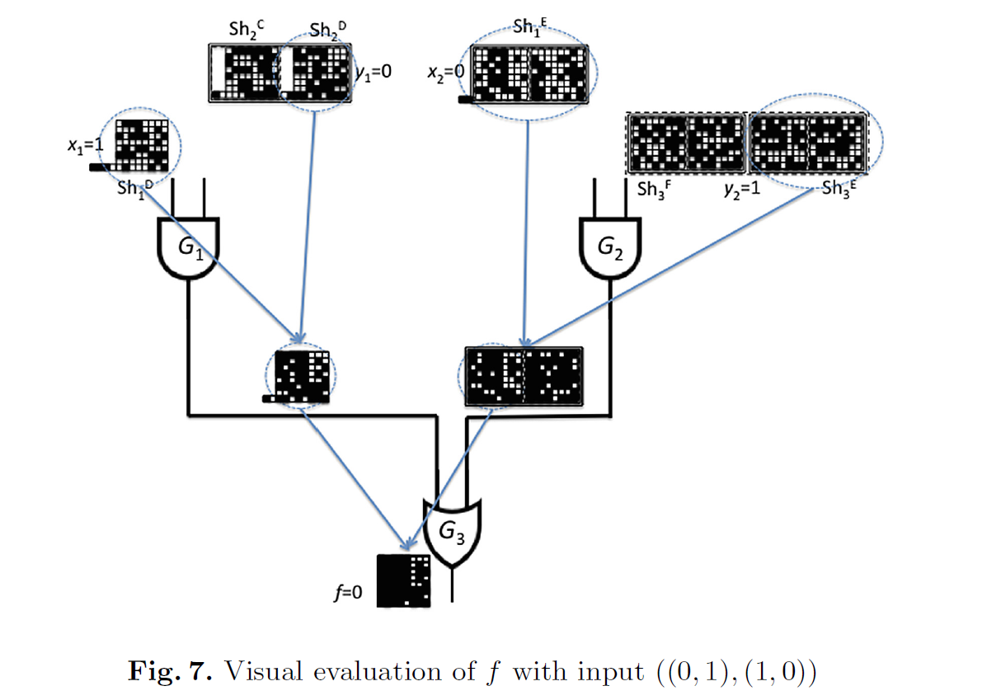
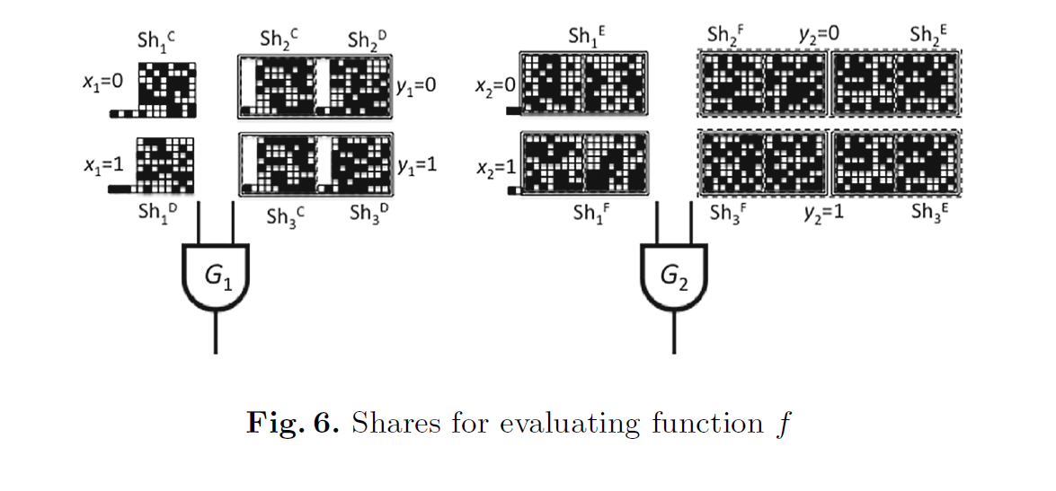
Tool for Computation
Alice constructs a set of shares corresponding to the various possible inputs. Gives the shares corresponding to her input to Bob without revealing her input.
Bob selects the shares representing his input without revealing to Alice. Superposed image is answer and revealed to both.

Slide 20
Conclusion
This paper served as an introduction to the field of visual cryptography, giving an overview of the main models for black and white image encryption as well as alternative methods.
It points out some open problems for these models
It describes classical applications and new potential applications

Slide 21
Thank You! Questions?

