Slide 1
Improved bounds on 2-frameproof codes with length 4
Minquan Cheng · Jing Jiang · Qiang Wang
Presented by Ankith Prabhu

Slide 2
Introduction
Frameproof codes (FPCs) are widely studied as they are classic fingerprinting codes that can protect copyrighted materials.
Frameproof codes were first introduced by Boneh and Shaw [3] in the context of digital fingerprinting. There is more than one definition of frameproof codes in the literature, here the following version is used.

Slide 3
Preliminary Information
Let n, M and q be positive integers, and let Q be an alphabet of size q.
A set C={c₁, c₂, . . . , c_{M}} ⊆ Q^{n} is called an (n, M, q) code and each c = (c₁, c₂,. . . , c_{n})^{T} ∈ C is called a codeword. Without loss of generality, we may assume Q = {0, 1, . . . , q − 1}.
When Q = {0, 1}, we use the word “binary”.

Slide 4
Preliminary Information
Given an (n, M, q) code, the incidence matrix M(C) is the n × M matrix on Q = {0, 1, . . . , q −1} in which the columns are the M codewords in C.
For any code C ⊆ Q^{n}, for any 1 ≤ i ≤ n we define the set of i^{th} coordinates of C as C(i ) = {c_{i} ∈ Q | c = (c₁, c₂, . . . , c_{n})^{T} ∈ C}.

Slide 5
Preliminary Information
For any subset of codewords C₀ ⊆ C, we define the descendant code of C₀ by
desc(C₀) = {(c₁, c₂, . . . , c_{n})^{T} ∈ Q_{n} | c_{i} ∈ C₀(i ), 1 ≤ i ≤ n},
that is,
desc(C₀) = C₀(1) × C₀(2)×・ ・ ・×C₀(n).
The set desc(C₀) consists of all the n-tuples that could be produced by a coalition holding the codewords in C₀.
Using the notions of descendant codes and sets of i^{th} coordinates of codes, we can define frameproof codes.

Slide 6
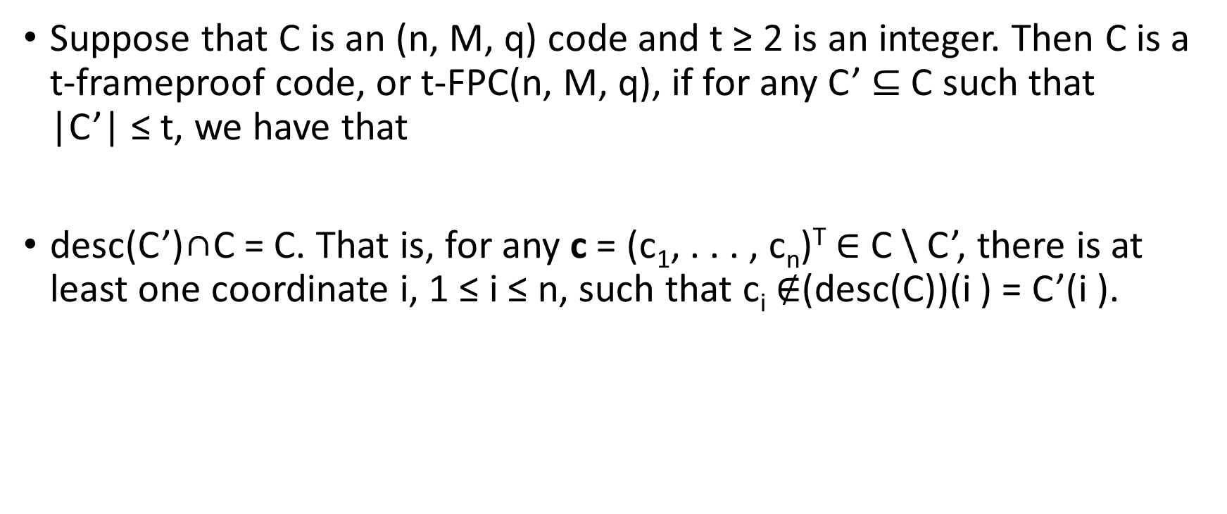
t-frameproof code
Suppose that C is an (n, M, q) code and t ≥ 2 is an integer. Then C is a t-frameproof code, or t-FPC(n, M, q), if for any C’ ⊆ C such that |C’| ≤ t, we have that
desc(C’)∩C = C. That is, for any c = (c₁, . . . , c_{n})^{T} ∈ C \ C’, there is at least one coordinate i, 1 ≤ i ≤ n, such that c_{i} $∉$(desc(C))(i ) = C’(i ).

Slide 7

A new upper bound
Given a 2-FPC(4, M, q), we can define the following q × q array for each k ∈ Q,
A_{i,k} (x) = {y | (i, k, x, y) ∈ C}. Clearly M = $Σ$_{i,x,k∈Q}|Ai,k (x)|.
U _{k} =
A_{0,k}(0) | A_{0,k}(1) | . . . | A_{0,k}(q-1)
A_{1,k}(0) | A_{1,k}(1) | . . . | A_{1,k}(q-1)
. | . |  | .
. | . |  | .
. | . |  | .
A_{q-1,k}(0) | A_{q-1,k}(1) | . . . | A_{q-1,k}(q-1)

Slide 8
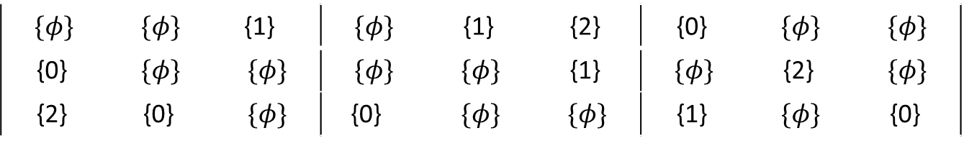
Example
C=
U=(U₀,U₁,U₂)=
0 | 1 | 2 | 2 | 0 | 0 | 1 | 2 | 0 | 1 | 2 | 2
0 | 0 | 0 | 0 | 1 | 1 | 1 | 1 | 2 | 2 | 2 | 2
2 | 0 | 0 | 1 | 1 | 2 | 2 | 0 | 0 | 1 | 0 | 2
1 | 0 | 2 | 0 | 1 | 2 | 1 | 0 | 0 | 2 | 1 | 0
$$\{φ\}$$ | $$\{φ\}$$ | {1} | $$\{φ\}$$ | {1} | {2} | {0} | $$\{φ\}$$ | $$\{φ\}$$
{0} | $$\{φ\}$$ | $$\{φ\}$$ | $$\{φ\}$$ | $$\{φ\}$$ | {1} | $$\{φ\}$$ | {2} | $$\{φ\}$$
{2} | {0} | $$\{φ\}$$ | {0} | $$\{φ\}$$ | $$\{φ\}$$ | {1} | $$\{φ\}$$ | {0}

Slide 9
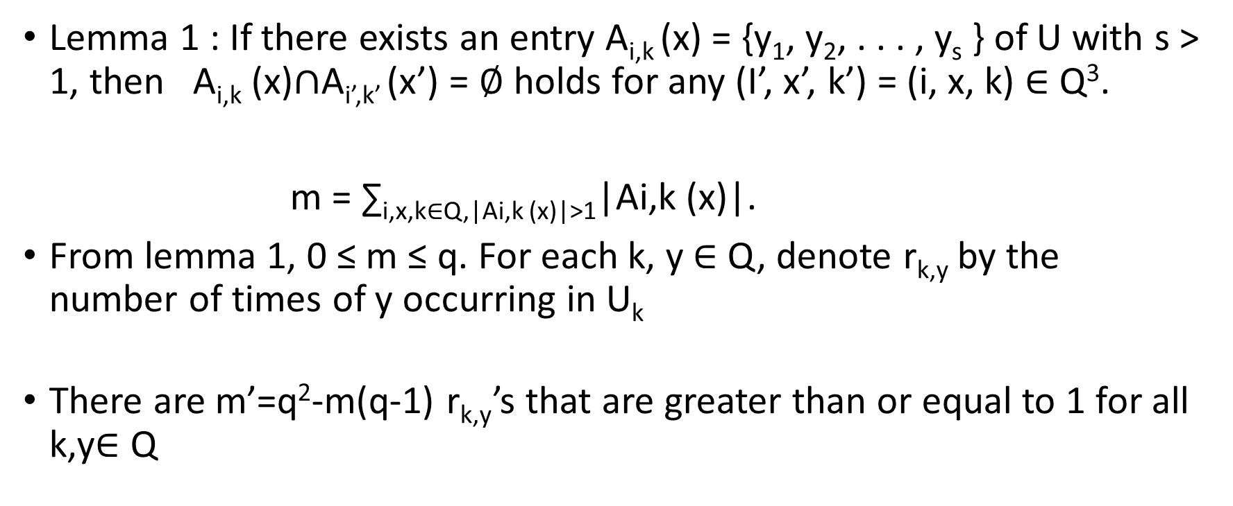
|A_{i,k}(x)| > 1
Lemma 1 : If there exists an entry A_{i,k} (x) = {y₁, y₂, . . . , y_{s} } of U with s > 1, then A_{i,k} (x)$∩$A_{i’,k’} (x’) = ∅ holds for any (I’, x’, k’) = (i, x, k) ∈ Q³.
m = ∑_{i,x,k∈Q,|Ai,k (x)|>1}|Ai,k (x)|.
From lemma 1, 0 ≤ m ≤ q. For each k, y ∈ Q, denote r_{k,y} by the number of times of y occurring in U_{k}
There are m’=q²-m(q-1) r_{k,y}’s that are greater than or equal to 1 for all k,y∈ Q

Slide 10
|A_{i,k}(x)| = 1
Lemma 2: If there exist two entries, say A_{i1,k} (x₁), A_{i2,k} (x₂) with A_{i1,k} (x₁) = A_{i2,k} (x₂) and |A_{i1,k} (x₁)| = |A_{i2,k} (x₂)| = 1, then A_{i1,k} (x₁) = ∅ and A_{i2,k} (x₂) = ∅ hold for any k’ ∈ Q \ {k}.
H = {(k, y) | r_{k,y} > 1, k, y ∈ Q} and h = |H|.
There are at least r_{k,y}(q − 1) empty entries for each rk,y > 1 from Lemma 2. Let M’ =∑ _{(k,y)∈H}r_{k,y}
Therefore the number of empty entries in U is (q − 1)M’ = (q − 1) ∑_{(k,y)∈H}r_{k,y}

Slide 11
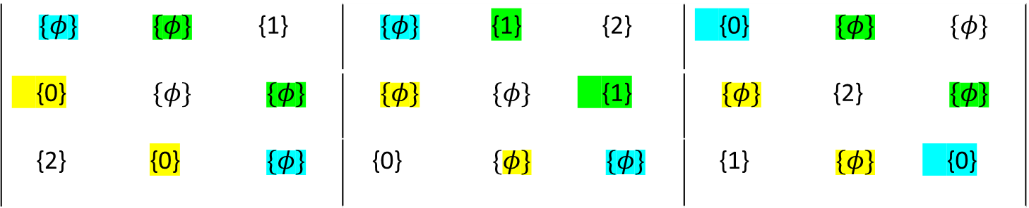
Example
U=(U₀,U₁,U₂)=
$$\{φ\}$$ | $$\{φ\}$$ | {1} | $$\{φ\}$$ | {1} | {2} | {0} | $$\{φ\}$$ | $$\{φ\}$$
{0} | $$\{φ\}$$ | $$\{φ\}$$ | $$\{φ\}$$ | $$\{φ\}$$ | {1} | $$\{φ\}$$ | {2} | $$\{φ\}$$
{2} | {0} | $$\{φ\}$$ | {0} | $$\{φ\}$$ | $$\{φ\}$$ | {1} | $$\{φ\}$$ | {0}

Slide 12
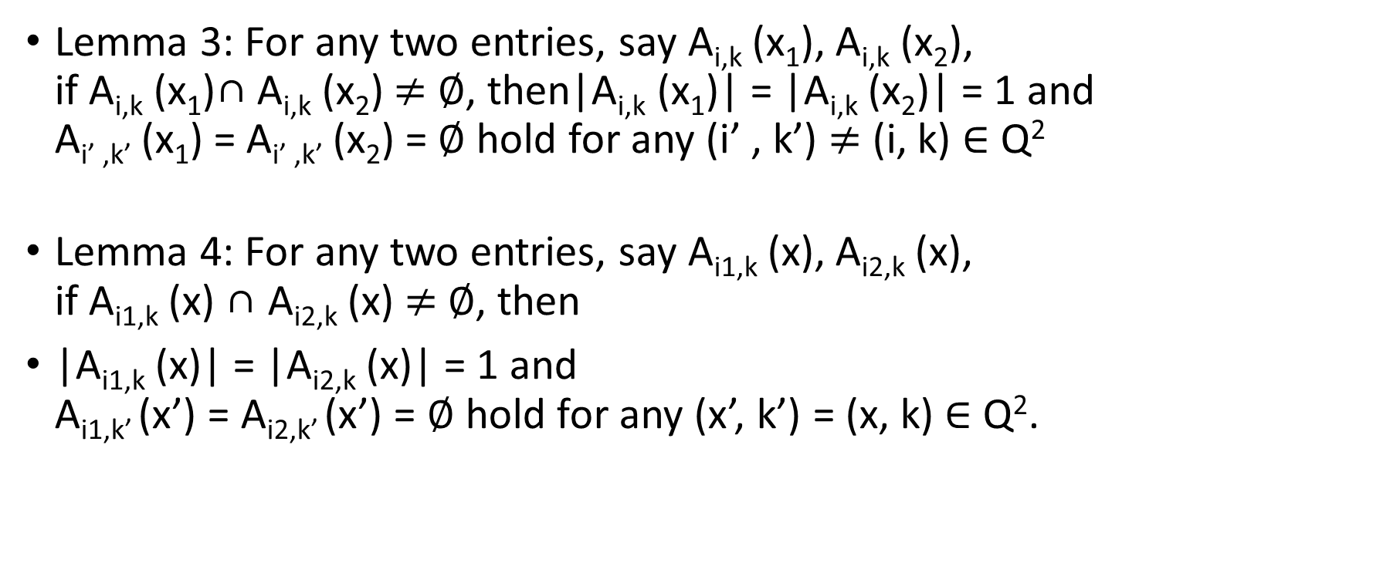
Contd…
Lemma 3: For any two entries, say A_{i,k} (x₁), A_{i,k} (x₂), if A_{i,k} (x₁)∩ A_{i,k} (x₂) $≠$ ∅, then|A_{i,k} (x₁)| = |A_{i,k} (x₂)| = 1 and A_{i’ ,k’} (x₁) = A_{i’ ,k’} (x₂) = ∅ hold for any (i’ , k’) $≠$ (i, k) ∈ Q²
Lemma 4: For any two entries, say A_{i1,k} (x), A_{i2,k} (x), if A_{i1,k} (x) ∩ A_{i2,k} (x) $≠$∅, then
|A_{i1,k} (x)| = |A_{i2,k} (x)| = 1 and A_{i1,k’} (x’) = A_{i2,k’} (x’) = ∅ hold for any (x’, k’) = (x, k) ∈ Q².

Slide 13
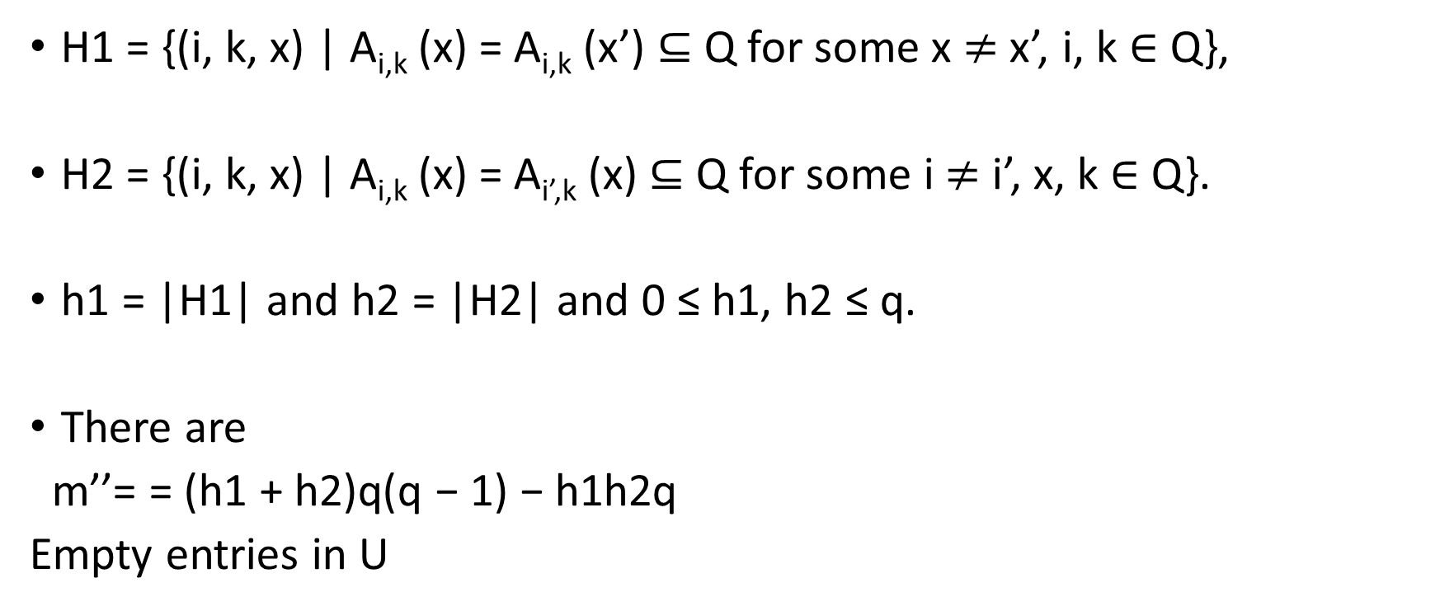
Contd…
H1 = {(i, k, x) | A_{i,k} (x) = A_{i,k} (x’) ⊆ Q for some x $≠$ x’, i, k ∈ Q},
H2 = {(i, k, x) | A_{i,k} (x) = A_{i’,k} (x) ⊆ Q for some i $≠$ i’, x, k ∈ Q}.
h1 = |H1| and h2 = |H2| and 0 ≤ h1, h2 ≤ q.
There are
m’’= = (h1 + h2)q(q − 1) − h1h2q
Empty entries in U

Slide 14
Upper Bound Proof
M’ + ∑_{k,y∈Q,rk,y=1} r_{k,y} + (q − 1)M’ + m’’ ≤ q³
( Filled entries) (Empty entries)
^{i.e}
M’ ≤ q² − 1/q ∑_{k,y∈Q,rk,y=1} r_{k,y} − m’’/q
M= ∑_{i,x,k ∈Q}|A_{i,k}(x)|
∑ _{i,x,k∈Q,|Ai,k (x)|>1}|A_{i,k} (x)| + ∑ _{i,x,k∈Q,|Ai,k (x)|=1}|A_{i,k} (x)|
m + M’ + ∑ _{k,y∈Q,rk,y=1} r_{k,y}

Slide 15
Contd..
∑ _{k,y∈Q,rk,y=1}r_{k,y} ≤ m’ − h = q² − m(q − 1) − h.
M ≤ 2q² – q – m(q-3) – (h1 + h2)(q - 1) + h1h2 – h(q - 1)/q
2q² − 8q < 2(q − 2)² + 1 ≤ M ≤ 2q² − q − (h1 + h2)(q − 1) + h1h2.
h1 + h2 < 8 when q > 48
M ≤ q² − m(q − 2) − h + hq + h1 + h2 < q² − m(q − 2) + h(q − 1) + 8.

Slide 16
Contd..
2q² − 8q + 9 ≤ M < q² − m(q − 2) + h(q − 1) + 8 ≤ q² + h(q − 1) + 8.
When q > 48, h ≥ q − 7
2q² − 2q + 8 − 7/q
Therefore when q > 48, M(2, 4, q) ≤ 2q² − q + 7 always holds.

Slide 17
Thank you

